Slide 1


Slide 2
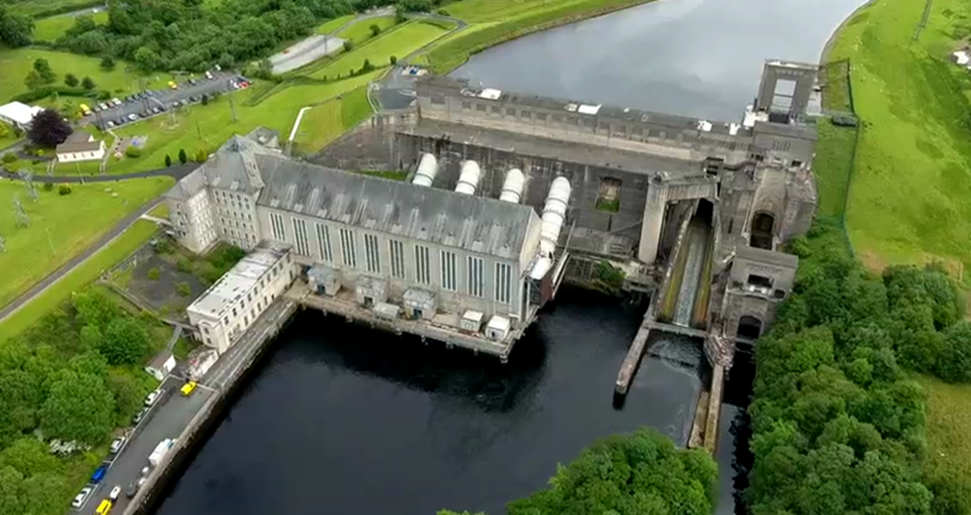

The pursuit of sovereignty and the impact of partition, 1912-1949
Economic and social policies of Cumann na nGaedheal
Industrial policy: the Shannon Scheme, 1924-1937
LC History syllabus links:

Slide 3
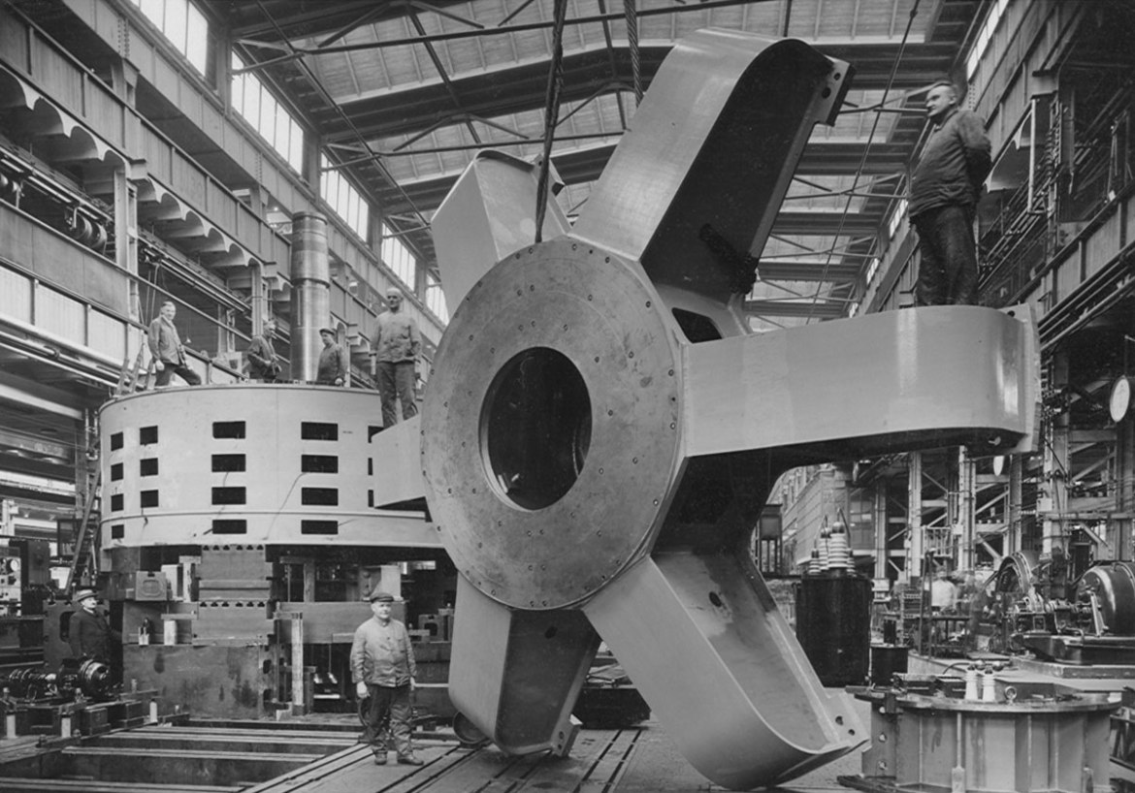
Learning Intentions:
To be able to explain why the Shannon Scheme was a necessary project undertaken by the Cumann na nGaedheal government.
To be able to describe how the Shannon Scheme was constructed and the cost of construction.
To assess the impact of the Shannon Scheme on the Irish Free State in the 1920s and 1930s.
Image: ESB archives

Slide 4
Why did the government undertake to build a hydro-electric power station at Ardnacrusha, Co. Clare?
Think-pair-share: In the 1920s, Ireland produced very little electricity compared with other European countries.
Why do you think this was the case?

Slide 5
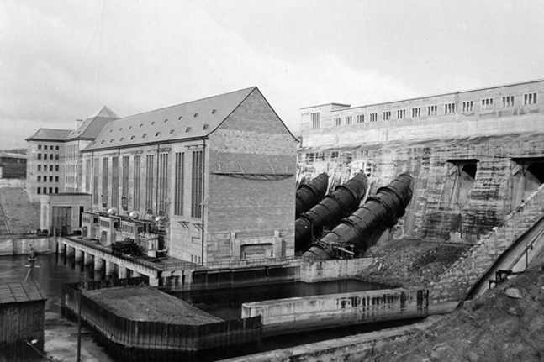
Why did the government undertake to build a hydro-electric power station at Ardnacrusha, Co. Clare?
Unlike other European countries, Ireland lacked the fossil fuels (e.g. coal) needed to produce electricity.
In September 1924, the German company Siemens proposed to the Cumann na nGaedheal government a project that would harness the power of the River Shannon to create electricity.
In August 1925, construction began of the Shannon Hydro-Electric Scheme at Ardnacrusha, Co. Clare.
Image: ESB archives

Slide 6
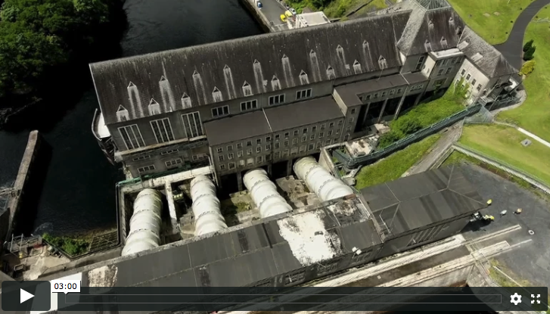
2. How was the Shannon Scheme built and what did it cost?
Watch the video:
(b) In groups discuss...
Based on the evidence in the video clip, do you think that the Shannon Scheme was a costly project for the Irish Free State? Explain your answer.
Do you think the project could have been undertaken by the Irish Free State alone? Why was German assistance/collaboration needed?

Slide 7
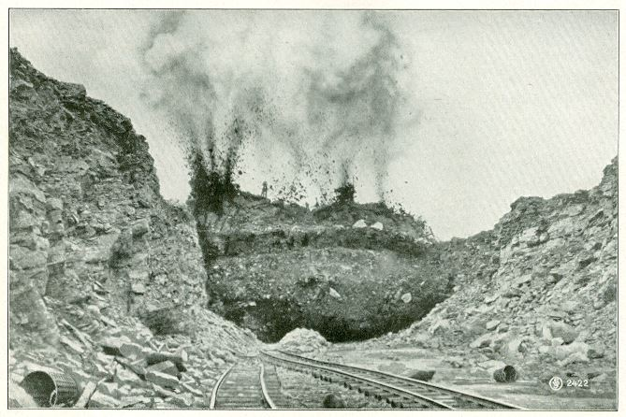
2. How was the Shannon Scheme built and what did it cost?
The total cost of the project was £5.2m. This was the equivalent of 20% of the Irish government’s entire revenue budget for 1925.
A workforce of up to 5000 people was employed during its construction. This included German and Irish workers.
The Shannon Scheme opened in 1929 and by 1937 Ardnacrusha power station supplied 87% of electricity requirements in Ireland.
Blasting rock for the construction of the Shannon Scheme. Image: ESB archives

Slide 8
3. What was the impact of the Shannon Scheme on the Irish Free State in the 1920s and 1930s?
Watch the video:
(b) In groups discuss...
Based on a second viewing of the video clip, what evidence can you find to suggest that the construction of the Shannon Scheme was a significant achievement for the Irish Free State?

Slide 9
3. What was the impact of the Shannon Scheme on the Irish Free State in the 1920s and 1930s?
The historian Diarmaid Ferriter has described the decision of the Cumann na nGaedheal government to undertake the construction of the Shannon Scheme as follows:
“The decision...was not only a far-sighted and innovative move, but also the government’s most significant gesture in the direction of industrialisation.”
Do you agree with Ferriter’s assessment? Explain your answer.

