Slide 1


Slide 2
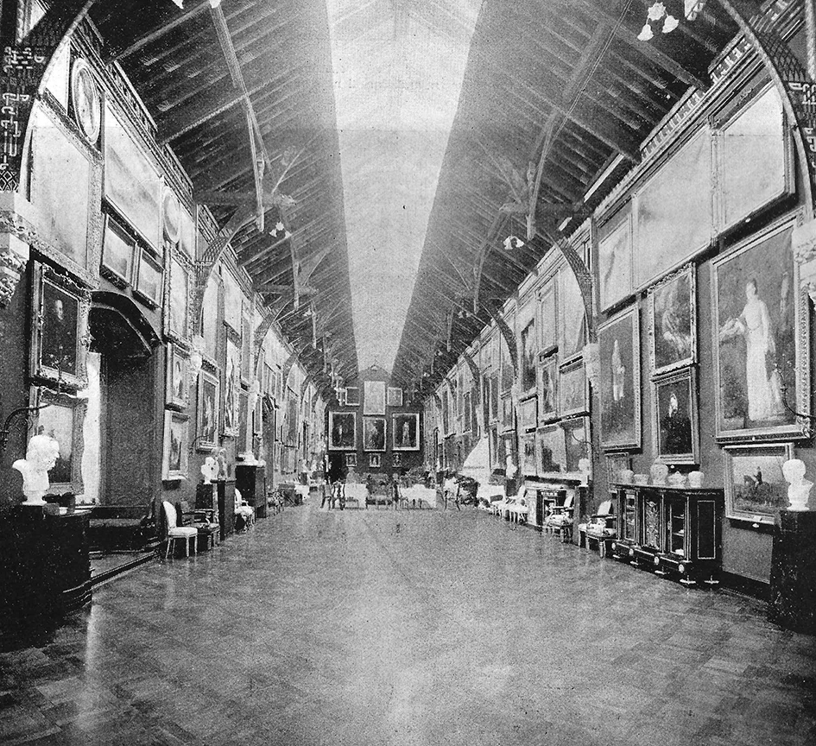

Curriculum Links: Transition Year History
This resource could be used to teach a Transition Year unit on life in 19th century Ireland
The Picture Gallery, Kilkenny Castle.

Slide 3
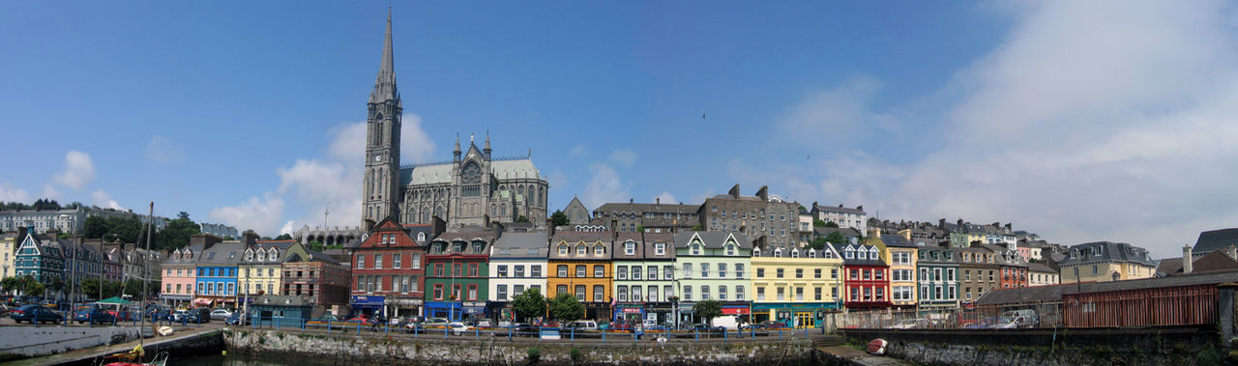
Learning Intentions:
to understand the growth of the middle class in Ireland by examining the dwellings of the new merchant class in Cobh/Queenstown, Co. Cork.
to understand how the upper classes maintained their traditions and respectability by studying the redevelopment of Kilkenny Castle in the 1800s.
to explain why it is difficult to account for the living conditions of cottiers/working class in 19th century Ireland.

Slide 4
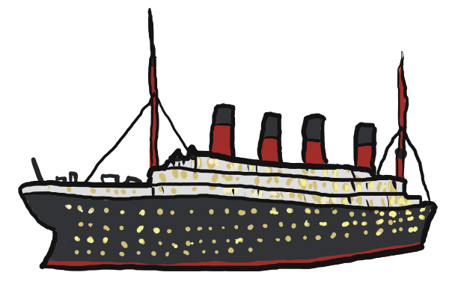
The growth of the middle class in Cobh/Queenstown, Co. Cork
Think-pair-share: What do you already know about the town of Cobh, Co. Cork? What is it famous for?
Fact: Cobh is well-known as the last port of call of the Titanic. It called at the town on 11 April 1912 before its ill-fated voyage across the Atlantic.

Slide 5
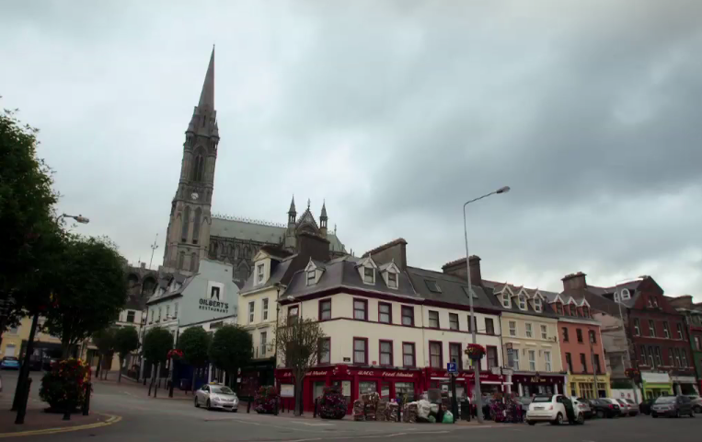
The growth of the middle class in Cobh/Queenstown, Co. Cork
The town of Cobh is located in Cork harbour.
It was known as Cove from 1750 onwards and was renamed Queenstown in honour of Queen Victoria when she visited the town in 1849.
It was renamed Cobh by the Irish Free State following independence in 1922.
During the 1800s Cobh grew in prosperity because of its use as a naval military base.

Slide 6
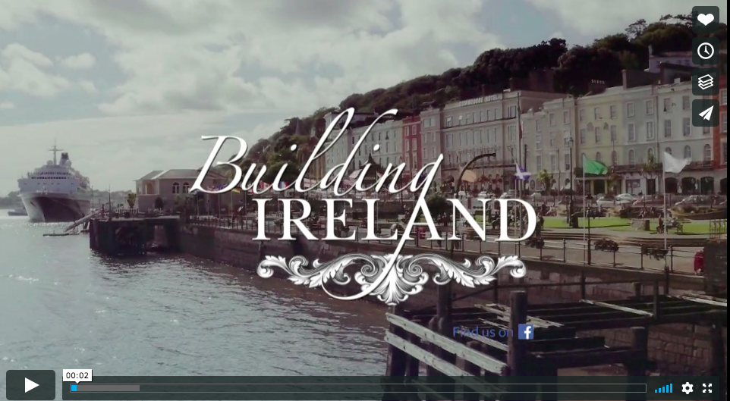
1. The growth of the middle class in Cobh/Queenstown, Co. Cork.
Watch the video clip at least twice:

Slide 7
1. The growth of the middle class in Cobh, Co Cork.
(b) Write the answers to the following questions:
What made Cobh an attractive place to live for the ‘new prosperous middle class’?
Look at the ‘Deck of Cards’ terrace of houses. Based on the exterior view shown in the video clip, what type of people do you think lived in these houses?
According to the architect, what type of people owned the houses on the Crescent?
How did the design of the Crescent help to show the status of its owners?
What was unique about the Crescent in Ireland in the 1850s?
Notes:
Teachers could print this slide to distribute to students so that they can see the questions while watching the video clip.

Slide 8
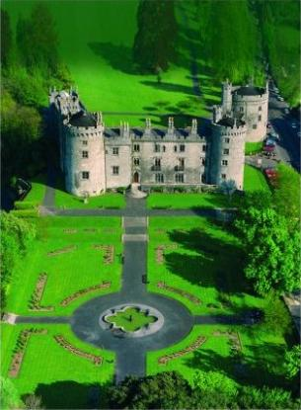
2. Upper class living: the renovation of Kilkenny Castle in the 1800s
Kilkenny Castle dates from the 1200s, when an Anglo-Norman castle was built at the site by William Marshal.
The castle was the seat of the Butler family for almost 600 years.
The Butlers of Ormonde carried out extensive renovations to the castle in the 1800s.
The castle was renovated and additions were made in the Gothic style, which was fashionable at the time.

Slide 9
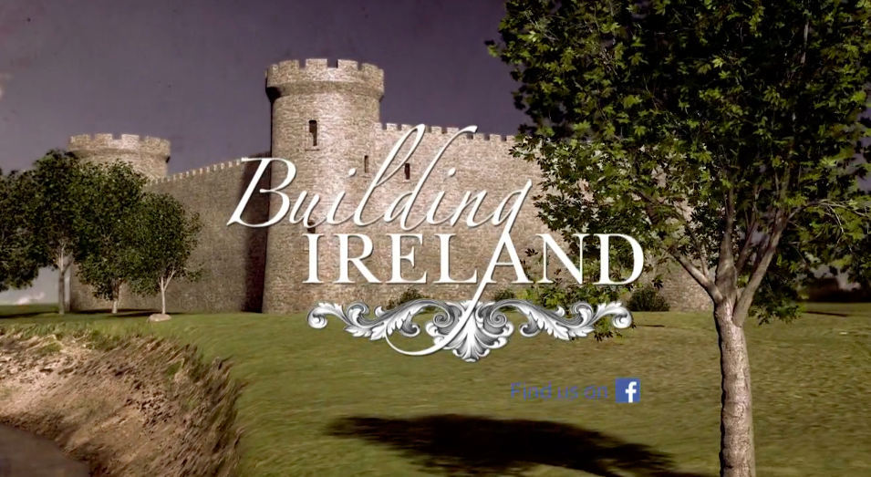
2. Upper class living: the renovation of Kilkenny Castle in the 1800s
Watch the video:
(b) In groups discuss...
What do you think of Robertson’s decision to decorate the exterior of the castle with medieval/gothic features? Would a 21st century architect do something like this?
What does the Moorish staircase and Picture Gallery tell us about the status of the Butlers of Ormonde in the 1800s?
What was the significance of having Scandinavian, Anglo-Saxon and Celtic decorations in the Picture Gallery?

Slide 10
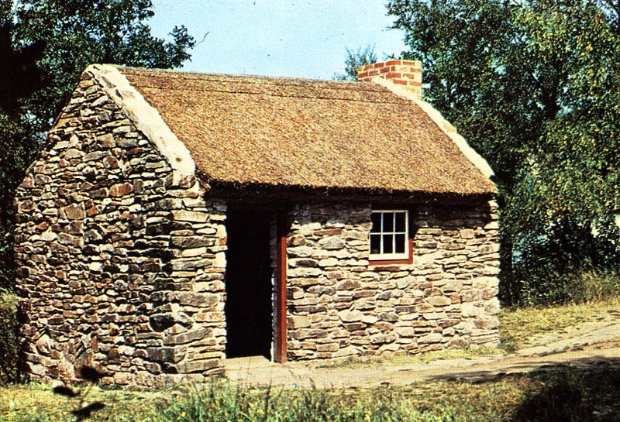
3. Living conditions for the working class/cottier class in 19th century Ireland.
In this lesson we have examined evidence of the living conditions for the middle and upper classes in Ireland in the 1800s.
There is a lack of material evidence of the living conditions for the working/cottier class in Ireland in the 1800s.
Why do you think this is the case?
Reconstruction of a cottier’s dwelling house at the Ulster Folk and Transport Museum, Cultra

