Slide 1
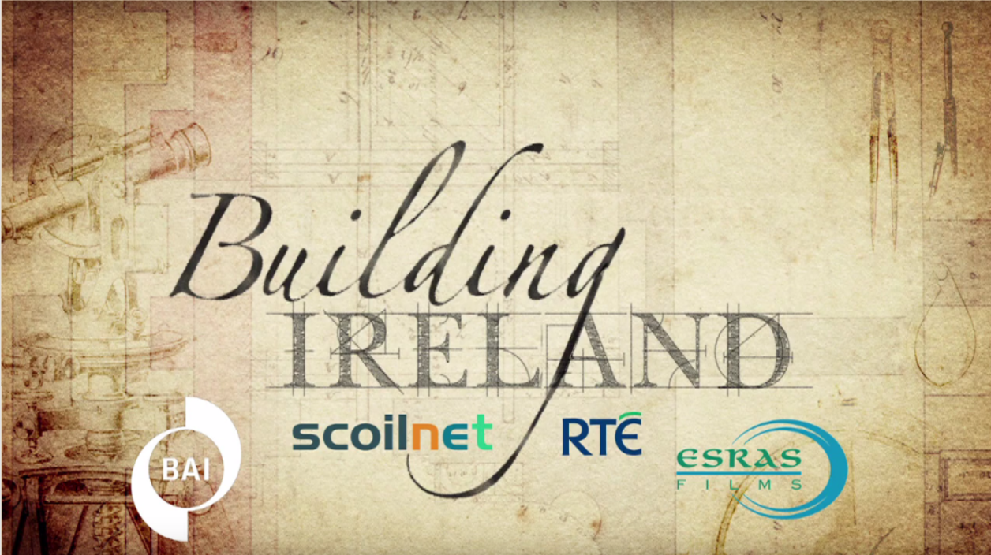

Slide 2
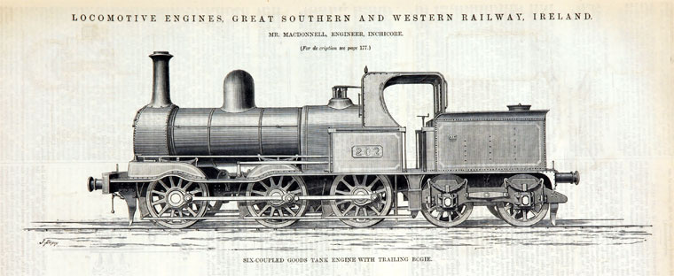

JC History syllabus links:
Social change: from farm to factory Changes in transport and leisure in the 19th century

Slide 3
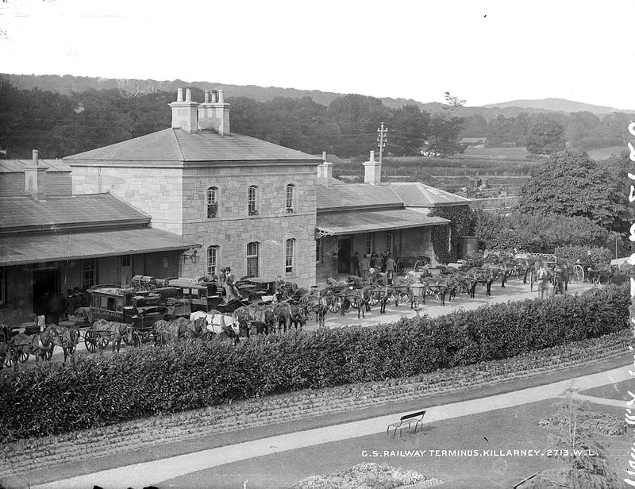
Learning Intentions:
To be able to explain why the upper and middle classes were able to take holidays in the 1800s
To be able to describe the type of holiday offered by the tourist town of Killarney
To assess whether or not this type of holiday was available to all members of Victorian society
The Great Southern Railway terminus in Killarney, Co. Kerry, ca. 1890

Slide 4
Why were the upper and middle classes able to take holidays in the late 1800s/early 1900s?
Think-pair-share: What type of transport did you use to get to your last holiday destination? How do you think your mode of transport was different to the modes of transport available in the 1800s?

Slide 5
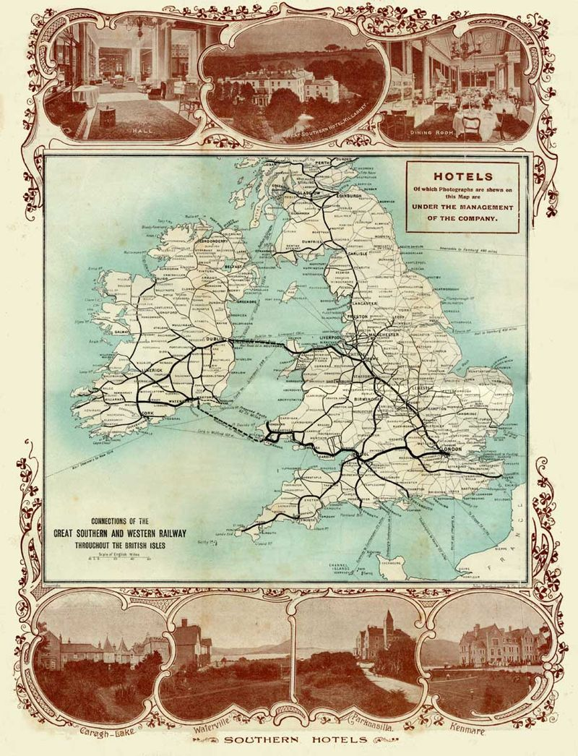
Why were the upper and middle classes able to take holidays in the late 1800s/early 1900s?
The first railway line from Dublin to Killarney opened in 1854. A hotel opened beside the railway station in Killarney, known as the Railway Hotel.
The railway line was operated by the Great Southern and Western Railway, a company established in 1844.
By 1902, GSWR had established connections throughout Britain and Ireland (see map). This enabled tourists to travel to Killarney on package holidays.
Notes:
Map shows GSWR connections throughout Britain and Ireland in 1902.

Slide 6
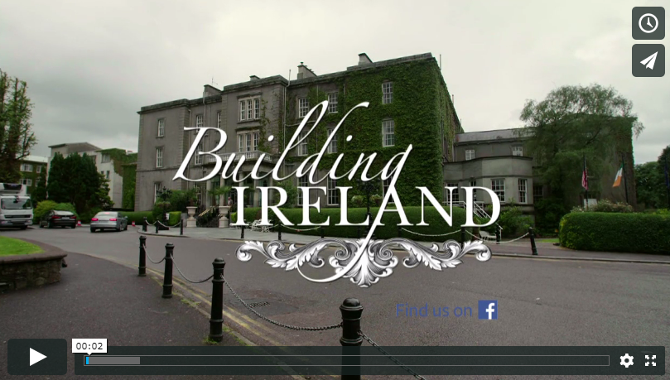
2. Describe the type of holiday offered by the tourist town of Killarney.
Watch the video clip at least twice:

Slide 7
2. Describe the type of holiday offered by the tourist town of Killarney.
(b) Write the answers to the following questions:
What does the presenter mean when she says the Great Southern and Western Railway ‘enjoyed a total monopoly’ in the tourist town of Killarney?
Describe the system of lighting at the Great Southern Hotel.
According to the historian, where did the tourists come from during the early history of the hotel?
What led to an increase in visitors coming to Killarney from England?
What kind of facilities and services did the Victorian visitors to the hotel expect to have during their stay?
Notes:
Teachers could print this slide to distribute to students so that they can see the questions while watching the video clip.

Slide 8
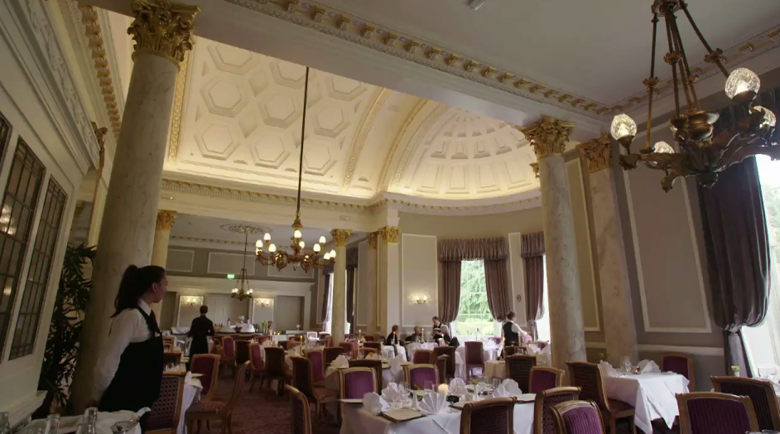
3. Was the type of holiday offered by the Railway Hotel available to all members of Victorian society?
Based on the video clip, it is evident that the type of holiday offered by the Railway Hotel was only available to upper classes.
What types of holiday could the middle and working classes afford, in your opinion?
Could some afford to have any holiday at all? If not, how did they occupy their leisure time?
Extension activity: Use your textbook/internet to research the types of leisure activity available to the working classes during the Industrial Revolution.

