Slide 1


Slide 2
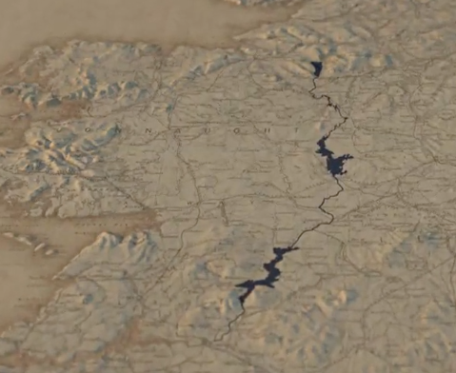
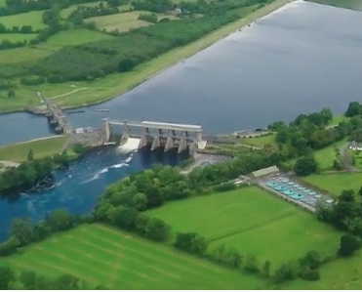

JC Geography syllabus links:
Human activities interact in a variety of ways with natural landscape processes
All images screenshots from the video clip

Slide 3
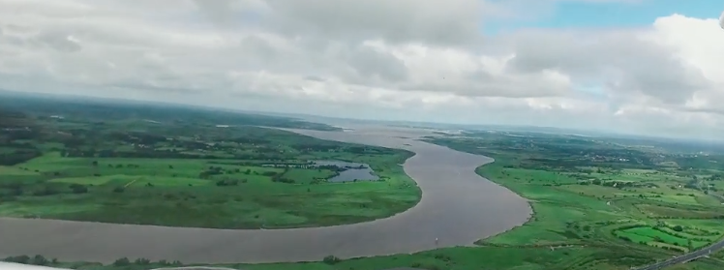
Learning Intentions:
In this unit, we will learn how
our understanding of river processes allows the correct site selection for HEP dams
people can interact with the natural course of a river
consequences such as flooding need to be carefully considered before finalising any decisions when dealing with altering natural processes

Slide 4
Warm up activity:
Jot down a similar KWL table into your copy. Fill in the first two columns now and the last column when you have completed this presentation on the River Shannon and HEP stations.
What I Know | What I Want to know | What I Learned

Slide 5
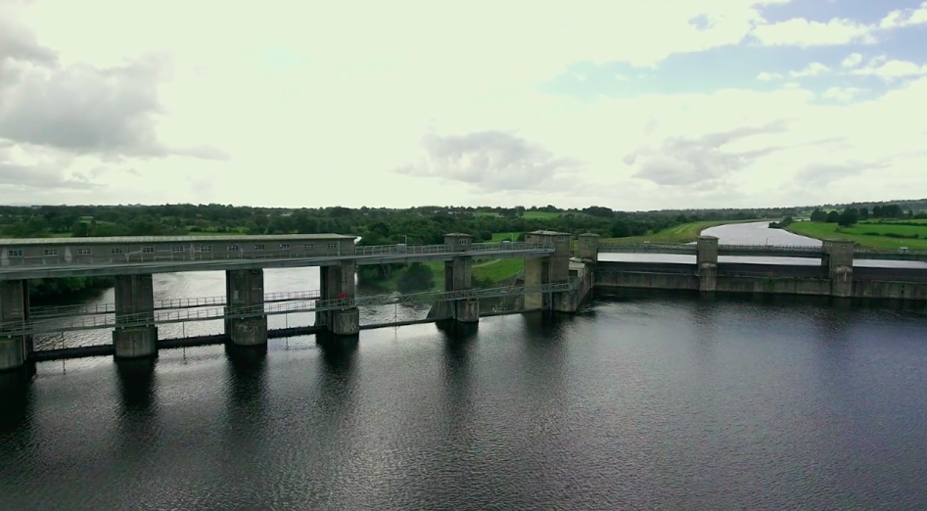
Watch the 2.27 min video clip:
After watching the video clip define the following
geographical terms:
HEP
Terrain
Meander
Flooding
Natural Resource
Canal
Embankment

Slide 6
Definitions of geographical terms:
Here are the definitions of the geographical terms used in the video clip. Compare them against your answers and see how many you answered correctly:
HEP: Hydro Electric Power
Terrain: The landscape
Meander: A bend or curve in a river
Flooding: Increase volume of water in a river, usually occurring after heavy rainfall, that causes it to break its banks and spread out over the surrounding landscape
Natural Resource: Is something in nature that can be used it includes water, soil and rocks. It can be renewable or non-renewable
Canal: A man-made waterway
Embankment: A man-made levee or bank used to hold back water

Slide 7
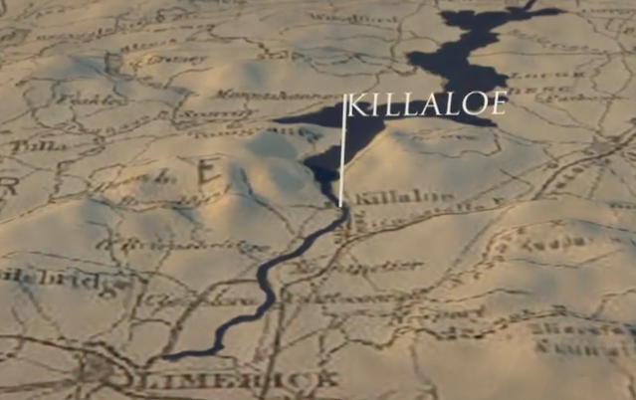
Now watch the video clip again and answer the following questions:
Why are HEP dams created?
What could engineers never agree on?
What problems did engineers encounter when examining the course of the river?
What are the characteristics of the ideal place for a dam, according to the presenter?
Why was the location of Killaloe not a good option for the proposed dam’s location?

Slide 8
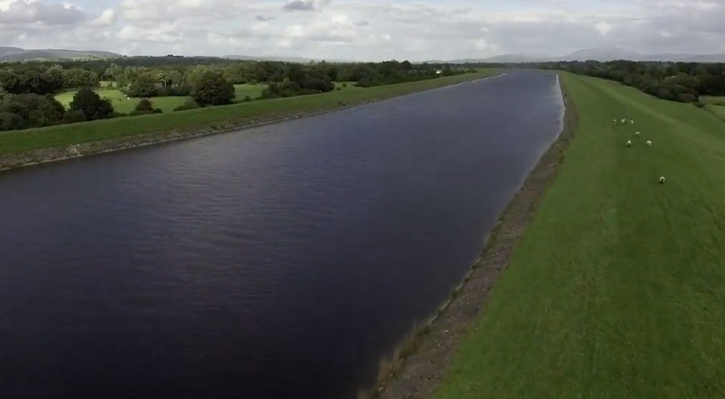
Now watch the video clip again and answer the following questions:
6. How did the engineers finally solve this problem?
7. What was the name of the weir mentioned in the clip?
8. How long is the Headways?
9. What is the name of the dam that was created?
10. “This was the single biggest effort ever made to harness the natural resources of this island”, according to the presenter. Do you agree or disagree with this statement give three reasons for your answer.

Slide 9
‘What I Learned’ activity:
Now that you have completed this presentation on the River Shannon and HEP stations, fill in the last column ‘What I Learned’
What I Know | What I Want to know | What I Learned

Slide 10
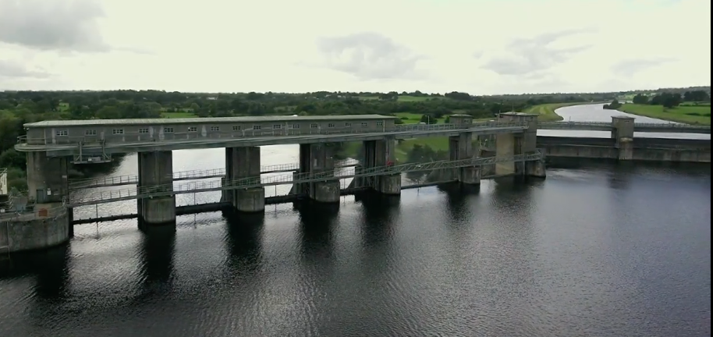
Extension Activity:
Part 1:
Now fill in the final column of the KWL chart that you have in your copy from earlier outlining the things that you learned about this topic.
Place a star beside anything that you learned in the L column that you found especially interesting.

Slide 11
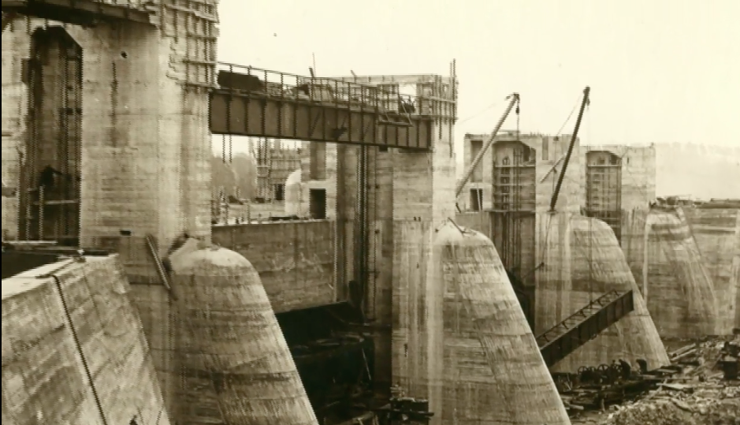
Extension Activity continued:
Part 2:
The construction of Ardnacrusha HEP station was a massive undertaking for the Irish government. See can you use your internet skills to research and find the answers to the following questions:
In what year was the HEP station completed?
How much did it cost the Irish Government?
How many cubic metres of water per second are released through its turbines?
In 2016 Ardnacrusha was accused of adding excess water into an already flooded landscape of the River Shannon see what you can find out about this? Do you agree or disagree with the statement. Give one reason for your answer.

Slide 12
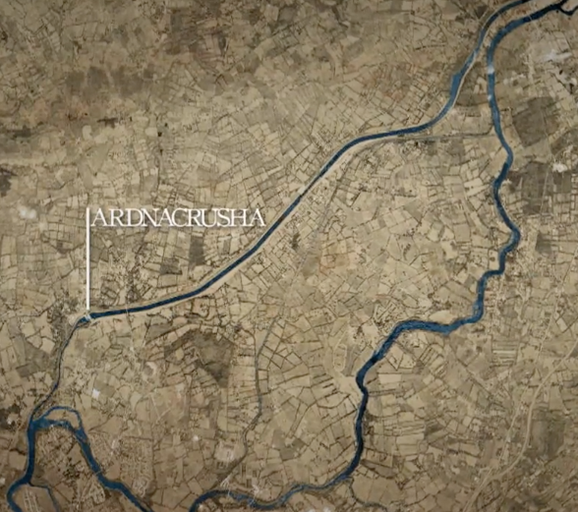
Links to new geography specification:
Strand 2: Exploring how we interact with the physical world
Learning outcome 2.7: investigate examples of how people interact and manage surface processes
Key skills used in class today:
•Being literate
•Managing my information and thinking
•Managing myself

Slide 13


