Slide 1


Slide 2
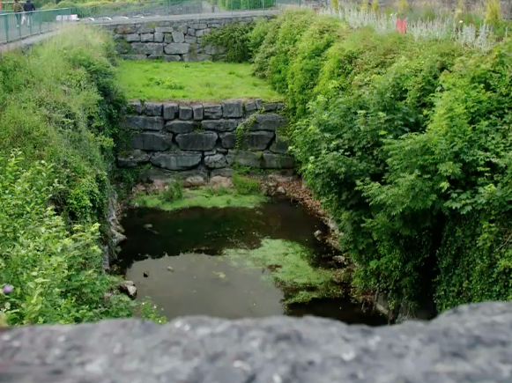

The crust of the earth is made up of rocks. These rocks vary in their origin, formation and characteristics
JC Geography syllabus links:
All images screenshots from the video clip

Slide 3
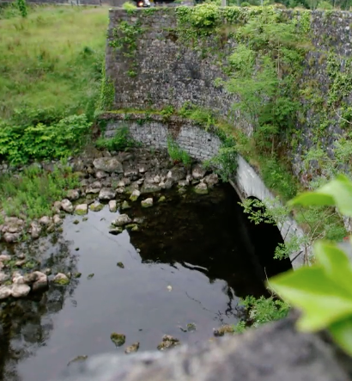
Learning Intentions:
In this unit, we will learn
the reasons behind the building of the canal way in Cong, Co. Galway
some of the underground features of a karst region
to further develop your knowledge of the permeable nature of limestone
further information about the process of carbonation, a type of chemical weathering

Slide 4
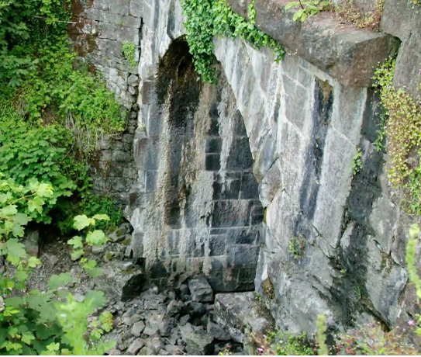
Warm up activity:
Blue Sky Thinking
In pairs, write down on the post-its in front of you, what you think will be discussed in this video clip. The information is based on disappearing canals in Galway that flow over a bedrock of limestone.

Slide 5
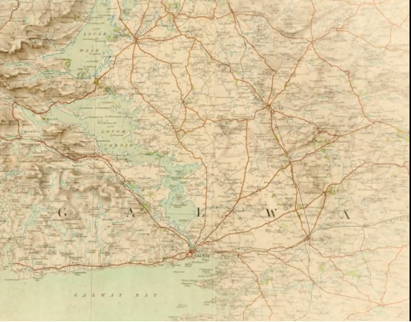
Warm up activity continued:
When you have two or three answers that you both agree with, stick them to the window of the classroom. We will revisit these answers after we have watched the video clip
Remember there is no such thing as a wrong answer here!

Slide 6
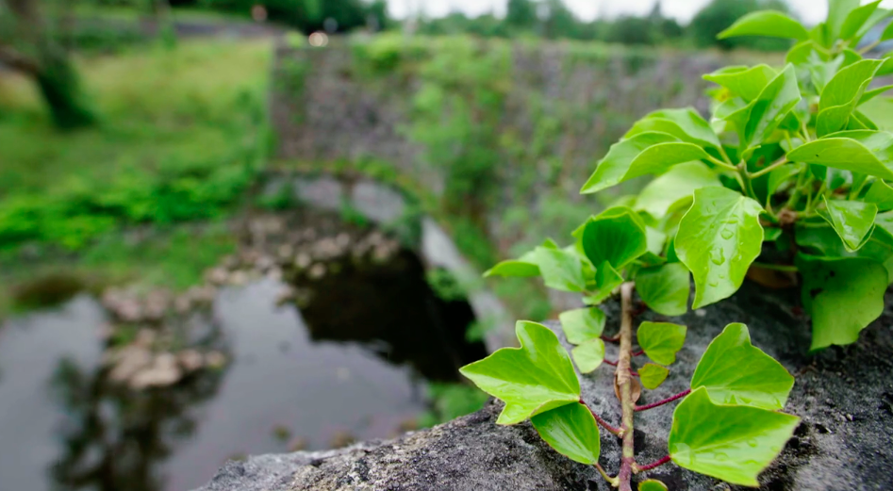
Stop and jot
After each 30 seconds the video will be paused, you are to write down at least one thing that you have learned while listening to this part of the video clip
You will have at least seven pieces of information jotted in your copy by the end of watching this video clip
Place a star beside any new information discovered
Watch the 3.31 min video clip:

Slide 7
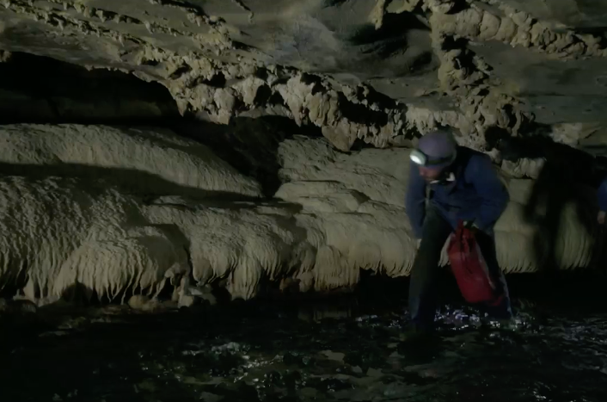
Two Stars and a wish
If the questions on the post-it’s placed on the window earlier were answered in the video clip place them now on the whiteboard in your classroom
Next write down two stars (things that you have learned in class today). See if you can link this information with what you have previously studied on weathering and karst landscapes
Finally, construct one wish (one think you would still like to know about this topic). If you are stuck you can use some of the post-its that are still on the classroom window to help you!
Extension Activity:

Slide 8
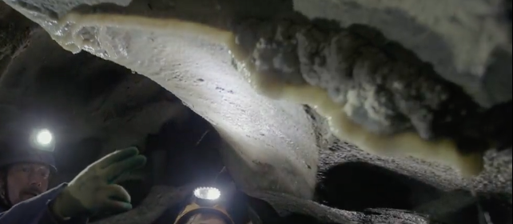
Extension activity continued:
Your wish post-it is to be placed on the classroom door as you leave
Remember you will be asked what you wished for in tomorrow’s class so don’t forget!

Slide 9
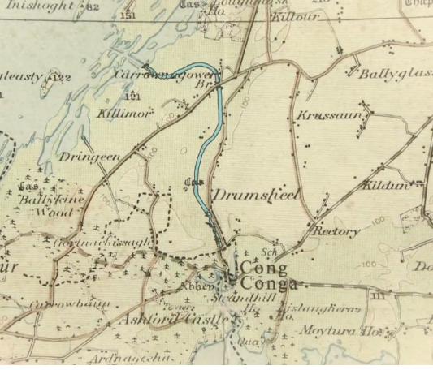
Links to new geography specification:
Strand 1: Exploring the physical world
Learning outcome 1.3: analyse the processes and effects of weathering and mass movement on our landscape.
Key skills used in class today:
•Managing my information and thinking
•Managing myself
•Being literate
•Communicating
•Working with others
•Being creative

