Slide 1


Slide 2
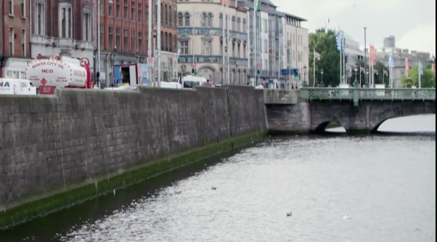

The growth of towns and cities has occurred within the historical periods through the development of economic, administrative and social activities
JC Geography syllabus links:
All images are screenshots from the video clip

Slide 3
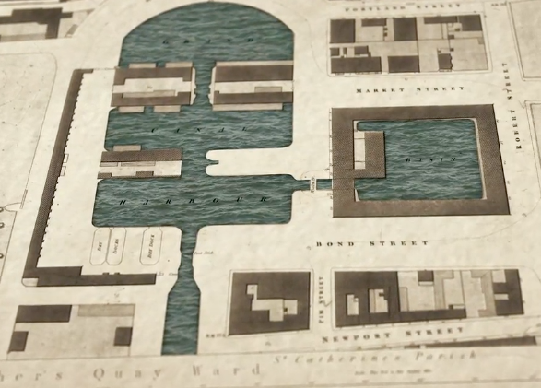
Learning Intentions:
In this unit, we will learn how:
cities e.g. Dublin grew during the Georgian period (1714-1830)
the old industries e.g. textiles and distilleries, were located around the Liberties area of Dublin
some of the place names of the area developed

Slide 4

Warm up activity:
Diamond 8 activity part 1
Look at the following factors affecting the location of the textile industry in Dublin city during the eighteenth century:
Resource materials
Large workforce
Transport links
Markets
Capital
Preference of investors and the local community
Services
Government policies

Slide 5
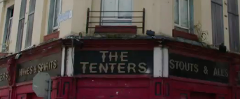
Warm up activity continued:
Diamond 8 activity part 2
Draw the following table into your copy
Decide in your pairs where each factor should be placed on the Diamond 8 sheet, by ranking the factors in order of importance, the most important at the top and the least important at the bottom
Most Important
Least Important

Slide 6
Before you watch the video clip:
Anticipation exercise:
Write down if you agree or disagree with the following statements:
The River Liffey was used as a resource for the textile industry
The main industrial hub of 18th Century Dublin City was called the Grand Canal Basin
100,000 people lived in the Liberties area of Dublin City in the 18th Century
Tannery Alley, Mill St. and Weavers Sq. all areas found in Dublin City today were named after the textile industries that located there in the 18th century

Slide 7

Watch the 2.46 min video clip:

Slide 8
Now after watching the video clip:
B) Anticipation exercise:
Now, after watching the video clip, write down if you agree or disagree with the following statements:
The River Liffey was used as a resource for the textile industry
2. The main industrial hub of 18th Century Dublin City was called the Grand Canal Basin
3. 100,000 people lived in the Liberties area of Dublin City in the 18th Century
4. Tannery Alley, Mill St. and Weavers Sq. all areas found in Dublin City today were named after the textile industries that located there in the 18th century
Did you change any of your answers? What were the reasons for this?

Slide 9
Extension activity:
Placemat activity part 1:
Divide into groups of four
Draw the placemat diagram on the righthand side
of the screen into your copy

Slide 10
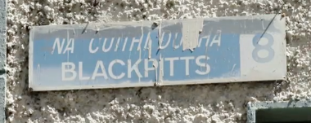
Extension activity continued:
Placemat activity part 2:
3. On one section of the placemat write down one thing that you learned from the video clip
4. Pass it to another member of your group to write their answer in the next section
5. Continue the process for the third and fourth member of your group.

Slide 11

Extension activity:
Placemat activity part 3:
6. Then examine all four answers on the placemat. Next decide through group discussion which one you will relay back to the class
7. You must jot down reasons underneath the other options why you did not choose them e.g. ‘we had studied this in class already’ or ‘this is not accurate what he really said was’ or ‘we all agreed this is not as closely related to geography as the other answer’

Slide 12
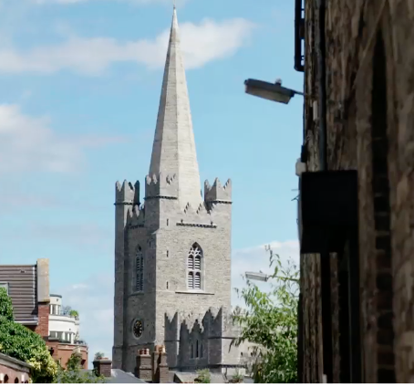
Links to geography specification:
Strand 3: Exploring people, place and change
Learning outcome 3.5: examine the cause and effects of urban change in an Irish town or city
Key skills used in class today:
•Managing my information and thinking
•Managing myself
•Communicating
•Working with others
•Being literate
•Being creative

