Slide 1


Slide 2

Junior Cycle History: Learning outcomes
1.3 Students will be able to demonstrate awareness of their cultural inheritance through an appreciation of historically significant places and buildings
1.6 Appreciate the contribution of archaeology and new technology to historical enquiry.

Slide 3
Building Ireland Dublin’s Distilleries: Learning outcomes
To explain the term ‘landmark building’ and identify examples of landmark buildings in your area
To describe the purpose of St. Patrick’s Tower/Roe’s Distillery in Dublin in the 1800s and explain why it was a landmark building
To understand how the work of the archaeologist can provide us with evidence of the past

Slide 4
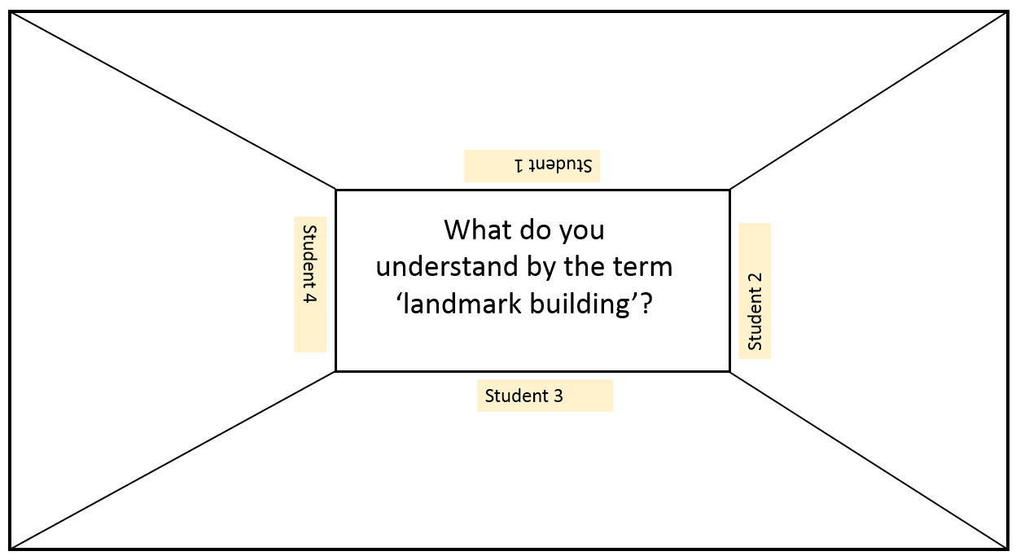
Starter: Placemat activity
To explain the term ‘landmark building’
Notes:
Students should be divided into groups of four and given blank copies of the placemat activity template. Each student thinks about their understanding of the term ‘landmark building’ and writes their ideas in their space on the placemat. The group then discusses the suggested definitions and agrees on a consensus.

Slide 5
...is often large and dominates the landscape.
...often has an important function in the local area.
...often had an important function in the local area in the past.
...is often a beautiful building of architectural importance.
A ‘landmark building’ is one that...

Slide 6
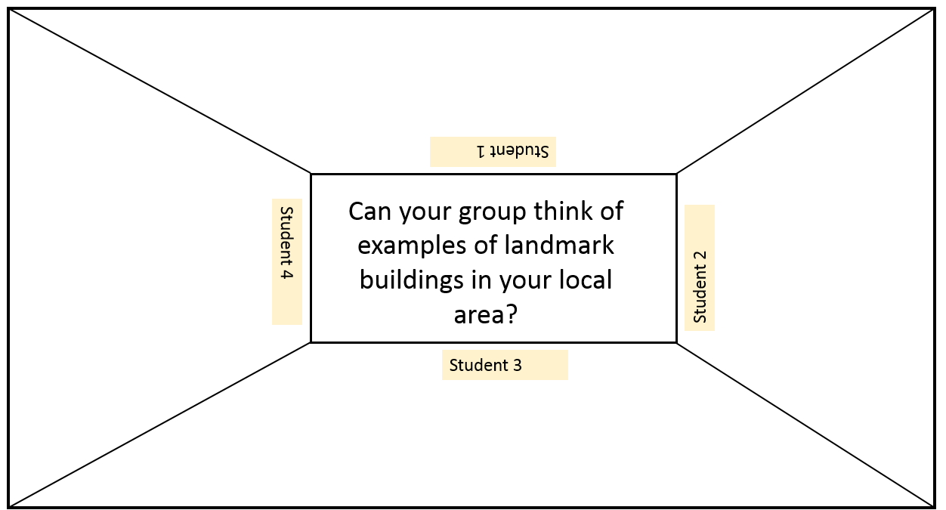
Starter: Placemat activity
To identify examples of landmark buildings in your area
Notes:
Students should be divided into groups of four and given blank copies of the placemat activity template. Each student thinks about their understanding of the term ‘landmark building’ and writes their ideas in their space on the placemat. The group then discusses the suggested definitions and agrees on a consensus.

Slide 7
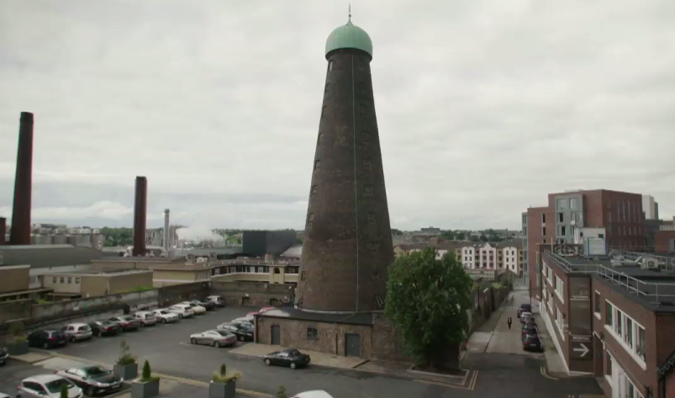
2. St. Patrick’s Tower/Roe’s Distillery as a landmark building in Dublin
Watch the video clip at least twice:
(b) Answer the following questions, based on the first half of the clip:
Why do you think St. Patrick’s Tower was an important landmark in Dublin in the 1800s?
What was the purpose of the tower?
Why do you think it continues to be a landmark building in Dublin today?

Slide 8
3. To understand how the work of the archaeologist can provide us with evidence of the past
Watch the interview with the archaeologist
(b) Answer the following questions:
Name one type of building that the archaeologist uncovered at Roe’s Distillery during her excavation.
What evidence did the archaeologist uncover to show that Roe’s Distillery was self-sufficient?
What two things was the archaeologist surprised by as a result of the excavation?

Slide 9
Building Ireland Dublin’s Distilleries: Plenary
How do you think excavations, like the one at Roe’s Distillery, help the historian to learn about the past?
Can you think of any old industrial buildings in your area that could be excavated by an industrial archaelogist?

