Slide 1
Introducing BIOMATERIALS

Slide 2
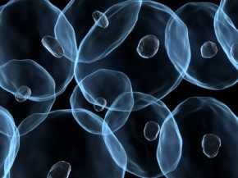
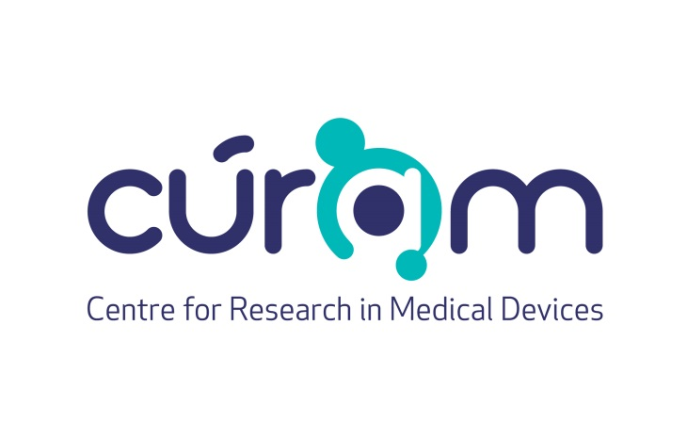
Teachers in Residence Programme
Iseult Mangan and Tom Flanagan
Notes:
http://www.celldataservices.co.uk/biomaterials

Slide 3
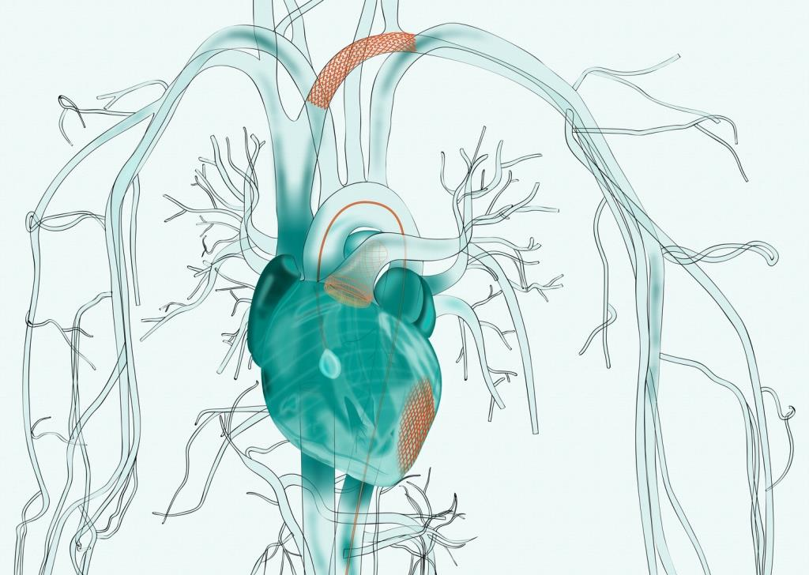
MEDICAL DEVICES
Any material, apparatus, software or other article that is used to:
Diagnose, prevent, monitor or treat a disease or injury
Investigate, replace or modify a part or process of the body

Slide 4
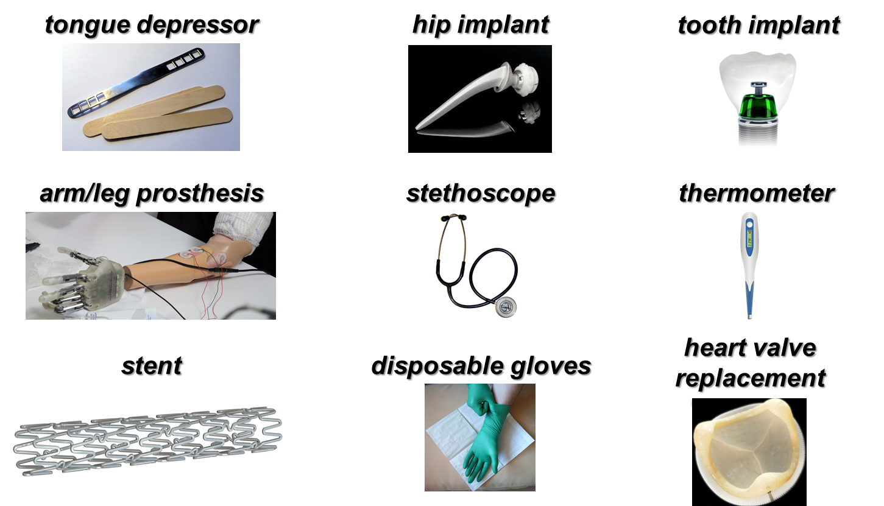
CAN YOU NAME SOME
MEDICAL DEVICES?
Notes:
https://upload.wikimedia.org/wikipedia/commons/0/00/Stainless_steel_and_ultra_high_molecular_weight_polythene_hip_replacement_%289672239334%29.jpg
https://upload.wikimedia.org/wikipedia/commons/0/0f/Mundspatel.jpg
https://upload.wikimedia.org/wikipedia/commons/d/d7/Stethoscope.png
https://pixabay.com/en/thermometer-digital-temperature-36852/
https://www.flickr.com/photos/campusbiomedico/12326026754
https://vimeo.com/8316149
https://upload.wikimedia.org/wikipedia/commons/5/59/Surgical_gloves_27.JPG
https://upload.wikimedia.org/wikipedia/commons/a/af/Kovovej.png
https://upload.wikimedia.org/wikipedia/commons/2/23/Teeth.jpg

Slide 5
Biomaterials are used to make
medical devices
What are BIOMATERIALS?

Slide 6
What are Biomaterials?
A biomaterial is made from a natural or synthetic material that can be engineered to help the body heal itself
A biomaterial can be introduced into the body as part of an implanted medical device or used to replace an organ
They can be temporary or permanent

Slide 7
Biomaterials must be biocompatible
The body must not fight or attack the material
Cannot be toxic
Cannot cause inflammation
Cannot cause an allergic reaction
Biomaterials

Slide 8
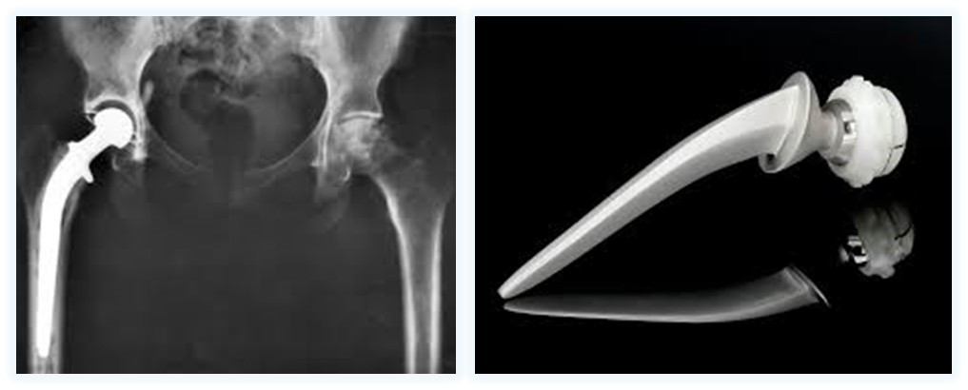
SYNTHETIC BIOMATERIALS
Materials made by humans, like plastic or metal
Good:
They are easy to make and exactly the way you need
Bad:
Sometimes the body does not like them
Notes:
https://upload.wikimedia.org/wikipedia/commons/2/2f/Hip_replacement_Image_3684-PH.jpg
https://upload.wikimedia.org/wikipedia/commons/0/00/Stainless_steel_and_ultra_high_molecular_weight_polythene_hip_replacement_%289672239334%29.jpg

Slide 9
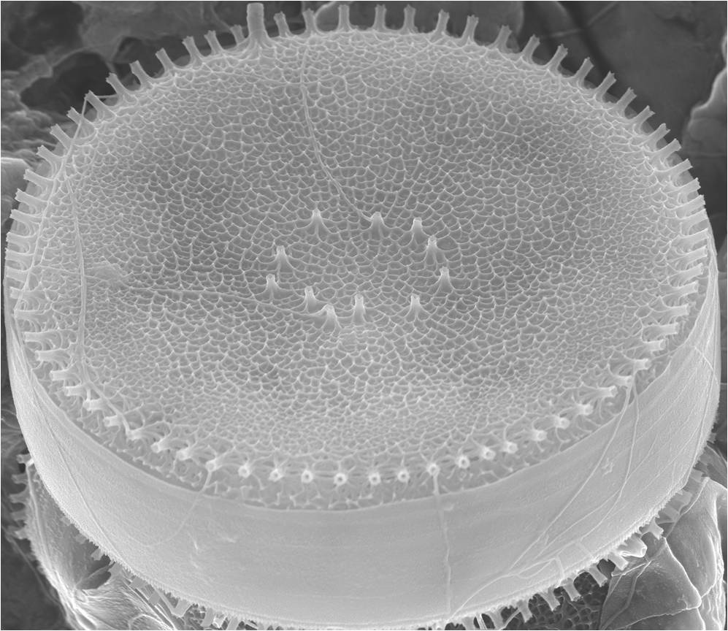
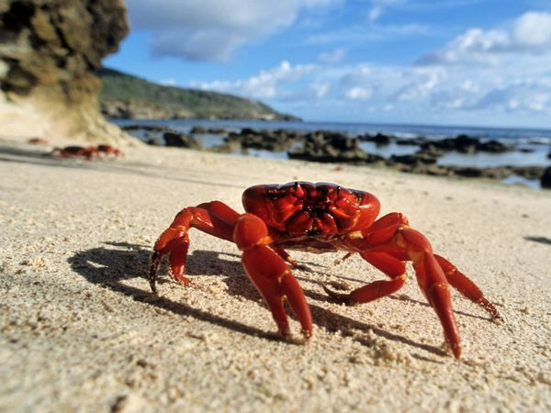
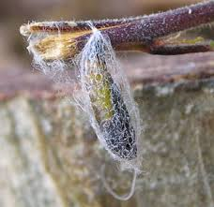
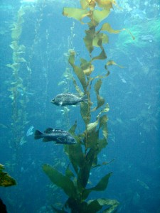
NATURAL BIOMATERIALS
Materials from nature and made from cells
Algae found in freshwater and seawater
Shells of crabs and prawns
Silk from butterfly
cocoons
Alginate from seaweed
Good: The body likes them Bad: People can’t make them
Notes:
http://www.gojiberryblog.com/2011/09/11/how-to-revive-your-plants/
http://gpwalsh.com/the-shift/
http://animals.nationalgeographic.com/animals/invertebrates/red-crab/

Slide 10
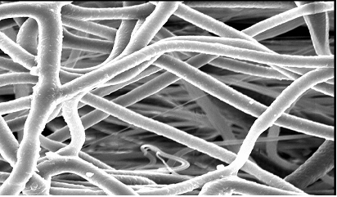
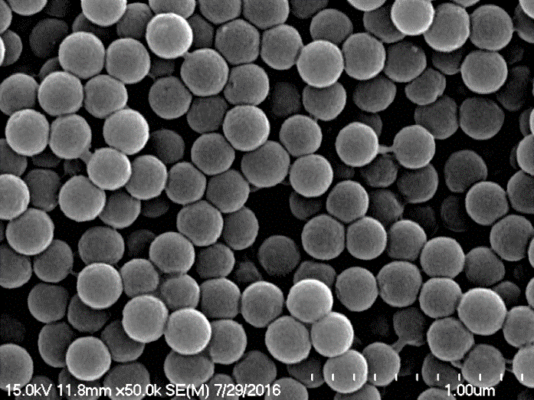
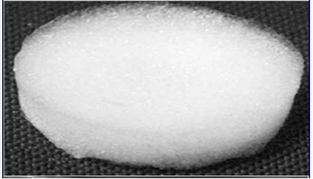
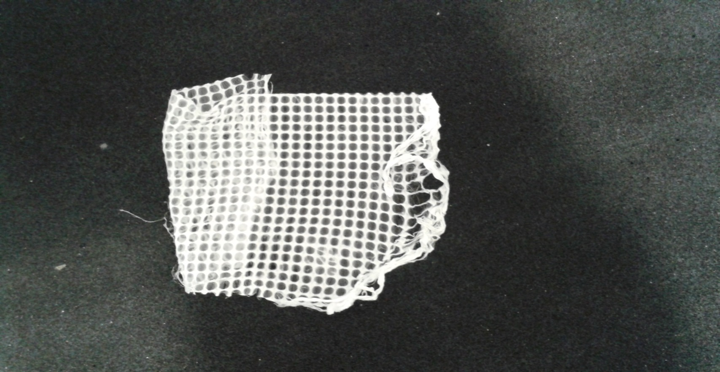
Fibres
Nanospheres
Biomaterials can take many forms
to support new tissues to grow
Sponges
Meshes

Slide 11

Cells can be added to biomaterials…
…to repair tissues, like the heart or tendons
Cells
Biomaterial
Put back into the body
to help new tissues to grow
Medicine

Slide 12
Medicine can be added to biomaterials…
Medicine makes cells do different things:
Make more cells proliferate
Behave in certain ways differentiate
Move into the biomaterial migrate

Slide 13
Activity 1: History of Devices
Contribution of medical devices to medical history
Create a timeline of:
2) Historical events
1) Medical devices developments

Slide 14
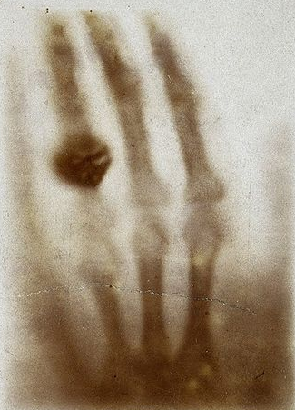
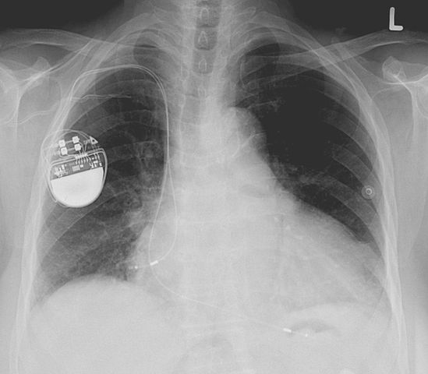
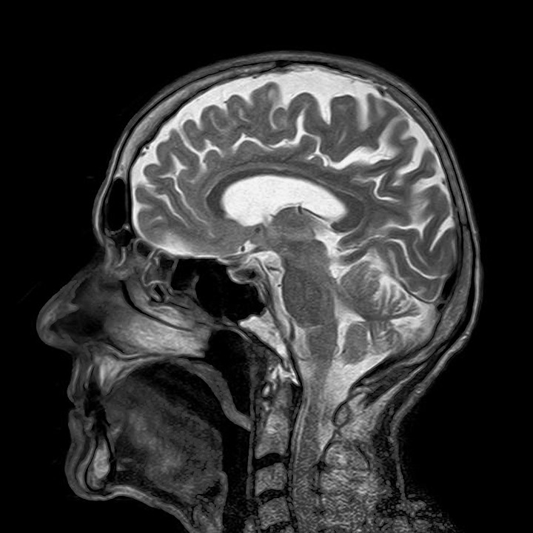
Milestones of Medical Devices
Flexible Catheter
MRI
X-ray Imaging
Stethoscope
General Anaesthetic
Pacemaker
Notes:
Image: https://commons.wikimedia.org/wiki/File:Pacemaker.jpg
Image: https://upload.wikimedia.org/wikipedia/commons/7/79/First_medical_X-ray_by_Wilhelm_R%C3%B6ntgen_of_his_wife_Anna_Bertha_Ludwig%27s_hand_-_18951222.jpg
Image: https://pixabay.com/en/mri-magnetic-x-ray-skull-head-782459/
Card Image: https://www.flickr.com/photos/internetarchivebookimages/14759632836
Card Image: https://en.m.wikipedia.org/wiki/File:Stethoscope-2.png
Card Image: https://commons.wikimedia.org/wiki/File:US_Navy_030513-N-1577S-001_Lt._Cmdr._Joe_Casey,_Ship%27s_Anesthetist,_trains_on_anesthetic_procedures_with_Hospital_Corpsman_3rd_Class_Eric_Wichman_aboard_USS_Nimitz_(CVN_68).jpg
Information: http://www.nytimes.com/interactive/2012/10/05/health/digital-doctor.html?_r=0#/#time15_375
Flexible Catheter-Benjamin Franklin invented the flexible catheter, made of hinged metal segments, for his brother John, who suffered from bladder stones. Previously, catheters had been hard tubes, jammed into the bladder through the urethra.
Stethoscope-René Laënnec, a French physician, invented the stethoscope, a trumpet-shaped wooden tube, to examine a woman whose heart he could not hear by pressing his ear to her chest.
Anaesthesia-Dr. Crawford W. Long performed the first operation using diethyl ether as an anesthetic. He pressed an ether-soaked towel against the patient's face to put him to sleep, then removed one of two tumours from his neck. He billed the patient $2, itemizing the cost of the ether as well as the operation.
X-Rays-Wilhelm Conrad Röntgen, a German physicist, discovered X-rays and took the first picture using X-rays of his wife Anna’s hand. When she saw her skeleton she exclaimed “I have seen my death!”
Pacemaker-Dr. Albert S. Hyman demonstrated a heart pacemaker. The device was about 10 inches long and weighed less than a pound; it supplied the heart with a current with adjustable voltage.
MRI-Dr. Raymond V. Damadian announced that he had patented a technique using nuclear magnetic resonance to distinguish between normal and cancerous tissue.

Slide 15
Historical Events
American War of Independence
End of Soviet Union
World War II Begins
American Civil War
World War I Begins
Queen Victoria’s Reign Begins

Slide 16
First Medical Device and Event
A catheter is a thin tube that can be inserted in the body to treat diseases or perform a surgical procedure.
1752
Flexible
Catheter
1775–1783
American War of Independence
Benjamin Franklin invented the flexible catheter made of metal in 1752 when his brother John suffered from bladder stones!

Slide 17
Second Medical Device and Event
A stethoscope is used to listen to the inside of the body, most often the lungs and heart.
1816
Stethoscope
1837
Queen Victoria’s Reign Begins
René Laennec (France) invented the stethoscope because he was uncomfortable placing his ear on women's chests to hear heart sounds!

Slide 18
Third Medical Device and Event
A general anaesthetic allows medical procedures to be caused without pain.
1842
General Anaesthetic
1861-1865 American Civil War
General anesthetic was used in 95% of Civil War surgeries. Hollywood concept of “biting the bullet” to help relieve the pain is not true!
Dr. Crawford W. Long used ether on a patient who had two tumours removed from the neck. The patient paid two dollars for the procedure.
Notes:
Information: http://www.civilwarmed.org/anesthesia/
In the mid-19th century parties were held where young socialites used to inhale gases such as sulphuric ether to induce euphoria. At one such party, Dr. Crawford W. Long observed a party goer inhale ether and take a heavy fall, but display no indication of pain. With this in mind, Dr. Long performed his first surgical procedure using ether on March 30, 1842, when he removed a tumour from the neck of a young man who did not feel any pain.

Slide 19
Fourth Medical Device and Event
X-ray imaging creates pictures of the inside of your body shown in different shades of black and white.
1895
X-ray Imaging
1914
World War I Begins
During WWI Madame Marie Curie invented vehicles containing an x-ray machine and photo darkroom equipment which could be driven on the battlefield for army surgeons.
German physics professor Wilhelm Röntgen took the first x-ray image of his wife‘s hand. When she saw the picture, she said "I have seen my death."
Notes:
Information: http://theconversation.com/marie-curie-and-her-x-ray-vehicles-contribution-to-world-war-i-battlefield-medicine-83941
During WWI Madame Marie Curie invented vehicles containing an x-ray machine and photographic darkroom equipment (nicknamed “Little Curies”) which could be driven right up to the battlefield where army surgeons could use x-rays to guide their surgeries. In addition to the mobile x-ray cars that travelled around the battlefront, Curie also oversaw the construction of 200 radiological rooms at various fixed field hospitals behind the battle lines.
Frustrated by delays in getting funding from the French military, Curie approached the Union of Women of France, a philanthropic organization that gave her the money needed to produce the first “Little Curie”. Curie asked wealthy Parisian women to donate more vehicles. Soon she had 20, which she outfitted with x-ray equipment. Curie then trained women volunteers, including her daughter Irene, to operate the x-ray equipment. In order to operate the x-ray machines the women were taught about the physics of electricity and x-rays, as well as practical lessons in anatomy and photographic processing. A total of 150 women received x-ray training from Curie.

Slide 20
Fifth Medical Device and Event
Pacemakers are devices that use electrical impulses to regulate the beating of the heart if it is too slow, fast or irregular.
1932
Pacemaker
1939
World War II Begins
In 1932, American physiologist Albert Hyman built the first pacemaker that was powered by a hand-cranked motor.
During the 1930s, artificial heart stimulation was controversial and thought of as reviving the dead!
Notes:
Information: http://broughttolife.sciencemuseum.org.uk/broughttolife/techniques/pacemaker
After the Second World War, smaller pacemakers were developed some of which were worn like a necklace. In 1958, the first pacemaker was implanted in a patient named Arne Larsson in Sweden. The device failed after three hours and a second device lasted two days.

Slide 21
Sixth Medical Device and Event
Magnetic resonance imaging (MRI) is a medical imaging technique used to form pictures of the body using strong magnetic fields.
1977
MRI
1991
End of Soviet Union
In 1960s Russia at the height of the cold war, a lieutenant named Vladislav Ivanov filed a patent with the USSR State Committee for Inventions and Discovery at St. Petersburg for an MRI device.
The Soviet committee rejected Ivanov’s idea, and afterwards the Red Army started to spy on him, because they thought he wasn’t working enough at his job.
Raymond Vahan Damadian performed the first full body scan of a human in 1977 to diagnose cancer.
Notes:
Information: https://www.nature.com/articles/426375a
Ivanov could not appeal the committee’s decision as Red Army officers could not publish abroad.

Slide 22
Activity 2: Properties of Biomaterials
Smooth or rough?
Heart
Brain
Bone
Liver
Eye
Skin
Hard or soft?
Where in
the body?
Transparent or opaque?
Stiff or flexible?
Thin or thick?

Slide 23
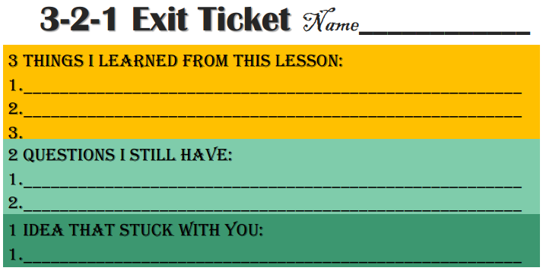
Evaluation

Slide 24
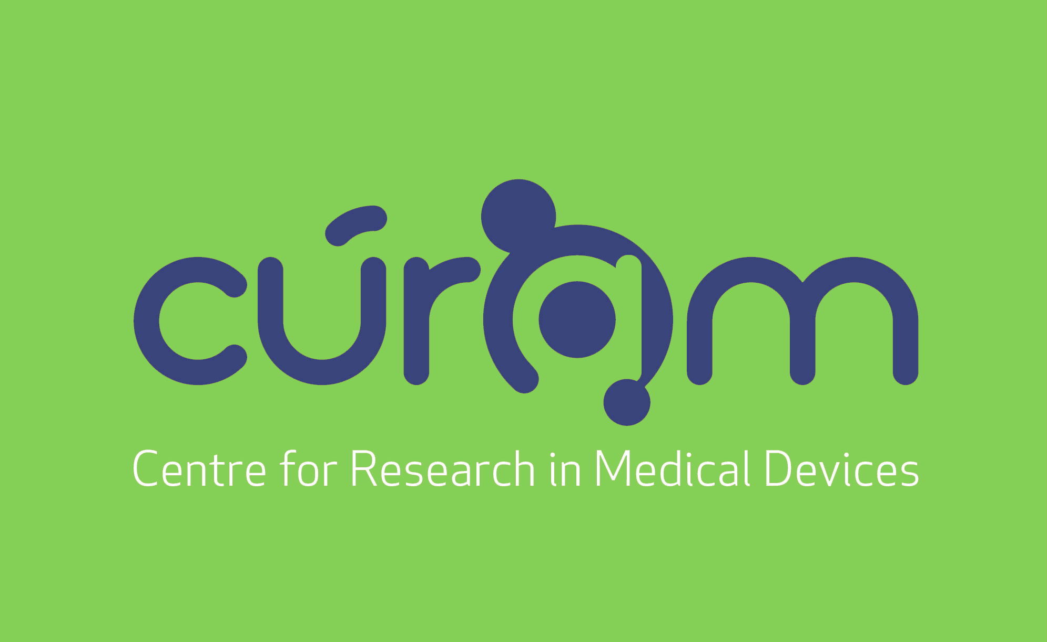

Slide 25
References:
Handbook of Materials for Medical Devices, 2003 ASM International
“Milestones in Medical Technology,” New York Times, Published October 10, 2012
www.celldataservices.co.uk/biomaterials
commons.wikimedia.org
www.flickr.com
www.pixabay.com
vimeo.com
www.gojiberryblog.com/2011/09/11/how-to-revive-your-plants/
gpwalsh.com/the-shift/
animals.nationalgeographic.com/animals/invertebrates/red-crab/
Sincere thanks to all of the researchers who gave lectures and generously gave their time throughout the course.
Thanks also to all the participating teachers who very kindly shared ideas and resources.

Slide 26
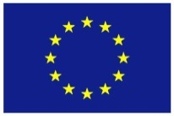




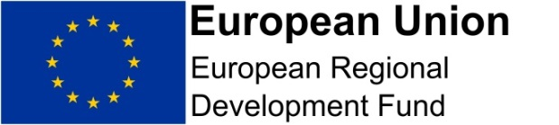

This publication has emanated from research conducted with the financial support of Science Foundation Ireland (SFI) and is co-funded under the European Regional Development Fund under Grant Number 13/RC/2073.
This project has been funded by the European Union Seventh Framework Programme under Marie Curie Initial Training Networks (FP7-PEOPLE-2012-ITN) and Grant Agreement Number 317304 (AngioMatTrain). This project has also been funded by the European Union Horizon 2020 Programme (H2020-MSCA-ITN-2015) under the Marie Skłodowska-Curie Innovative Training Networks and Grant Agreement Numbers 676408 (BrainMatTrain) and 676338 (Tendon Therapy Train).

