Slide 1
Introducing the BRAIN
and Spinal Cord

Slide 2
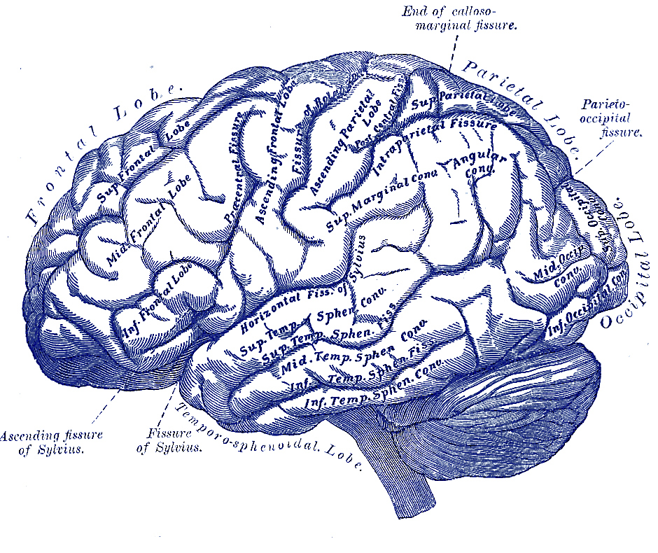

Teachers in Residence Programme
Carmel Rourke and Ann McGreevy
Notes:
Brain and Spinal Cord
Parkinson’s Disease
Adaptable for both Primary and Secondary school
IMAGE- GREY’S ANATOMY

Slide 3
What Do We Want to Know?
What is Parkinson’s disease?
What is a neuron?
How does the brain send messages to the body?
Notes:
Class discussion around Parkinson’s disease
Has anyone every heard of Parkinson’s disease?
Does anyone know anyone with Parkinson’s Disease?
What is it?
What does it do?
What causes it?
Who has it?
What are the symptoms?

Slide 4

Parkinson’s Disease
Michael J. Fox is a famous actor who now has Parkinson’s disease
Watch a video of
Michael J. Fox
Listen as he describes what it is like living with Parkinson’s disease
Video can be accessed at:
https://www.youtube.com/watch?v=ECkPVTZlfP8
Notes:
Watch a video with Michael J. Fox who has Parkinson’s disease.
Take note of the symptoms-shakes, tremors
https://www.youtube.com/watch?v=ECkPVTZlfP8
Other videos with Michael J. Fox:
https://www.youtube.com/watch?v=v8JCzz0tCds
https://www.youtube.com/watch?v=OiHsTXqh1mY
https://www.youtube.com/watch?v=koL0PWCJ4lo
Image:
https://commons.wikimedia.org/wiki/File:Back-to-the-future-logo.svg

Slide 5
Neuron-Nerve Cell
Cell Body
Dendrite
Axon

Slide 6
The region where two neurons meet is called the synapse
The synapse is a gap between the neurons that the message must jump across
Chemicals, called neurotransmitters, carry the messages across the gaps
Dopamine is a type of neurotransmitter in the brain
Neuron 1
Neuro-
transmitters
Synapse
Neuron 2

Slide 7
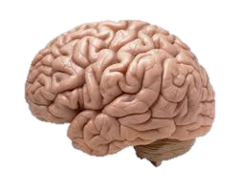

How does the message travel from the brain to muscles?
How Dopamine Carries a Message
Brain
Muscle
Notes:
Images:
https://www.flickr.com/photos/flamephoenix1991/8376271918
https://pixabay.com/en/muscle-bodybuilding-academy-1660249/

Slide 8
Neurons at a Synapse
Presynaptic neuron
Postsynaptic neuron
Brain
Synapse
Muscle
Presynaptic
vesicles
Postsynaptic
receptors

Slide 9
Dopamine at a Synapse
= Dopamine
Brain
Muscle
Dopamine starts at the vesicles of the presynaptic neuron
Jumps across the synapse, and
Is caught by the receptors of the postsynaptic neuron
Result: Muscles move properly

Slide 10

If Dopamine Levels are Too Low
= Dopamine
Brain
Muscle
?
Low levels of dopamine start at the vesicles of the presynaptic neuron
Jump across the synapse, and
Not enough is caught by the receptors of the postsynaptic neuron
Result: Muscles do not move properly

Slide 11
Demonstration: Students Act as Neurons
Form a first line of three students
  The first line represents the presynaptic neuron
  Each student represents a vesicle on the presynaptic neuron
Form a second line of three students
The second line represents the postsynaptic neuron
Each student represents a receptor on the postsynaptic neuron
Notes:
Prepare three plastic eggs carrying separate parts of the message:
Egg 1 = “Jump”
Egg 2 = “Three times”
Egg 3 = “Forwards and Backwards”
Form a first line of three students-This line represents neuron 1, each student represents a vesicle on neuron 1
Form a second line of three students-This line represents neuron 2, each student represents a receptor on neuron 2

Slide 12
If Dopamine Levels are Too Low
  Two of the students in the presynaptic neuron get a plastic egg containing a message inside of it. The two plastic eggs represent low levels of dopamine.
  The two students in the presynaptic neuron throw the plastic eggs across the “synapse” to two students in the postsynaptic neuron.
The two students in the postsynaptic neuron perform the task given by combining the messages in the two plastic eggs.
Since only two plastic eggs crossed the synapse, the students in the postsynaptic neuron did not receive the entire message and will not be able to perform the task properly.
Notes:
Have the students throw the plastic eggs carrying only two parts of the message:
Egg 1 = “Jump”
Egg 2 = “Three times”

Slide 13
If Dopamine Levels are Correct
Three of the students in the presynaptic neuron get a plastic egg containing a message inside of it. The three plastic eggs represent correct levels of dopamine.
The three students in the presynaptic neuron throw the plastic eggs across the “synapse” to three students in the postsynaptic neuron.
The three students in the postsynaptic neuron perform the task given by combining the messages in the three plastic eggs.
Since three plastic eggs crossed the synapse, the students in the postsynaptic neuron received the entire message and will be able to perform the task properly.
Notes:
Have the students throw the plastic eggs carrying all parts of the message:
Egg 1 = “Jump”
Egg 2 = “Three times”
Egg 3 = “Forwards and Backwards”
Highlight how the movement is different now that the entire message has been received

Slide 14
Cause of Parkinson’s Disease
Neurons that make dopamine start to die.
Dopamine tells the brain to move muscles.
If dopamine levels are too low, muscles will not move as they should.
Low levels of dopamine results in tremors, stiff joints, a slow walk and many other symptoms.

Slide 15
Substantia Nigra
Dopamine is released by a structure in the brain called the substantia nigra.
In Parkinson’s disease, neurons in the substantia nigra are damaged which causes too little dopamine to be released.
substantia nigra

Slide 16
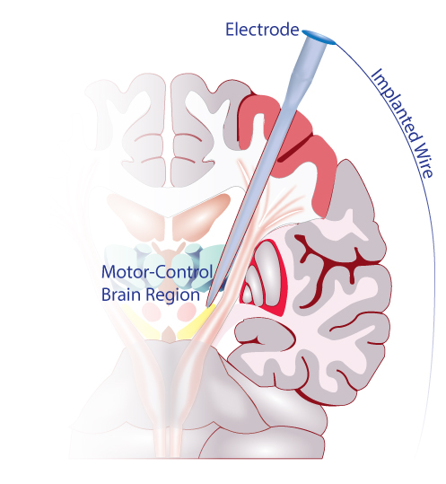
Deep Brain Stimulation
An electrode is surgically placed deep in the brain.
The electrode is connected to a battery placed under the skin below the collarbone.
Electrical signals are sent to control activity in the brain.
Works like a pacemaker for the brain.

Slide 17
Activity: Designing a medical device
Students work in groups of 3 or 4
Students must:
1. Plan
2. Build
3. Test
4. Assess
Goal: To design and build a medical device to reach deep in the brain for deep brain stimulation
Notes:
Teacher’s Tip
Make jelly of a thick solid consistency or freeze if too wobbly!
Have an extra brain for each group as they tend to get seriously damaged

Slide 18

1. The Plan
The medical device must:
Be able to reach deep in the brain.
Not cause damage to the brain.
Be easy for the surgeon to use.

Slide 19
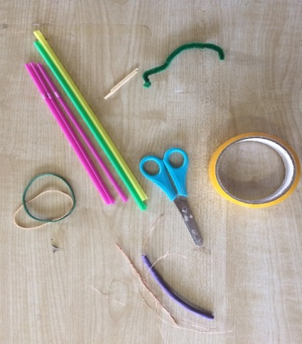
2. Build
Discuss appropriate materials from selection
Toothpicks
Paper clips
Thin/Thick straws
Thin/Thick wire/Pipe cleaners
Scissors
Lollipop sticks
Sticky tape

Slide 20
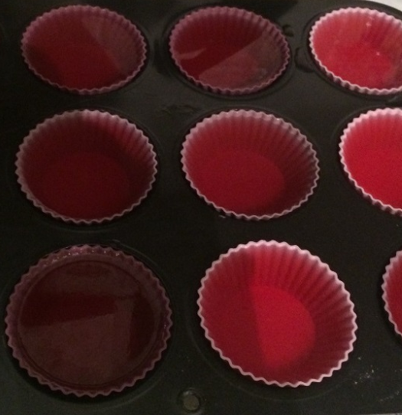
3. Test
Test the medical device on the model brain made from jelly.
The human brain feels the same as jelly!
The black dot at the bottom of the jelly is the area to reach with the medical device.
Examine the damage caused to your “brain” after testing the medical device.

Slide 21
4. Assess
Do you think your medical device worked? Why or why not?
How could you make your medical device work better?
Show your medical device to the rest of the class.

Slide 22
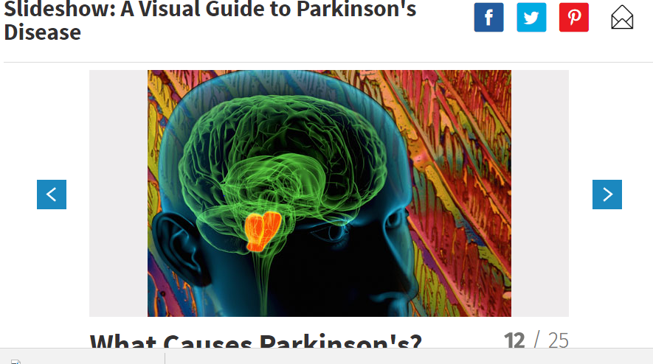
Additional Resource
Slide show: A Visual Guide to Parkinson’s Disease
What causes Parkinson’s?
http://www.webmd.com/parkinsons-disease/ss/slideshow-parkinsons-overview

Slide 23


Slide 24
References:
www.flickr.com
www.pixabay.com
smart.servier.com
commons.wikimedia.org
Gray’s Anatomy
Acknowledgements:
Sincere thanks to all of the researchers who gave lectures and generously gave their time throughout the course.
Thanks also to all the participating teachers who very kindly shared ideas and resources.

Slide 25







This publication has emanated from research conducted with the financial support of Science Foundation Ireland (SFI) and is co-funded under the European Regional Development Fund under Grant Number 13/RC/2073.
This project has been funded by the European Union Seventh Framework Programme under Marie Curie Initial Training Networks (FP7-PEOPLE-2012-ITN) and Grant Agreement Number 317304 (AngioMatTrain). This project has also been funded by the European Union Horizon 2020 Programme (H2020-MSCA-ITN-2015) under the Marie Skłodowska-Curie Innovative Training Networks and Grant Agreement Numbers 676408 (BrainMatTrain) and 676338 (Tendon Therapy Train).

