Slide 1
Senior Cycle Economics - National Seminar 2
Session 1

Slide 2
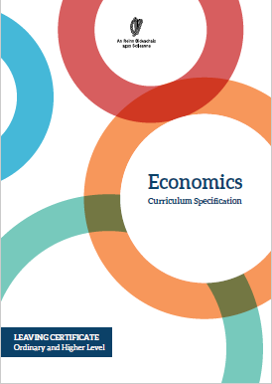
Economics National Seminar Day 2
Welcome
https://www.ncca.ie/en/senior-cycle/curriculum-developments/subjects-and-frameworks-in-development/economics

Slide 3

Purpose for today
180 hours minimum duration
Higher & Ordinary level
September 2019 introduction
First examination June 2021
Assessment: Exam 80% Research Study 20%
To support teachers in enabling students to collect, organise, present, analyse and interpret data with and without the use of technology and come to an informed view in evaluating current economic issues
To assist teachers in engaging with and implementing the new Specification through inquiry-based approaches with a focus on the role of data and information in Economics

Slide 4
Overview of the Seminar
Session 1 9:30 - 11:00 | Supports provided by PDST Realising the shared vision - the journey so far Embracing data in the teaching and learning of Economics
Tea/Coffee Break 11:00 - 11:15
Session 2 11:15 - 1:00 | Key Skills in Economics Data inquiry tasks in the Economics classroom
Lunch 1:00 - 2:00
Session 3 2:00 - 3:30 | Data competencies Effective questioning in Economics Assessment criteria

Slide 5
Key Messages
Economics is a subject for all and through its exploration students will be prepared and empowered to contribute to society and meet future challenges with confidence.
Strand 1 is a unifying strand, the themes of which permeate strands 2-5 of the Specification and will be progressively developed over the course of senior cycle.
An inquiry-based approach to teaching and learning cultivates students’ critical thinking skills in economics by encouraging them to ask questions relating to the world around them and apply their learning in differentiated, collaborative, creative and innovative ways.
The collection, organisation, analysis and interpretation of data allows students to hypothesise and critically evaluate economic concepts and theories, allowing them to form justifiable opinions/conclusions around economic issues.

Slide 6
Supports provided by PDST
Scoilnet
PDST Website
School Visits
PDST Supports
Professional Learning Communities
Webinars
Seminars

Slide 7

Timeline Round 1 2019/2020
Webinar
Webinar
Sept 2019
Christmas 2019
Summer 2020
Sept/Oct
Nov/Dec
Jan/Feb
Mar/Apr
CoP
Nov/Dec
CoP
CoP
CoP
CoP
CoP
Mar/Apr
Professional Learning Community
Professional Learning Community
National Seminar 2
National Seminar 3

Slide 8
By the end of session one, participants will have:
Discussed the progression towards realising their vision for students of Economics
Examined integrated teaching and learning approaches to support students in the practical application of economic knowledge to their lives
Considered the importance of rigour in developing students’ capacity to research, analyse and interpret economic data and information
Explored a range of resources to support teaching and learning in the Economics classroom

Slide 9
Your Shared Vision
Reference:
Our students will:
Apply theory to practical real world issues and form a well-rounded world view.
Think critically and generate an informed opinion on economic issues.
Develop research skills.
Understand their impact on society and contribute to a sustainable future.
Appreciate how they can become active citizens in a sustainable society.
Feel empowered and engage in more independent learning.
Engage with material with a greater depth of understanding instead of just memorising facts.
Enjoy the subject.
Become more economically literate.
Extracts from National Seminar Day 1, Jan-Feb 2019

Slide 10

The Journey So Far...
How have you come closer to realising your shared vision for economics learning in the classroom?
What unexpected learning has emerged for you?
What?
So what?
Now what?
Rolfe et al, 2001

Slide 11
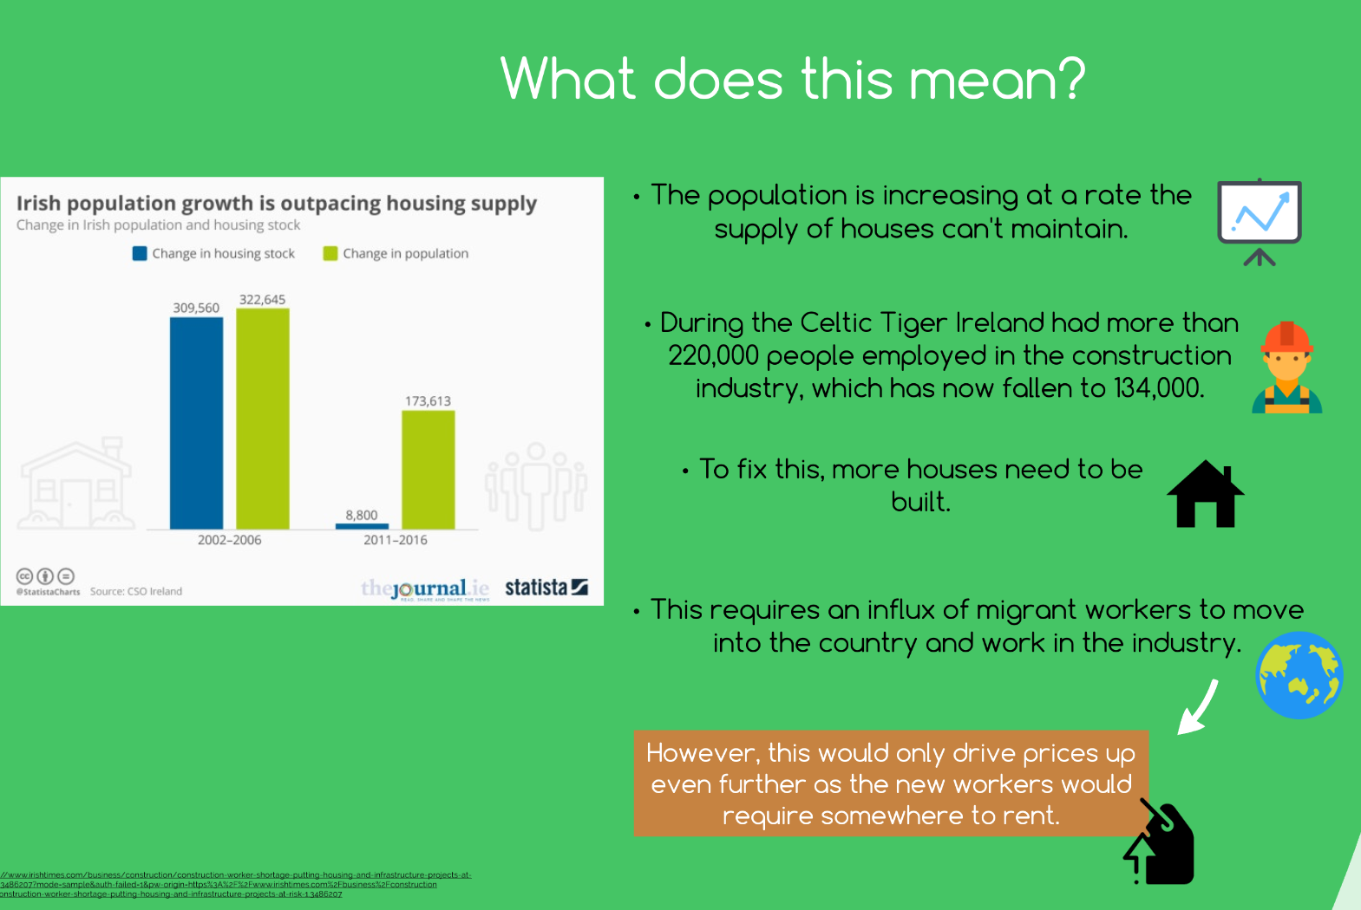

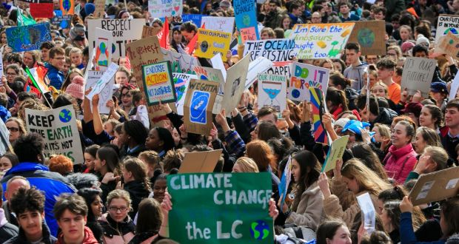
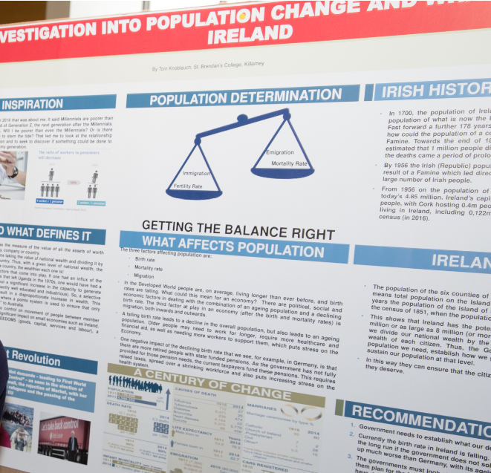
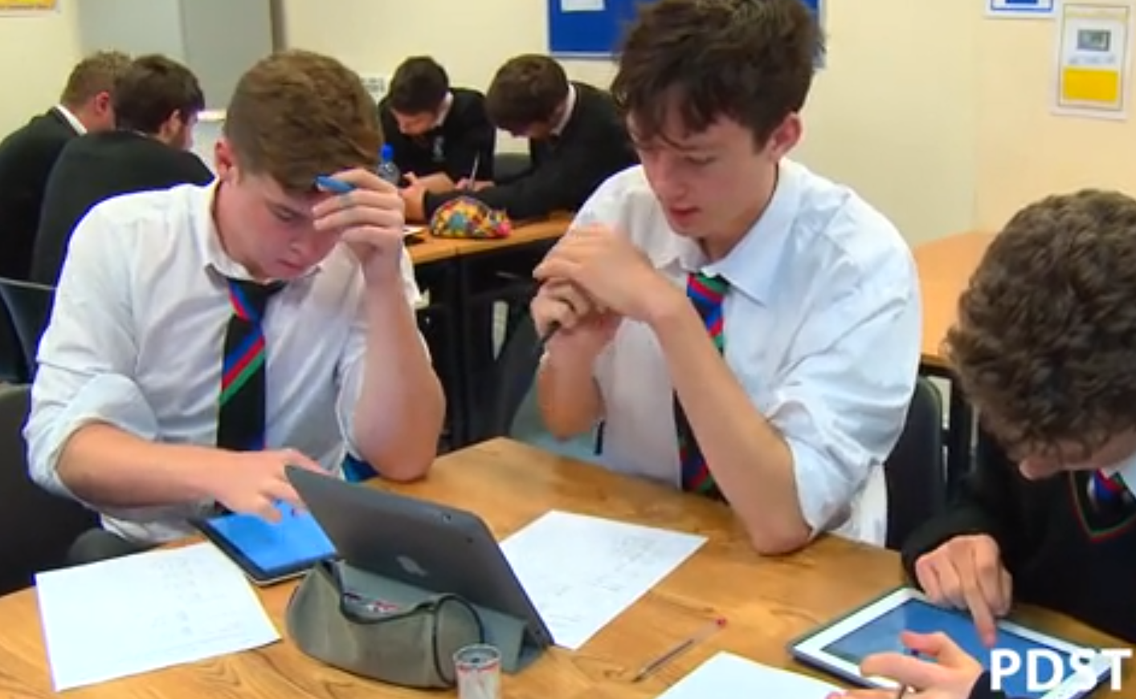
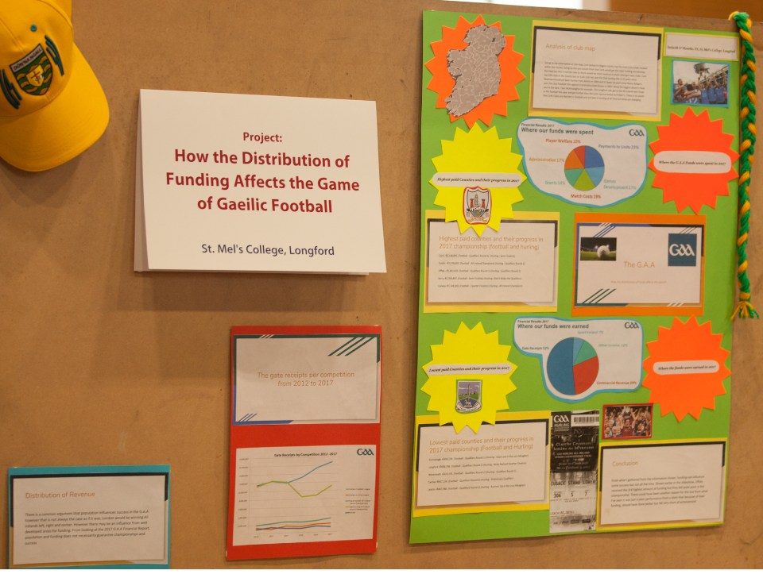
Young Economist of the Year (YEOTY) Entries

Slide 12


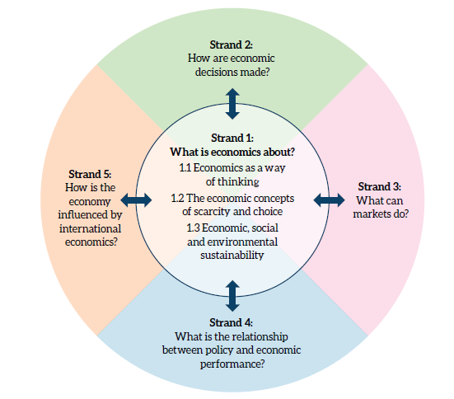
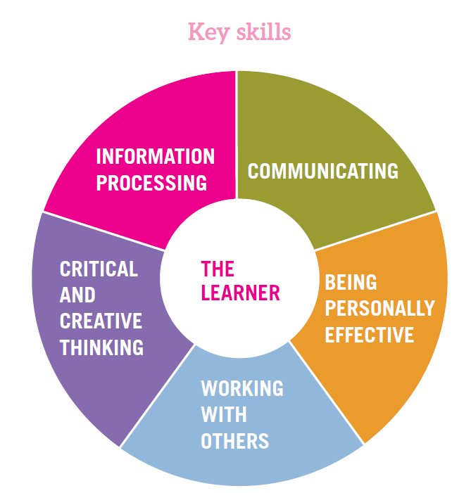
Activity

Slide 13
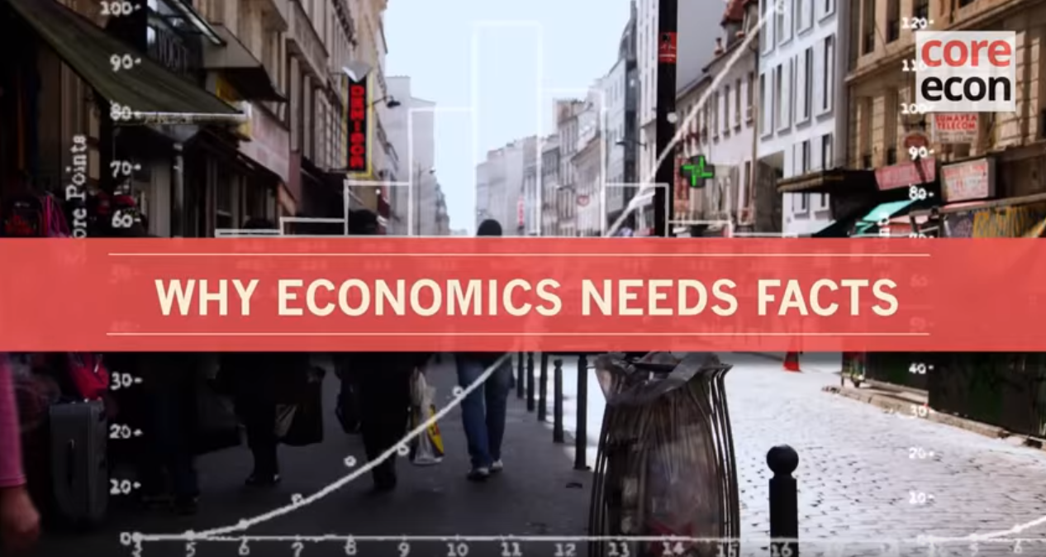
The Importance of Data in Economics
Core Economics https://www.youtube.com/watch?v=KMHaT_WUF54

Slide 14
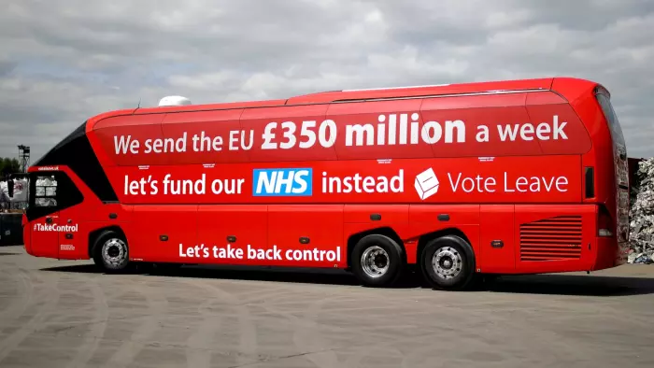

Bias
Validity
Reliability
Source:The Guardian 17 July 2016 article https://www.theguardian.com/science/2016/jul/17/politicians-dodgy-statistics-tricks-guide

Slide 15



Aims and Expectations - Embracing Data
“Using skills of critical thinking, data analysis and decision making through the study of economics, students will be prepared and empowered to contribute to society and manage future challenges confidently.”
Economics Specification p.6
“...research and analyse qualitative and quantitative economic information and data from various sources, present and justify conclusions and make informed decisions.”
Economics Specification p.7
https://www.education.ie/en/Publications/Policy-Reports/lit_num_strategy_full.pdf
https://www.education.ie/en/Publications/Education-Reports/STEM-Education-in-the-Irish-School-System.pdf

Slide 16
End of Session 1

