Slide 1
Senior Cycle Economics - National Seminar 2
Session 2

Slide 2
By the end of session two participants will have:
Explored how Senior Cycle key skills are embedded throughout the learning outcomes in the Economics specification
Discussed and considered the role of rich inquiry-tasks in enhancing student learning in the Economics classroom
Developed approaches that enable students to collect, organise, analyse and interpret data/information in the exploration of economic behaviour and interactions

Slide 3
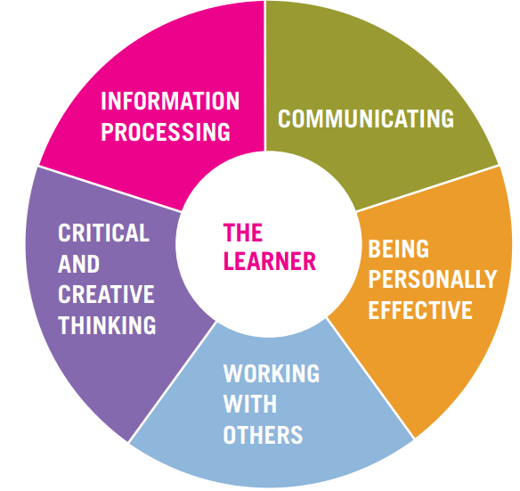
Senior Cycle Key Skills
“The key skills are embedded within the learning outcomes of the specification and will be assessed in the context of the assessment of the learning outcomes.”
Economics Specification, page 11
“They will develop information processing and
critical and creative thinking skills by examining and evaluating economic data and information to identify patterns and relationships, offering informed viewpoints and opinions and applying those conclusions to new or existing economic problems.”
Economics Specification, page 12

Slide 4
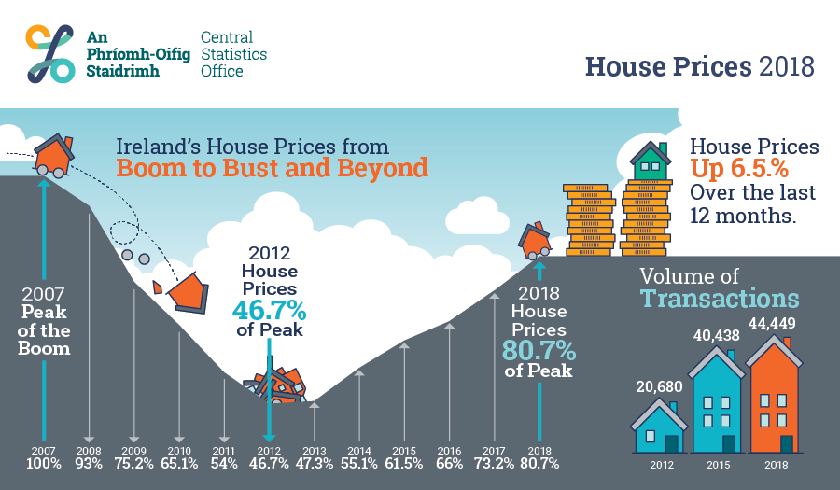
Suggest a Strand 2 learning outcome which students could explore in conjunction with this infographic. How could it be used to promote key skills development?

Slide 5


Slide 6

An Inquiry Task
What economic concepts are evident?
What does the data show?
Are there other issues to be considered?

Slide 7
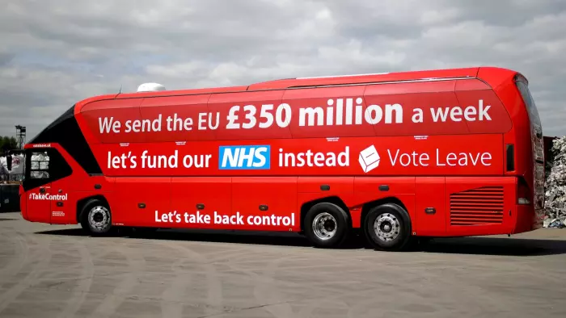

Bias
Validity
Reliability
Source:The Guardian 17 July 2016 article https://www.theguardian.com/science/2016/jul/17/politicians-dodgy-statistics-tricks-guide

Slide 8
Utilising an Inquiry Approach
Pose an Inquiry Question
Develop Lines of Inquiry
How do carbon emissions relate to economic growth?
TH
What is the case for increasing carbon taxes?
What interventions can Government employ to decrease carbon emissions?
What would the broader implications of increased carbon taxes be?

Slide 9
Teaching and Learning Using an Inquiry Approach
Interpreting Information
(Critical Reflection)
Resourcing the Inquiry
Reporting Findings
Written summary
Structured questions
Digital Technologies
Classroom discussion
Presentations etc.
Classroom materials
What information is relevant to my inquiry?
Is the information from a reliable source?
How does the information connect to what I already know?
Does this information raise new lines of inquiry?
Do other questions arise?
Online Research
Other sources
Does this raise new inquiry questions for further exploration of the learning outcomes?

Slide 10
Utilising an Inquiry Approach
Pose an Inquiry Question
Develop Lines of Inquiry
How do carbon emissions relate to economic growth?
TH
What is the case for increasing the carbon tax?
What interventions can Government employ to decrease carbon emissions?
What would the broader implications of increased carbon taxes be?

Slide 11
The Use of Rich Inquiry Tasks
Multiple Entry / Exit Points
Include Tasks That:
Have reduced scaffolding
Are intriguing
Contain Inherent Ambiguity
Encourage exploration
Have more than one outcome
Motivate curricular content
Rich Inquiry Tasks
Collaborative Problem Solving
Hypothesising
Demonstrable learning
Testing
Broad Skills Set
Constructivism
Drawing
Conclusions
Defending Their Reasoning

Slide 12
End of Session 2

