Slide 1
Senior Cycle Economics - National Seminar 2
Session 3

Slide 2
Key Messages
Economics is a subject for all and through its exploration students will be prepared and empowered to contribute to society and meet future challenges with confidence.
Strand 1 is a unifying strand, the themes of which permeate strands 2-5 of the specification and will be progressively developed over the course of senior cycle.
An inquiry-based approach to teaching and learning cultivates students’ critical thinking skills in Economics by encouraging them to ask questions relating to the world around them and apply their learning in differentiated, collaborative, creative and innovative ways.
The collection, organisation, analysis and interpretation of data allows students to hypothesise and critically evaluate economic concepts and theories, allowing them to form justifiable opinions/conclusions around economic issues.

Slide 3
By the end of session three participants will have:
Explored competencies which will be required by Economics students
Gained an understanding of how students can be supported to develop competencies
Gained an appreciation of the role of effective questioning in support of student learning
Used assessment criteria to support student learning

Slide 4

Competencies for Economics
Competencies
Knowledge
Skills
Attitudes and Values
https://pixabay.com/illustrations/icon-people-talk-conversation-chat-2967797/
OECD (2018)

Slide 5

What is Effective Questioning?
“It is the framing, delivering, timing, soliciting and responding to questions in order to provide information about student knowledge, understanding and skills. It informs teacher's planning and teaching strategies to move students from where they are to where they need to go.”
NCCA Focus on Learning (2015, 1)
“Quality questioning is not possible without quality questions;”
Walsh and Sattes (2011, 4)
https://pixabay.com/photos/question-question-mark-help-2309042/

Slide 6
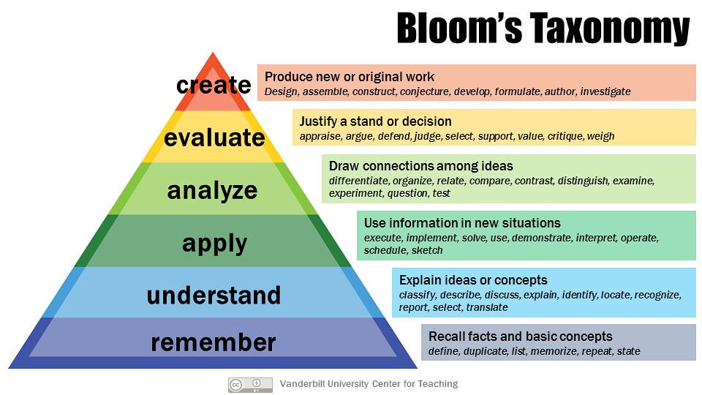
analyse
https://www.flickr.com/photos/vandycft/29428436431

Slide 7


Assessment Criteria
Assessment criteria for the research study
Economics Curriculum Specification 2018, Page 29-30

Slide 8
Assessment Criteria
Criteria | High Level of Achievement | Moderate Level of Achievement | Low Level of Achievement
Engagement with the topic | Thorough | Good | Some
Clarity and insights gained
Relevance and reliability
Application of concepts and theories
Manipulation of data
Conclusions
Reflection

Slide 9

Timeline Round 1 2019/2020
Webinar
Webinar
Sept 2019
Christmas 2019
Summer 2020
Sept/Oct
Nov/Dec
Jan/Feb
Mar/Apr
CoP
Nov/Dec
CoP
CoP
CoP
CoP
CoP
Mar/Apr
Professional Learning Community
Professional Learning Community
National Seminar 2
National Seminar 3

Slide 10

Now what?
https://pixabay.com/photos/question-question-mark-help-2309040/

Slide 11

Our Learning
Chance to reflect

Slide 12
Key References for the Day
Rolfe, G., Freshwater, D., Jasper, M. (2001) Critical reflection in nursing and the helping professions: a user’s guide. Basingstoke: Palgrave Macmillan.
Dwyer, Bernadette. 2016, Engaging all students in internet research and inquiry, The Reading Teacher, 69(4) pp.383-389
Gast Ged,(2019) Effective questioning and classroom talk to develop learning & higher order thinking, promoting imagination, speculation, creative thinking & to pitch a suitable challenge level p1-29 accessed May 7th 2019 http://www.nsead.org/downloads/Effective_Questioning&Talk.pdf

Slide 13
End of Session 3
Thank you for your participation today!

