Slide 1



Slide 2
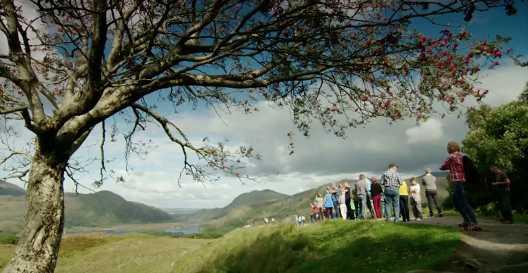

Learning Intentions:
In this unit, we will learn how
The birth of tourism in Ireland came about
Killarney developed as a tourist destination in the 1750’s
The development of railways greatly impacted on tourism in Killarney in the 1830’s

Slide 3
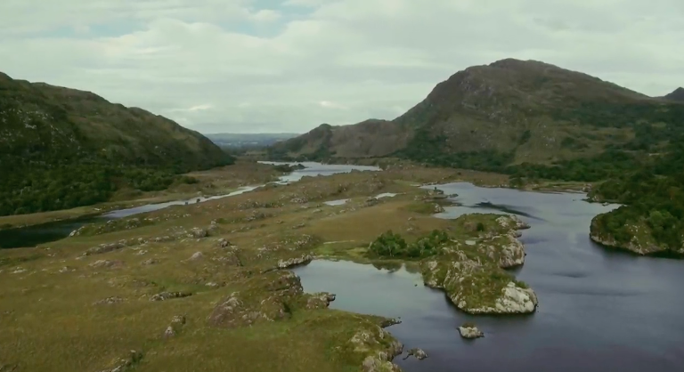
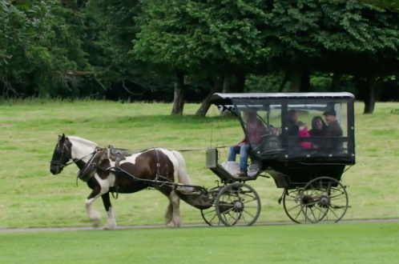
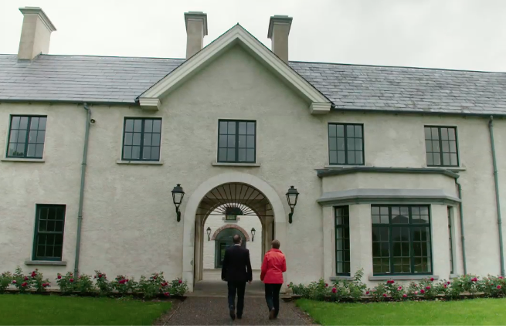
Warm Up Activity:
In pairs brainstorm glacial features that you have studied in your geography course that could be present in Killarney
Next brainstorm facilities or activities that might be on offer for tourists when visiting Killarney as a holiday destination

Slide 4
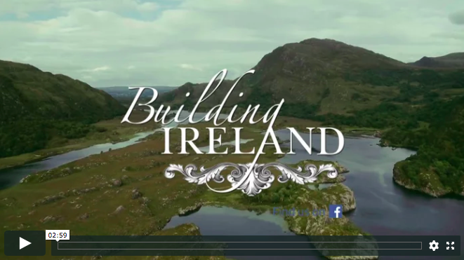
Now Watch the 2.54 min Video:
Make notes of glacial features, tourist attractions or facilities that you see or hear mentioned that were not on your list.

Slide 5
Compare Your Answers in Your Pairs:
After watching the video clip complete the following venn diagram. On the left hand side place glacial features and on the right tourist facilities. In the centre list features that could be considered as both.
Glacial features only
Tourist facilities only
Both

Slide 6
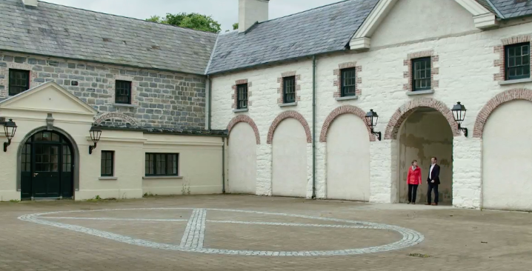
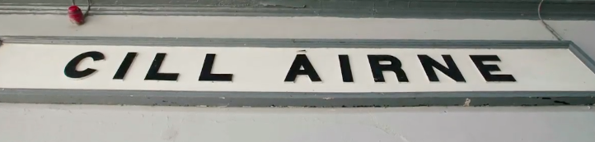
Now Complete the Following Questions about the Video Clip:
What did Thomas Brown the fourth Viscount of Kildare mean by the statement “the wealth of Killarney is not buried beneath the landscape it is the landscape”?
Why did the Grand Tour of the eighteenth century fall out of favour?
How large was the Brown’s estate at its height?
In what ways had Thomas Brown started making an income through tourism on his estate?
What country was the landscape of Killarney likened to?
What features of tourism were people more interested in during the romantic period?
What technological revolution came in the 1830’s and had a major impact on Killarney?

Slide 7
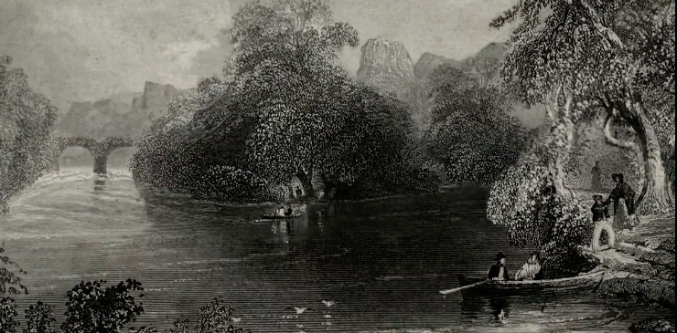
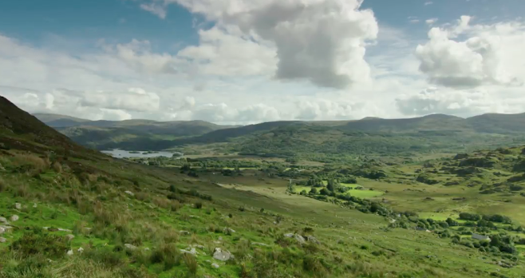
Peer Evaluation:
Now pass your answers to the person sitting beside you.
We will watch the video clip again and you will assess each other's work.
Listen closely as all the answers are in the clip.
If you are unsure of any answers put them to the class.
Each person's work will be marked out of 7 marks for accuracy.

Slide 8
Now Watch the 2.54 min Video Again and Correct Each Other’s Work:

Slide 9
Curriculum Link:
Ask an expert
The material covered in this clip closely links to your history course. Why not ask an expert (your history teacher) to expand on some of the topic mentioned in this clip:
The Big House and landlords in Ireland
The history of the Grand Tour
The coming of the railway to Ireland

Slide 10
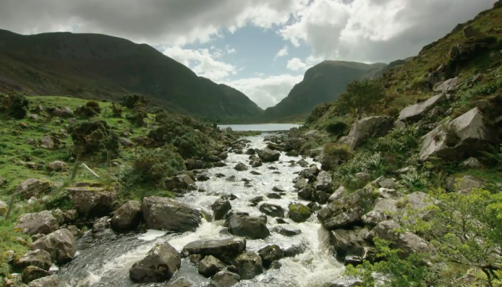
Links to JC Geography Specification:
Strand 2: Exploring how we interact with the physical world
Learning outcome 2.9: assess the interrelationships between the physical world, tourism and transport
Key skills used in class today:
Being literate
Managing my information and thinking
Managing myself
Communicating
Being numerate
Working with others
Being creative

Slide 11
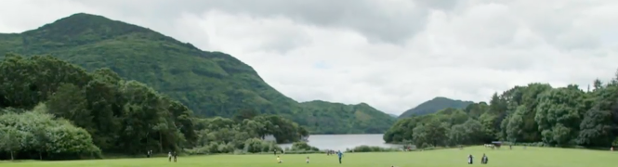
JC Geography Syllabus Link:
Tourism: A case study. Tourist services and facilities tend to be located in particular regions which offer various attractions e.g. areas of natural beauty. Tourism may also lead to the development of transport and communication links.

