Slide 1



Slide 2
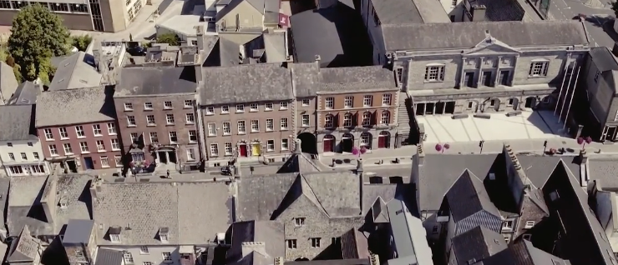

Learning Intentions:
In this unit, we will learn about
Some of the features of a Norman settlement found in Kilkenny City
How town planning laws were in place during this period
The beginnings of market gardening in sixteenth century Kilkenny City

Slide 3
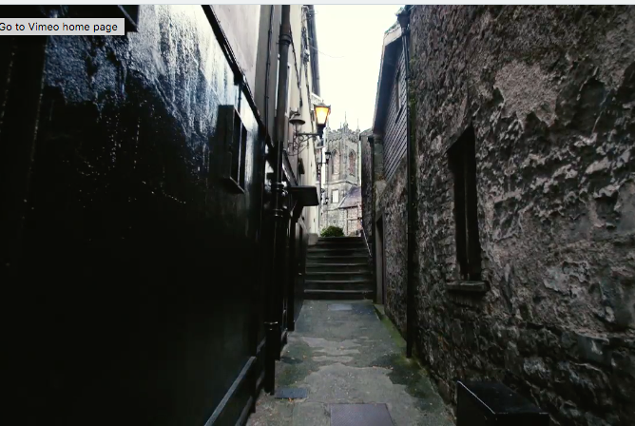
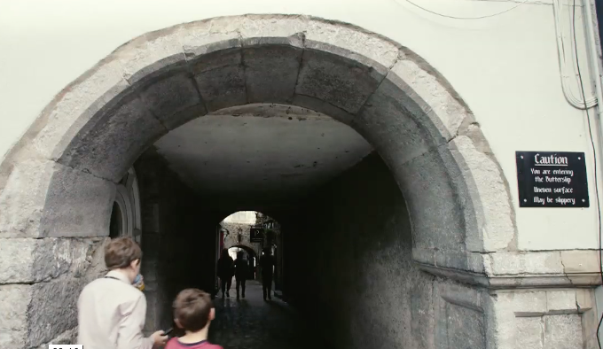
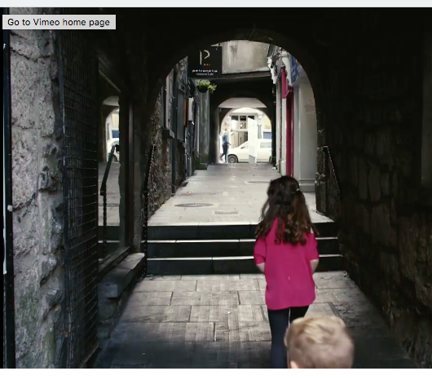
Warm Up Activity:
Think - Pair - Share
Individually think about the answer to this question:
What are some of the features of a Norman town?

Slide 4
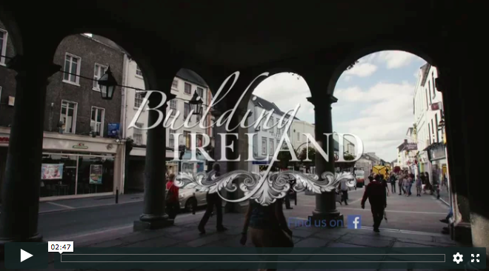
Watch the 2.41 min Video Clip:
Now in your pairs write down anymore features that were mentioned in the video clip that you had not already recorded. Share your answers with the class:

Slide 5
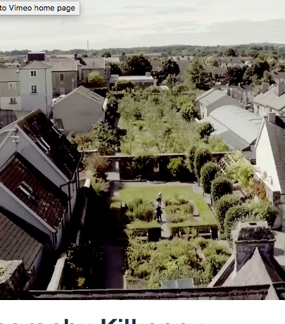
Research Activity:
These plots were used for market gardening. This is the growing of fruits and vegetables to sell to a nearby urban area.
Research where the majority of market gardening in Ireland takes place today?

Slide 6
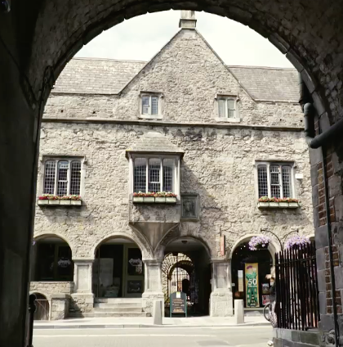
Curriculum Link:
Ask an expert
The material covered in this clip closely links to your history course. Why not ask an expert (your history teacher) to expand on some of the topic mentioned in this clip:
How and why the Normans came to Ireland
Burgage plots in Norman towns
Trade during the medieval period

Slide 7
Extension Activity:
3-2-1
At the end of this presentation write down the following:
3 things that you learned during this presentation
2 things that you found interesting during this presentation and why you would like to learn more about them
1 question you still have about the material covered in this presentation

Slide 8
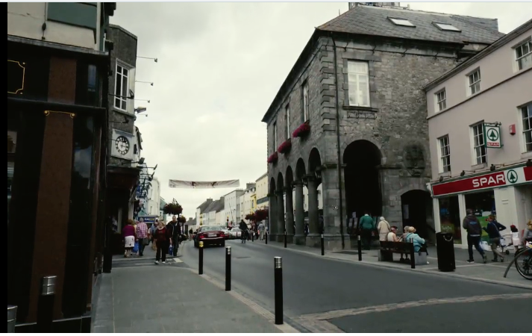
Links to the Geography Specification:
Strand 3: People, place and change
Learning outcome 3.4: consider the factors affecting the location and origin of rural and urban settlement in Ireland
Key skills used in class today:
Being literate
Managing my information and thinking
Managing myself
Communicating
Being numerate
Working with others
Being creative

Slide 9
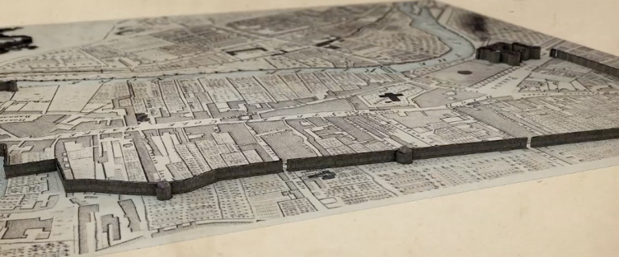
JC Geography Syllabus Link:
The landscape today shows evidence of human settlement past and present. The location of initial settlement in an area is related to: where people were coming from and their need for water, food, defense and communication e.g. Norman times

