Slide 1


Slide 2
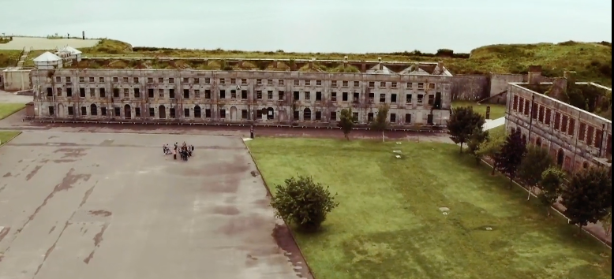

JC Geography Syllabus Links:
Historically, developed states have often exploited less developed states. Even today richer states tend to dominate world markets and this makes it difficult for poorer states to develop economically.
Local setting - Ireland in the past

Slide 3
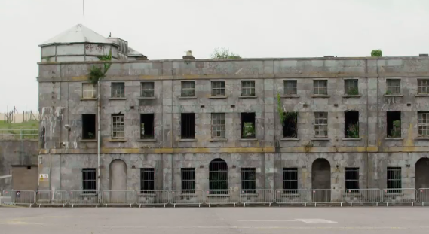
Learning Intentions:
In this unit, we will learn how
Colonialism impacted on Ireland through the history of Spike Island Co. Cork
How Irish labourers became an important commodity exported throughout the British Empire
The concept of social engineering during this period

Slide 4
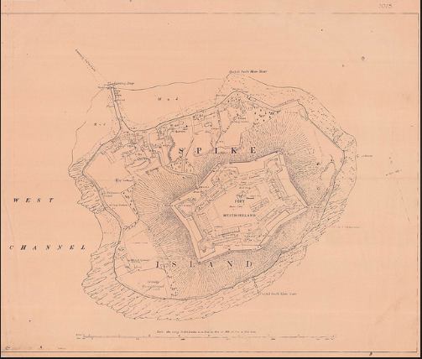
Warm Up Activity:
Blue Sky Thinking:
Spike Island was used as a prison during the 19th century. Why do you think it was located on an island off the coast of Cork?
On post it’s write out as many answers as you can think of.
Now pick the two or three answers that you are the most happy with. Stick them to the window of the classroom. We will revisit these answers after we have watched the video clip
Remember there is no such thing as a wrong answer here!

Slide 5
Before you Watch the Video Clip:
Fact/Falsehoods:
Complete the following table before you watch the video clip. Tick if you believe the statement is true or false.
Statement | Fact (True) | Falsehood (False)
Homeless people were imprisoned on Spike Island.
Archaeologists from UCD were excavating the site.
There were problems with violence in the prison
Irish labourers worked in Tanzania

Slide 6
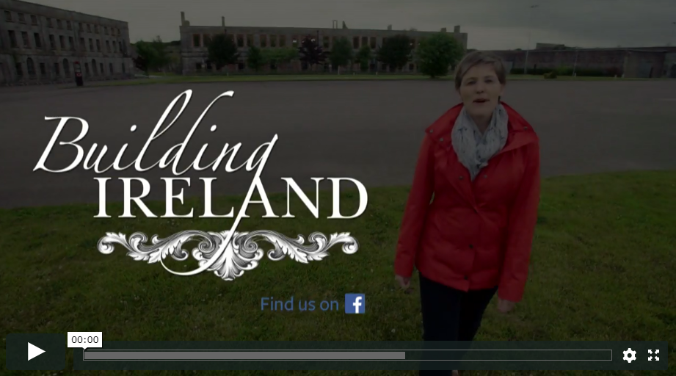
Now Watch the Video Clip:
https://vimeo.com/232965064

Slide 7
After you watch the video clip:
Fact/Falsehoods:
Now look at your answers again and see if there are any that you would change after watching the video clip. If any of the statements are incorrect write in the correct answers now in the last column.
Statement | Fact (True) | Falsehood (False) | Corrections after watching the video clip
Homeless people were imprisoned on Spike Island.
Archaeologists from UCD were excavating the site.
There were problems with violence in the prison
Irish labourers worked in Tanzania

Slide 8
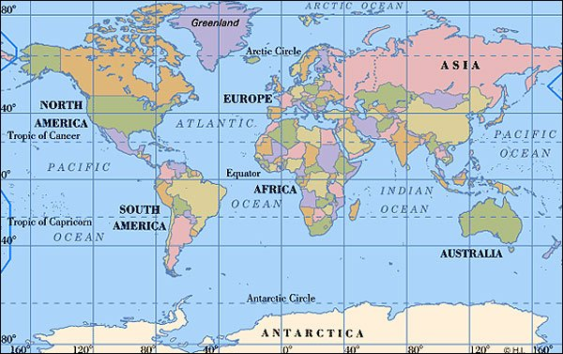
Extension Activity Part 1:
Using a map of the world similar to the one here research the countries that were part of the British Empire during the 1840’s when Spike Island was a penal colony.
Make a list of these countries.

Slide 9
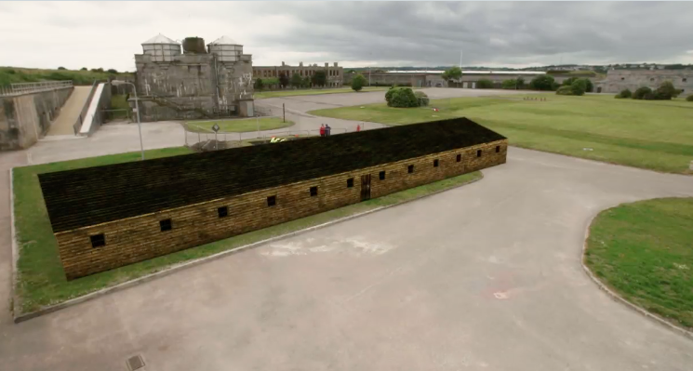
Extension Activity Part 2:
3. Now shade these countries in on the world map.
4. Finally draw lines from Spike Island to these countries to show the extent of the influence Irish prisoners had on man-made infrastructure of the world during the nineteenth century.

Slide 10
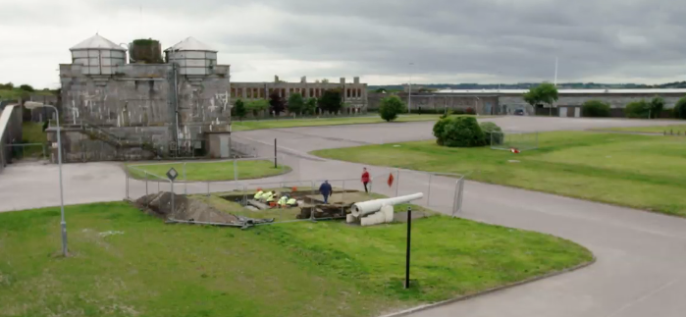
Exit Pass:
Now return to the Post it’s that are on the window of your classroom from the Blue Sky Thinking activity you completed earlier. Pick one that you feel is correct and place it on the classroom door as you leave.

Slide 11
Links to Geography Specification:
Strand 3: Exploring people, place and change
Learning outcome 3.6: identify global patterns of economic development
Key skills used in class today:
•Managing my information and thinking
•Managing myself
•Being literate
•Communicating
•Working with others
•Being creative

