Slide 1
Finding Correlation Coefficient
&
Line of Best Fit

Slide 2
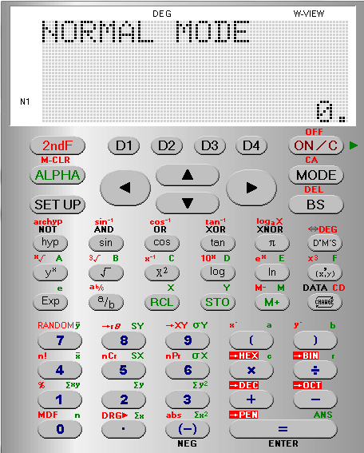
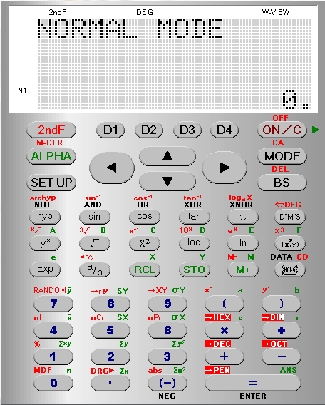
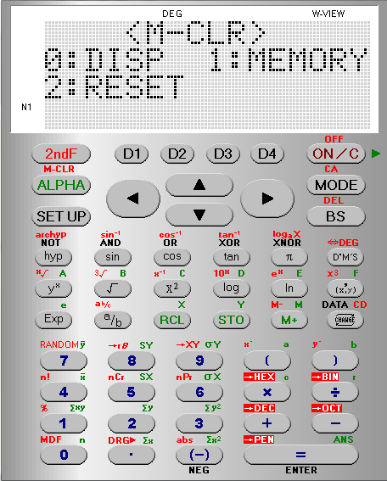
Finding Correlation Coefficient
Find the Correlation Coefficient for the following data
We want to
M CLR
the calculator to
Clear its Memory
Rainfall (x cm) | 4.5 | 3.0 | 5.2 | 5.0 | 2.1 | 0 | 0 | 1.2 | 3.2
No. of tourists (1000’s | 5.0 | 8.0 | 0.8 | 4.2 | 4.8 | 7.4 | 9.4 | 8.6 | 2.6
Finding Correlation Coefficient

Slide 3
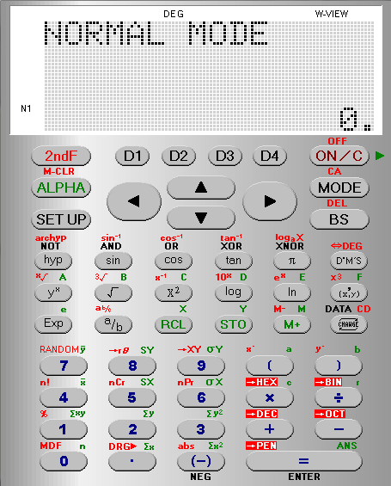
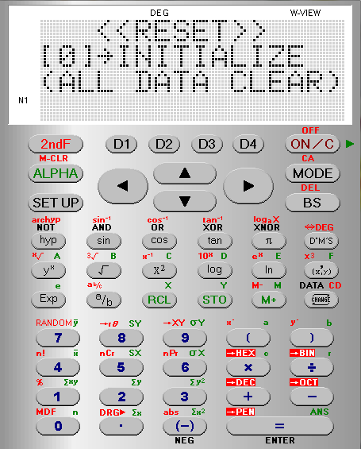

Rainfall (x cm) | 4.5 | 3.0 | 5.2 | 5.0 | 2.1 | 0 | 0 | 1.2 | 3.2
No. of tourists (1000’s | 5.0 | 8.0 | 0.8 | 4.2 | 4.8 | 7.4 | 9.4 | 8.6 | 2.6
We want to
M CLR
the calculator to
Clear its Memory
Finding Correlation Coefficient

Slide 4
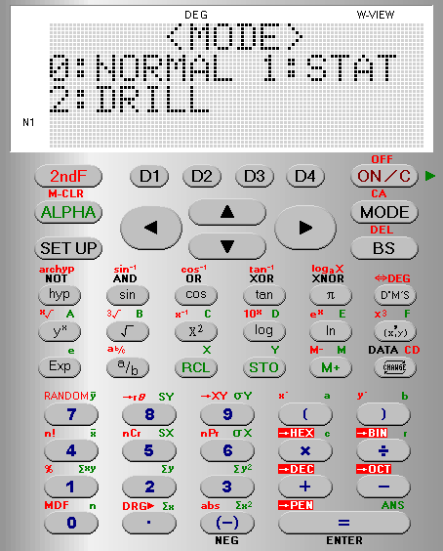
Rainfall (x cm) | 4.5 | 3.0 | 5.2 | 5.0 | 2.1 | 0 | 0 | 1.2 | 3.2
No. of tourists (1000’s | 5.0 | 8.0 | 0.8 | 4.2 | 4.8 | 7.4 | 9.4 | 8.6 | 2.6
We want the calculator
in STATS mode
Finding Correlation Coefficient

Slide 5
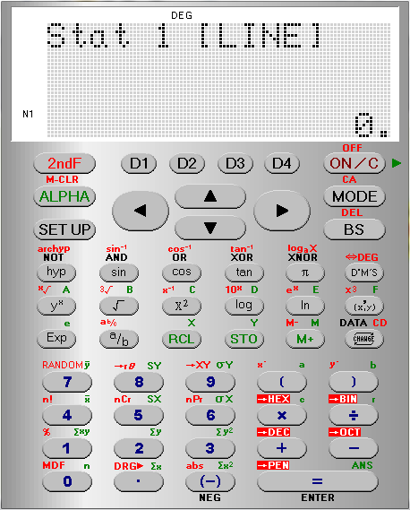
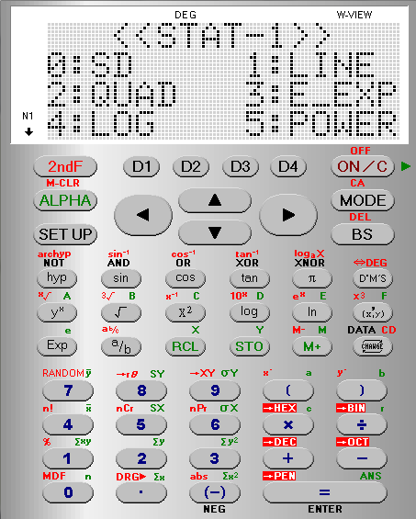
Rainfall (x cm) | 4.5 | 3.0 | 5.2 | 5.0 | 2.1 | 0 | 0 | 1.2 | 3.2
No. of tourists (1000’s | 5.0 | 8.0 | 0.8 | 4.2 | 4.8 | 7.4 | 9.4 | 8.6 | 2.6
We want to find a LINE linking the points
Finding Correlation Coefficient

Slide 6
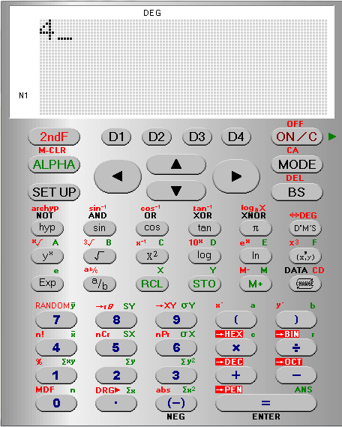
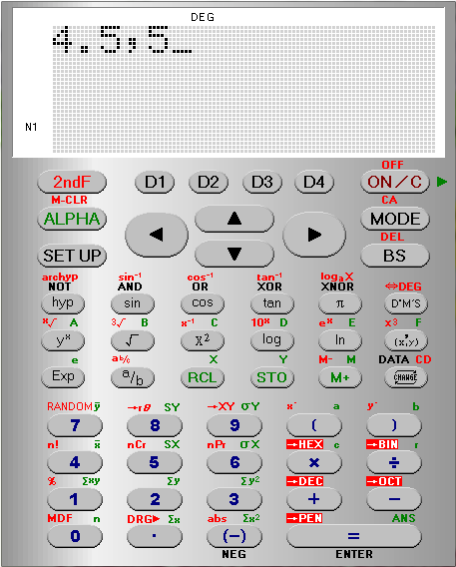
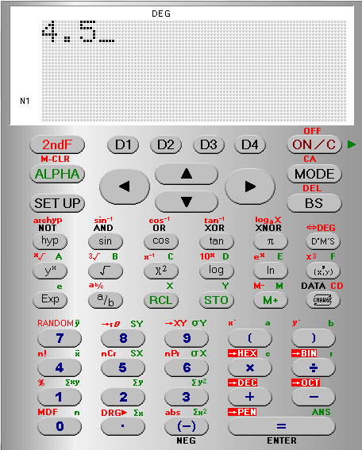
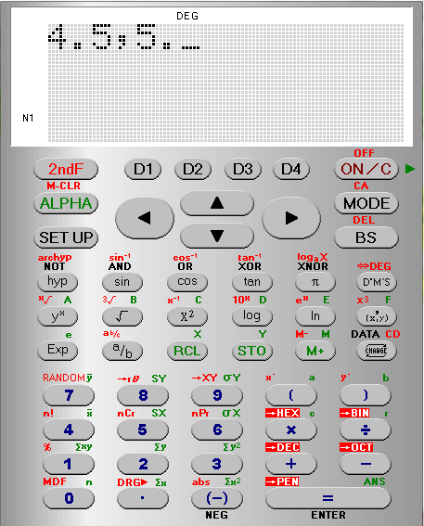
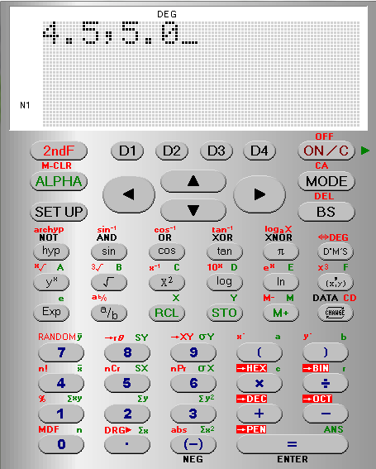
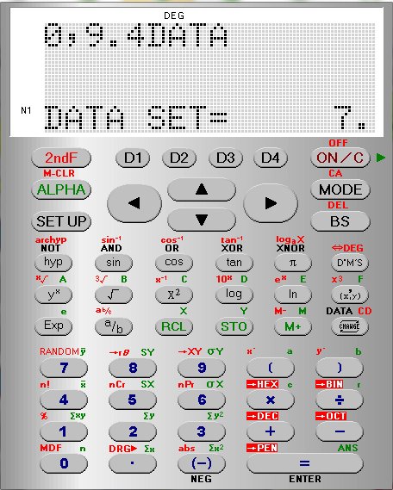
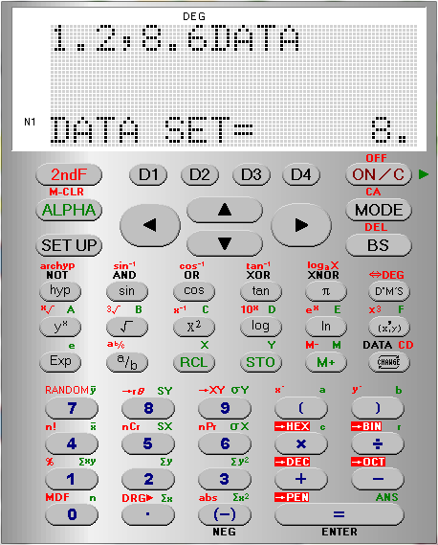
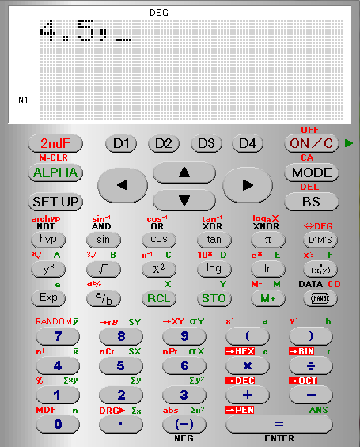
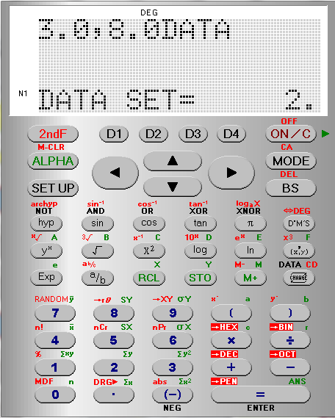
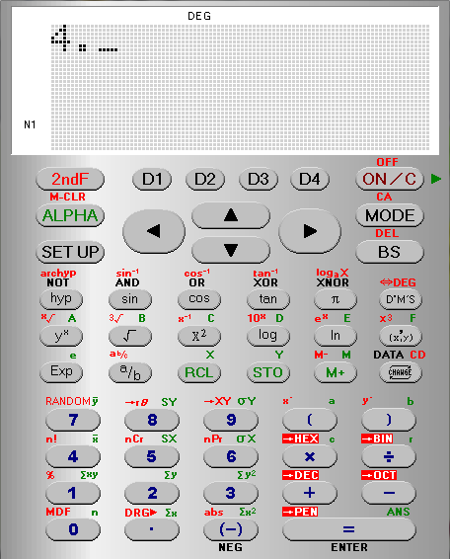
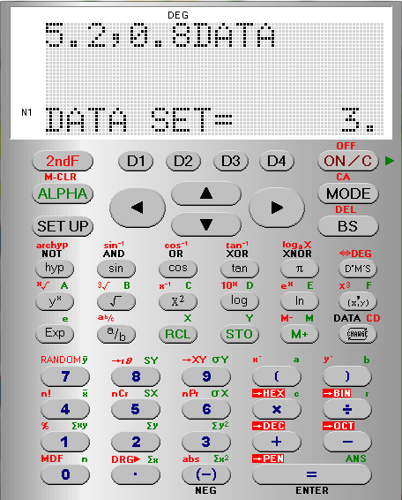
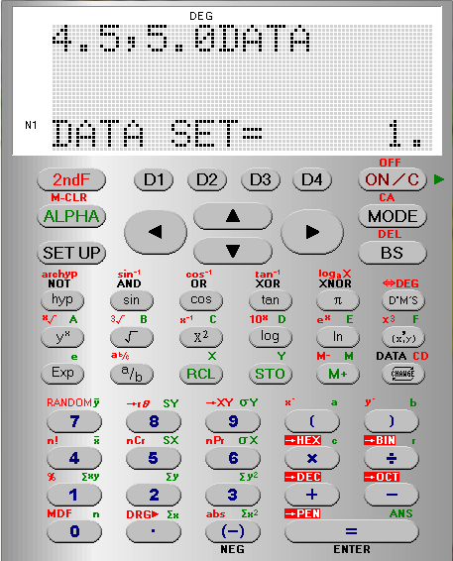
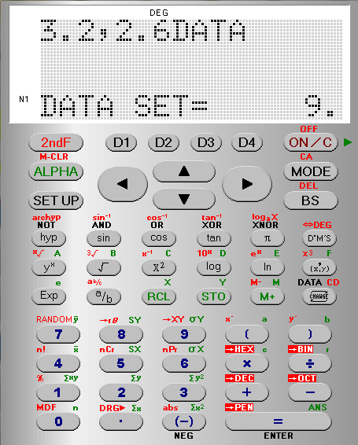
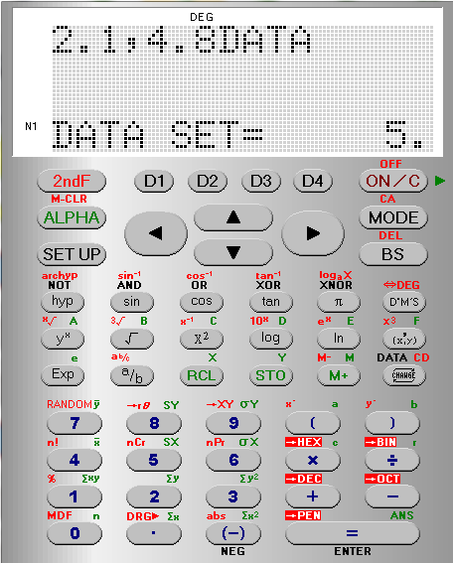

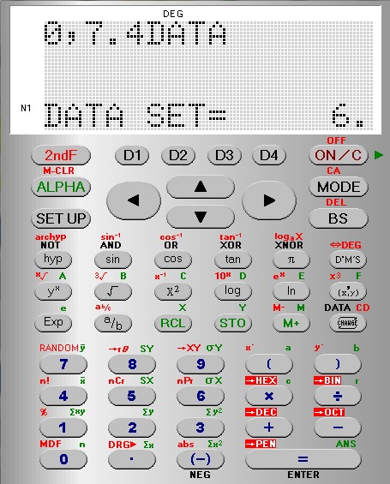
Rainfall (x cm) | 4.5 | 3.0 | 5.2 | 5.0 | 2.1 | 0 | 0 | 1.2 | 3.2
No. of tourists (1000’s | 5.0 | 8.0 | 0.8 | 4.2 | 4.8 | 7.4 | 9.4 | 8.6 | 2.6
Repeat the process entering all the Data in the table
Enter each pair of points separated by a comma
Pressing
DATA
afterwards
Finding Correlation Coefficient

Slide 7
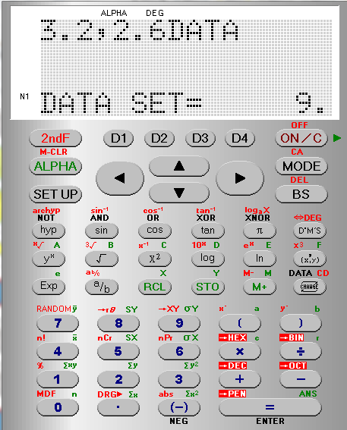
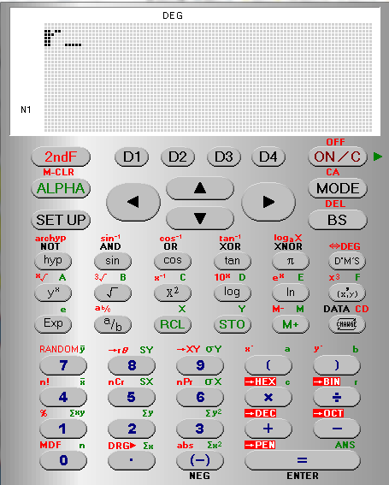
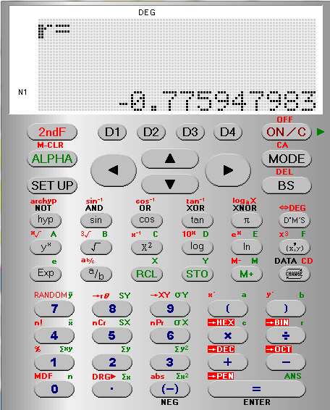
Rainfall (x cm) | 4.5 | 3.0 | 5.2 | 5.0 | 2.1 | 0 | 0 | 1.2 | 3.2
No. of tourists (1000’s | 5.0 | 8.0 | 0.8 | 4.2 | 4.8 | 7.4 | 9.4 | 8.6 | 2.6
We want the
Correlation
Coefficient
r
Its in Green so press ALPHA first
The
Correlation
Coefficient
= -0.775947983
Finding Correlation Coefficient

Slide 8


Rainfall (x cm) | 4.5 | 3.0 | 5.2 | 5.0 | 2.1 | 0 | 0 | 1.2 | 3.2
No. of tourists (1000’s | 5.0 | 8.0 | 0.8 | 4.2 | 4.8 | 7.4 | 9.4 | 8.6 | 2.6
Line of Best Fit
Y = a + bx
a
= 8.66
b
b = -1.12
Y = 8.66 – 1.12x
Finding Correlation Coefficient

Slide 9
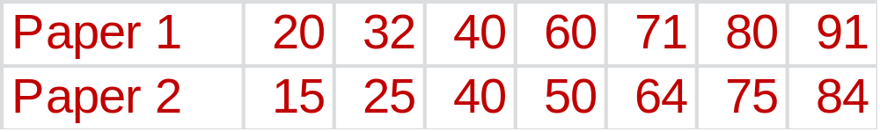
Questions
1. The marks of 7 pupils in two Maths papers are as follows :
a) Plot the marks on a scatter graph.
(Paper 1 marks on the horizontal axis and
Paper 2 marks on the vertical axis)
b) Is there any correlation between the marks on Paper 1
and Paper 2 ?
  Use your calculator to find the Correlation coefficient
  d) Find the equation of the Line of Best Fit for the data
Eve achieves a score of 6 on Test A. Use the line of best fit
to give an estimate of her score on Test B.
Objective : To practise stating correlation.

Slide 10
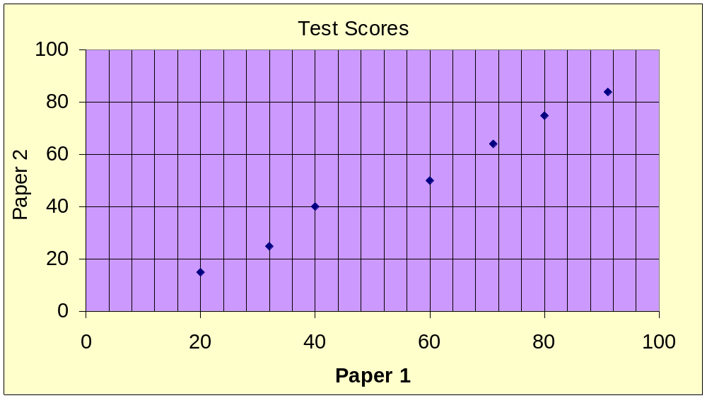
Answers
1. Yes there is positive correlation between Paper1 and
Paper 2.

Slide 11
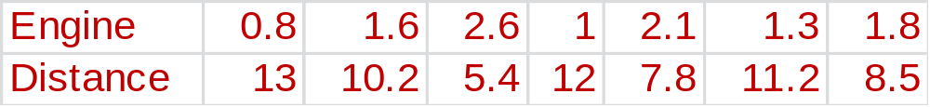
Top Gear are doing a review of cars. The table below shows
the engine size of a car in litres and the distance it travelled in
km on one litre of petrol.
Top Gear want to know if there is any correlation between
engine size and distance travelled.
a) Plot the marks on a scatter graph.
b) Is there any correlation between the Engine Size and Distance
  Use your calculator to find the Correlation coefficient
  d) Find the equation of the Line of Best Fit for the data
e) A car has a 2.3 litre engine. How far would you expect
it to go on one litre of petrol ?

Slide 12
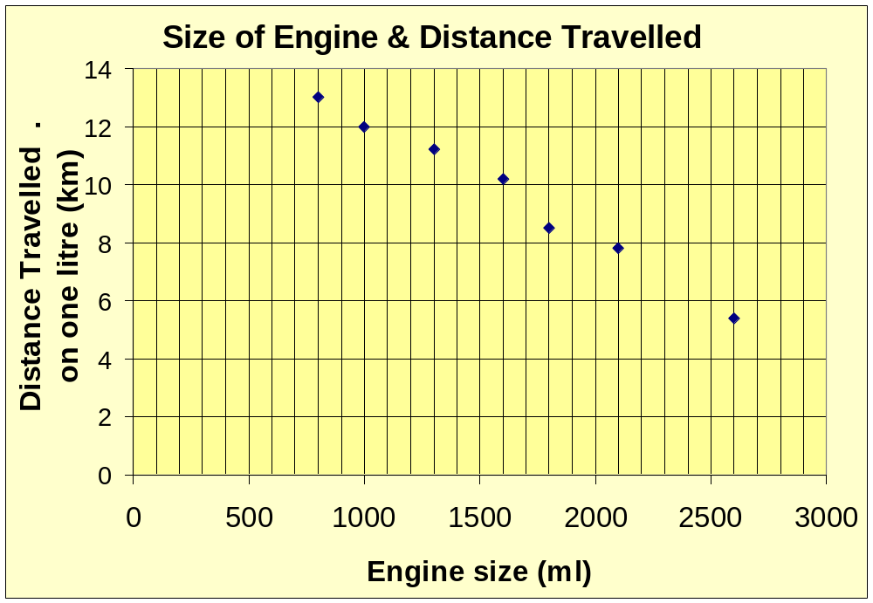
Answers
2. Yes there is negative correlation between engine size and the distance travelled on one litre of petrol.

