Slide 1
Senior Cycle Economics - National Seminar 3
Session 2

Slide 2
By the end of session two participants will have:
Discussed how teachers can support students to develop effective research practices and use Economics as a way of thinking
Considered the merits of selected strategies for developing students ability to examine both familiar and unfamiliar contemporary economic issues

Slide 3
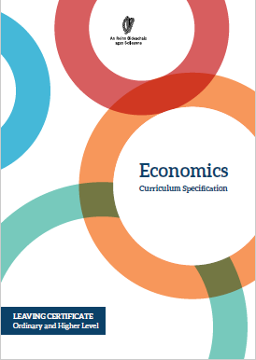
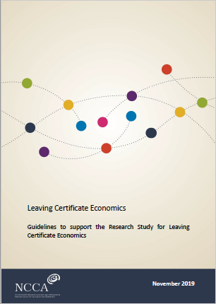
Economics as a way of thinking

Slide 4

Supporting student engagement
Text discussion groups
https://commons.wikimedia.org/wiki/File:Group-1825509.jpg

Slide 5
Utilising an Inquiry Approach
Drawing Conclusions
Reflection
Analyse and evaluate the sources of information
What can I conclude?
How well does it connect with my line of inquiry/aim of my research study?
How do the conclusions relate to the economic concept(s) chosen?
Does this information raise new lines of inquiry?
What else is important?
New knowledge or understanding
What did I do well/not do well?
What skills have I developed? How might they be useful in the future?
Has my thinking changed? How?
Have questions for further research been raised?
Evaluate your evidence
What does this evidence tell me about my line of inquiry?
What does this evidence not tell me about my line of inquiry?
Does this raise new inquiry questions for further exploration?

Slide 6

Utilising an Inquiry Approach
Choose a line of inquiry
What do I want to know about the topic?
What do I already know about the topic
What do I need to know?
Does this raise new inquiry questions for further exploration?
Sources of information and data
Application of the concept(s) to the line of inquiry
How do I know the information is reliable and valid?
How does the concept(s) chosen apply to the line of inquiry I have set out?
How is the information relevant to my inquiry?
What parts support/do not support my line of inquiry?

Slide 7
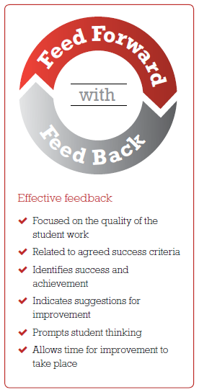
Feedback
“Feedback to any student should be about the
particular qualities of his or her work, with advice on
what he or she can do to improve, and should avoid comparisons with other students.”
Inside the Black Box, Black and Wiliam, 1998
https://www.ncca.ie/media/1925/assessment-booklet-3_en.pdf

Slide 8
End of Session 2

