Slide 1
Senior Cycle Economics - National Seminar 3
Session 3

Slide 2
By the end of session three participants will have:
Considered the ways in which students interpret graphs and construct graphical representations
Discussed digital and non-digital tools which could be used to support the study of graphs in senior cycle Economics
Reflected on the importance of students being able to analyse graphs effectively for the purposes of researching a topic/question or line of inquiry

Slide 3
The Use of Rich Inquiry Tasks
Multiple Entry / Exit Points
Include Tasks That:
Have reduced scaffolding
Are intriguing
Contain Inherent Ambiguity
Encourage exploration
Have more than one outcome
Motivate curricular content
Rich Inquiry Tasks
Collaborative Problem Solving
Hypothesising
Demonstrable learning
Testing
Broad Skills Set
Constructivism
Drawing
Conclusions
Defending Their Reasoning

Slide 4
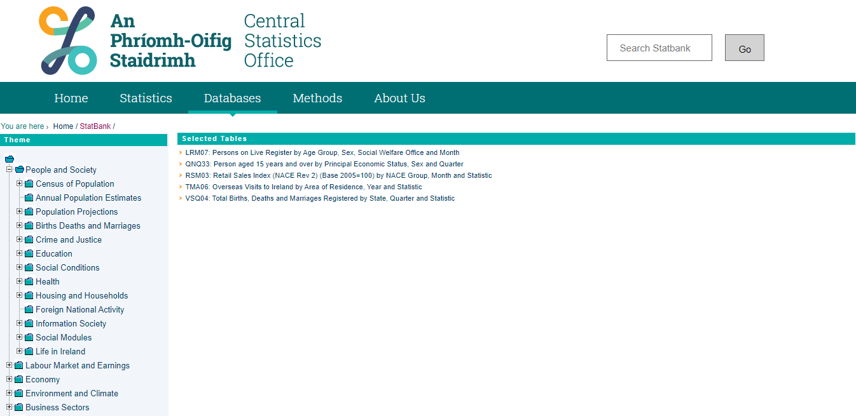
Statbank

Slide 5
Graphing in Economics
The specification seeks to enable students to:
“discuss, explain and communicate the outcomes of their analysis and activities in
verbal, graphical and other forms, using technology where appropriate.”
(Economics Specification, 2018, Page 7)
“Graphically represent/construct a graphical representation…” - Learning Outcomes

Slide 6


Graphing Tools
Active Learning Boards
Geogebra

Slide 7


Economics and STEM

Slide 8
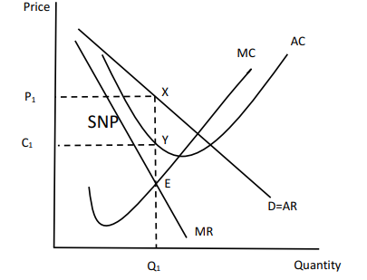
Example

Slide 9

Timeline Round 1 2019/2020
Webinar
Webinar
Sept 2019
Christmas 2019
Summer 2020
Sept/Oct
Nov/Dec
Jan/Feb
Mar/Apr
CoP
Nov/Dec
CoP
CoP
CoP
CoP
CoP
Mar/Apr
Professional Learning Community
Professional Learning Community
National Seminar 2
National Seminar 3

Slide 10
Key Messages
Economics is a subject for all and through its exploration students will be prepared and empowered to contribute to society and meet future challenges with confidence.
Strand 1 is a unifying strand, the themes of which permeate Strands 2-5 of the specification and will be progressively developed over the course of senior cycle.
An inquiry-based approach to teaching and learning cultivates students’ critical thinking skills in Economics by encouraging them to ask questions relating to the world around them and apply their learning in differentiated, collaborative, creative and innovative ways.
The collection, organisation, analysis and interpretation of data allows students to hypothesise and critically evaluate economic concepts and theories, allowing them to form justifiable opinions/conclusions around economic issues.

Slide 11

Now what?
https://pixabay.com/photos/question-question-mark-help-2309040/

Slide 12

Our Learning
Chance to reflect

Slide 13
End of Session 3
Thank you for your participation today!

