Slide 1
Introducing STEM CELLS

Slide 2
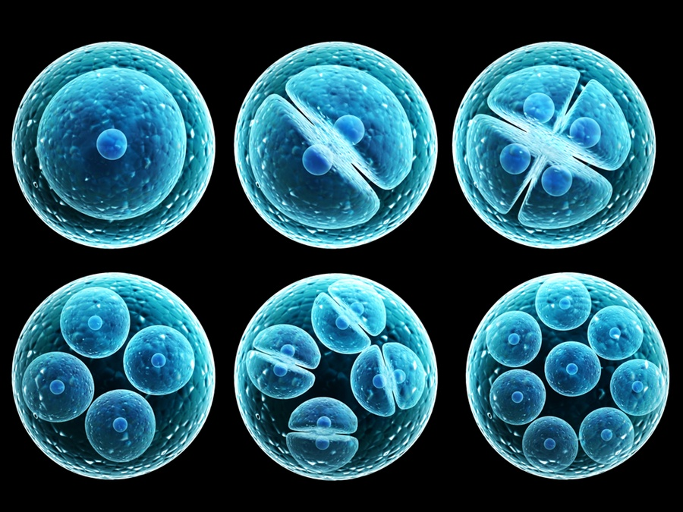

Teachers in Residence Programme
Colm Caomhánach and Róisín Ní Bhraiain
Notes:
Lukiyanovoa Natalia/frenta/shutterstock

Slide 3
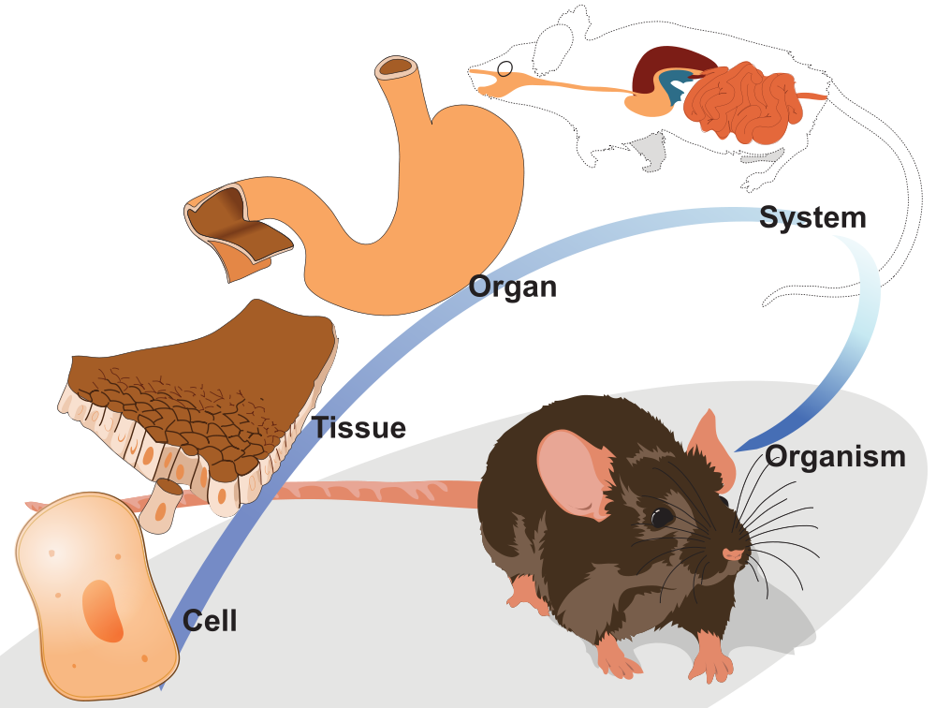
How animals are ‘organised’

Slide 4
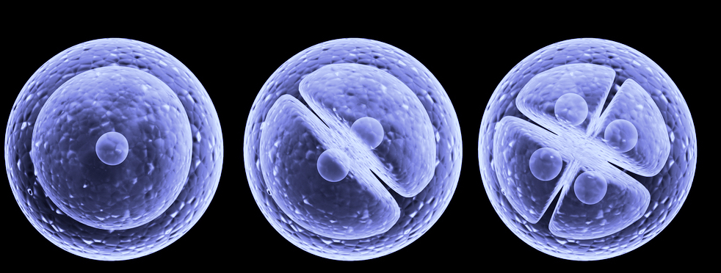
Cells
Cells are the smallest building blocks that make up the body
There are 3 types of cells:
Young Cells
Teenage Cells
Grown Up Cells
As a cell gets older it gets more defined and is “stuck” as a certain type of cell
As a cell gets older it can lose the ability to change or regenerate
Notes:
Lukiyanovoa Natalia/frenta/shutterstock

Slide 5
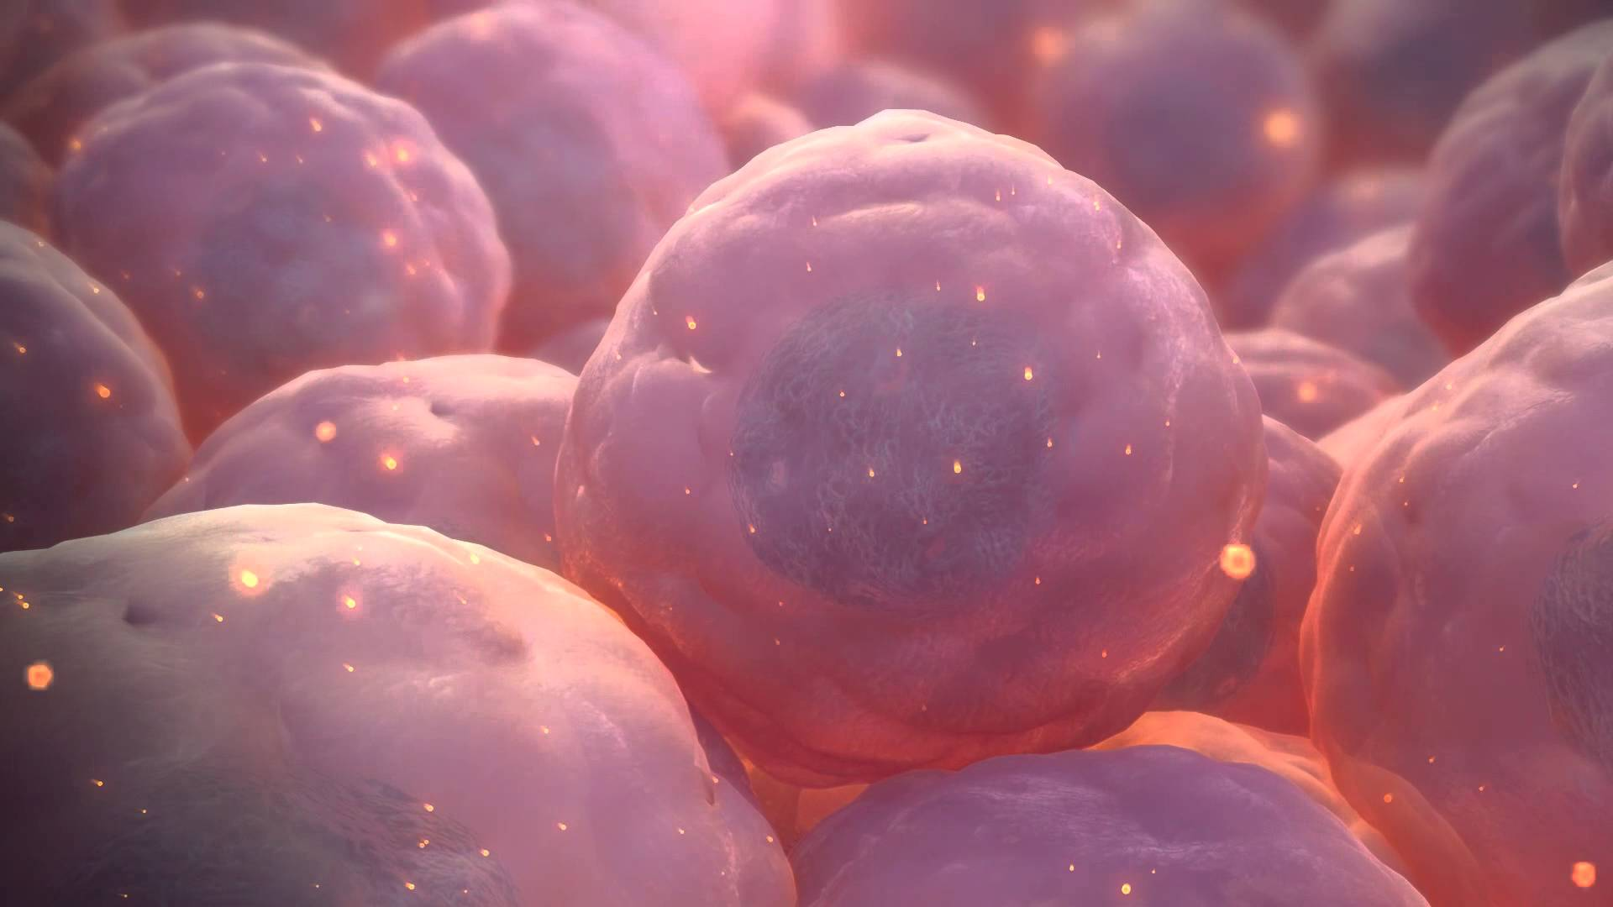
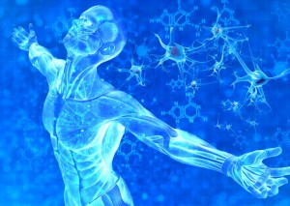
Stem cells are special because:
  1) They can copy themselves.
  (Not all cells can do this!)
  2) They can make other types of cells.
Our body uses stem cells to replace damaged or dead cells.
We hope that we can use them in the future to treat diseases.
Notes:
https://goo.gl/images/CbYRk5
http://try.stem-kine.com

Slide 6
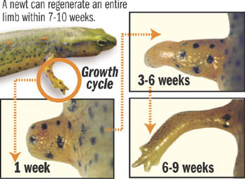
Regeneration
Regeneration is the ability of an animal's cells to make new body parts when they are an adult.
A newt can regenerate an entire limb within 7-10 weeks
For example, some animals can do more than just make new skin, they can grow new arms or even heads!
Notes:
https://goo.gl/images/KcNC4N

Slide 7
Stem Cells and Regeneration
When an animal is developing, most of the cells turn into a particular type.
Cells become blood cells, heart cells, bone cells, etc.
During development, stem cells sometimes remain that do not turn into a type of cell.
Some animals can use their stem cells to regenerate lost or damaged body parts.
In order for animals to do this, their stem cells need to get the right signals from the rest of the body.

Slide 8
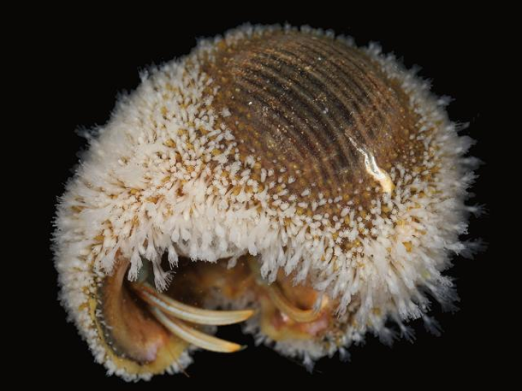
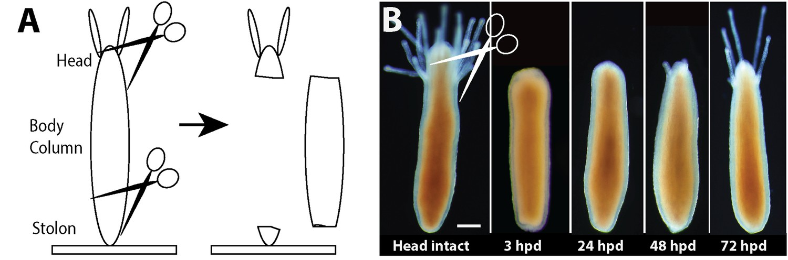
Head Regeneration in Hydractinia
Hydractinia (also know as snail fur) is a small sea creature that lives on the shell of Hermit Crabs.
Hydractinia can regenerate its head within 72 hours of being cut off.
Notes:
Bradshaw et al, 2015; https://elifesciences.org/articles/05506#fig2

Slide 9
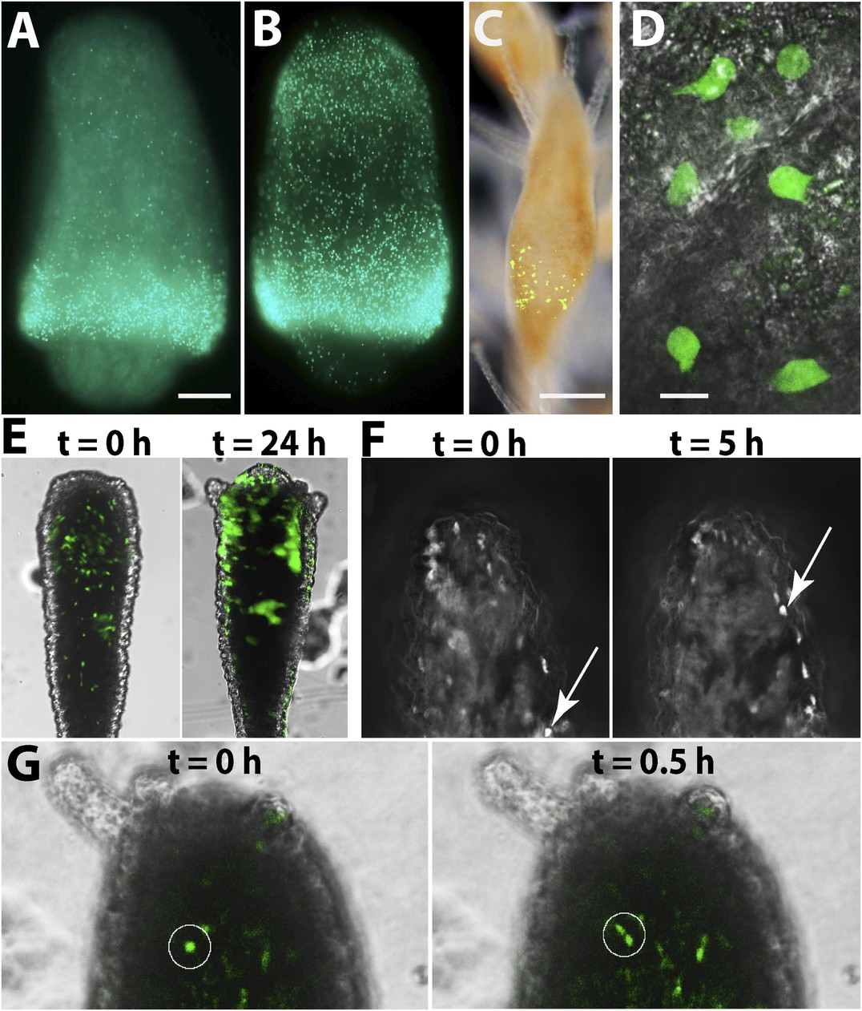
Stem Cells and Regeneration
Hydractinia have the correct genetic recipe for regeneration
Specific genes get turned on and send signals to stem cells in the body
These signals cause the stem cells to move (red arrows) to the area that needs regeneration
Notes:
Bradshaw et al, 2015; https://elifesciences.org/articles/05506#fig5

Slide 10
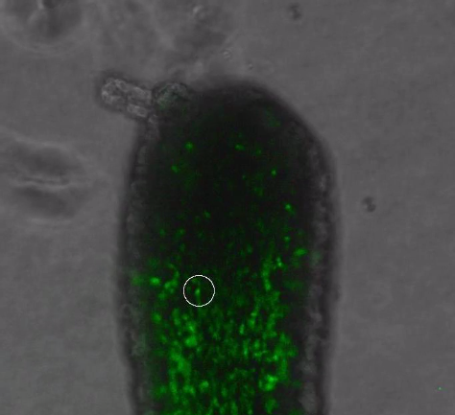
Stem Cell Moving into Head for Regeneration
“Video 2”, Bradshaw et al., 2015
Movie can be downloaded at: https://elifesciences.org/articles/05506#media2
Notes:
Bradshaw et al, 2015; https://elifesciences.org/articles/05506#media2

Slide 11
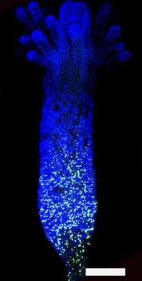
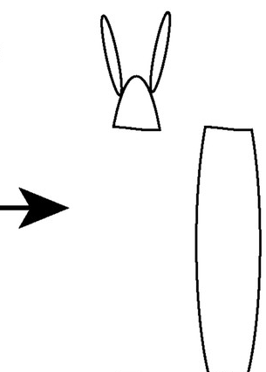
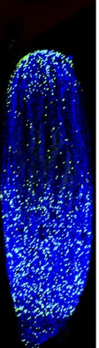
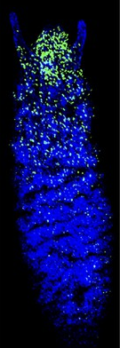
Hydractinia Regeneration
In an uninjured Hydractinia the stem cells (green) are located on the bottom
When the head is cut off the stem cells (green) begin to move to the injured head to start regeneration
Regeneration occurs when stem cells arrive and multiply
Notes:
Bradshaw et al, 2015; https://elifesciences.org/articles/05506#fig3

Slide 12
Stem Cells Have Two Jobs
A stem cell can do one of two things:
Self-renew =
Make copies of itself
Differentiate =
Turn into a specific “specialised” type of cell
Once a stem cell differentiates, it generally loses its ability to self-renew!

Slide 13
Why are Two Jobs Necessary?
Start with one stem cell that divides into two stem cells
Self-renewing cells - Make sure stem cells do not run out
Differentiated cells - Replace dead or damaged cells
After three divisions, finish with one self-renewing cell and
three differentiated cells

Slide 14
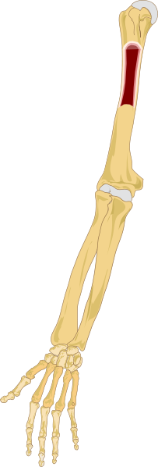
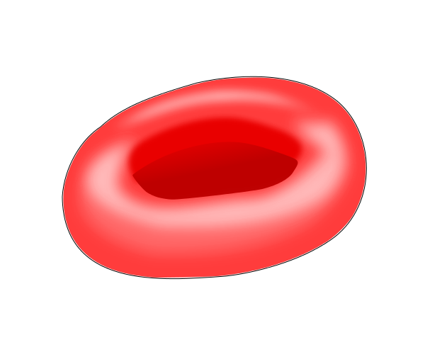

Example: Blood Cells
Blood stem cells are found in your bone marrow in the middle of your bones
Blood stem cells can differentiate into more specialised cells such as red blood cells
Red blood cells only live up to 120 days so they need to be continuously replaced
Once the blood stem cells differentiate into red blood cells, they lose their ability to self-renew
Notes:
https://commons.wikimedia.org/wiki/File:Right_arm_bone_marrow.svg
https://commons.wikimedia.org/wiki/File:Red-blood-cell_illust.svg
https://pixabay.com/en/calendar-icons-calendar-icons-month-925109/

Slide 15
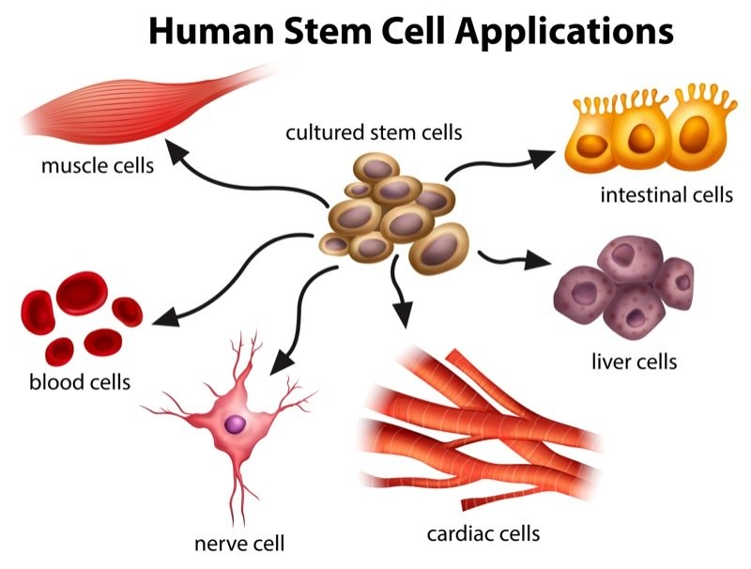
Stem cells are found all over the body and can turn into various differentiated cells
Notes:
https://goo.gl/images/aFplMG

Slide 16
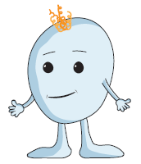
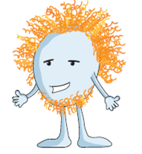
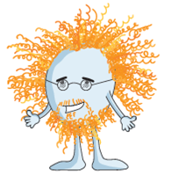
Cartilage Lineage
Cartilage = A rubber-like tissue made of collagen and elastin that covers and protects the ends of bones at joints
Transitory Chondrocyte
Articular Chondrocyte
Cartilage
↑ Self-renewal
↓ Differentiation
↓ Self-renewal
↑ Differentiation

Slide 17

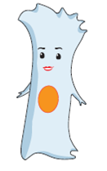
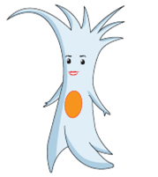
Tendon Lineage
Tendon = A band of tissue that connects muscle to bone
Mesenchymal Stem Cell
Tenoblast
Tenocyte
↑ Self-renewal
↓ Differentiation
↓ Self-renewal
↑ Differentiation

Slide 18

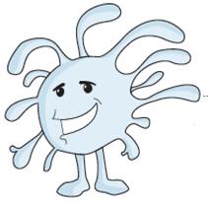
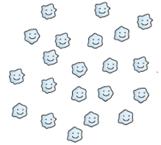
Blood Cell Lineage
Thrombocyte (Platelet) = A cell found in the blood involved in clotting to stop bleeding
Hematopoetic Stem Cell
Megakarocyte
Thrombocyte
↑ Self-renewal
↓ Differentiation
↓ Self-renewal
↑ Differentiation

Slide 19
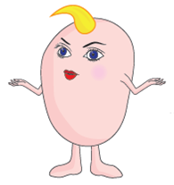
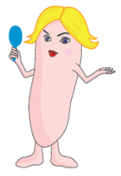
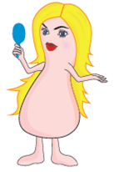
Skin Lineage
Skin = The outer protective covering of the body which has up to seven layers of tissue, including the epidermis
Epidermal Stem Cell
Keratinocyte (Young)
Keratinocyte (Old)
↑ Self-renewal
↓ Differentiation
↓ Self-renewal
↑ Differentiation

Slide 20
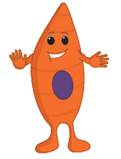


Muscle Lineage
Muscle = The tissue responsible for movement throughout the body from walking to pumping blood
Myoblast
Myoblast (Tube)
Muscle
↑ Self-renewal
↓ Differentiation
↓ Self-renewal
↑ Differentiation

Slide 21


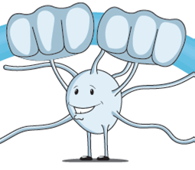
Myelin Sheath Lineage
Myelin Sheath = An insulating layer surrounding the axon of neurons allowing signals to be transmitted quickly from the brain to the body
Neural Stem Cell
Glial Progenitor Cell
Oligodendrocyte
↑ Self-renewal
↓ Differentiation
↓ Self-renewal
↑ Differentiation
Notes:
As the lineage progresses the cells start forming a protective layer, the Myelin Sheath, around the axon of the neurons. This is represented by the cells’ hands wrapping around the axon in the images.

Slide 22


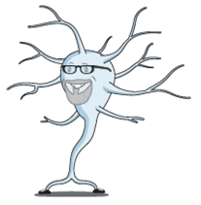
Neuron Lineage
Neuron = A cell that receives and transmits information in the brain
Neuronal Stem Cell
Neurocyte
Neuron
↑ Self-renewal
↓ Differentiation
↓ Self-renewal
↑ Differentiation

Slide 23


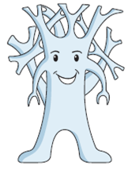
Bone Lineage
Bone = A living tissue containing blood vessels and cells which allow it to grow and repair itself
Transitory Osteoblast
Osteoblast
Osteocyte
↑ Self-renewal
↓ Differentiation
↓ Self-renewal
↑ Differentiation

Slide 24
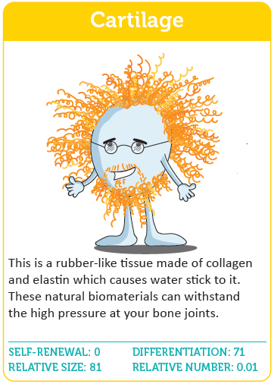
Get into pairs
Layout all of the cards out face up
One pair chooses a card without showing it to anyone
The pair read out the description on their chosen card
The class tries to guess what stem cell the pair have chosen
Activity 1:
“Guess Who” Style

Slide 25
Get into pairs
Shuffle then deal half the cards to each player face down
A player reads out the value from a category from the top card
The player with the highest value wins and gets all of the cards, and places them on the bottom of his/her pile
The person with all of the cards at the end is the winner
Activity 2:
“Top Trumps” Style

Slide 26
There are 6 groups of cards
Each group contains 3 steps of differentiation
Take note of the different types of cells and what they specialise in
Notice how the higher differentiated a cell is, the lower its self-renewing power
Notice how the lower differentiated a cell is, the higher its self-renewing power
Activity 2:
“Top Trumps” Style

Slide 27


Slide 28
References:
Bradshaw et al., eLife 2015;4e05506
commons.wikimedia.org
pixabay.com
goo.gl/images/aFplMG
goo.gl/images/CbYRk5
try.stem-kine.com/lf-1/
Sincere thanks to all of the researchers who gave lectures and generously gave their time throughout the course. A special thanks to Mikey Creane, Linda Howard, Maciej Doczyk, Elke Rink and the BrainMatTrain fellows for helping develop the content of the slides and card game.
Thanks also to all the participating teachers who very kindly shared ideas and resources.

Slide 29








This publication has emanated from research conducted with the financial support of Science Foundation Ireland (SFI) and is co-funded under the European Regional Development Fund under Grant Number 13/RC/2073.
This project has been funded by the European Union Seventh Framework Programme under Marie Curie Initial Training Networks (FP7-PEOPLE-2012-ITN) and Grant Agreement Number 317304 (AngioMatTrain). This project has also been funded by the European Union Horizon 2020 Programme (H2020-MSCA-ITN-2015) under the Marie Skłodowska-Curie Innovative Training Networks and Grant Agreement Numbers 676408 (BrainMatTrain) and 676338 (Tendon Therapy Train).

