Slide 1

Ultraviolet Radiation
Research and reveal what ultraviolet radiation is.
This activity will help students to:
1. Find out information about ultraviolet radiation.
2. Consider and evaluate the quality of information from sources.
3. Present information in a structured way.
Learning Outcomes:
Science
(LO: 5.6, 1.6, 1.7)

Slide 2
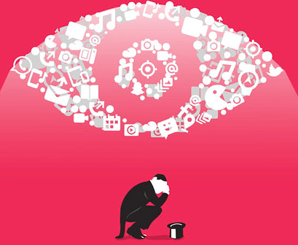
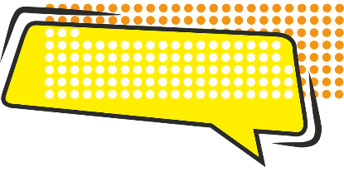

Research Activity
Key Skills: Communicating, Managing Myself, Managing Information and Thinking, Being Literate.
Try these guidelines when setting up your classroom to facilitate a research activity.
1
Discuss the importance of considering the quality of information from different sources.
2
Explore how students can evaluate sources of information.
3
Illustrate how students can cite and reference the sources they use.
4
Provide students with the opportunity to research the topic of ultraviolet radiation using the research template and mini-questions provided.
Research is the systematic investigation into and study of materials and sources in order to establish facts and reach new conclusions.

Slide 3
Research Activity - Stages
Key Skills: Communicating, Managing Myself, Managing Information and Thinking, Being Literate.
One of the best ways to organise your research is to divide your work into separate ‘mini-tasks’ or ‘mini-questions’
Choosing a Topic
Ultraviolet Radiation
Identify Key Questions
Find Sources and Materials
Take Notes on Sources
Answer Key Questions
Present Findings and Conclusions.
Which part of the research process to do you think is the most important? Explain your reasoning.

Slide 4
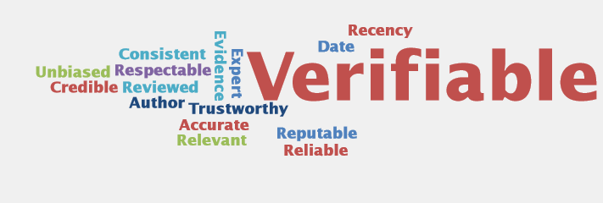
Research Activity - Quality of Information
Key Skills: Communicating, Managing Myself, Managing Information and Thinking, Being Literate.
The following words are often used to describe good sources of information.
Do you know the meaning of each of these words? Which of these words would you use when defending the sources you used?
Explain your reasoning...
Extension: Create a Wordle listing words that describe poor sources of information.

Slide 5
Evaluating Sources
Key Skills: Communicating, Managing Myself, Managing Information and Thinking, Being Literate.
How can you tell if a source is reliable? How can you tell if information is biased or one-sided?
Rank these sources from the most reliable to least reliable.
Blog post from an influencer
World Book Online article
NASA website
Irish Cancer Society website
Wikipedia article
Website selling Sun Cream
World Health Organisation Publication
Newspaper Report
A friend
My science school book
________________________
________________________
________________________
________________________
________________________
________________________
________________________
________________________
________________________
________________________
Guide to Evaluating Sources
Notes:
Questions to focus students:
Who is the author? What qualifies him/her to speak on the subject? Is the purpose of the information to inform, to persuade, to sell, or even to entertain?
Who is sponsoring this website? Are any biases at play?
Is the information evidence based? Has the information been peer-reviewed? Is the author an expert in the field? Can you identify the author? Is the author reputable and trustworthy? Is the URL .gov or .edu?
Can you verify this information from another source?
When was the website published?
Has it been updated recently? Is the information current and up-to-date?

Slide 6

What is ultraviolet radiation?
How was ultraviolet light discovered?
Ultraviolet Radiation
What are the harmful effects of UV rays?
What is the main source of UV radiation on Earth?
What environmental factors affect the amount of UV exposure you get outdoors?
What is ultraviolet radiation used for?
Scientists separate ultraviolet rays into three categories—known as UVA, UVB, and UVC—according to wavelength. Describe each category.
UVA
UVB
UVC
What are the main ways to protect yourself from UV radiation?

Slide 7
What are ultraviolet rays?
UV rays are an invisible form of light. They lie just beyond the violet end of the visible spectrum. The UV rays have shorter wavelengths than visible light. They are invisible to the human eye but the presence of UV radiation can be detected as it causes certain substances to fluoresce. Source: NASA
How was ultraviolet light discovered?
In 1801, Johann Ritter conducted an experiment that proved the existence of UV light. In his experiment, he found that silver chloride, which decomposes in the presence of light, is more rapidly decomposed when exposed to radiation beyond the violet end of the light spectrum. Source: Britannica
Ultraviolet Radiation
What are the harmful effects of UV rays?
Being exposed to too much UV radiation causes sunburn, tanned skin, skin ageing, premature wrinkles and eye damage. Source: Irish Cancer Society
Exposure to the sun's ultraviolet rays over a long period can cause skin cancer and other changes in human cells. Such exposure also can damage or kill plants. Source: World Book Online
Teacher Reference
What is the main source of UV radiation on Earth?
What environmental factors affect the amount of UV exposure you get outdoors?
What is ultraviolet radiation used for?
Short wavelengths are used to kill bacteria and to sterilize surgical instruments.
Food and drug companies use germicidal lamps (UVC light) to disinfect various types of products and their containers.
Direct exposure to ultraviolet rays with wavelengths shorter than 320 nm produces vitamin D in the body.
To treat some skin disorders, such as acne and psoriasis.
Some instruments use ultraviolet rays to identify the chemical composition of unknown materials.
Source: World Book Online Article
The sun is the major natural source of ultraviolet rays. The rays can be produced artificially by passing an electric current through a gas or vapor, such as mercury
vapor. Source: World Book Online article
Sun height, latitude, cloud cover, altitude, the ozone layer, and ground reflection.
Source: WHO website
Scientists separate ultraviolet rays into three categories—known as UVA, UVB, and UVC—according to wavelength. Describe each category.
UVA (315-400 nm): UVA makes up most of the UV that reaches the Earth surface. It reaches the deeper layer of the skin causing skin ageing, eye damage and skin cancer.
UVB (280-315 nm): Medium-wavelength UVB is very biologically active but cannot penetrate beyond the superficial skin layers. It is responsible for delayed tanning and burning. Most solar UVB is filtered by the atmosphere.
UVC (100-280 nm): Short-wavelength UVC is the most damaging type of UV radiation. However, it is completely filtered by the atmosphere and does not reach the earth's surface. Source: WHO
What are the main ways to protect yourself from UV radiation?
Be aware of the UV Index level.
Protect your skin from UV damage with the SunSmart Code. Seek shade from direct and indirect UV rays. Cover skin with clothes and hat. Wear sunglasses. Use suncream.
Do not use Sunbeds.
Source: Irish Cancer Society

Slide 8




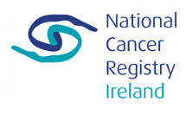



More Questions about UV Rays:
Visit the following websites to find out more information.
Notes:
In Slide Show mode, select the arrows to visit links.

