Slide 1
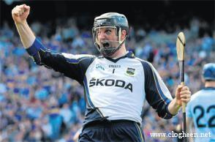
Brendan Cummins
Local and Tipperary Legend.

Slide 2
Past - pupil.
Brendan is a past - pupil of Ardfinnan N.S.
He practised his goalkeeping skills at the gates by Brett’s wall.

Slide 3
Tipp Senior Debut
He made his senior hurling debut in the 1993-94 National Hurling League.
He was just 19 years old.

Slide 4

Achievements:
Brendan won two All-Ireland medals, five Munster medals and three National Hurling League medals.
He was an All-Ireland runner-up on three occasions.

Slide 5
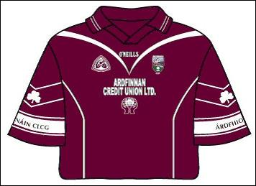
Local involvement:
At club level he plays hurling with Ballybacon-Grange and football with sister club Ardfinnan.

Slide 6
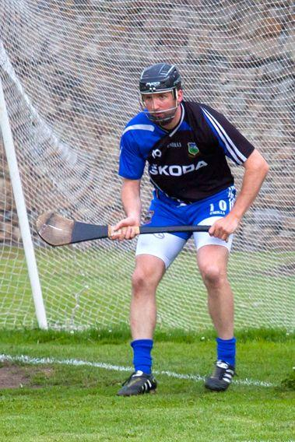
All-Stars.
Brendan has won 5 All-Star Awards, the first in 2000, the fifth in 2010.

Slide 7
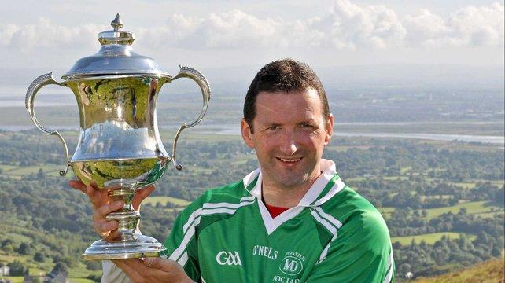
Poc Fada.
Cummins has also enjoyed success in the famous Poc Fada competition held annually in the Cooley Mountains. He went on to win six singles titles between 2004 and 2012.[

Slide 8
Retirement.
Throughout his hurling career Cummins made a record 73 championship appearances for Tipperary. He announced his retirement from inter-county hurling on 17 October 2013.

Slide 9
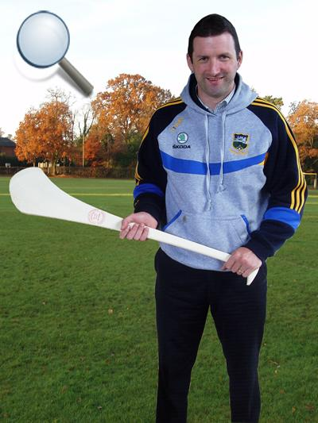
Brendan now coaches goalkeepers for a number of counties...as well as coaching the Ballybacon-Grange U6s!

