Slide 1
Homes: Ireland and the world
Human environments

Slide 2
Houses and homes
There are lots of different types of houses and homes in Ireland but there are even more different types throughout the world.
Today we will look at some of these.
Firstly lets look at some popular homes in Ireland.
Can you name any types before we start?

Slide 3
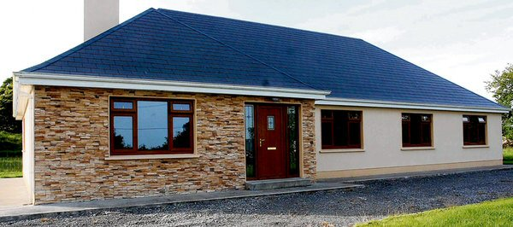
Bungalow
A bungalow is a house that only has one level.
Most bungalows do not have stairs.
This type of house is more commonly found in the countryside.

Slide 4
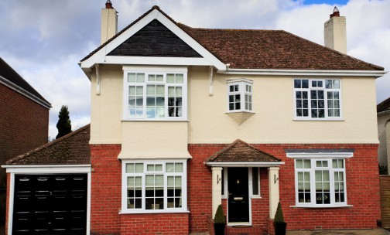
Detached house
A detached house is a house that is on its own and not joined to another house.
Have you seen this type of house before?

Slide 5
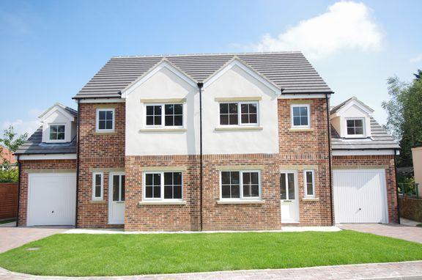
Semi detached house
A semi detached house is a house that is joined to another house on one side.
This type of house is very common in towns and cities in Ireland.

Slide 6
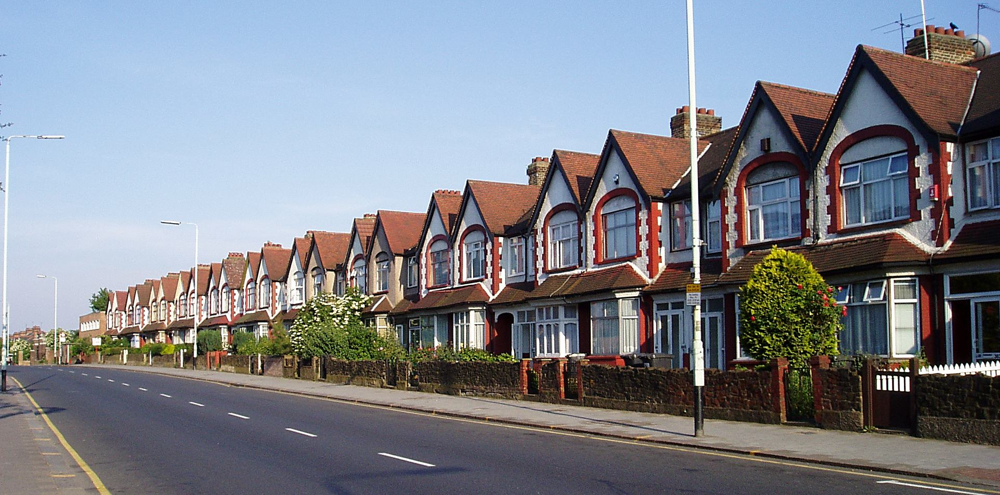
Terraced house
A terraced house is attached to other houses on both sides.
These are very common in the bigger cities in Ireland.
Why do you think that is?

Slide 7
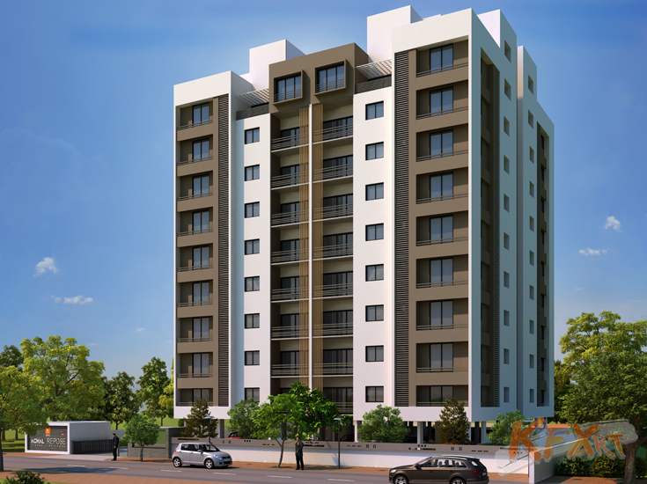
Apartment (flat)
An apartment is a group of rooms which make up a home.
They are often smaller than some of the other houses we have looked at.
Apartments are usually found in an apartment block, where lots of different families live.

Slide 8
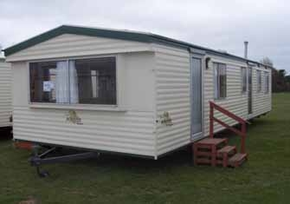
Caravan
A caravan can be moved from one place to another.
This type of home suits people who like to move from area to area.

Slide 9
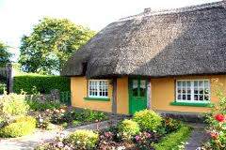
Cottage
A cottage is usually a one storey house.
The roof of a cottage is covered with straw, which is known as a thatched roof.
Cottages were very common in Ireland in the past but not so much nowadays.
Cottages are mostly found in the countryside in Ireland.

Slide 10
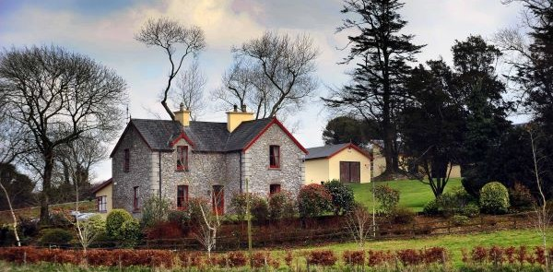
Farmhouse
Farmhouses are found in the Irish countryside.
A farmyard is usually close by and the house is often surrounded by lots of fields.
The farmer’s animals usually live in these fields.

Slide 11
Questions
What type of house do you live in?
What do we call a house which is attached on one side only?
What is the roof of a cottage made from?
Can you name the types of houses more common in the countryside?
What are the benefits to living in a caravan?
Why do you think cottages are not as popular as they were in the past?

Slide 12
Homes around the world
Human environments

Slide 13
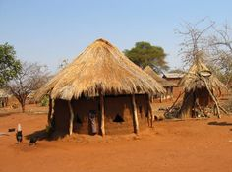
Huts in Africa
Many people in parts of Africa live in huts.
These huts are very small.
They are often made out of stones and mud.
The roof is made using branches from trees and straw.

Slide 14
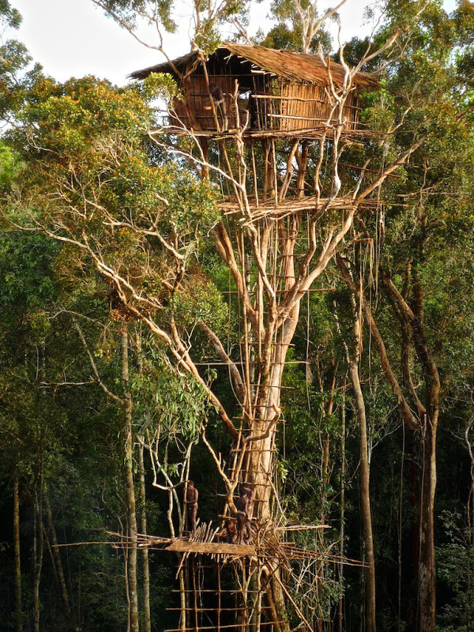
Treehouses in the rainforests
Some tribes who live in the rainforests of the world live in treehouses.
They build these houses high up in the trees.
Their houses are made out of wood and have a thatched roof.

Slide 15
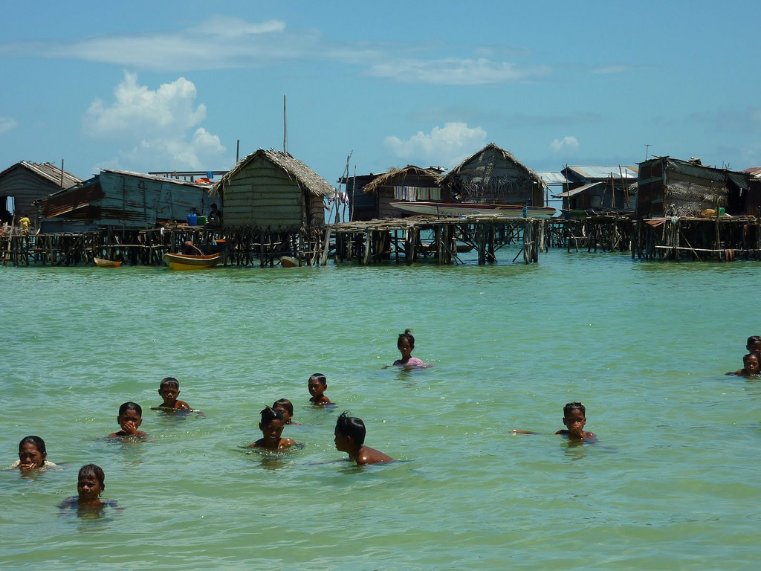
Houses in the sea
The Bajau people of Indonesia have built villages in the sea.
Their houses are made of timber and they also have thatched roofs.
The houses are built on top of big wooden stakes, which keep them above the water.

Slide 16
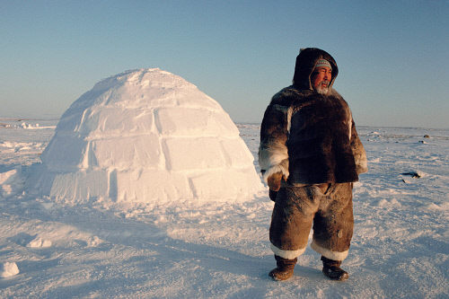
Igloos
The Inuit people of Canada and Greenland build houses out of blocks of snow. These houses are called igloos.
The igloo stops the freezing cold air from getting in.

Slide 17
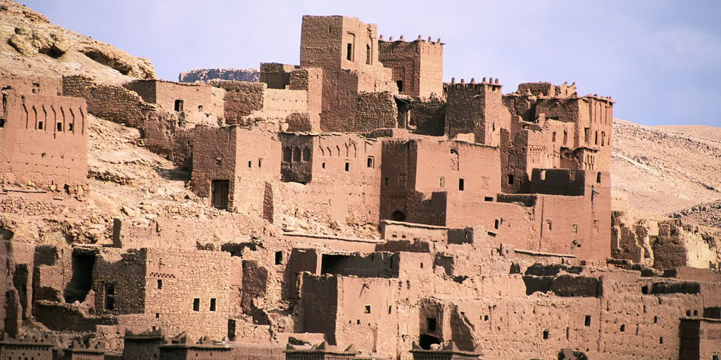
Stone and mud houses
The Berber people of Morocco live in houses made out of stone and mud.
These houses have flat roofs because it rarely rains.
The stone and small windows keep the house cool inside.

Slide 18
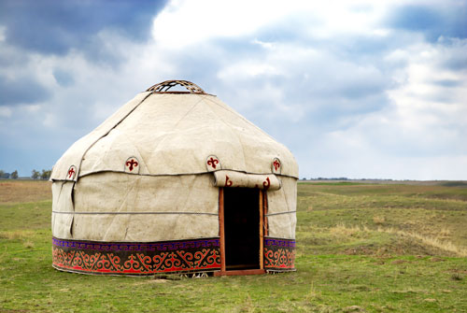
Yurt
The nomads of Mongolia live in Yurts which are round tents covered with animal skins or felt.
Nomads move from place to place with their animals.
The tent can be moved easily and can be set up in one hour.
They provide protection against bad weather.

Slide 19
Questions
Would you prefer to live in one of the homes in Ireland or one of those from a different country? Why?
In Ireland we usually build houses from stone. Why do you think this is?
Why do the people of other countries use different materials?
Can you discuss some of the differences between homes in Ireland and the homes we have seen in different countries?
If you had to live in a home in a different country which one would you choose? Why?

