Slide 1
The Novel Workbook

Slide 2
Make Connections
This reminds me of a time when I ___________
I know about this topic because I ___________
The setting of this book is just like ___________
This book is something like ___________
What's going on in this book is just like what's happening in ___________

Slide 3
Ask Questions
Before I read this text, I wonder about ___________
While I'm reading, I try to figure out ___________
After I read, I ask myself ___________
I wonder why___________
What does this word mean?
Why did ____________ do that?
What is going to happen next?
Why did the author put that part in there?
I have questions about this part because it doesn't make sense. I need to make sure I read it right. If I reread and fix a mistake, that might answer my question.

Slide 4
Visualize
The author gives me a picture in my mind when he or she describes ___________
I can really see what the author talks about when he or she ___________
I can draw a picture of what the author describes.

Slide 5
Determine Text Importance
I know these parts of the story are important because they match my purpose for reading, which was ___________
I believe the author thinks ____________ is important because ___________
I think the author's opinion about _____ is ______ because â€¦
This text uses the (cause/effect, problem/solution, description, compare/contrast, sequence/steps in a process) text structure. I can use a graphic organizer to help me understand it.
I see lots of information right here. I need to identify which parts are important and which parts are just interesting.
All these ideas are important, but I think some are more important than others. I need to determine which ideas are the most important.
This (chart, table, graph, time line) helps me understand that â€¦
These (boldfaced words, font changes, bullets, captions) help me locate what is important.
Let me take the big ideas and summarize the text.

Slide 6
Make Inferences
The author says this, but means ___________
If I read between the lines, the author tells me that ___________
The clues to prove my inference are ___________
Because of what the author said, I know that ___________
From the clues or information the author gives, I can conclude that ___________
I think that ____________ will happen next because the author says ____________.

Slide 7
Synthesize
This story or passage is really about___________My views on this are___________
My opinion of _________ is ___________
I first thought ________ about the topic. Now I think ___________
I've read a lot of information. Let me stop and think about this for a minute.
My judgment of this information is ___________
From this information, I can generalize that ___________

Slide 8
Knowledge (identification and recall of information):
“Who, what, when, where, how…?”
“Describe…”
Comprehension (organization and selection of facts and ideas):
“Retell…”
"Summarize..."
Application (use of facts, rules and principles):
“How is…an example of…?”
“How is…related to…?”
“Why is…significant?

Slide 9
Analysis (separation of a whole into component parts):
“What are the parts or features of…?”
“Classify …according to…”
“Outline / diagram…”
“How does…compare / contrast with…?”
“What evidence can you list for…?”
Synthesis (combination of ideas to form a new whole):
“What would you predict / infer from…?”
“What ideas can you add to…?”
“How would you create / design a new…?”
“What might happen if you combined…?”
“What solutions would you suggest for…?”
Evaluation (development of opinions, judgments, or decisions):
“Do you agree…?”
“What do you think about…?”
“What is the most important…?”
“Place the following in order of priority…”
“How would you decide about…?”
“What criteria would you use to assess…?”

Slide 10
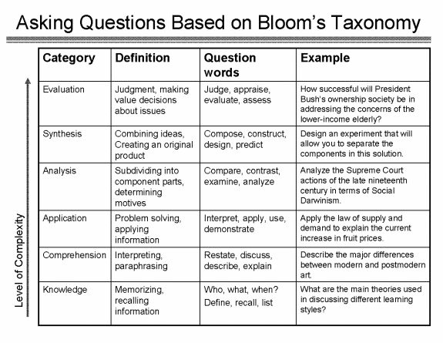

Slide 11
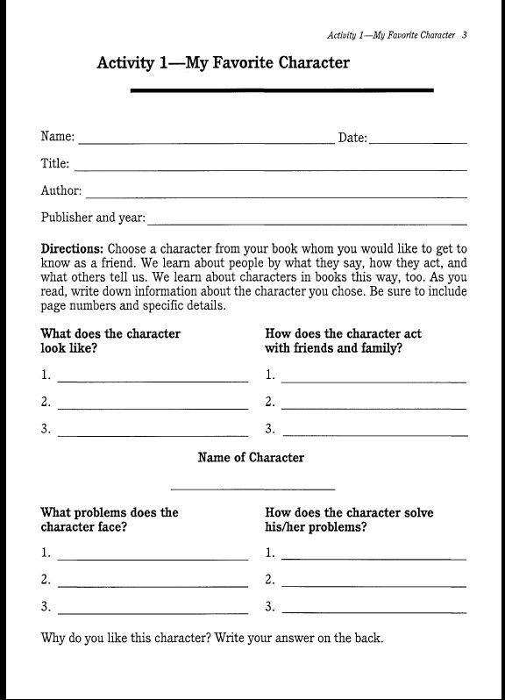

Slide 12
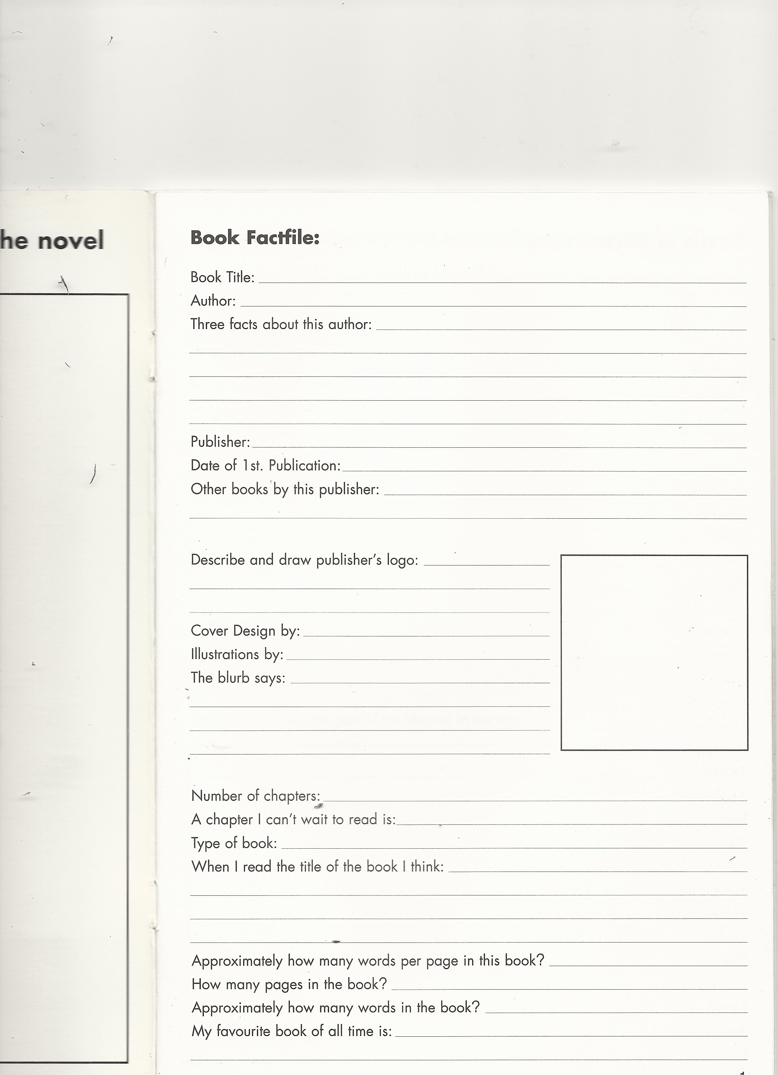

Slide 13
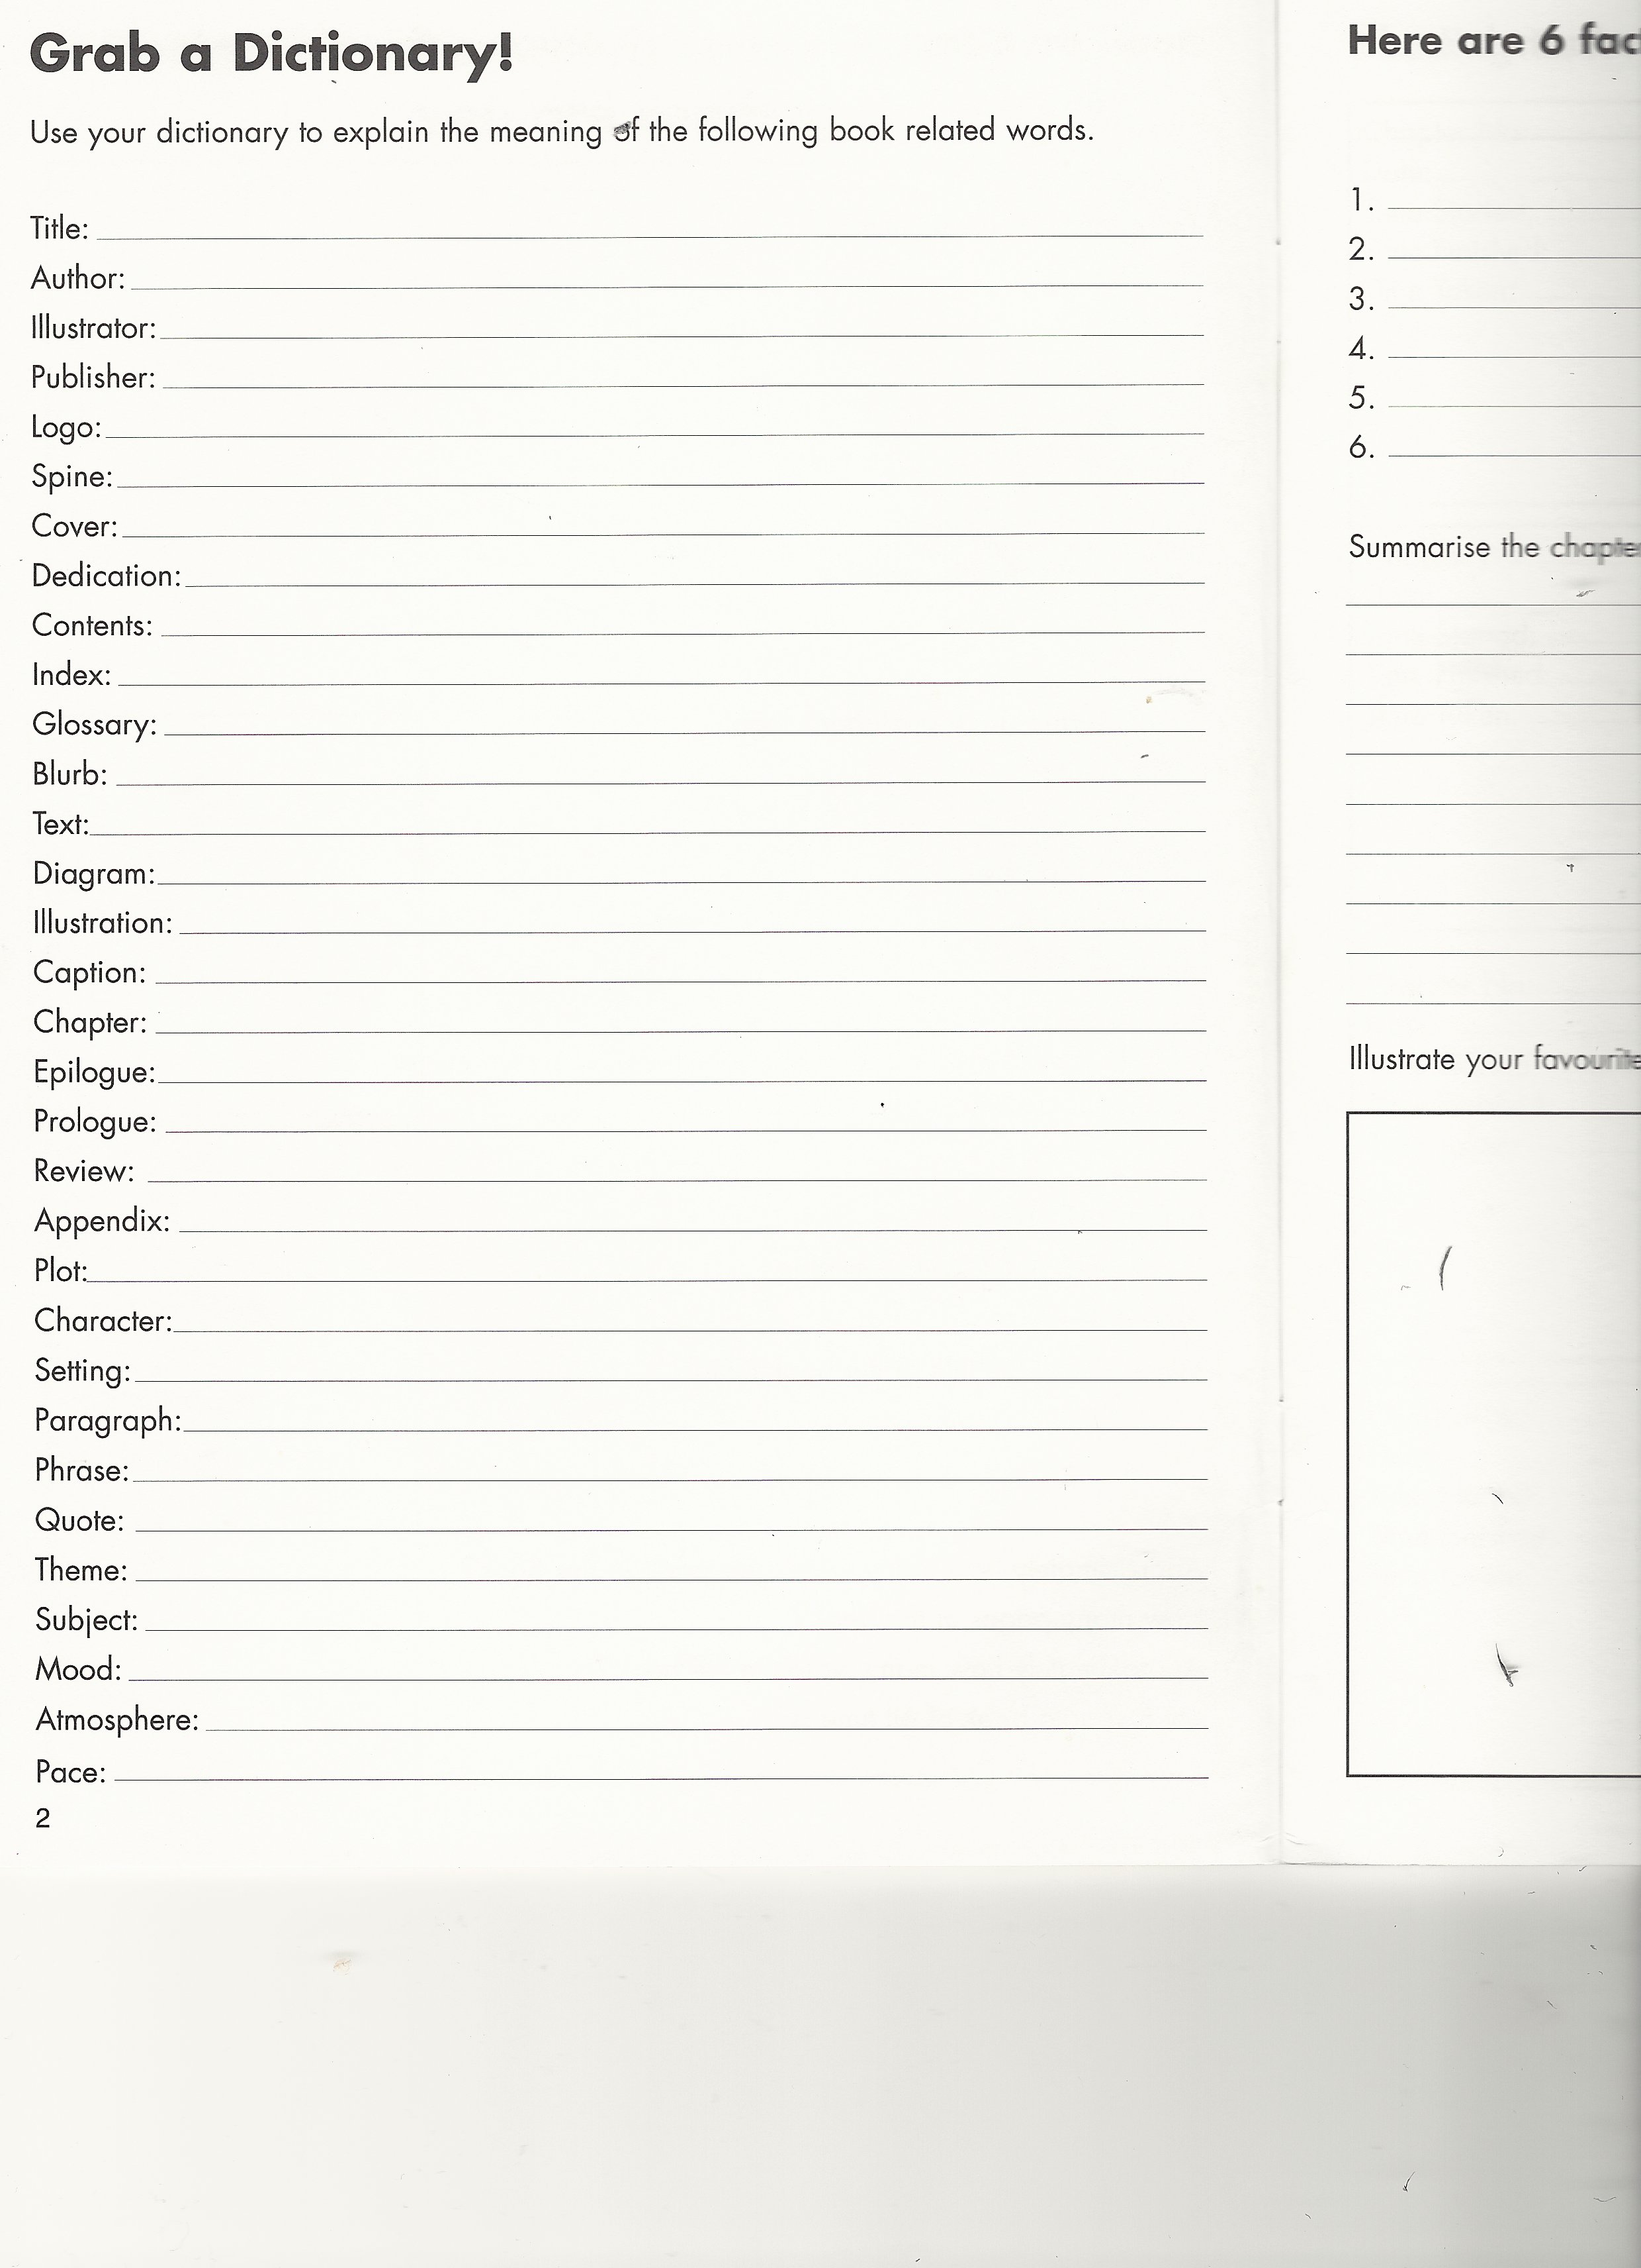

Slide 14
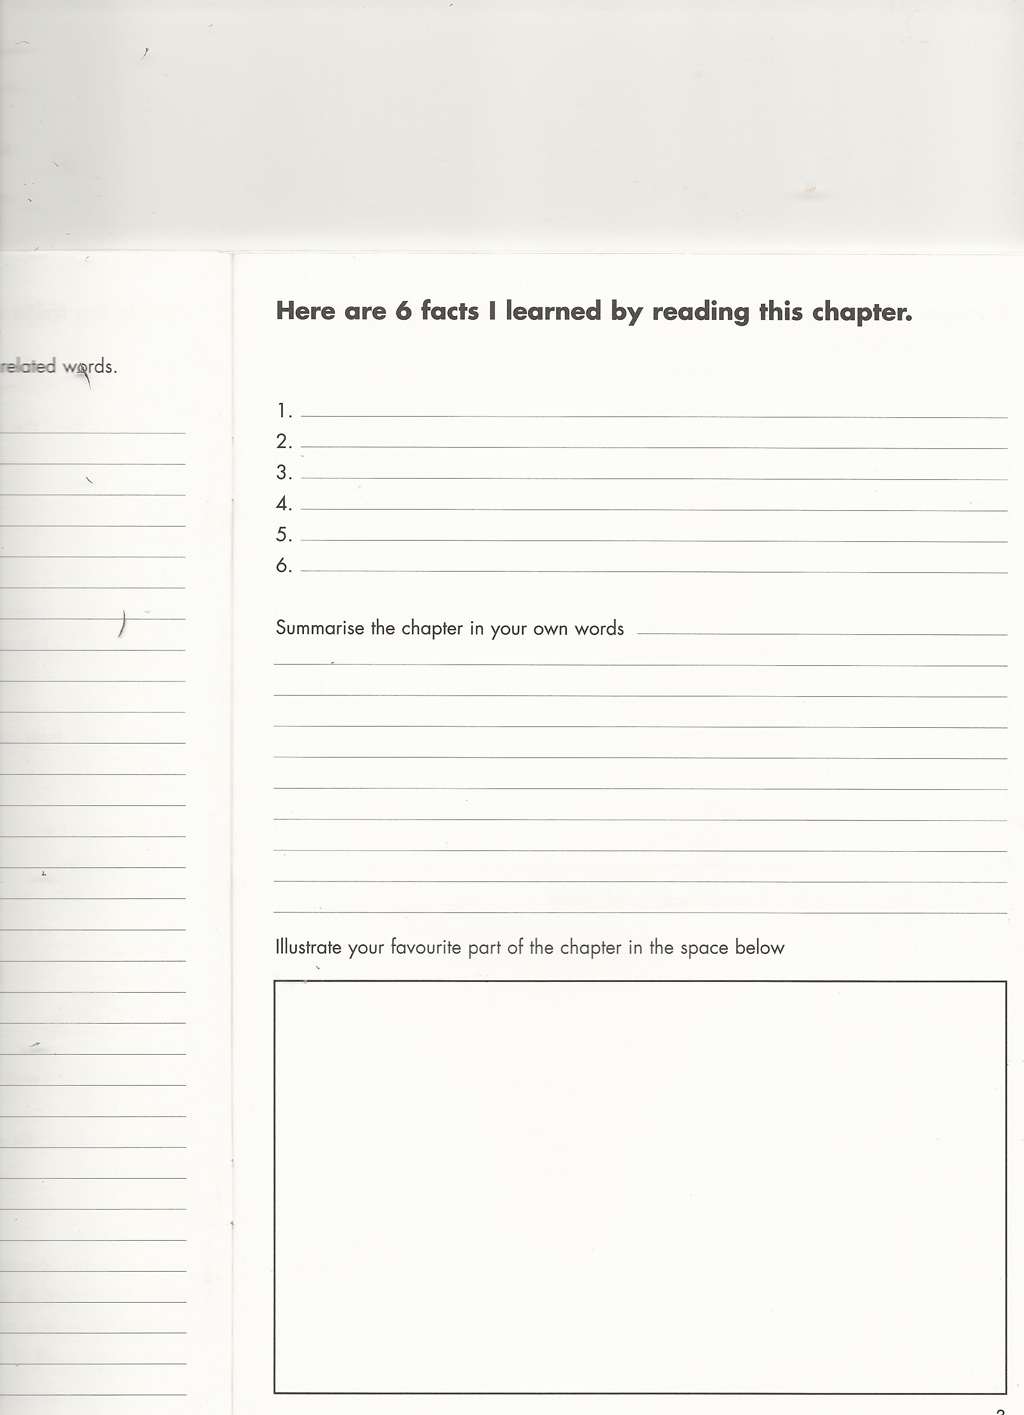

Slide 15
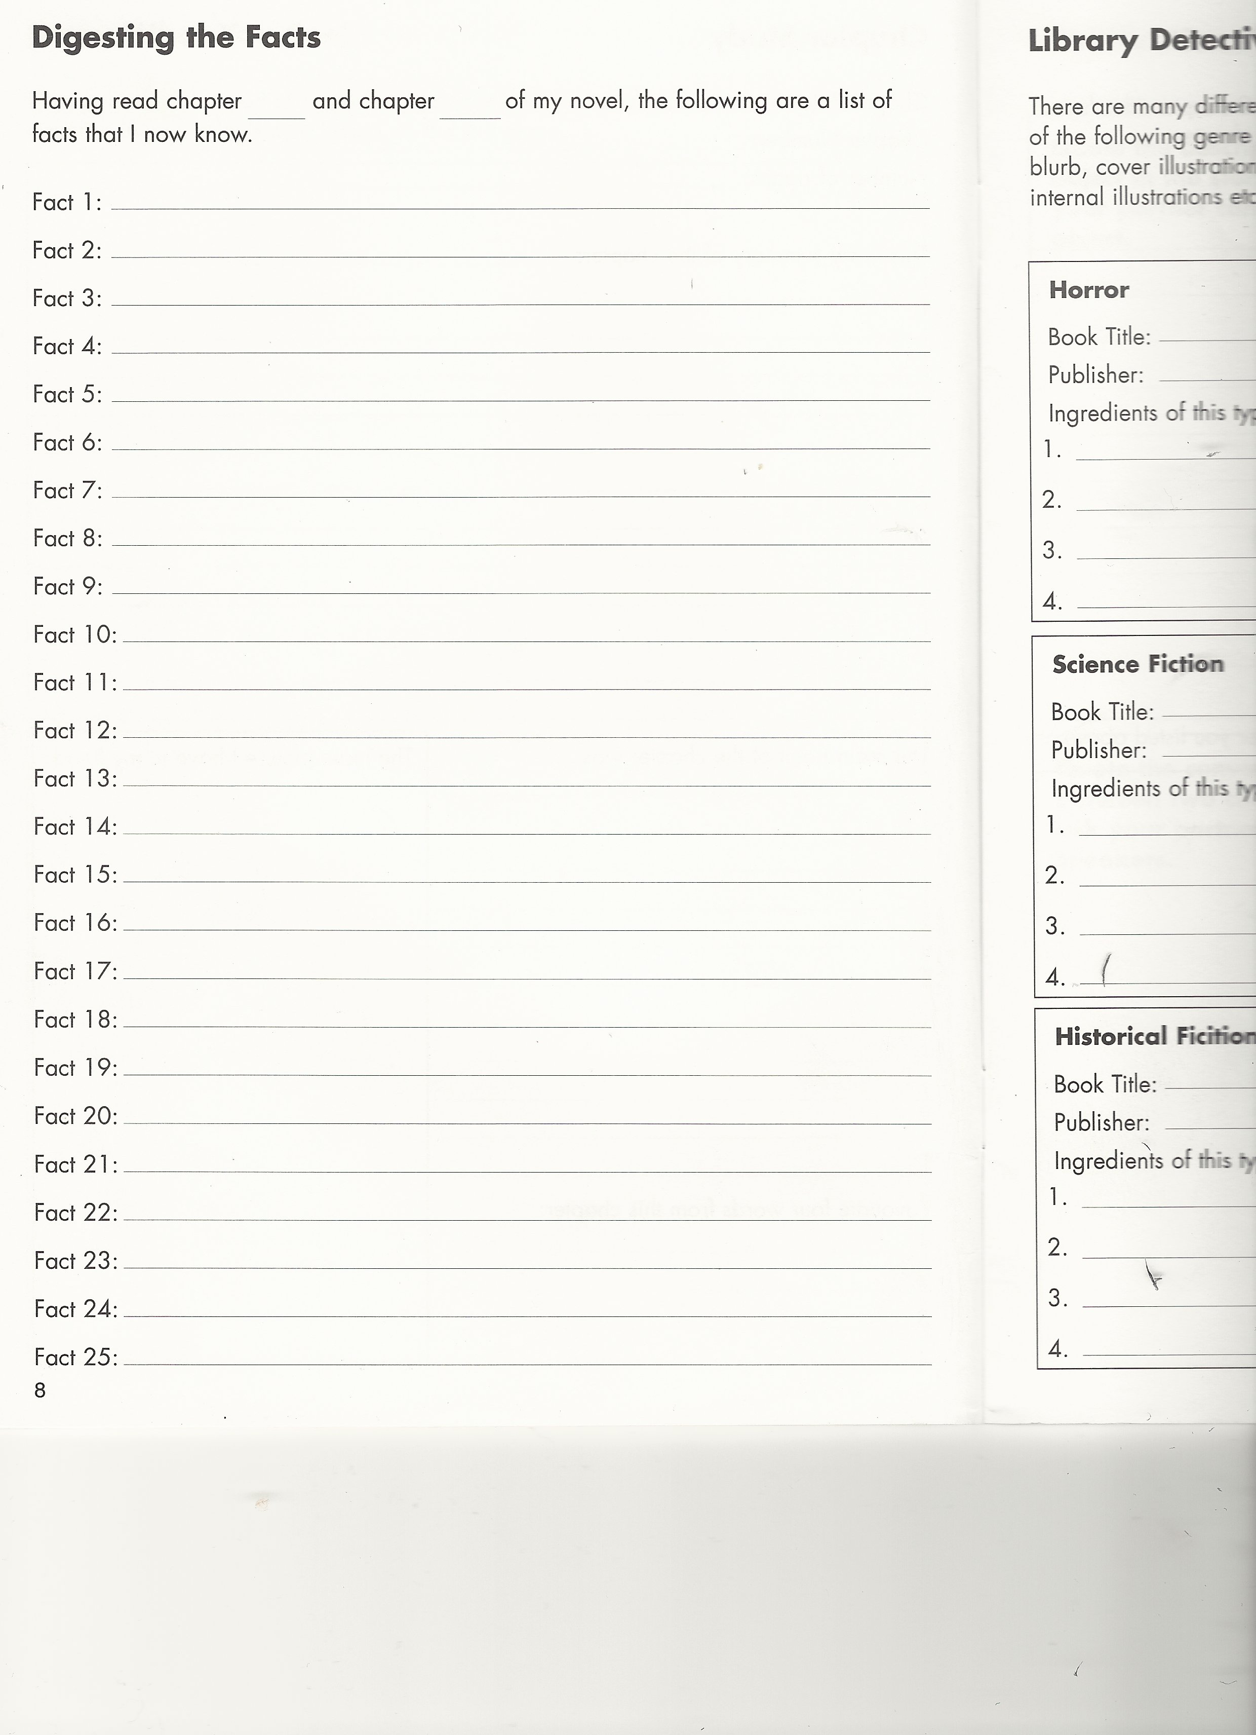

Slide 16
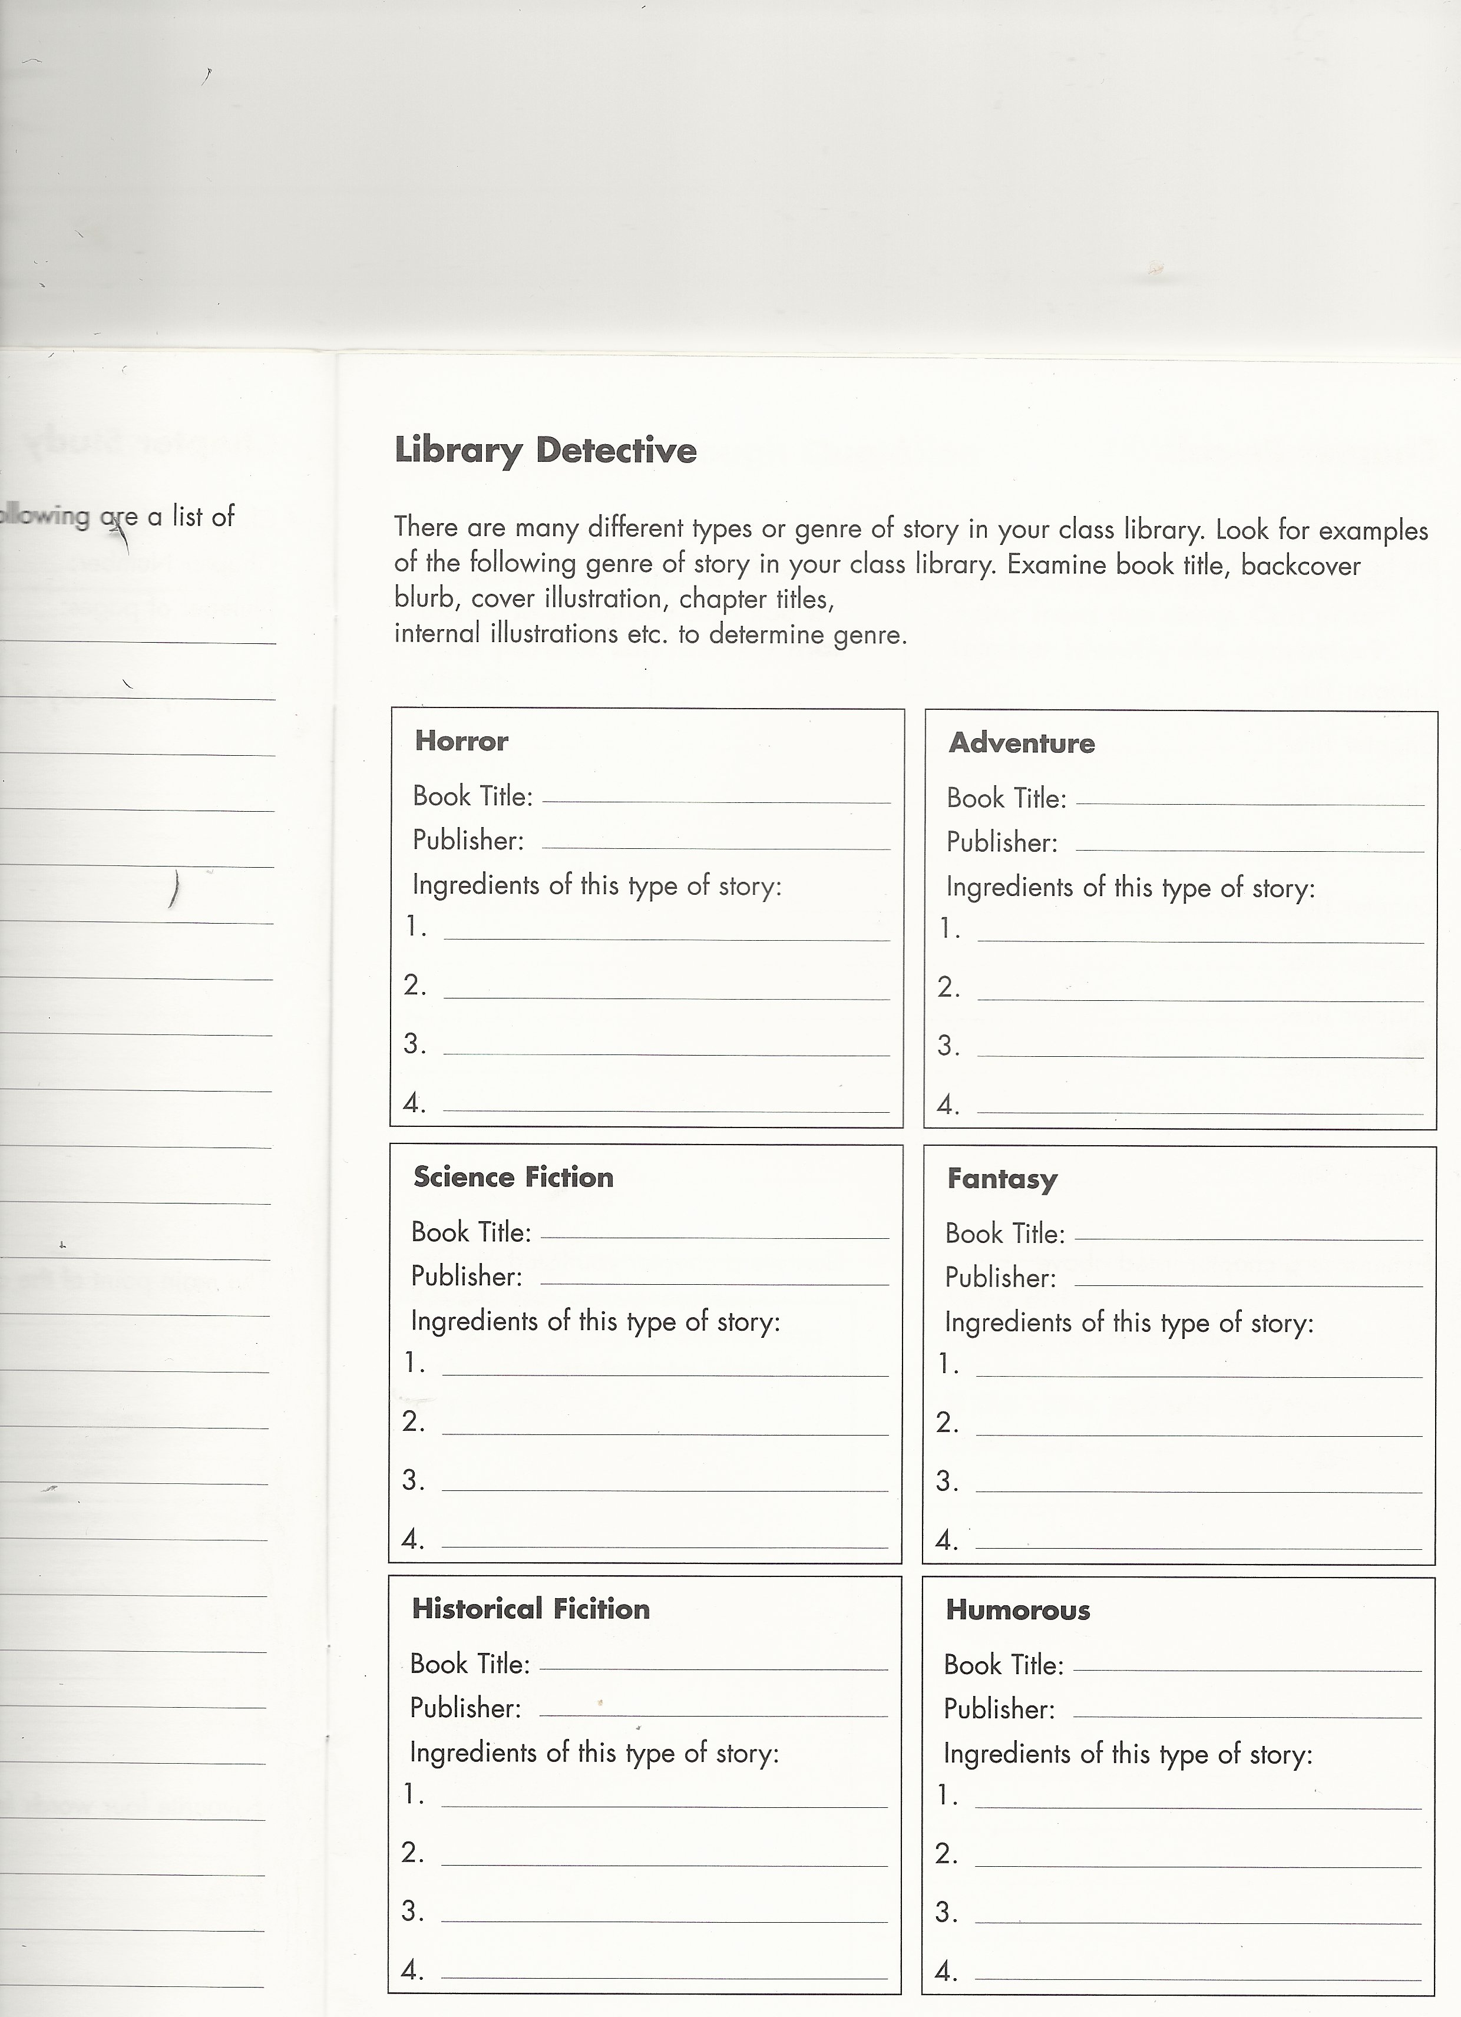

Slide 17
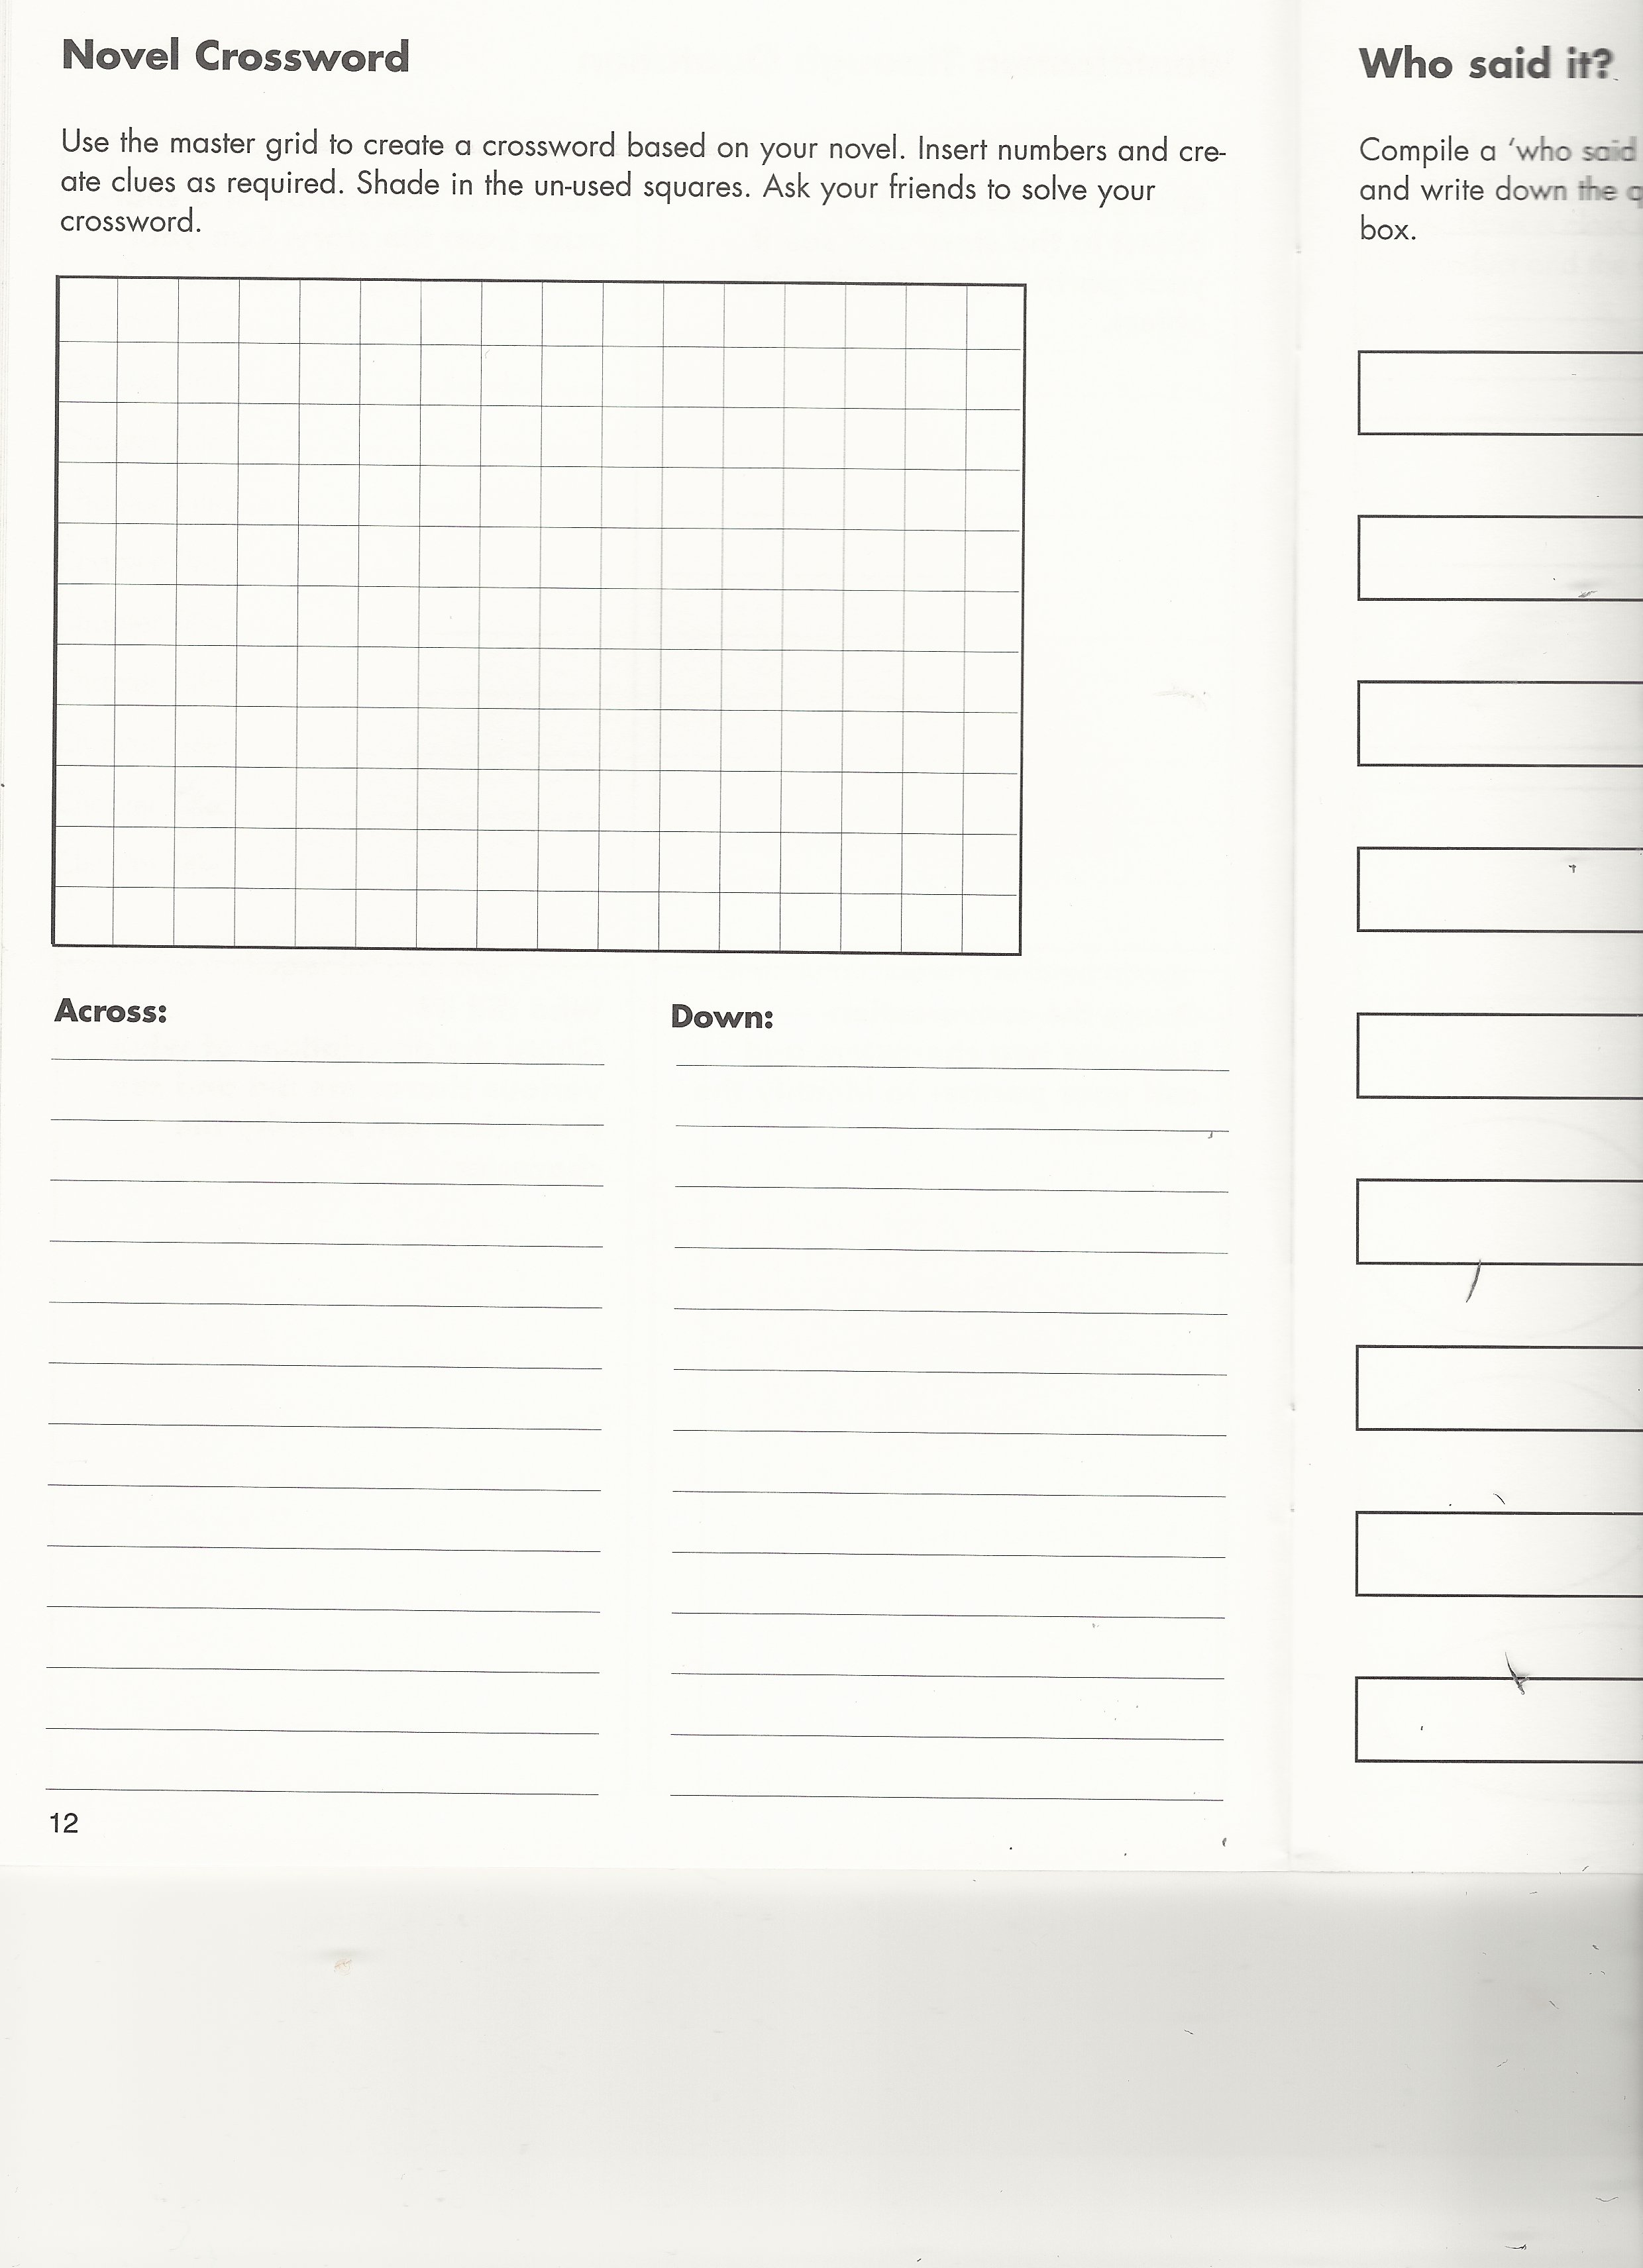

Slide 18
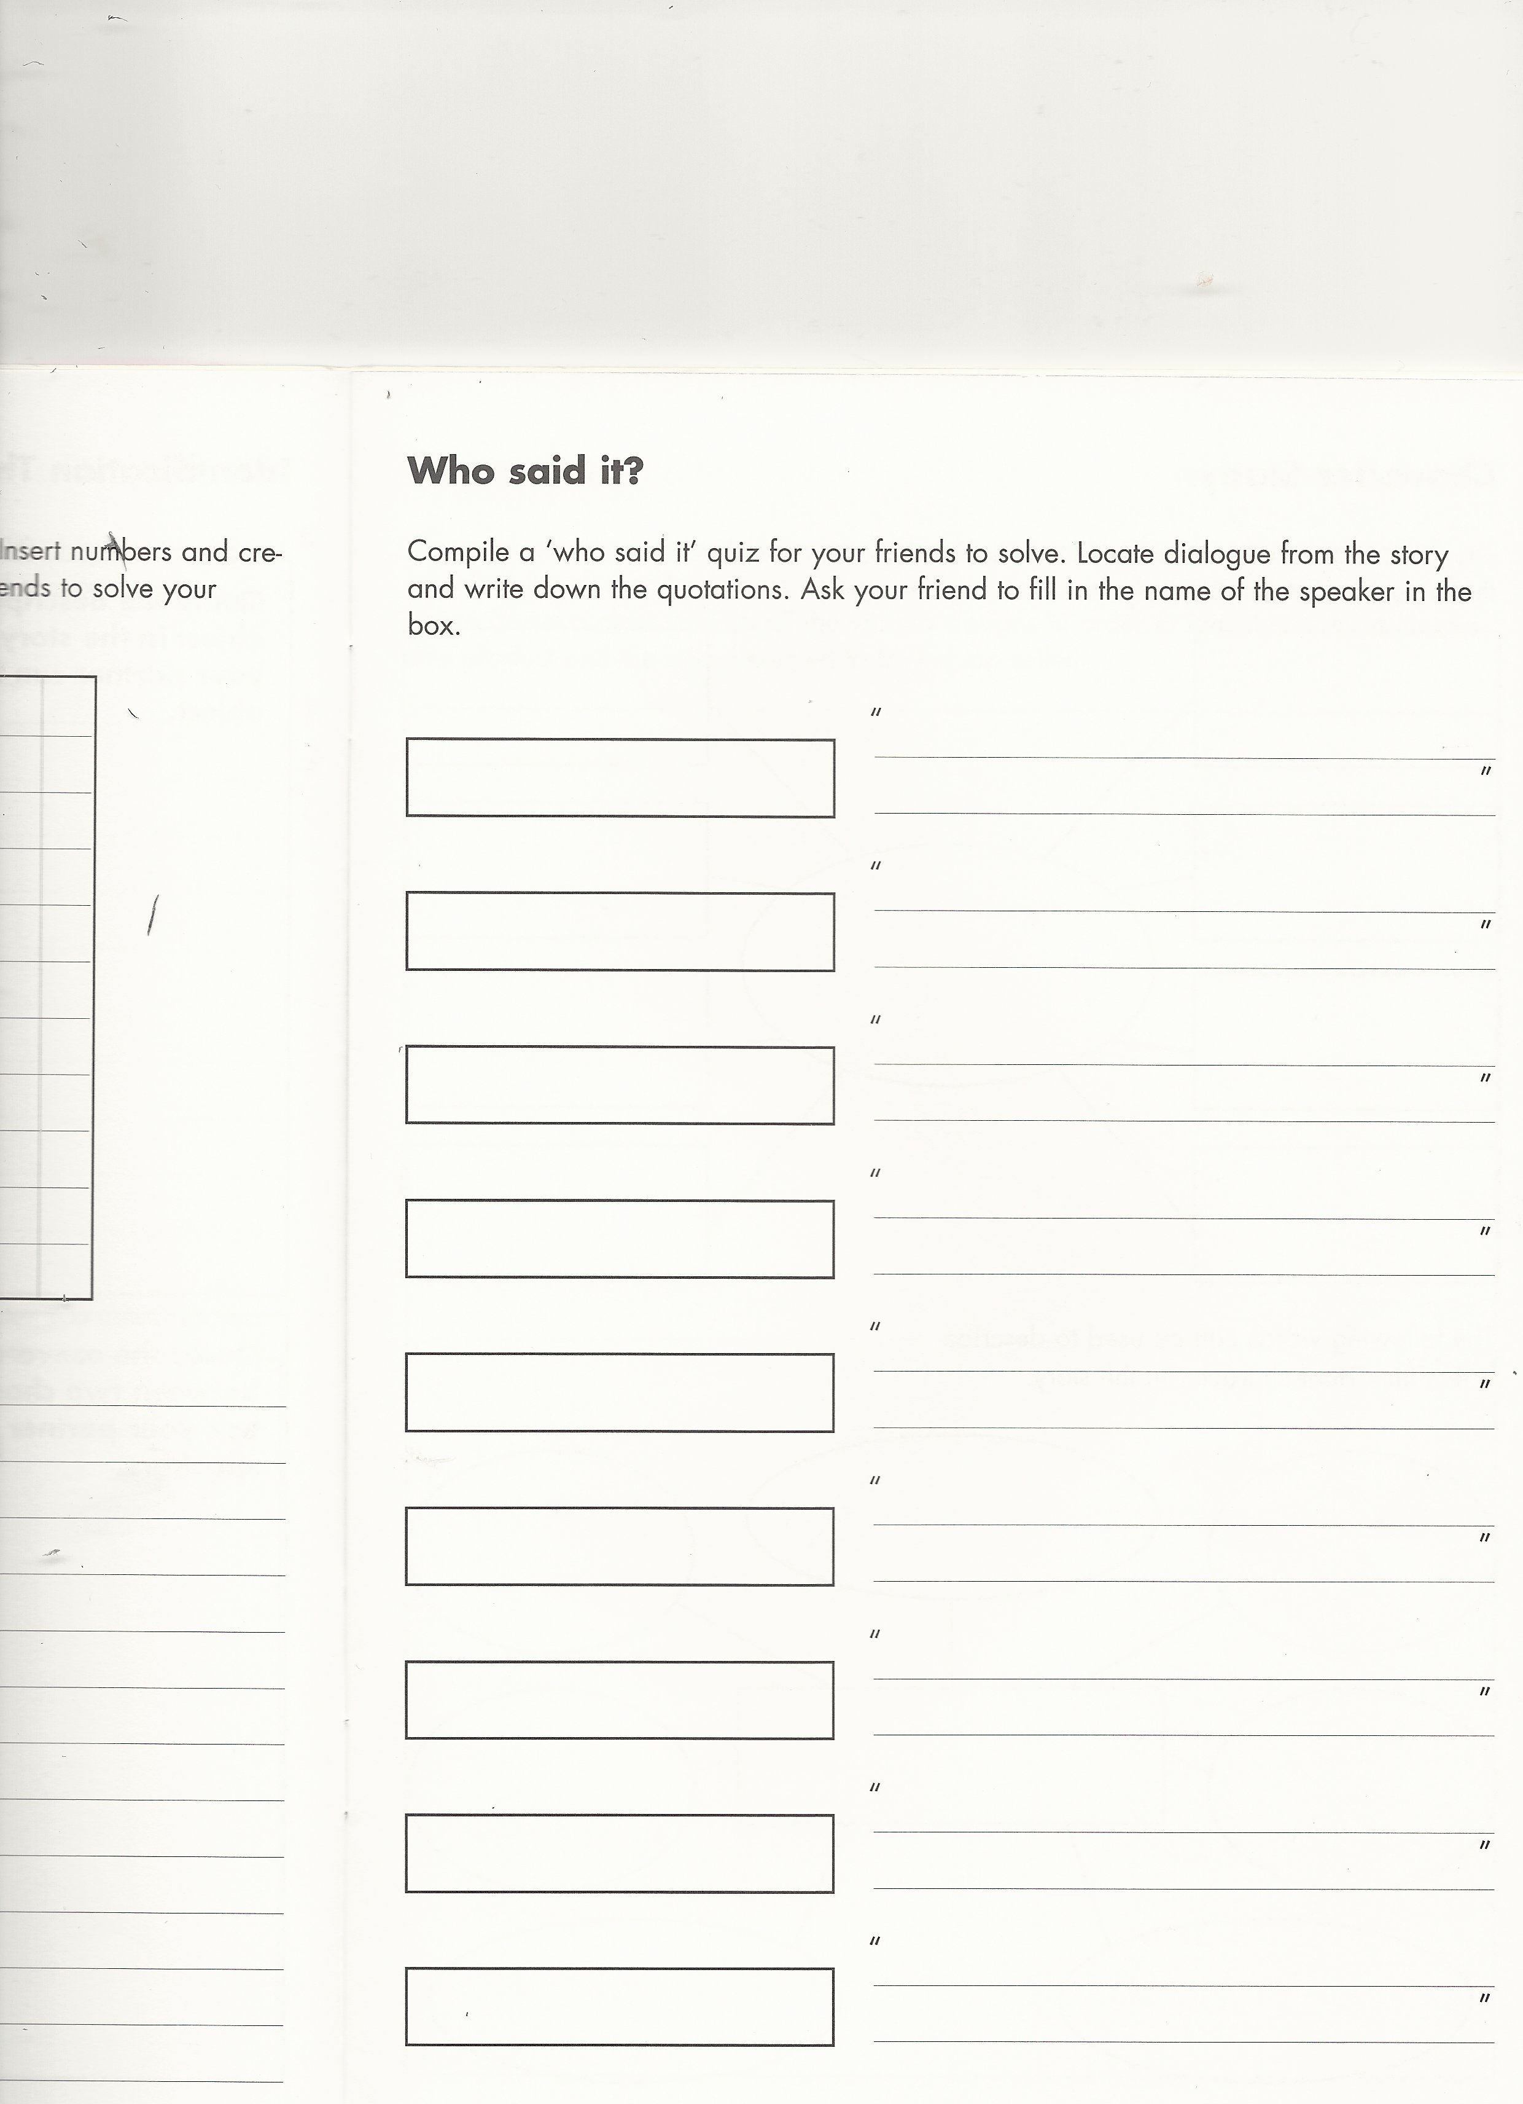

Slide 19
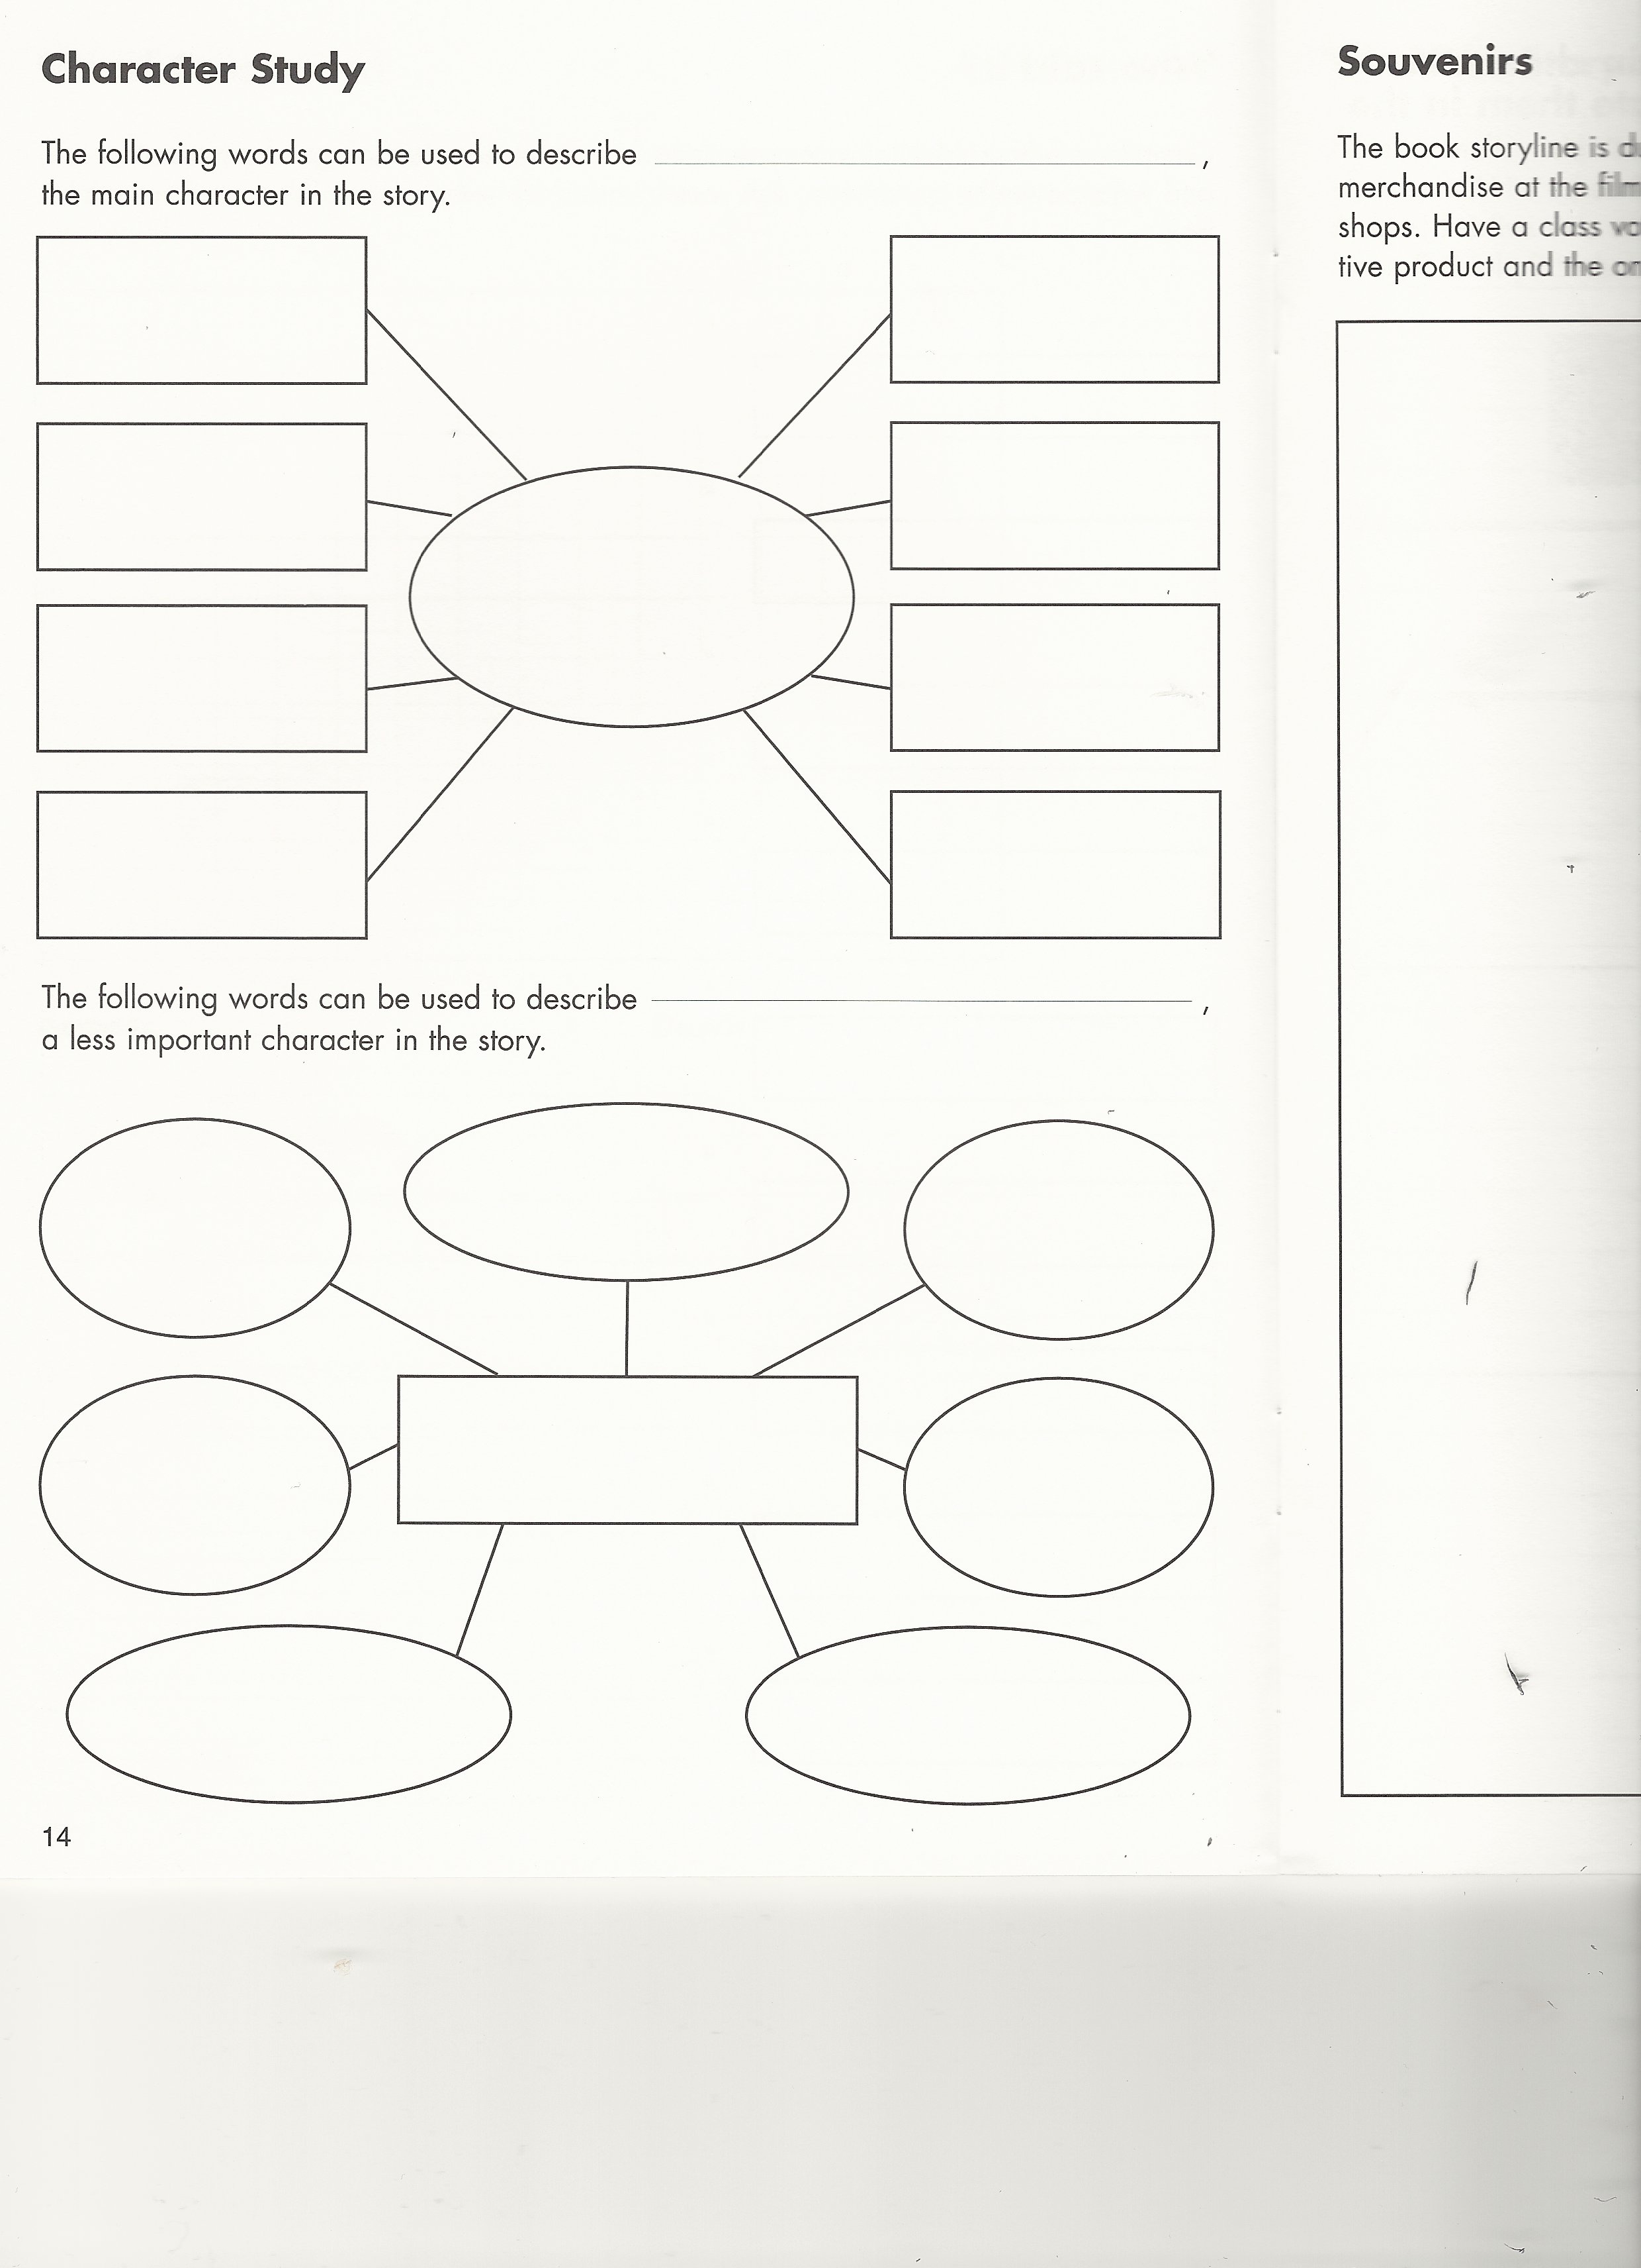

Slide 20
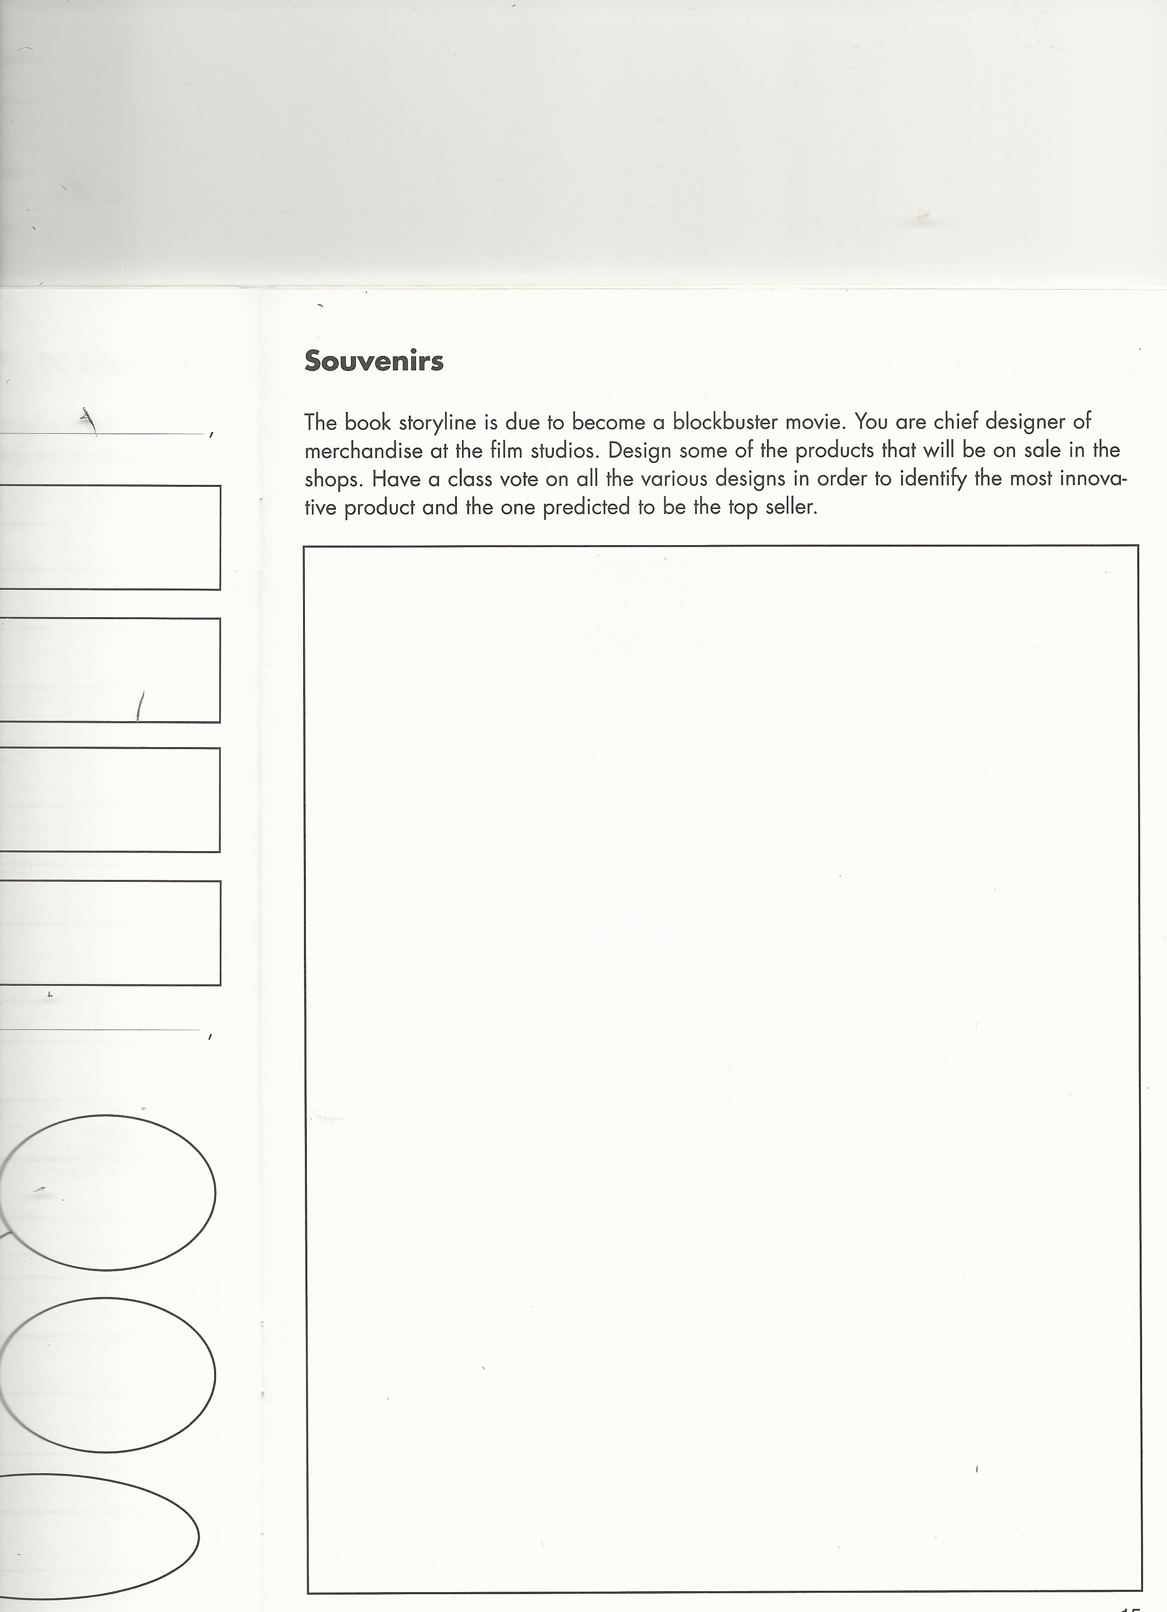

Slide 21
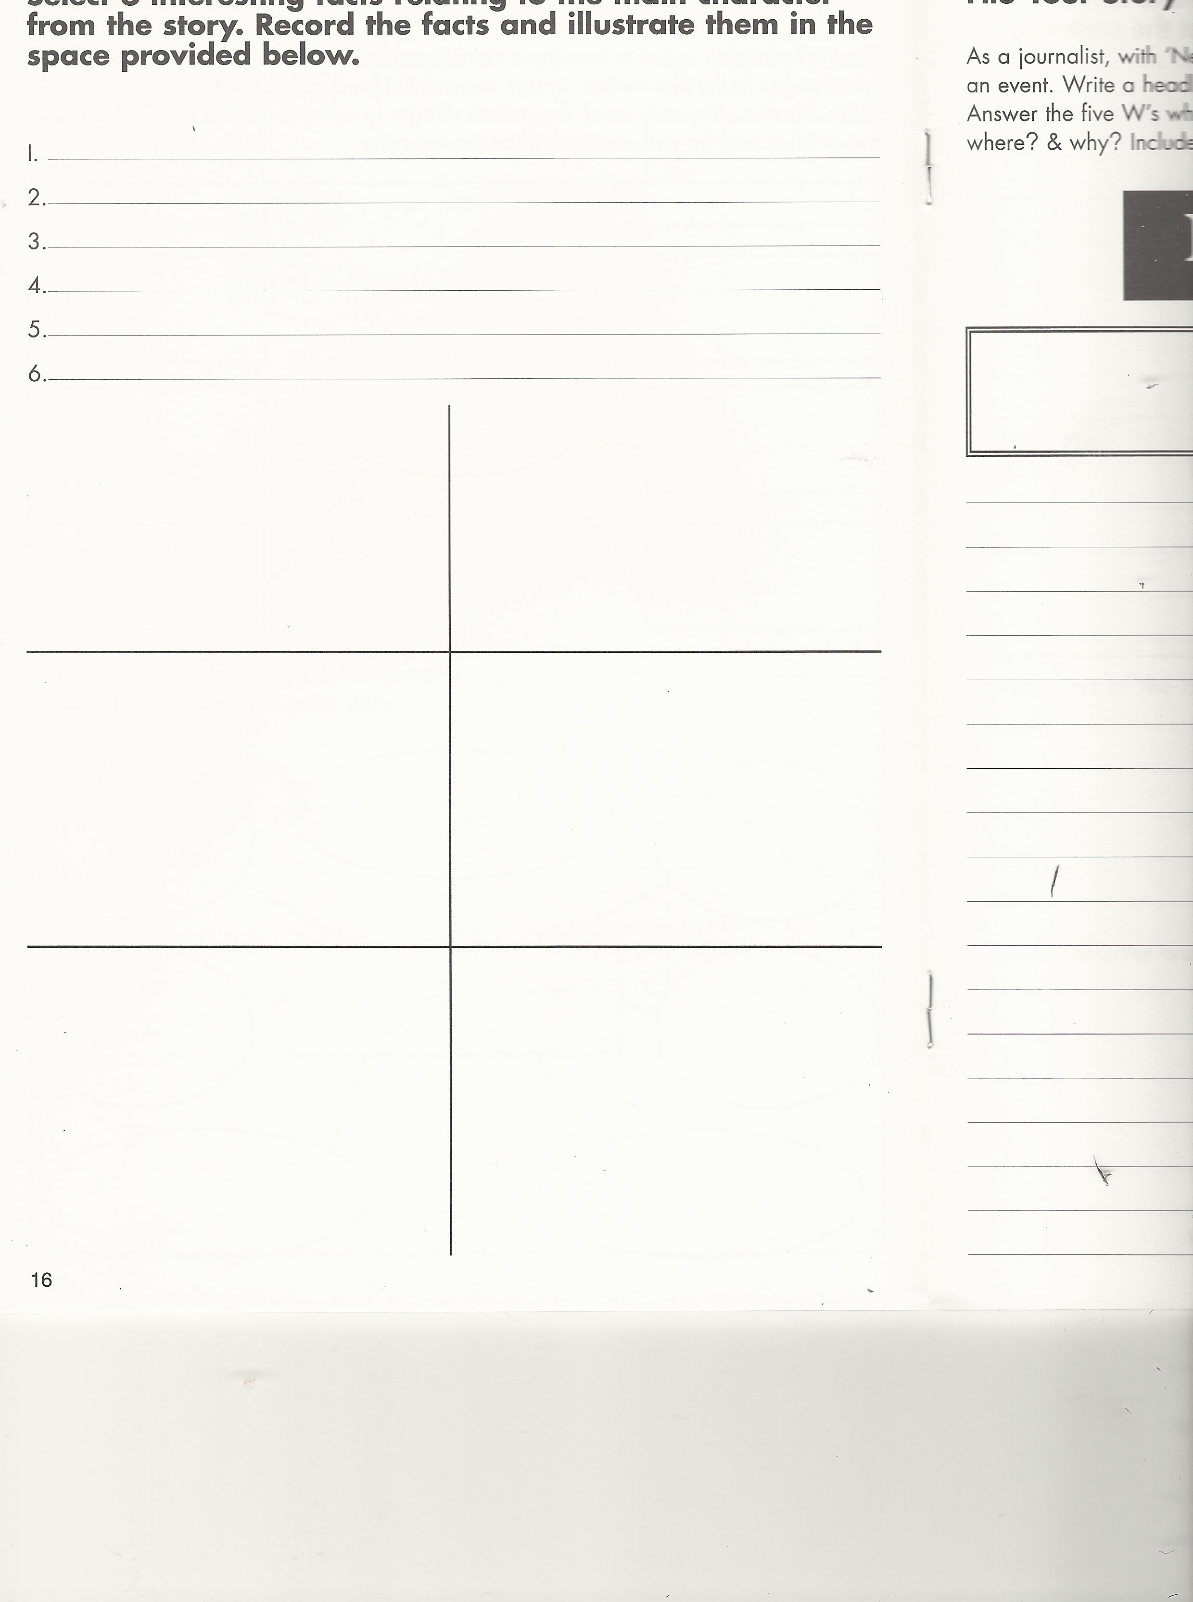

Slide 22
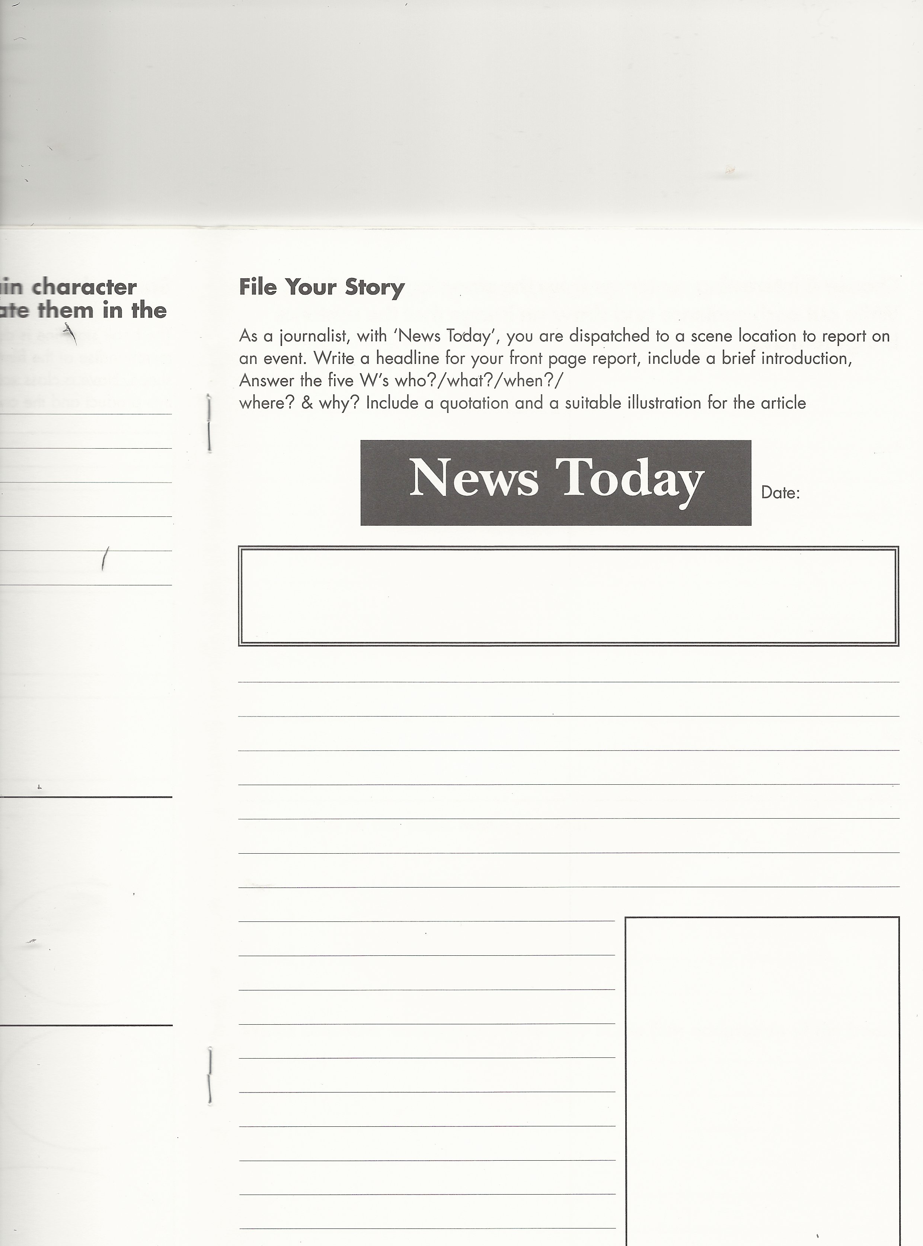

Slide 23
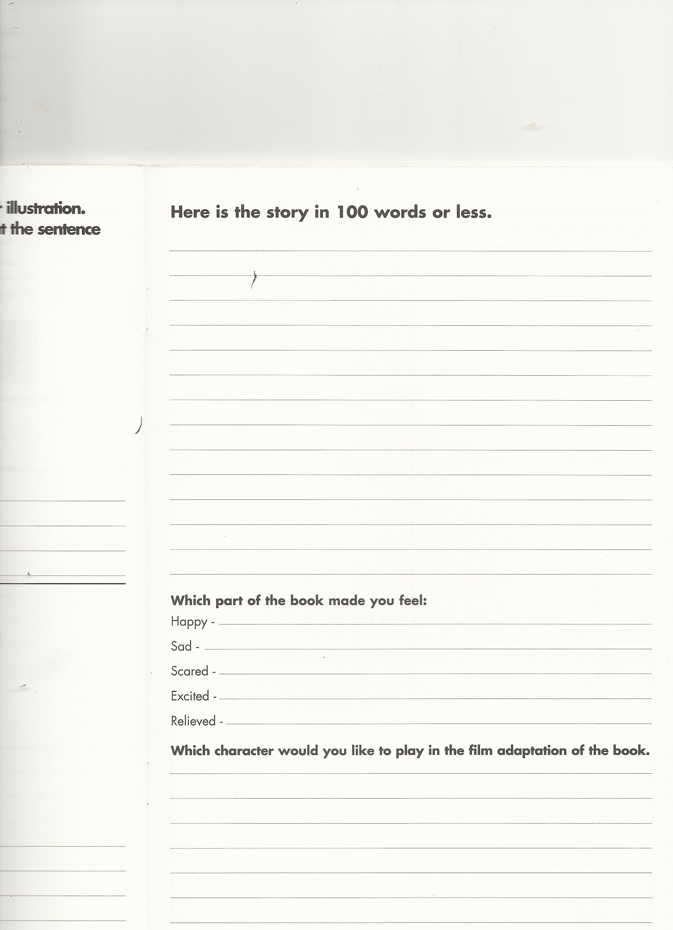

Slide 24
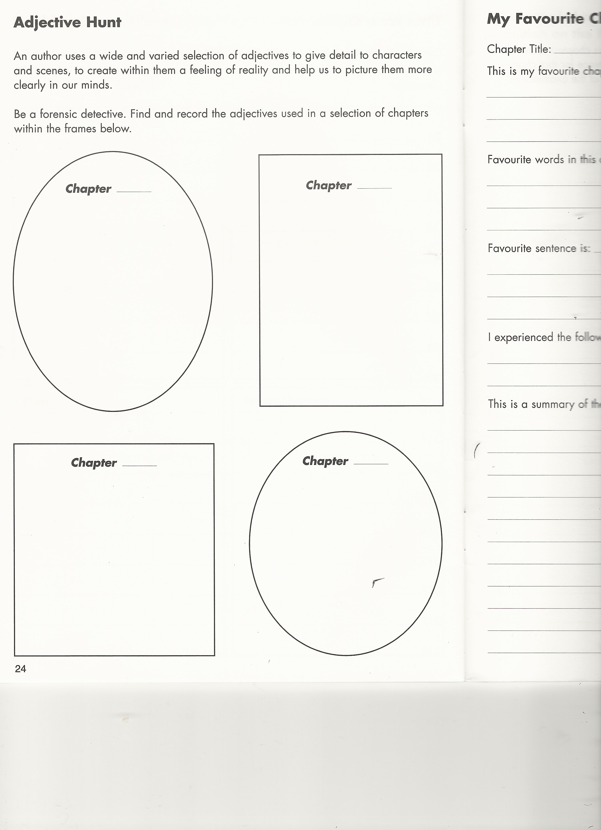

Slide 25
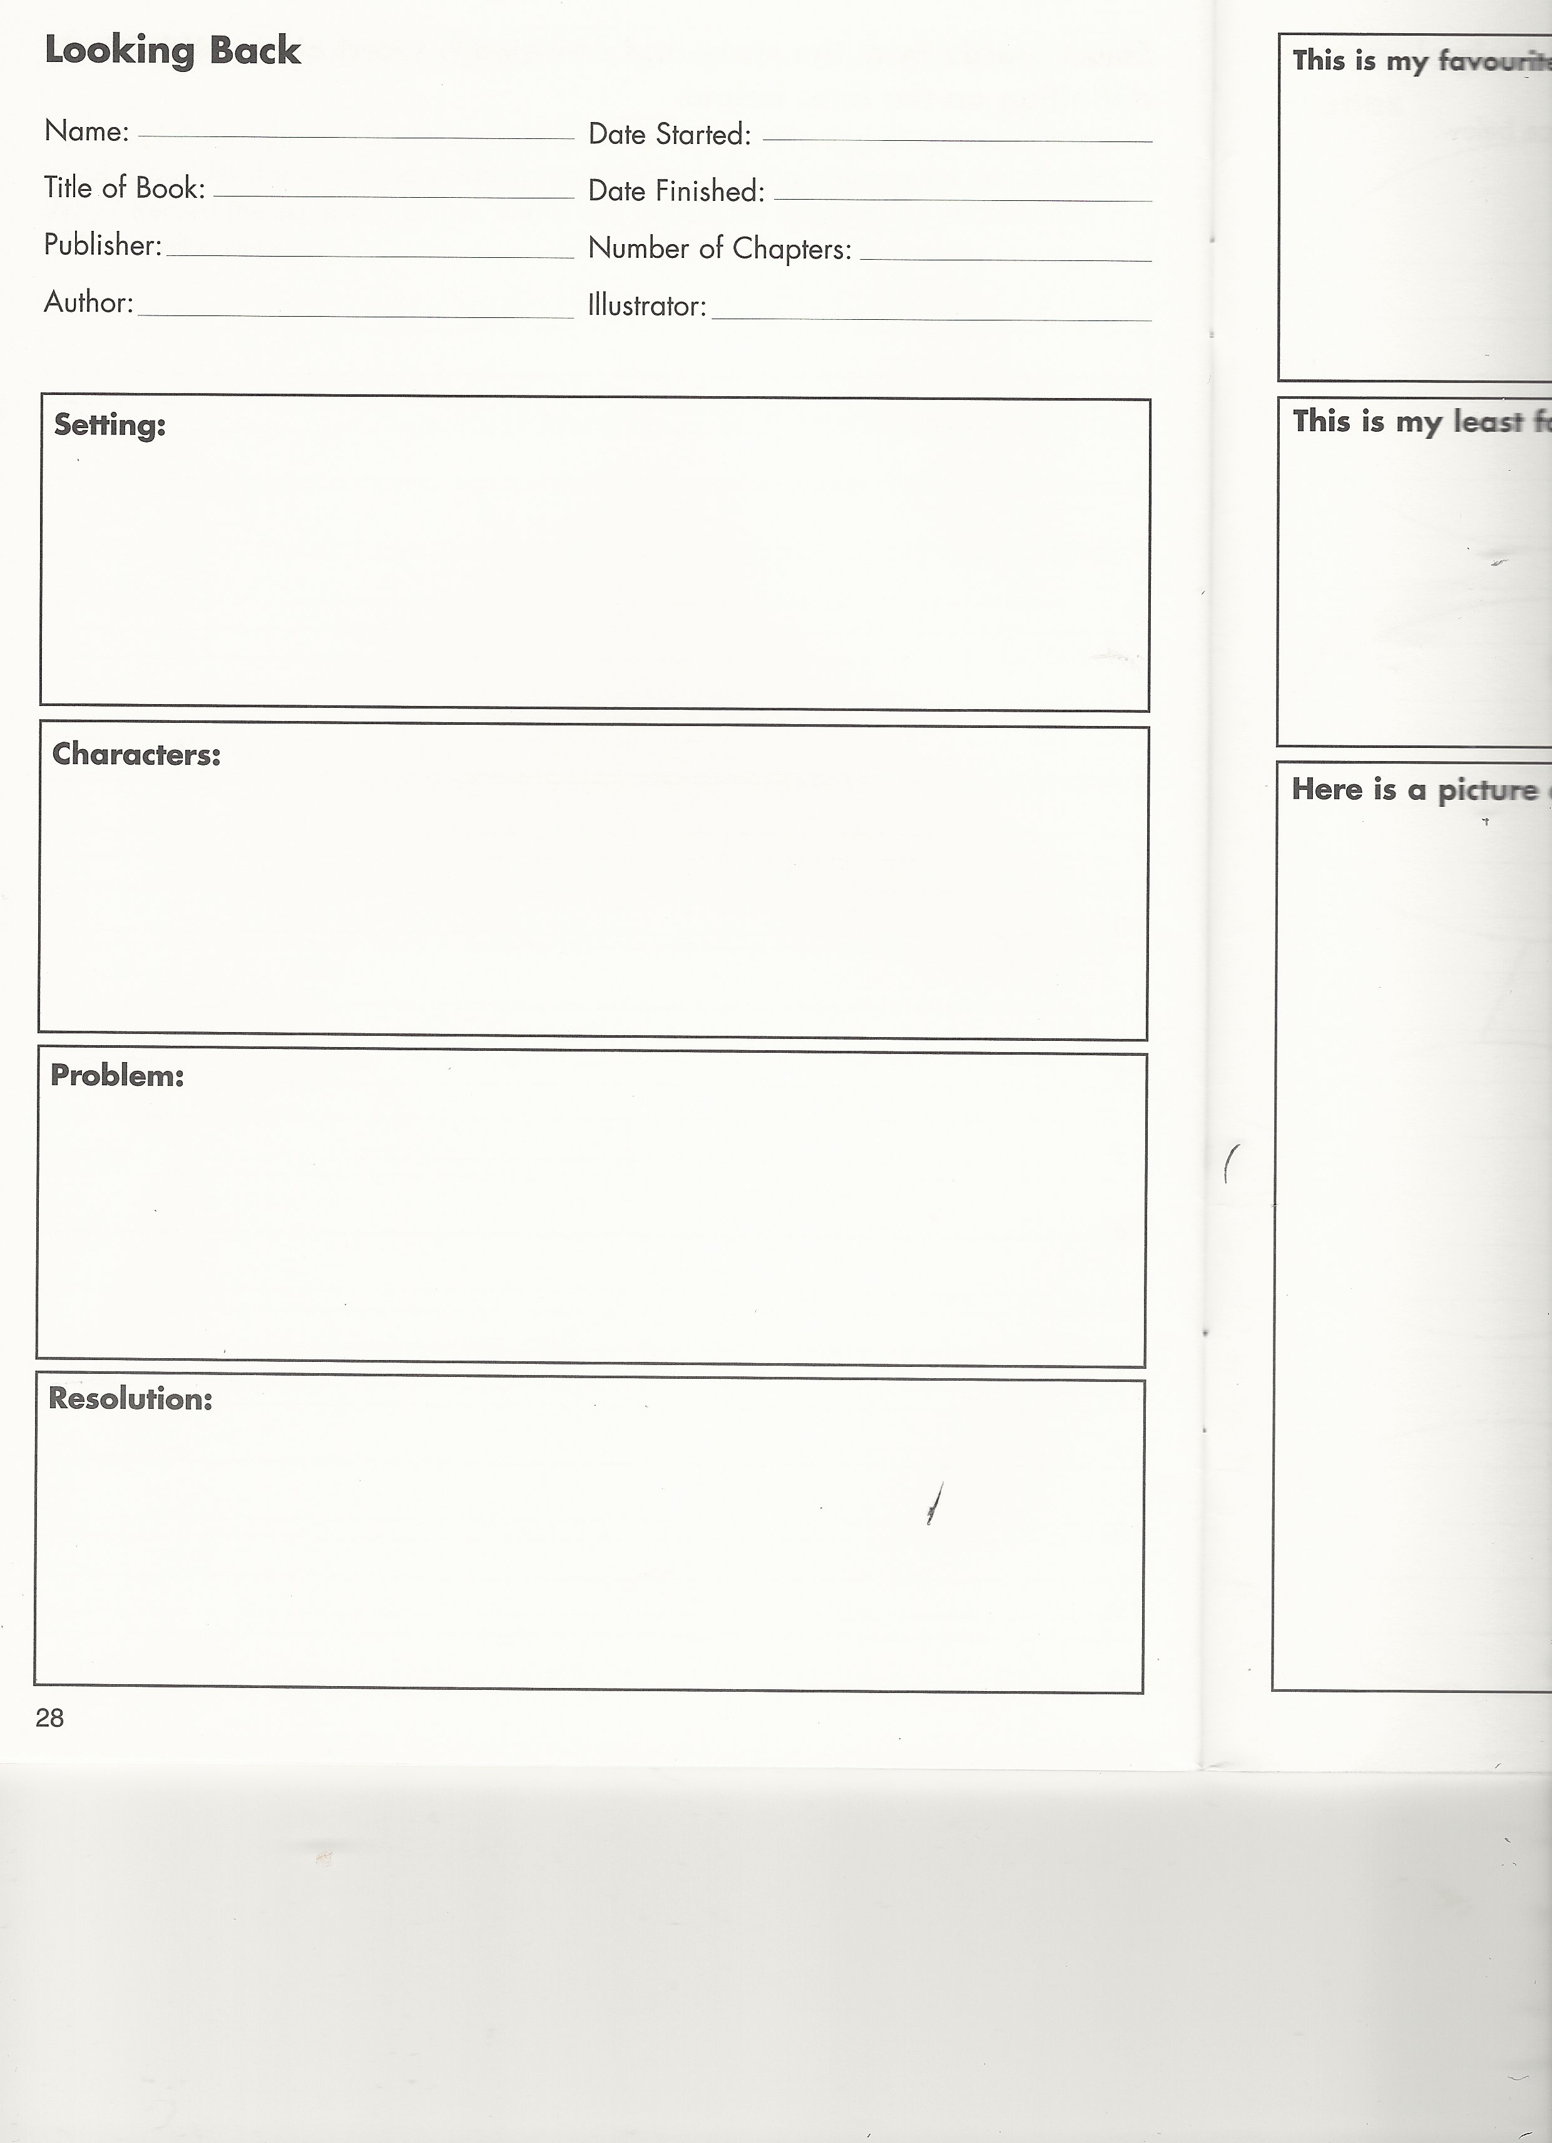

Slide 26
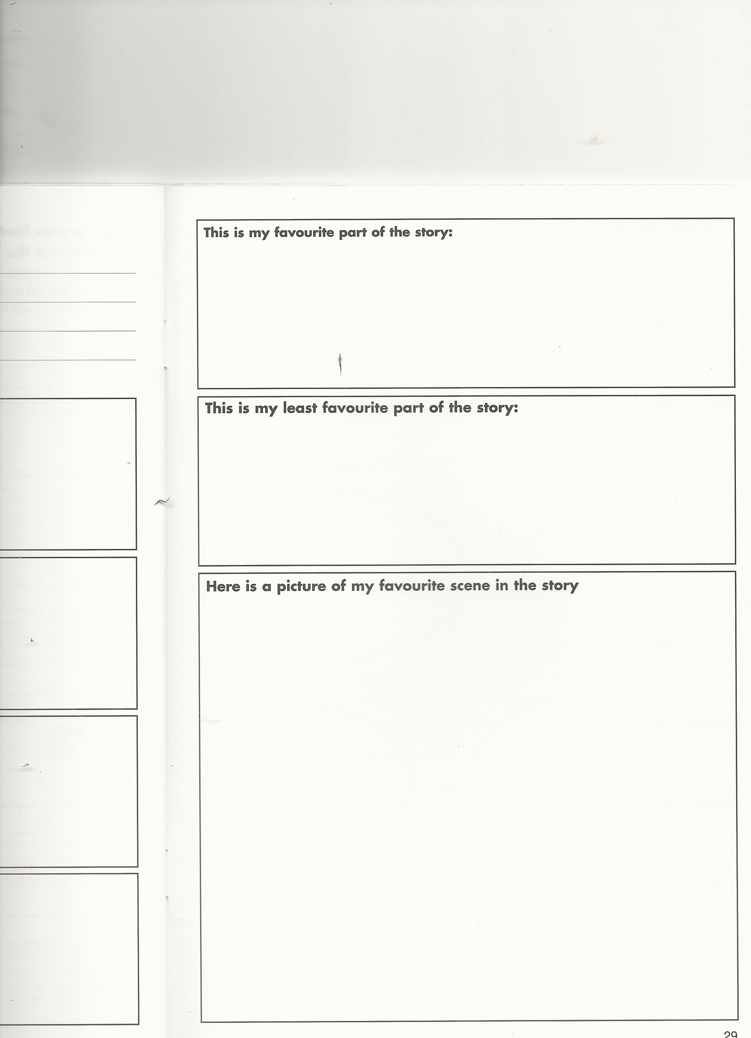

Slide 27
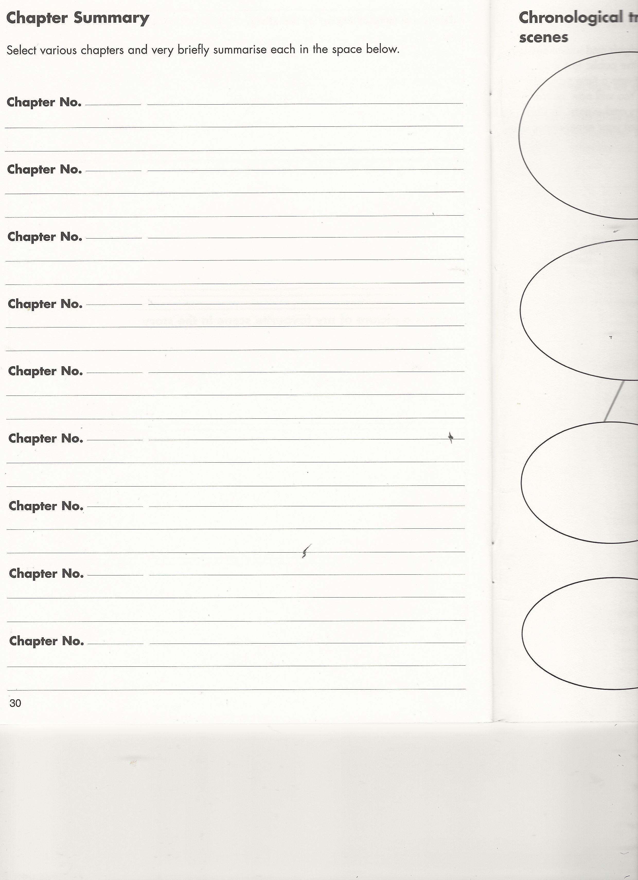

Slide 28
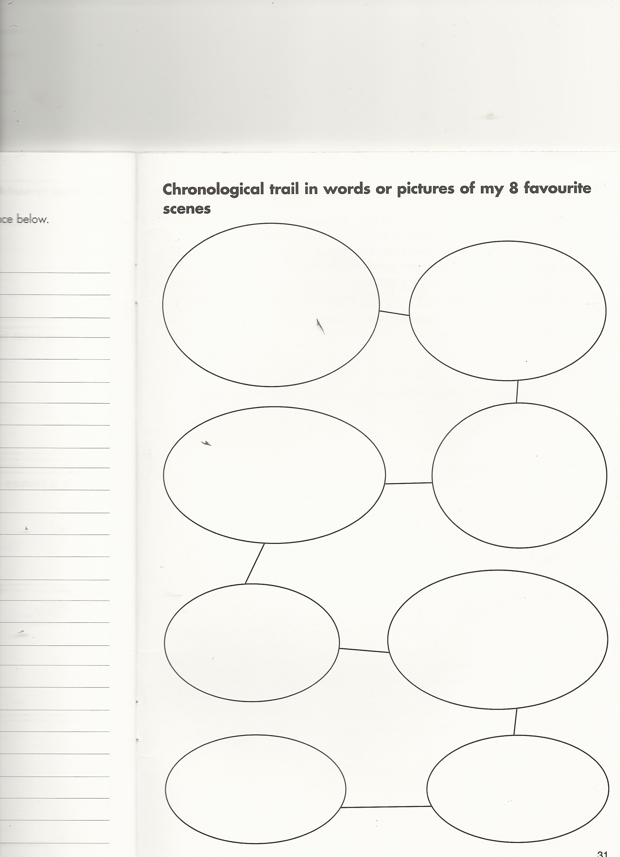

Slide 29
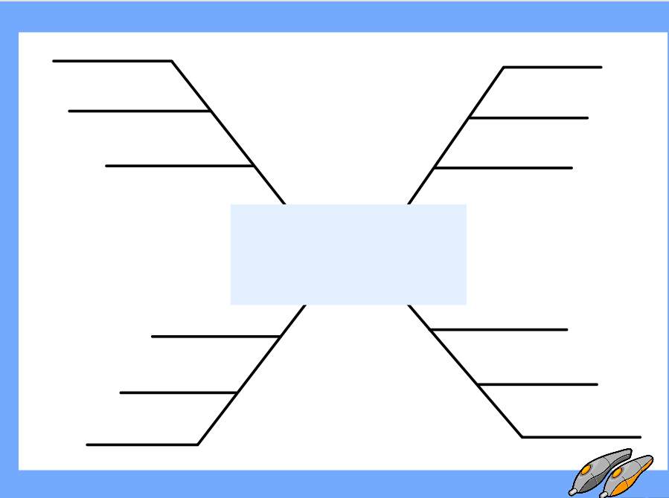

Slide 30
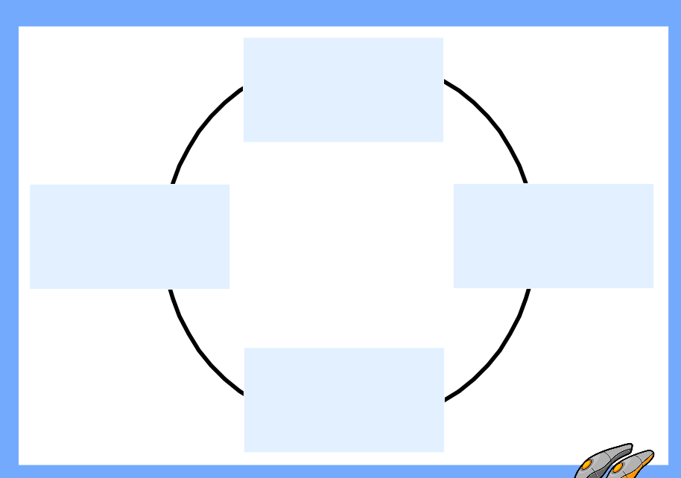

Slide 31
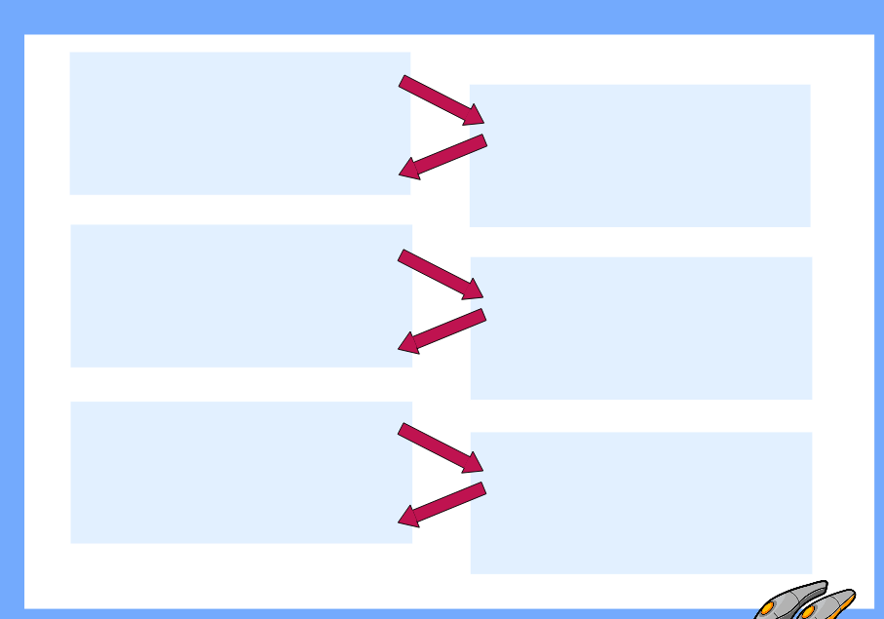

Slide 32
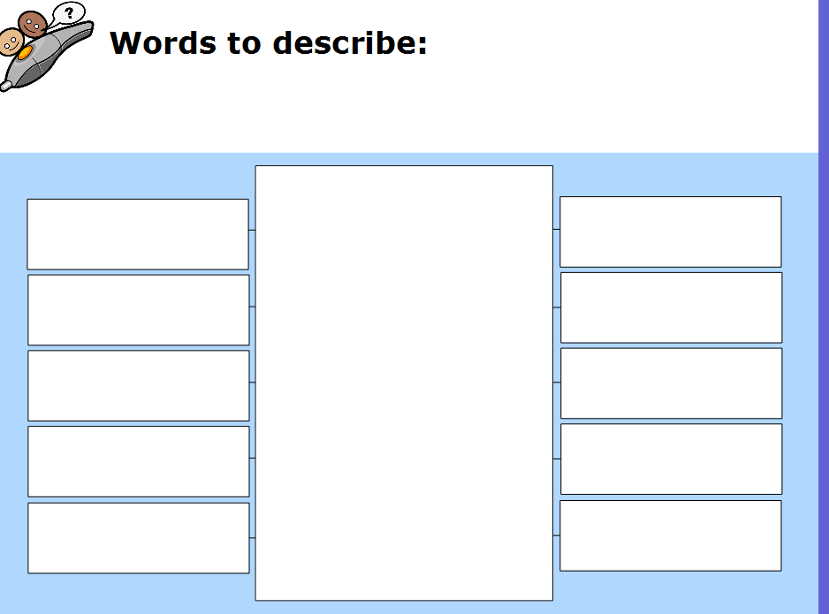

Slide 33
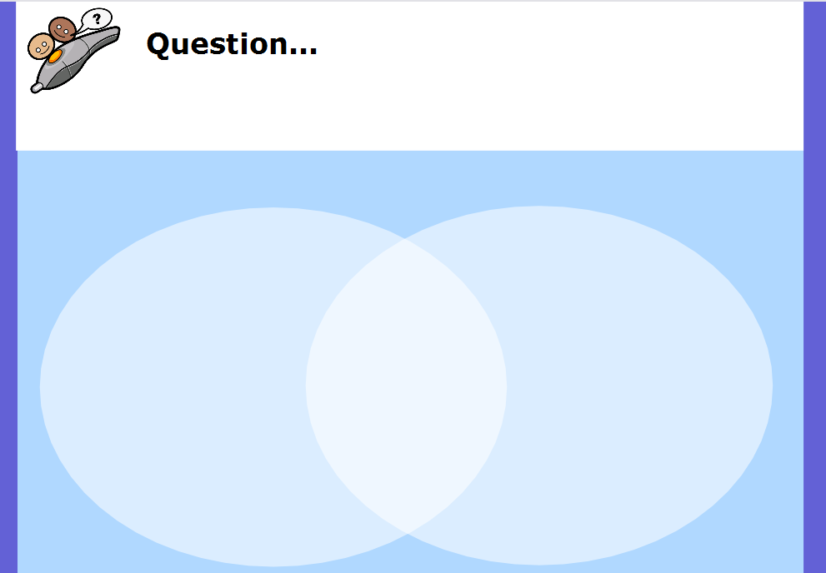

Slide 34
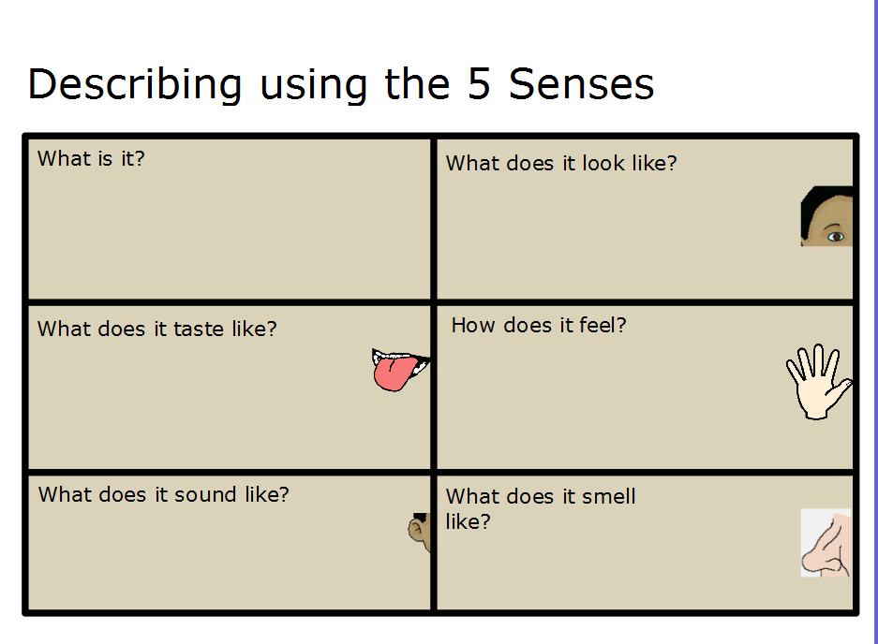

Slide 35
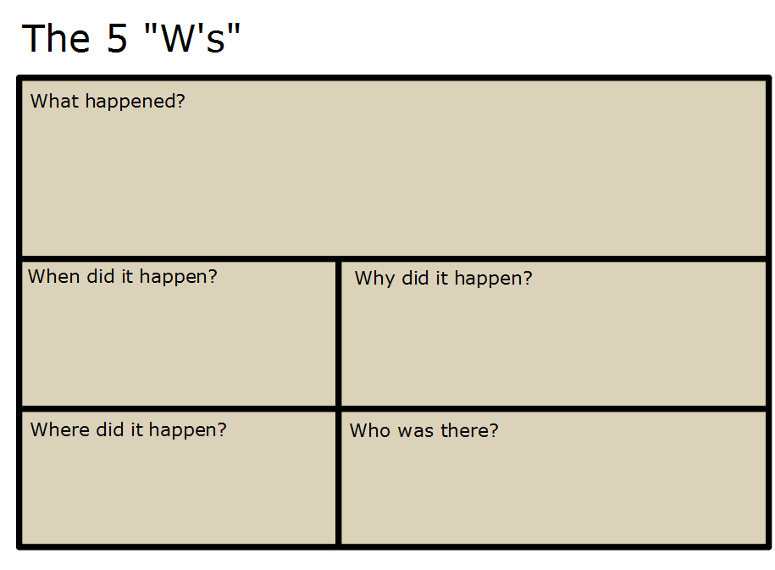

Slide 36
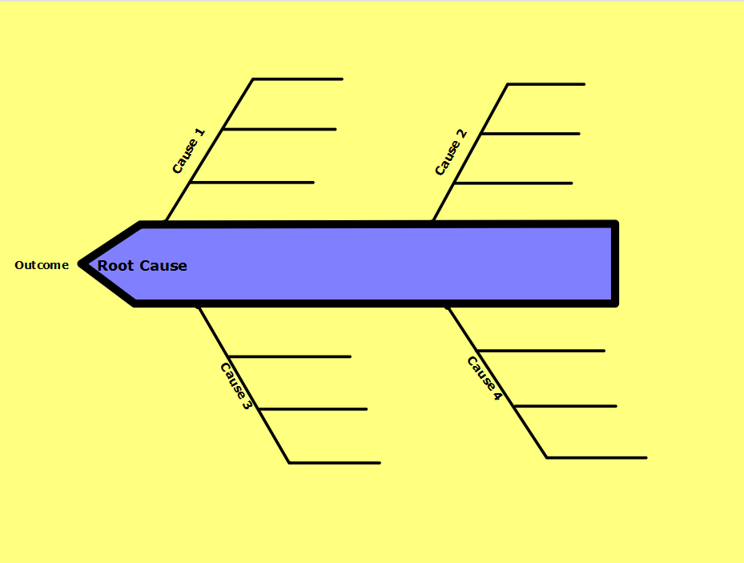

Slide 37
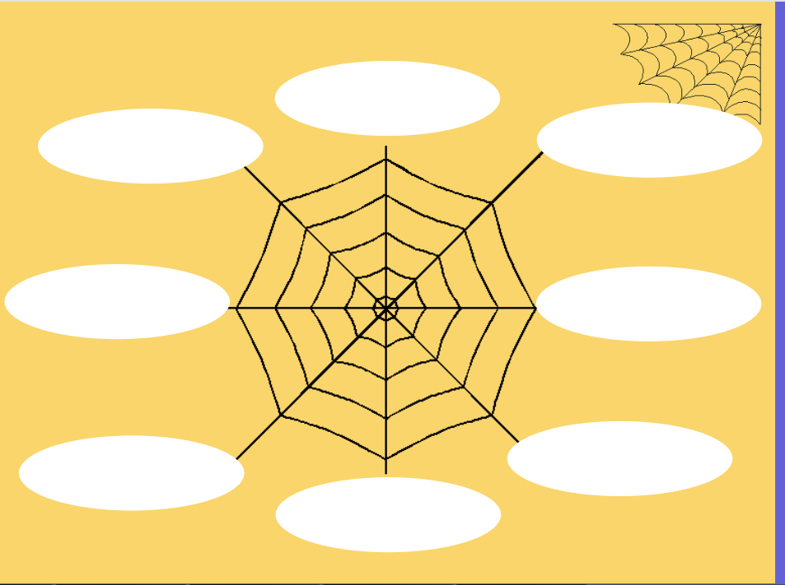

Slide 38
Letter to the author
Newspaper of the time
Dear Diary
Story Map
What if
Write a new ending
Choose a character as a friend
Write a letter to a character
Vocabulary exchange (synonyms)
Plot Events Response Writing
Poster Creator
Bookmark
Letter to the author
Book Sleeve
Comic Strip

Slide 39
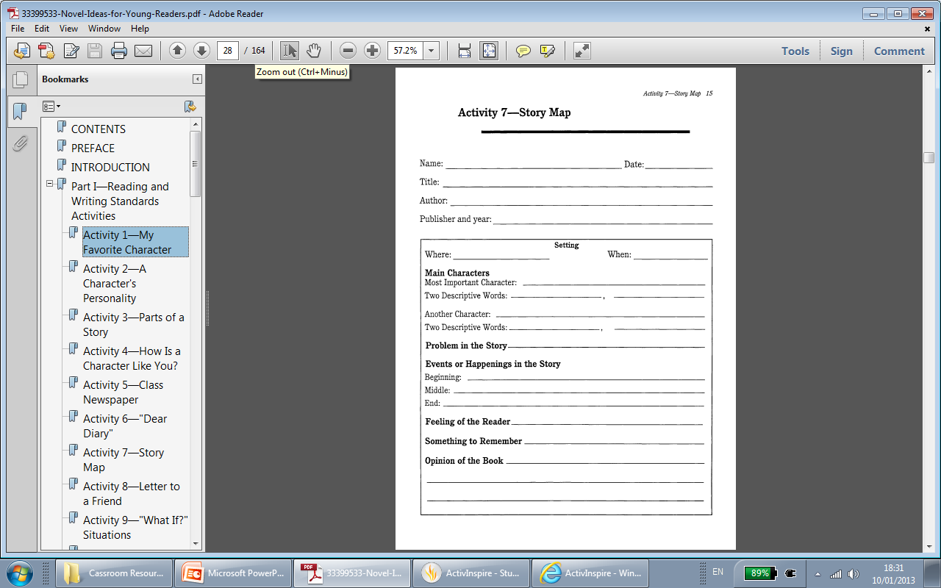

Slide 40
