Slide 1

Rainbow
Colours

Slide 2

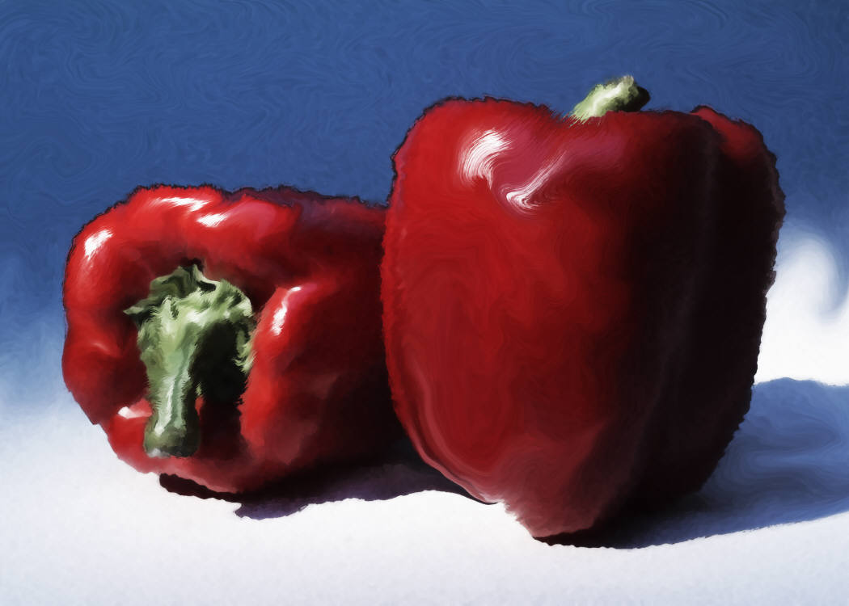


Red

Slide 3



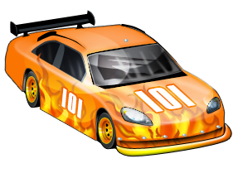
Orange

Slide 4
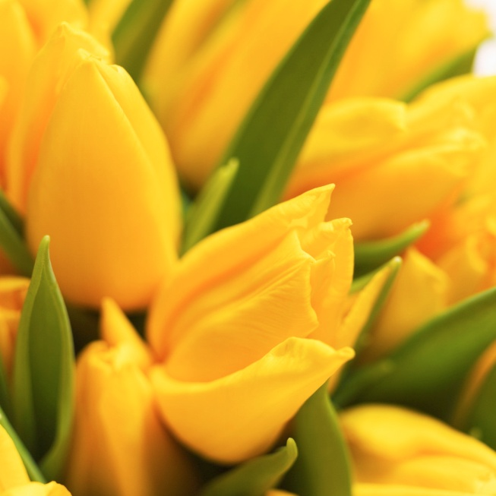




Yellow

Slide 5
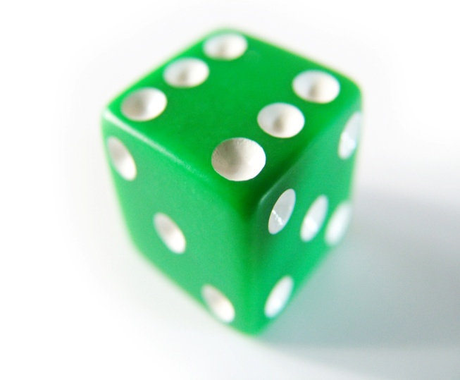

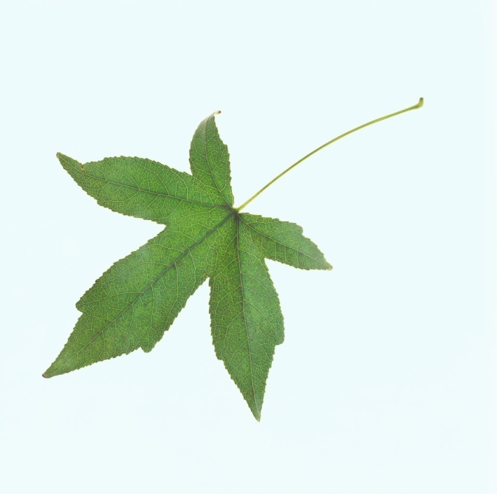

Green

Slide 6
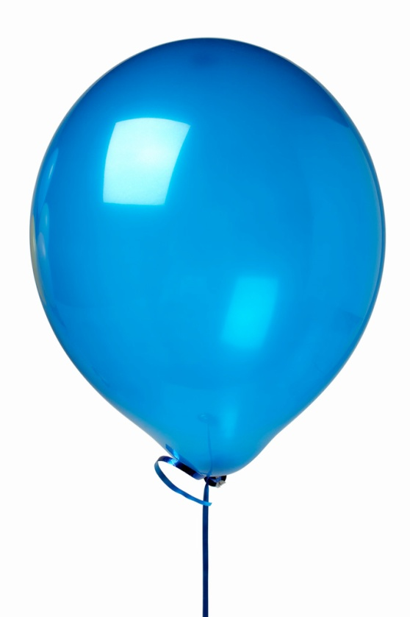



Blue

Slide 7

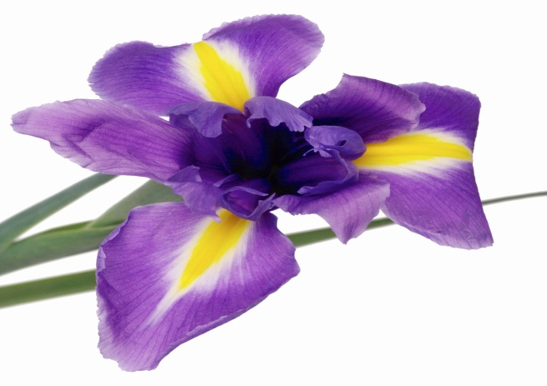




Purple

Slide 8
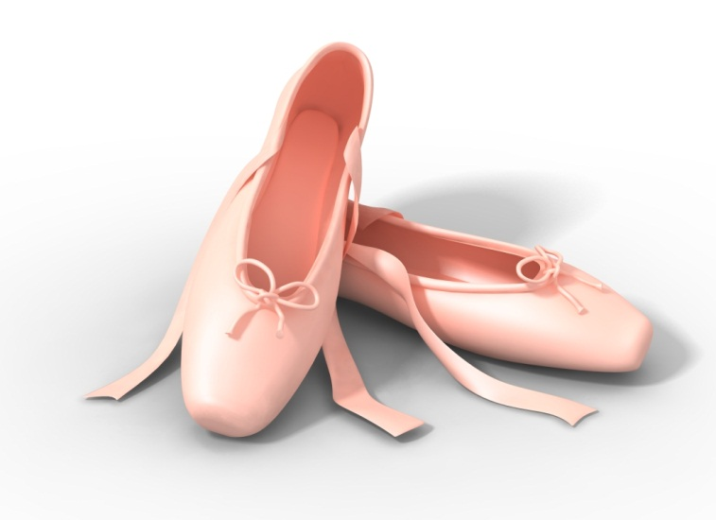

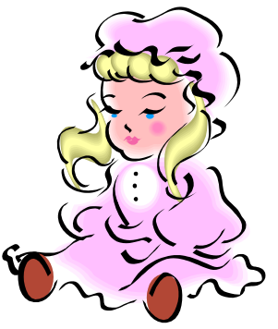


Pink

Slide 9

Are you ready to sing a song?
GREAT BIG RAINBOW
Sung to: "I'm a Little Teapot"
There's a great, big rainbow
In the sky,
With pretty colors
Way up high.
When it starts to rain
And the sun comes out-
A beautiful rainbow
Will pop out!
-Jean Warren

