Slide 1
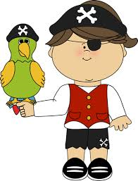
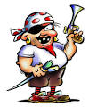
PIRATES !
Pirates, Pirates, Pirates,
________, ________, ________ Pirates.
Pirates , Pirates, Pirates,
_______, _______, _________ Pirates
Pirates, Pirates, Pirates,
______, ________, ________ Pirates
Pirates , Pirates , Pirates

