Slide 1

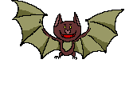

Who Wants To Be A Millionaire?
Halloween Edition

Slide 2
Question 1

Slide 3
How old is Halloween?
^{A} 2000 years
^{B} 600 years
^{C} 6000 years
^{D} 200 years

Slide 4
How old is Halloween?
^{A} 2000 years
^{B} 600 years
^{C} 6000 years
^{D} 200 years

Slide 5
€100

Slide 6
Question 2

Slide 7
What were the first celebrations at Halloween for?
^{A} Witches
^{B} Harvest
^{C} Sweets
^{D} Ghosts

Slide 8
What were the first celebrations at Halloween for?
^{A} Witches
^{B} Harvest
^{C} Sweets
^{D} Ghosts

Slide 9
€200

Slide 10
Question 3

Slide 11
Who were the first people to celebrate Halloween?
^{A} The Normans
^{B} The Saxons
^{C} The Celts
^{D} The Americans

Slide 12
Who were the first people to celebrate Halloween?
^{A} The Normans
^{B} The Saxons
^{C} The Celts
^{D} The Americans

Slide 13
€300

Slide 14
Question 4

Slide 15
When did the Celts have their new year?
^{A} November 1st
^{B} October 31st
^{C} January 1st
^{D} December 31st

Slide 16
When did the Celts have their new year?
^{A} November 1st
^{B} October 31st
^{C} January 1st
^{D} December 31st

Slide 17
€500

Slide 18
Question 5

Slide 19
How many seasons did the Celts have?
^{A} Ten
^{B} Four
^{C} Twelve
^{D} Two

Slide 20
How many seasons did the Celts have?
^{A} Ten
^{B} Four
^{C} Twelve
^{D} Two

Slide 21
€1,000

Slide 22
Question 6

Slide 23
What does “Samhain” mean?
^{A} End of summer
^{B} End of winter
^{C} Hibernating time
^{D} Harvest time

Slide 24
What does “Samhain” mean?
^{A} End of summer
^{B} End of winter
^{C} Hibernating time
^{D} Harvest time

Slide 25
€2,000

Slide 26
Question 7

Slide 27
How many ghosts were in the BOO picture?
^{A} 1
^{B} 2
^{C} 3
^{D} 4

Slide 28
How many ghosts were in the BOO picture?
^{A} 1
^{B} 2
^{C} 3
^{D} 4

Slide 29
€4,000

Slide 30
Question 8

Slide 31
What did Pope Boniface name November 1st ?
^{A} All Holy
^{B} All Harvest
^{C} All Souls
^{D} All Saints

Slide 32
What did Pope Boniface name November 1st ?
^{A} All Holy
^{B} All Harvest
^{C} All Souls
^{D} All Saints

Slide 33
€8,000

Slide 34
Question 9

Slide 35
What was standing at the door of the trick or treat house?
^{A} Ghost
^{B} Witch
^{C} Frankenstein
^{D} Vampire

Slide 36
What was standing at the door of the trick or treat house?
^{A} Ghost
^{B} Witch
^{C} Frankenstein
^{D} Vampire

Slide 37
€16,000

Slide 38
Question 10

Slide 39
Why did people first wear costumes at Halloween?
^{A} To have fun
^{B} To get sweets
^{C} To trick people
^{D} To fool ghosts

Slide 40
Why did people first wear costumes at Halloween?
^{A} To have fun
^{B} To get sweets
^{C} To trick people
^{D} To fool ghosts

Slide 41
€32,000

Slide 42
Question 11

Slide 43
What did people leave outside their homes?
^{A} Food
^{B} Gifts
^{C} Costumes
^{D} Flowers

Slide 44
What did people leave outside their homes?
^{A} Food
^{B} Gifts
^{C} Costumes
^{D} Flowers

Slide 45
€64,000

Slide 46
Question 12

Slide 47
What did people believe spirits did on Halloween?
^{A} Dress up
^{B} Haunt houses
^{C} Possess people
^{D} Eat food

Slide 48
What did people believe spirits did on Halloween?
^{A} Dress up
^{B} Haunt houses
^{C} Possess people
^{D} Eat food

Slide 49
€125,000

Slide 50
Question 13

Slide 51
How many dogs were dressed up?
^{A} 4
^{B} 5
^{C} 6
^{D} 3

Slide 52
How many dogs were dressed up?
^{A} 4
^{B} 5
^{C} 6
^{D} 3

Slide 53
€250,000

Slide 54
Question 14

Slide 55
What was the name of the Irish Trickster?
^{A} Stringy Jack
^{B} Stingy Jack
^{C} Stinging Jack
^{D} Sticky Jack

Slide 56
What was the name of the Irish Trickster?
^{A} Stringy Jack
^{B} Stingy Jack
^{C} Stinging Jack
^{D} Sticky Jack

Slide 57
€500,000

Slide 58
Question 15

Slide 59
What were the original Jack o’ lanterns made with?
^{A} Pumpkins
^{B} Apples
^{C} Peppers
^{D} Turnips

Slide 60
What were the original Jack o’ lanterns made with?
^{A} Pumpkins
^{B} Apples
^{C} Peppers
^{D} Turnips

Slide 61
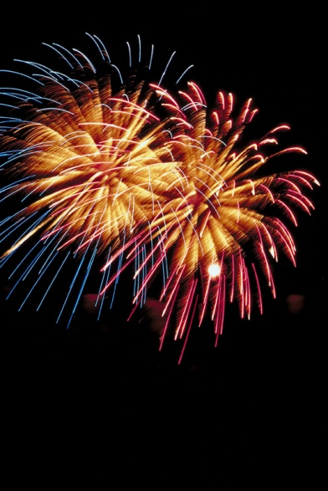
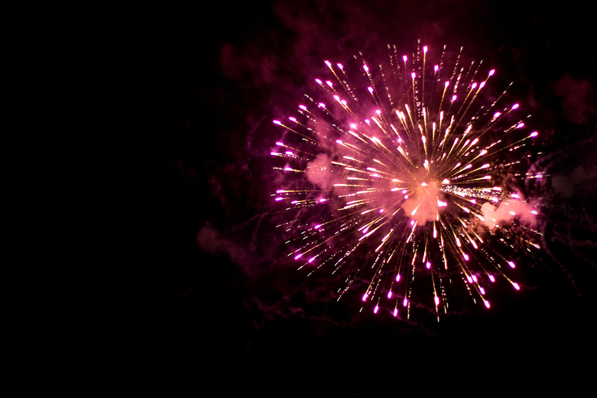

€1,000,000

Slide 62
