Slide 1
Compound word
game
By Paul Kenny
Notes:
Click on “You Choose a Name” & then on the WordArt toolbar, click on Edit Text. It could be Science Jeopardy or Social Studies Jeopardy…or whatever.

Slide 2
Rules
20 points for each right answer
10 points to be taken away for wrong answers
Notes:
You can revise this section. Think about which rules you want to use before you play. Revise the rules accordingly. Don’t move past this screen until the team names & buzzer sounds are decided. Decide who keeps score & who is the judge.

Slide 3
At the Park
The area of the park for children is called the ____________.
Notes:
Change “Category 1” for the Category you’ve chosen on the previous slide. Then Click & Drag to select “Type your question(answer) here.” Type the new text.

Slide 4
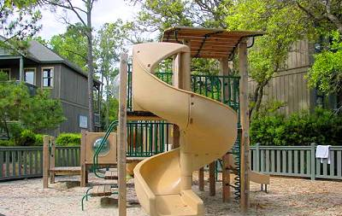
At the Park
playground
Notes:
Change out Category 1 for the category you’ve chosen. Change out the Answer above with the correct answer. Double-click on left to add clipart to your page. Click on the U (action button) to take you back to the game board. It’s important to click on this to take you back…otherwise you go to the next slide.

Slide 5
At the Park
A place where children might take a bucket and shovel to play.

Slide 6
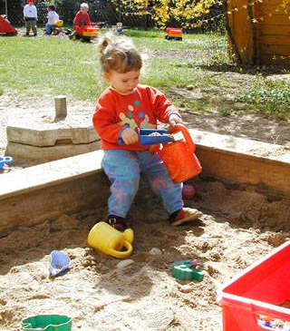
At the Park
A sandbox

Slide 7
At the Park
A path for people to stay off of the grass.

Slide 8
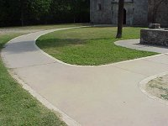
At the Park
A footpath

Slide 9
At the Park
Children sit on a board that goes up and down.

Slide 10
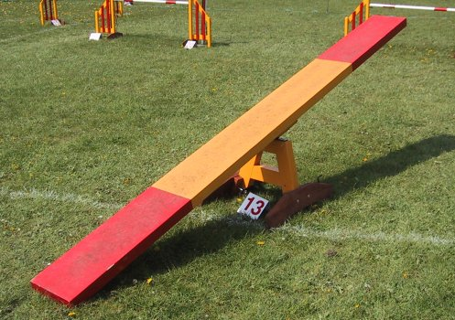
At the Park
A seesaw

Slide 11
At the Park
A game children might play with a stone and chalked squares on the ground that they have to jump into.

Slide 12
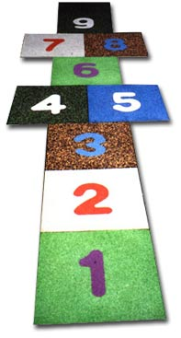
At the Park
hopscotch

Slide 13
Around the House
When the electricity goes off in your house, you may eat by this.

Slide 14

Around the House
candlelight

Slide 15
Around the House
This makes a sound that lets people know that they have company.

Slide 16

Around the House
A doorbell

Slide 17
Around the House -
An area in a house that has a mantel piece.

Slide 18
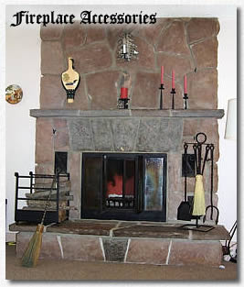
Around the house
A fireplace

Slide 19
Food
People eat this most at the movies.
I like mine with butter!

Slide 20

Food
popcorn

Slide 21
Food
A large green fruit that is full of seeds.

Slide 22
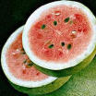
Food
a watermelon

Slide 23
Food
A flat food served with butter, lemon or sugar on it.

Slide 24

Food
a pancake

Slide 25
At the Beach
Collect these along the beach early in the morning.

Slide 26
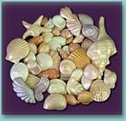
At the Beach
seashells

Slide 27
At the Beach
You must be very athletic to stand on one of these on the waves.

Slide 28
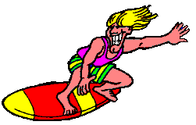
At the Beach
a surfboard

Slide 29
Around the House
This is where you sleep.

Slide 30
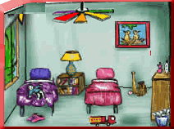
Around the House
a bedroom

Slide 31
Around the House
A place to pack clothes when you are going on a trip.

Slide 32

Around the House
a suitcase

Slide 33
Sports
The sport that you play with a small light ball.

Slide 34
Sports
Tabletennis

Slide 35
Sports
When a baseball player hits the ball out of the field it’s called what?

Slide 36
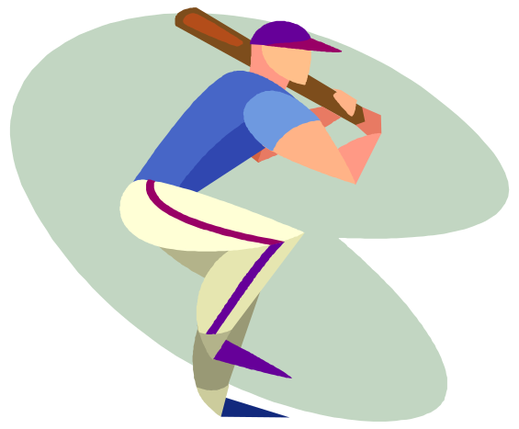
Sports - for 100
a homerun

Slide 37
Sports
A sport where a large soft white ball is bumped and set over a net is called?

Slide 38
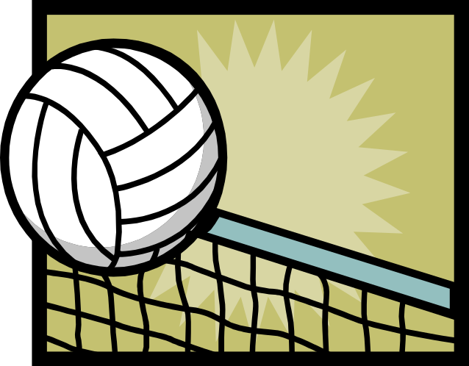
Sports
volleyball

Slide 39
Sports
Players on your team are called your ____________.

Slide 40
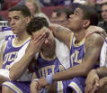
Sports
teammates

