Slide 1
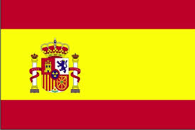
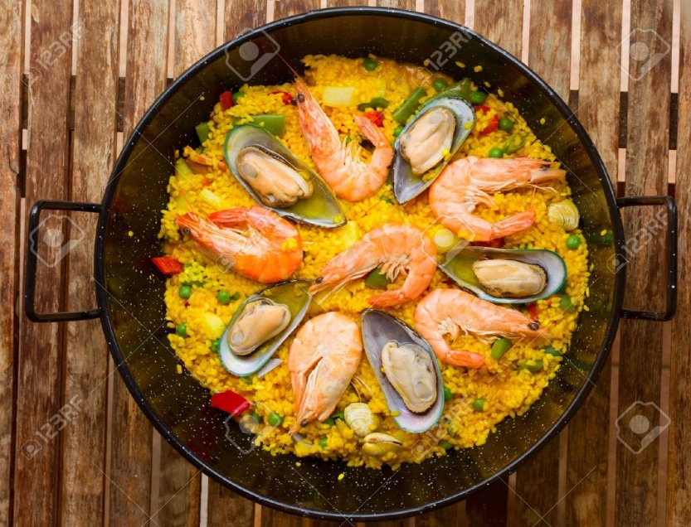
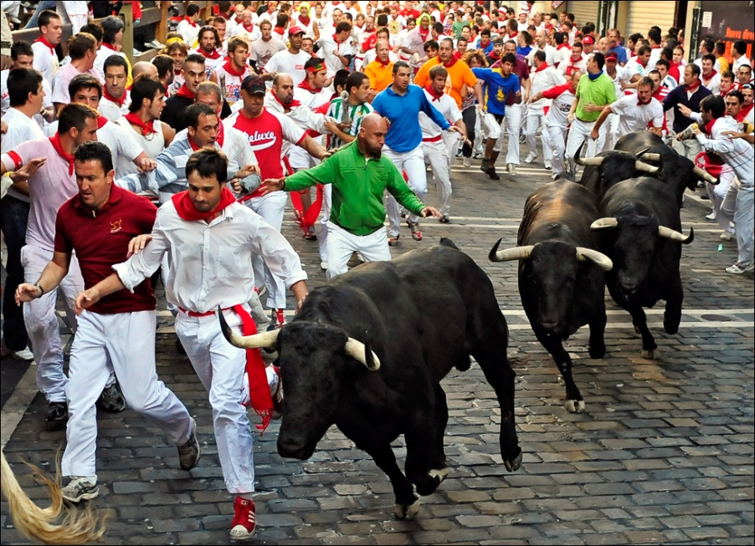
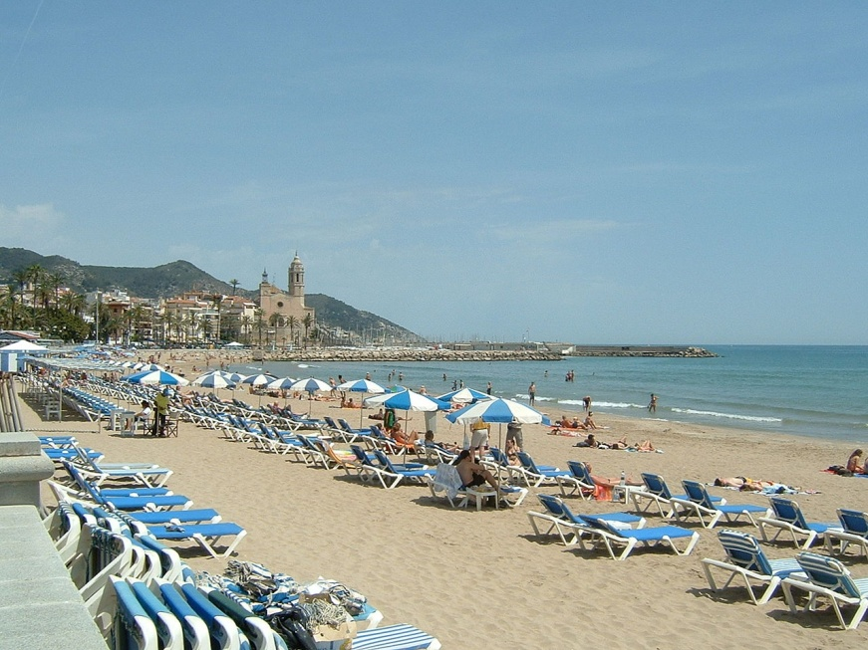
Spain

Slide 2
K W L
Discuss and make note in your copies.

Slide 3
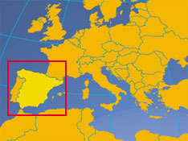
Where is Spain located?
Spain is a country in Europe. It is bordered by Portugal and France.

Slide 4
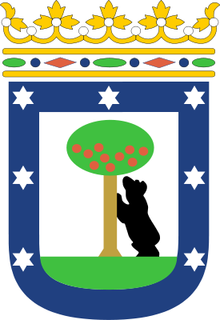
Spain’s Capital.
The capital city of Spain is Madrid. It is the largest city of Spain and is built on the River Manzanares. The symbol of Madrid is 'a bear eating from a strawberry tree'.

Slide 5
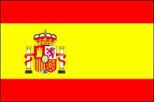
The Spanish flag
The Spanish flag has three horizontal stripes: red, yellow and red.
The meaning of the two colours of the flag of Spain could be:
- Yellow - symbol of generosity
- Red – symbol of bravery or strength.

Slide 6
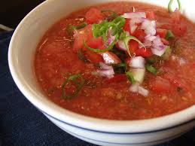
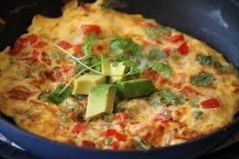
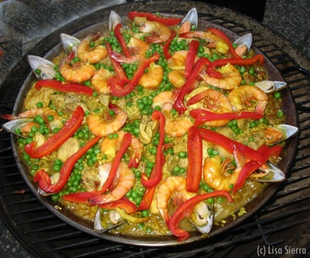
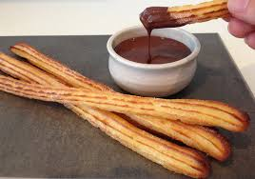
Some Spanish food.
Gazpacho
Spanish Omlette
Paella
Churros

Slide 7
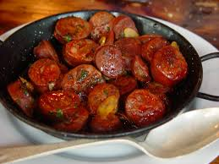
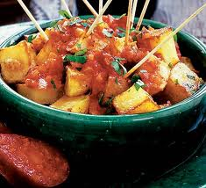
Chorizo- Spanish sausage
Patata Bravas

Slide 8
Eating in Spain.
Spanish people eat many times throughout the day.
Breakfast (El Desayuno) Around 7:30 am. Right before going to work a typical Spaniard might have a cup of coffee and perhaps a small piece of toast with butter and jam or a small bowl of cereal. Some don’t eat at all.
Mid-morning Snack/The “Real” Breakfast. At 10.00 am.

Slide 9
Lunch (La Comida): Lunch is almost always a hot meal and many restaurants offer a menu of the day (menú del día) that consists of an appetizer, main dish, drink, and dessert.
Afternoon Snack (La Merienda): Usually people have it between 5:00 and 6:30 in the evening. Typical afternoon snacks can be coffee and a pastry, a yogurt, or fruit, but can also be savoury snacks like a small sandwich and soda, or some cheese and Serrano ham or chorizo.
Dinner (La Cena): Depending on the person, dinner may be yogurt and some fruit or a salad. Some may have heavier meals. In the south people love to go for tapas.

Slide 10
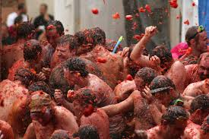
Festivals in Spain.
La Tomatina¨ - Valencia Tomato Fight Festival.
Every year in August around 30,000 people in the Spanish town of Bunol in Valencia throw more than 240,000 pounds of tomatoes at each other as part of the La Tomatina festival.

Slide 11
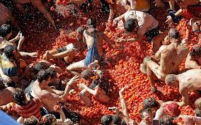
La Tomatina.

Slide 12
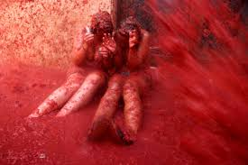
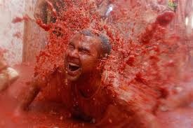
https://www.youtube.com/watch?v=Tkhz6f9Gv4w

Slide 13
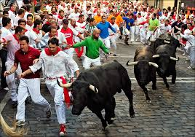
Bull Running
Every year from July 7th-14th thousands pack into Pamplona to start Spain's most famous bull-running fiesta to honour Saint San Fermin.
After daybreak on July 7th, runners gather at the bottom of Santo Domingo, which is the starting line. They crowd together and sing to the image of San Fermin.
Then, as a rocket goes off, a number of fighting bulls are let out onto the streets. A second rocket is then let off to make sure everyone knows the bulls are loose in the street. The bulls run along the narrow street to a bull ring. The runners dash along in front of the bulls.
People now journey from all around the world to run with the bulls.

Slide 14
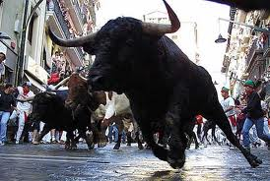
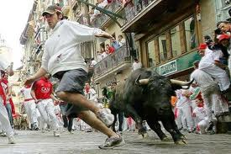
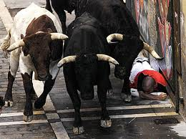

Slide 15
Opinion Writing.
The yearly bull run in Pamplona…….
Should it continue to take place? Consider the safety issues for people. Is the event really fun? Consider the welfare of the animals involved? Is it a pointless event? Think about tourism in the area if the event were to be cancelled.
Task : THINK- PAIR- SHARE
Activity: Research the topic and write a piece either for
or against bull running.

Slide 16
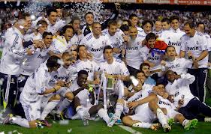
Sport in Spain.
Sports are a passion in Spain. Spain has some really talented ‘futbol’ teams such as Real Madrid and Barcelona.
Other popular sports include skiing, motor sport, basketball and tennis.

Slide 17
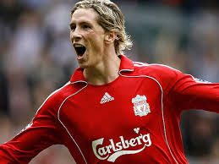
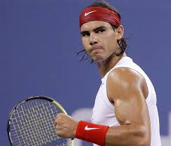
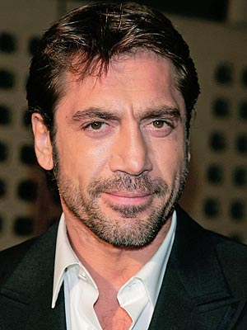
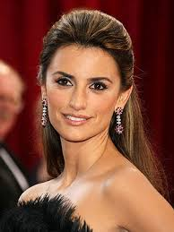
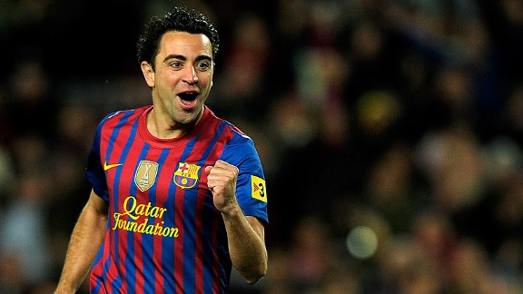
Famous Spanish People
Can you name any of them?
Choose any famous Spanish person and create a fact file on them.

Slide 18
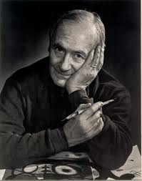
Artists Corner- Joan Miro
Joan Miro (1893-1983) was a Spanish painter and sculptor who produced vivid abstract works of art during much of the 1900s.
His works often have very descriptive titles.
Joan Miro's name is pronounced hoän mro.

Slide 19
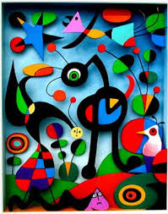
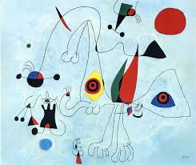
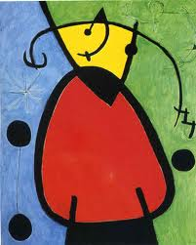
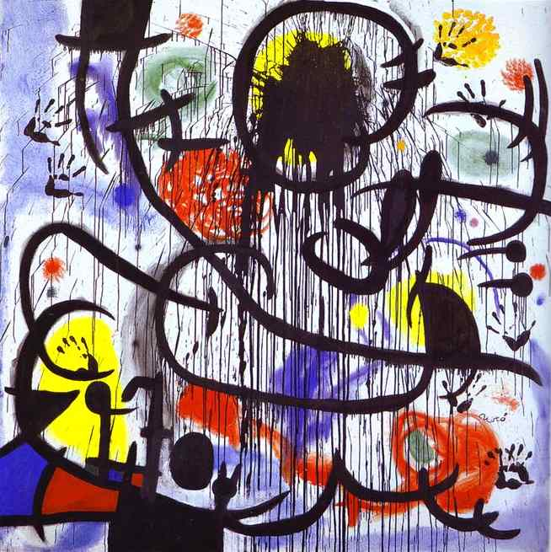

Slide 20
Some Spanish Phrases.
Hello- Hola
Please- Por favor
Thank you- Gracias
You’re welcome- De nada
Excuse me- Perdon
http://www.123teachme.com/learn_spanish/spanish_for_children

Slide 21
A Day in Spain.
What is it like to grow up in Spain? Find out how one Spanish girl spends her day.
http://www.timeforkids.com/destination/spain/day-in-life

Slide 22
Your name in Spain.
In Spain, everyone has two surnames.
The first is your father's first surname and the second is your mother's first surname.
Your father's surname is considered to be more important and that is why it is positioned first.
What would your name be if you lived in Spain?

Slide 23
Spanish Stations
Spanish map work
Spanish food
Spanish Language
Spanish Festivals
Complete the activity at each station . You will have 15 minutes to work at each station.

