Slide 1
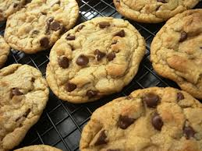
Procedure Writing
Can you remember any important points when writing instructions or a procedure?

Slide 2
What is procedure writing?
Procedural writing provides the reader with instructions or directions for doing something. A ‘How To’ document is procedural writing.
Examples of procedural writing include:
~ recipes
~ experiments
~ directions to locations
~ how to (how to build a snowman)
~ give rules for board games, sports, home, school etc.
~ how to make or play something

Slide 3
Procedural Writing Needs To:
Clearly state a goal or objective.
Provide an overview or a list of materials or resources needed.
Address any safety procedures that need to be followed.
Include all the steps for the procedure.
State instructions in a step by step pattern leaving nothing out. Use words like, first, next, then, finally…
The reader needs to be able to follow the procedural writing fully without having to make any assumptions.

Slide 4
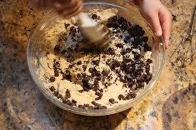
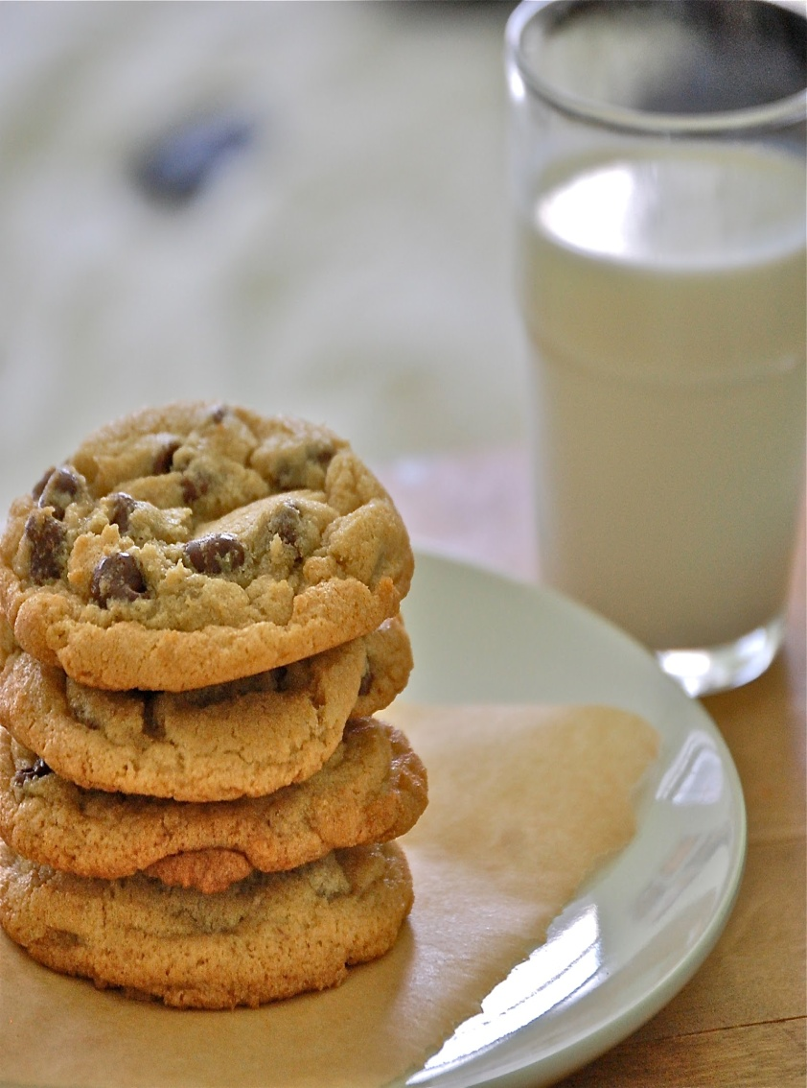
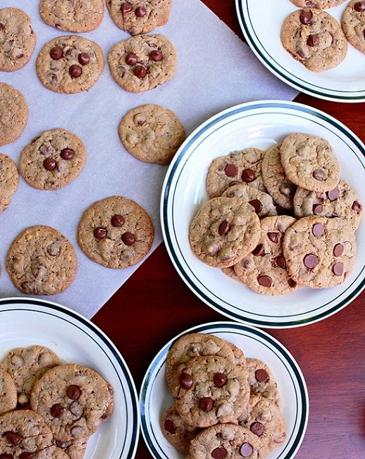
Today’s procedure is…..How to make chocolate chip cookies!

Slide 5
Chocolate chip cookies.
Ingredients.
85g butter
85g granulated sugar
85g brown sugar
Few drops vanilla essence
1 egg
170g self raising flour, sifted.
Pinch of salt
60g walnuts (optional)
60-120g chocolate chips

Slide 6
Method
Grease two baking trays.
Cream the butter with the sugar and vanilla essence.
Beat in the egg.
Fold in the flour and salt with the nuts and chocolate chips.
Drop spoonfuls of mixture onto the baking trays and bake the cookies at 175°C, Gas Mark 4 for 12-15 minutes.
Stand for 1 minute then place chocolate chip cookies on a wire rack to cool.

Slide 7
Pasta and tomato sauce recipe
Follow the link below for another recipe procedure.
https://prezi.com/rpqgwjjeeonb/untitled-prezi/#

