Slide 1
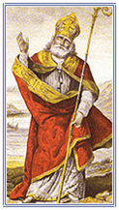
The Story of St. Patrick
By ………………………….

Slide 2
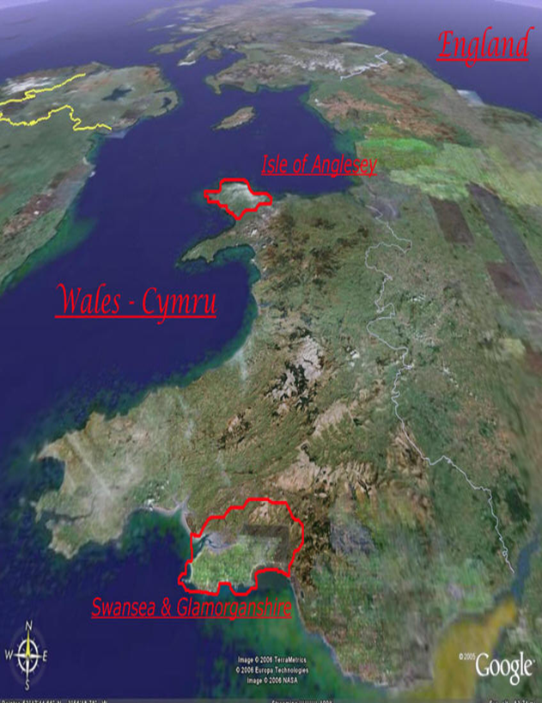
Saint Patrick was born in Wales in the year 387.
His family were wealthy and he lived in a lovely house.

Slide 3
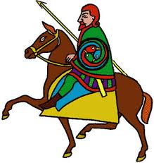
He was captured by Niall of the Nine Hostages and brought to Ireland.

Slide 4
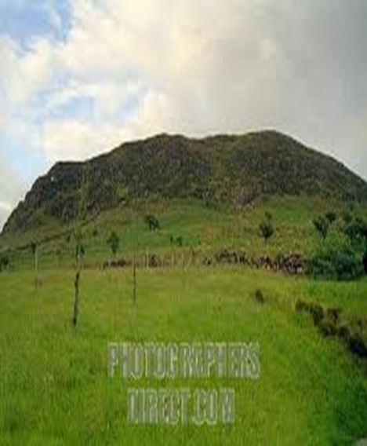
He was sold as a slave to a farmer from Co. Antrim called Milchú.

Slide 5
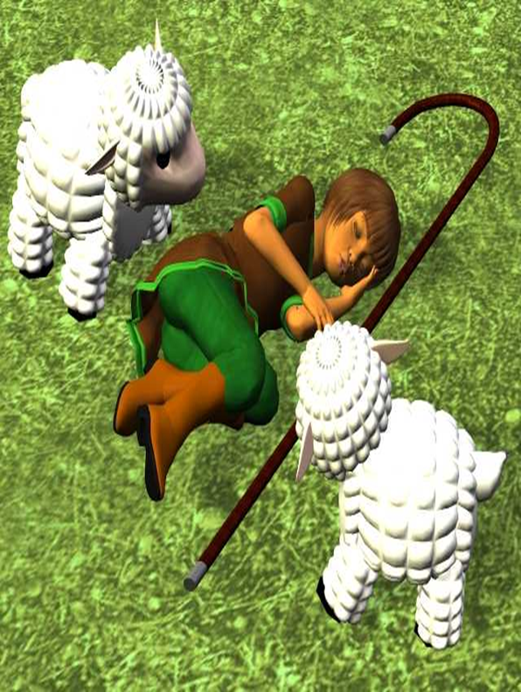
He was made mind sheep all on his own on Sliabh Mis.
Every night he prayed to God.

Slide 6
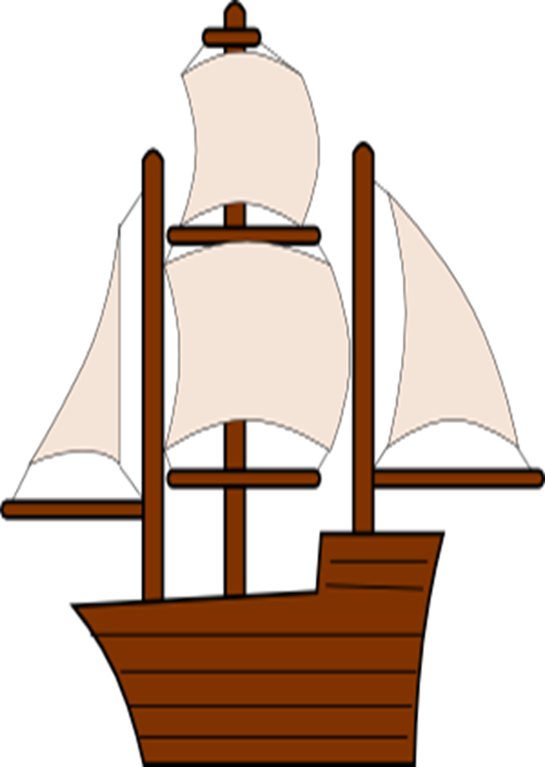
One night he heard God’s voice. God told him to escape. He told him there was a boat waiting for him to take him back to Wales.

Slide 7
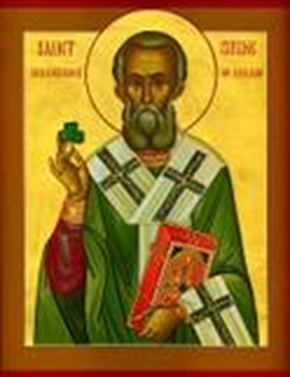
Soon after returning home he heard God’s voice again.
He told him to return to Ireland again to tell the people of Ireland about God.

Slide 8
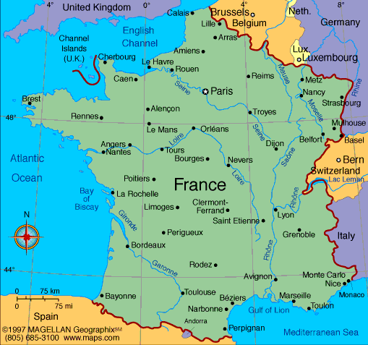
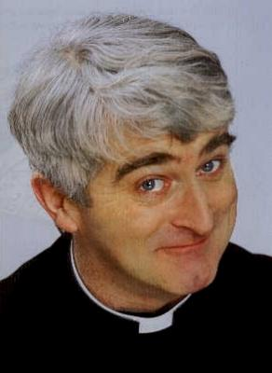
Patrick did as he was told and went to France to study for the priesthood.

Slide 9
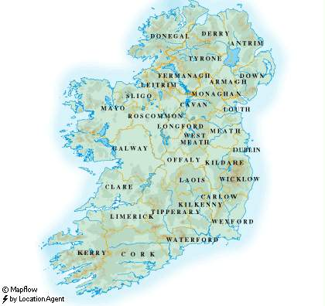
After returning to England. He went to Ireland to teach the people there about God.

Slide 10
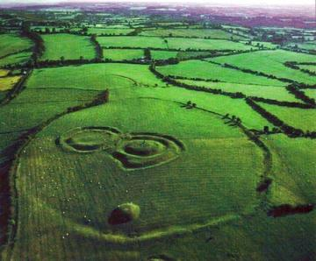
Patrick made his way to the Hill of Tara, Co. Meath, seat of the high king of Ireland. He lit a on the nearby Hill of Slane.
Patrick was summoned to Tara by the High King of Ireland as it was tradition to put out all fires at Easter time.

Slide 11
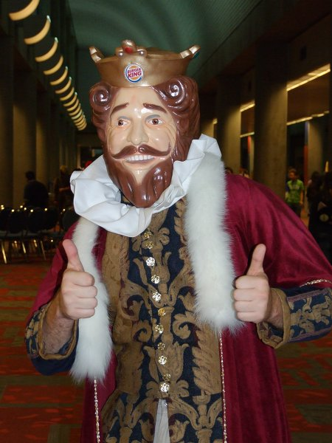
The King was so impressed by Patrick that he gave him permission to spread the word of God around his Kingdom.

Slide 12
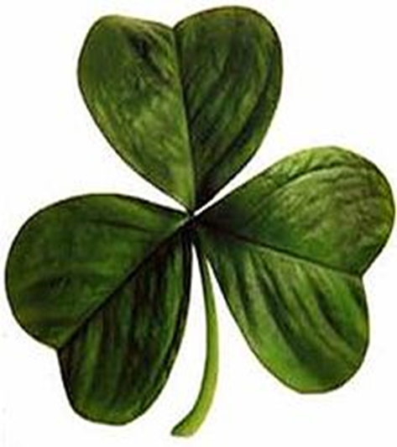
He used the symbol of the Shamrock.
Does anyone know what the three leaves stand for?
The Father, the Son and the Holy Spirit

Slide 13
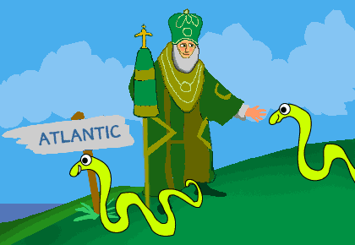
Patrick is also said to have banished all the snakes from Ireland.

Slide 14
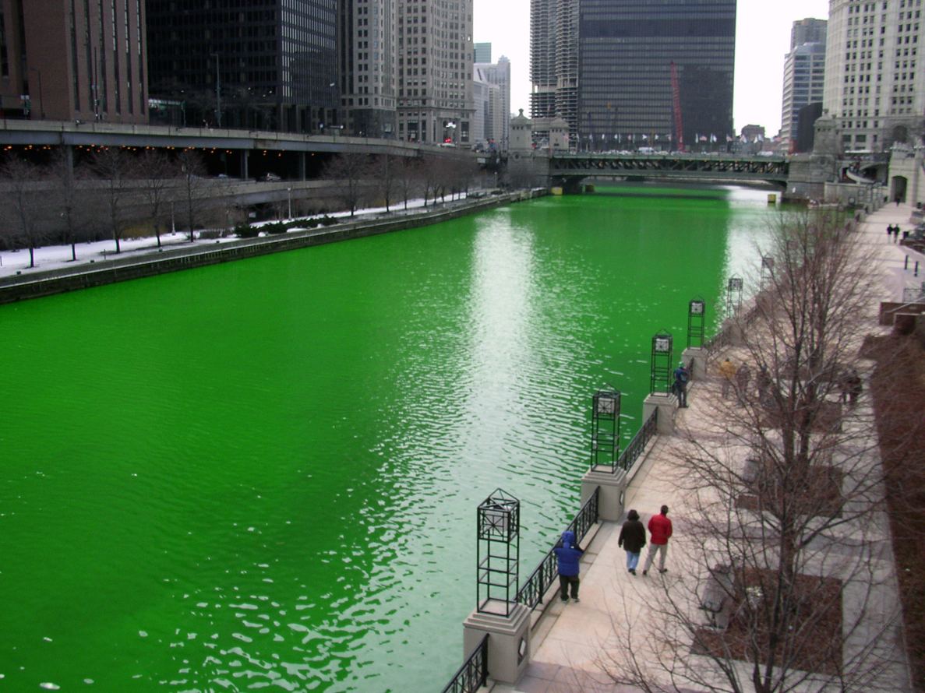
Today St. Patrick’s Day is celebrated all around the world on March 17th.
There are parades in every county in Ireland.
In Chicago they even dye the Hudson River green.

