Slide 1
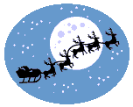
The History of Christmas

Slide 2
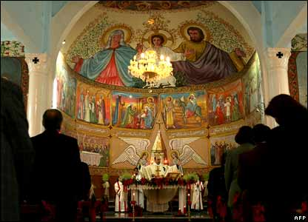
What do we mean by Christmas?
Every December we celebrate the birthday of Jesus Christ. This is why we call this time Christmas – because we celebrate the Mass for Christ.

Slide 3
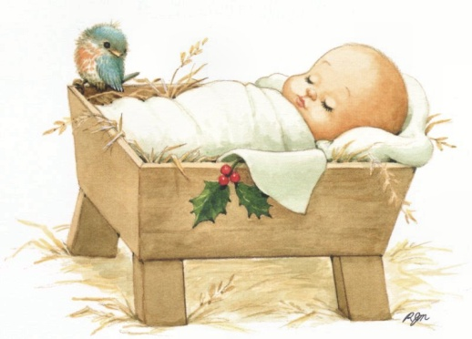

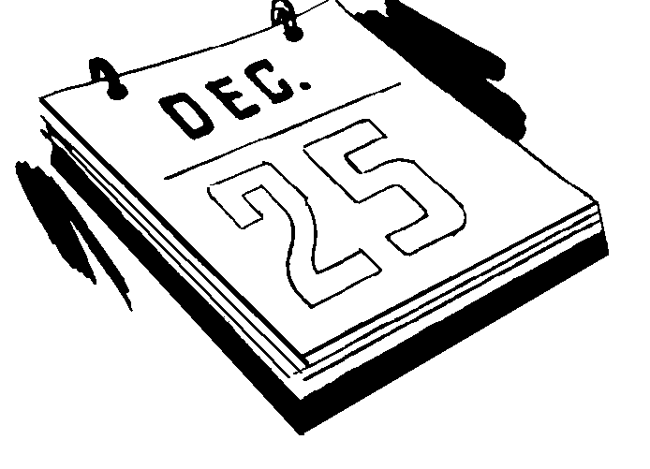
Jesus was born nearly 2000 years ago.
We celebrate his birthday on the 25th of December.

Slide 4
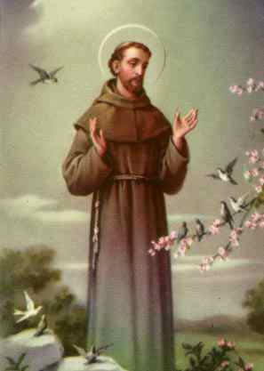
Why do we have a crib?
At Christmas time we make cribs to remember the story of Christmas.
The most famous crib was made by St. Francis of Assisi, the good saint who was so kind to animals.

Slide 5
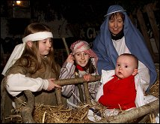
He wanted people to understand how hard it was to live in a poor manger. So he arranged to have a real crib with people and animals.

Slide 6
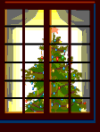
What about the Christmas Tree?
There is an old German legend which tells us how a Spruce Fir Tree became the first Christmas Tree....

Slide 7
Christmas Pudding!
We usually eat Christmas Pudding at the end of our Christmas dinner. But what we think of Christmas Pudding is not what it was like when it first began!
It started in the 1300’s as a porridge called ‘frumenty’ which was made from beef with raisins, currants, prunes, wines and spices.

Slide 8
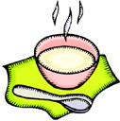
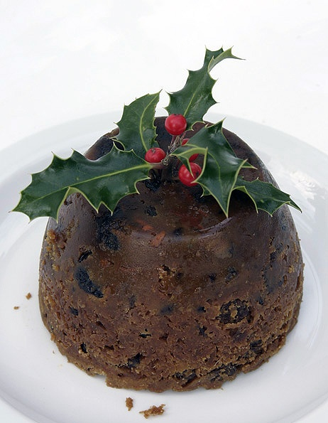

Slide 9
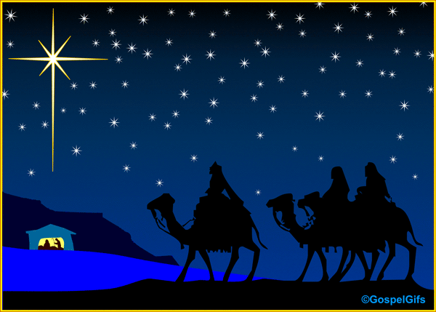
Some people say that the Christmas Pudding should be made with 13 ingredients to represent Jesus and His Apostles and that every person in the house should stir the pudding with a wooden spoon from east to west , in honour of the Wise Men!

Slide 10
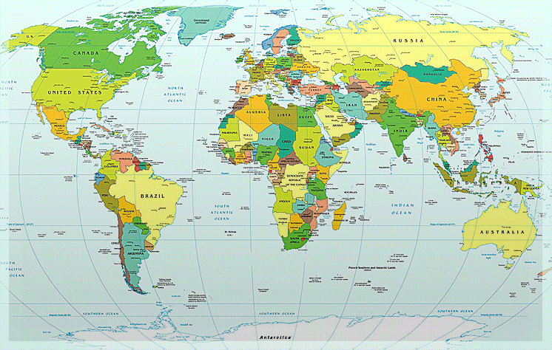
Christmas in other countries!

Slide 11
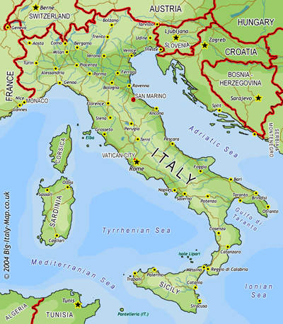

Slide 12

In Italy, on the evening of the day after Christmas, children are visited by a good witch named Strega Buffana. She flies around Italy on a broom and leaves treats for good children and coal for naughty children!

Slide 13
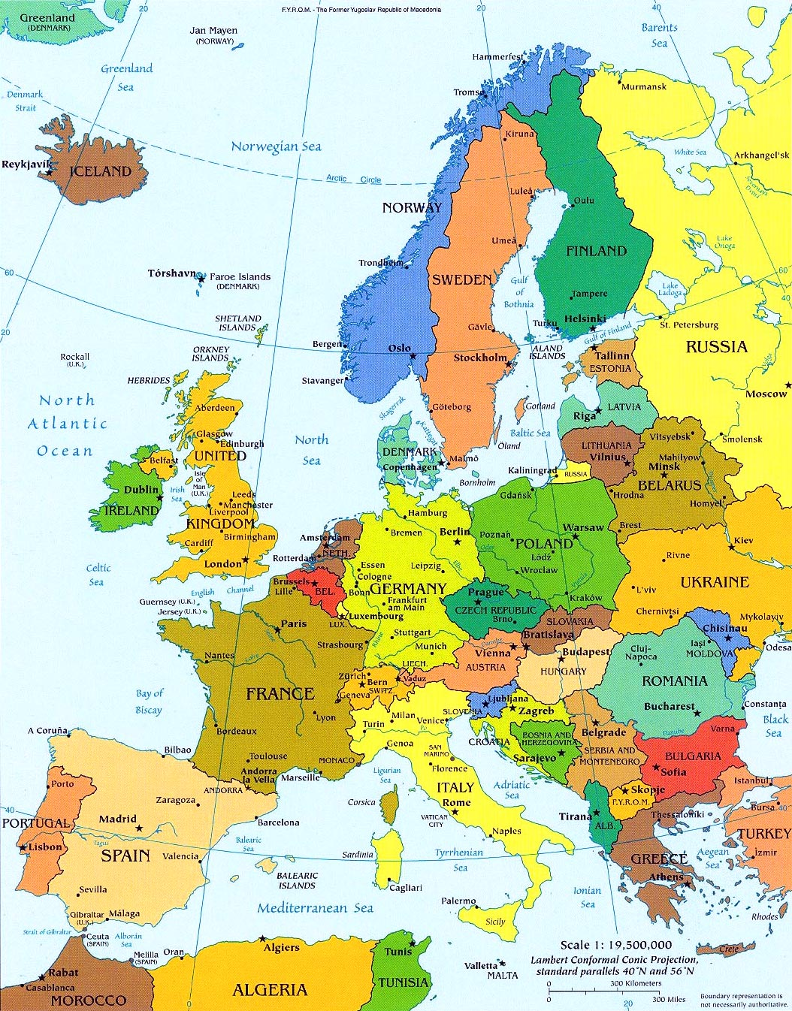

Slide 14
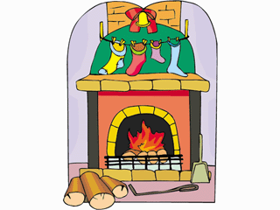
In France, young children leave their shoes by the fire on Christmas Eve for a gift from “le Pere Noel”.

Slide 15
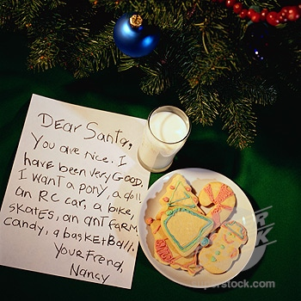
In Germany, children decorate their Christmas lists with pictures and then leave them on the windowsill overnight, weighed down with some sugar so they won’t be missed by Santa.

Slide 16
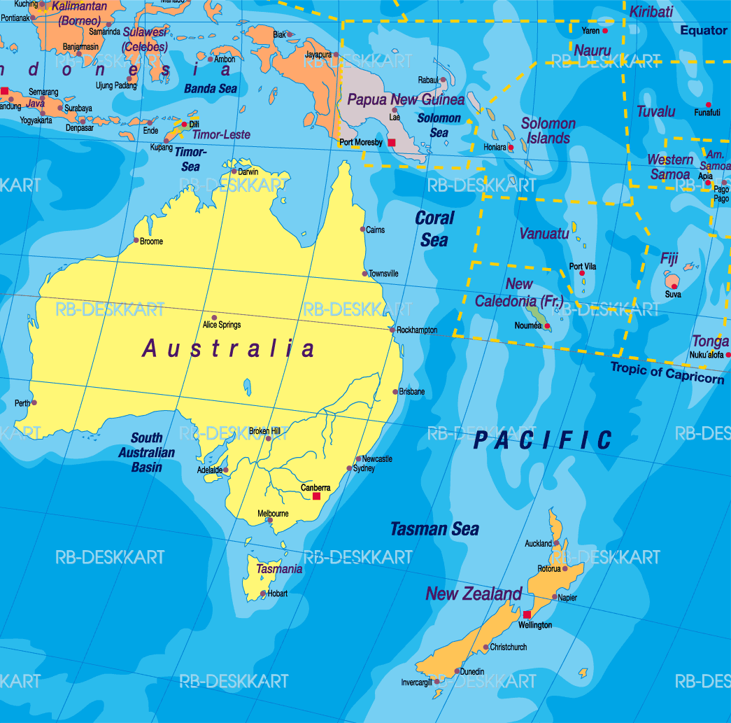

Slide 17
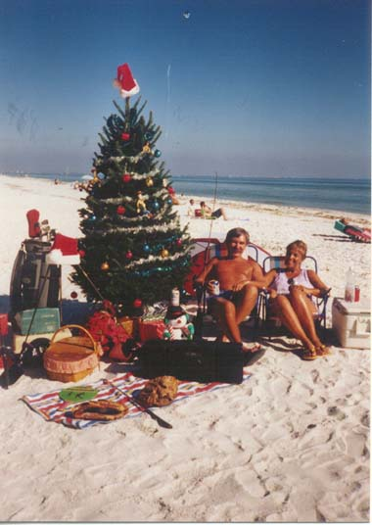
In New Zealand, it is the middle of summer at Christmas time. Instead of a hot drink for Santa, he often gets a cold drink to cool him down! On Christmas Day families often have a picnic or go to the beach for Christmas dinner!

Slide 18
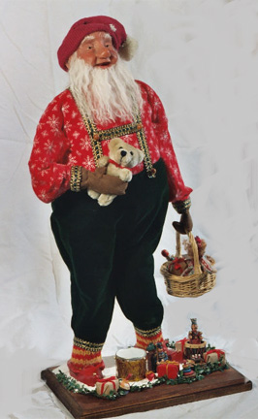
In Iceland, people believe in 13 different Santas! Each of the 13 Santas begin visiting their homes on December 12th and by Christmas Day, they’ve all arrived!

Slide 19

Nollaig Shona Duit!

