Slide 1
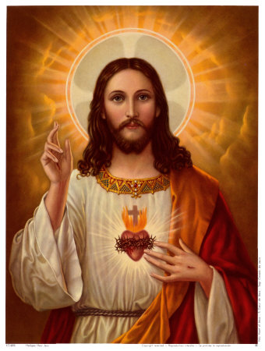
BC: Before Jesus was born
AD: After Jesus was born

Slide 2
What have the Romans ever done for us???

Slide 3
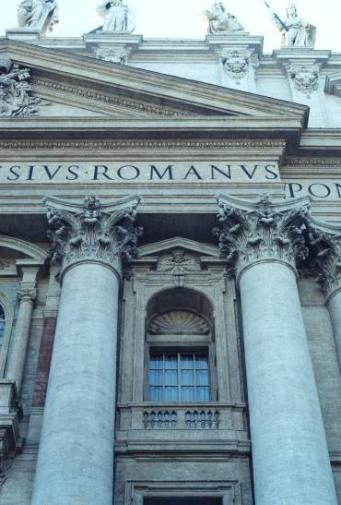
Architecture

Slide 4
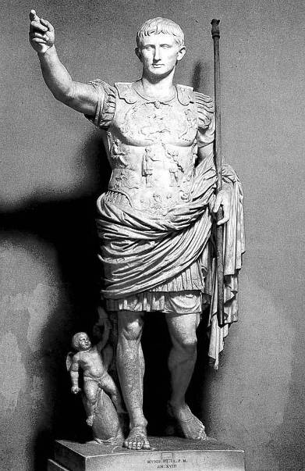
Art

Slide 5
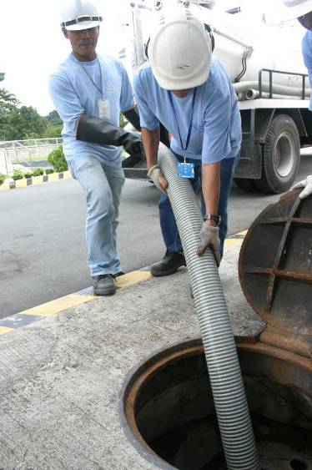
Drains and Sewers

Slide 6
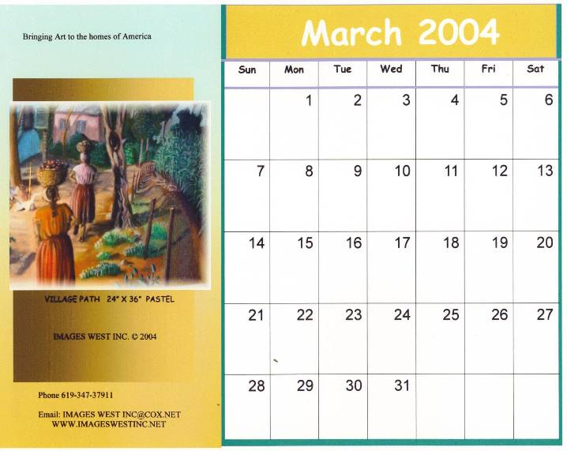
The Calendar

Slide 7
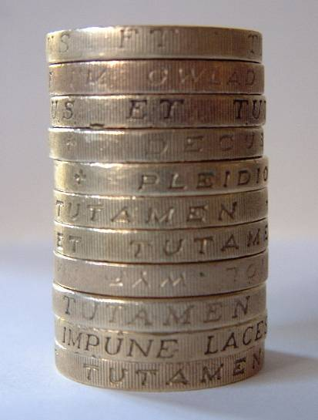
Coins

Slide 8
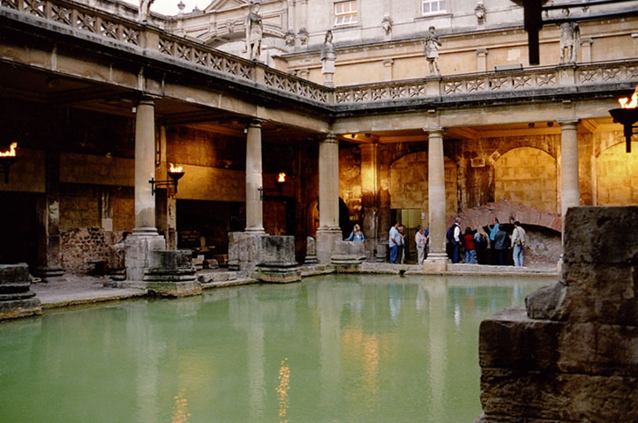
Heated Baths

Slide 9
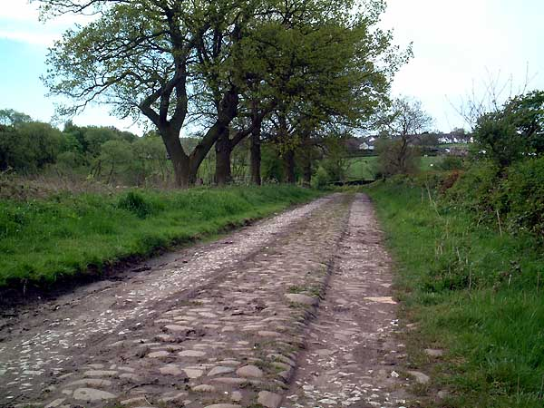
Roads

Slide 10
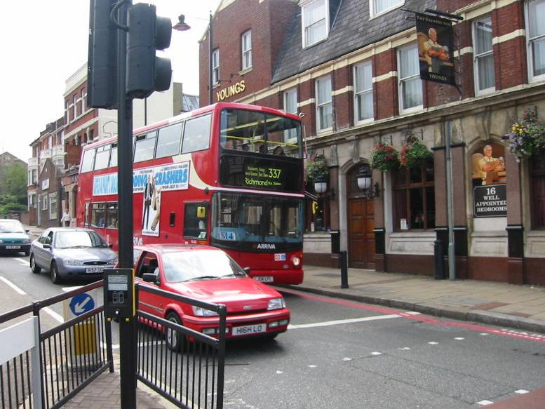
Towns

Slide 11
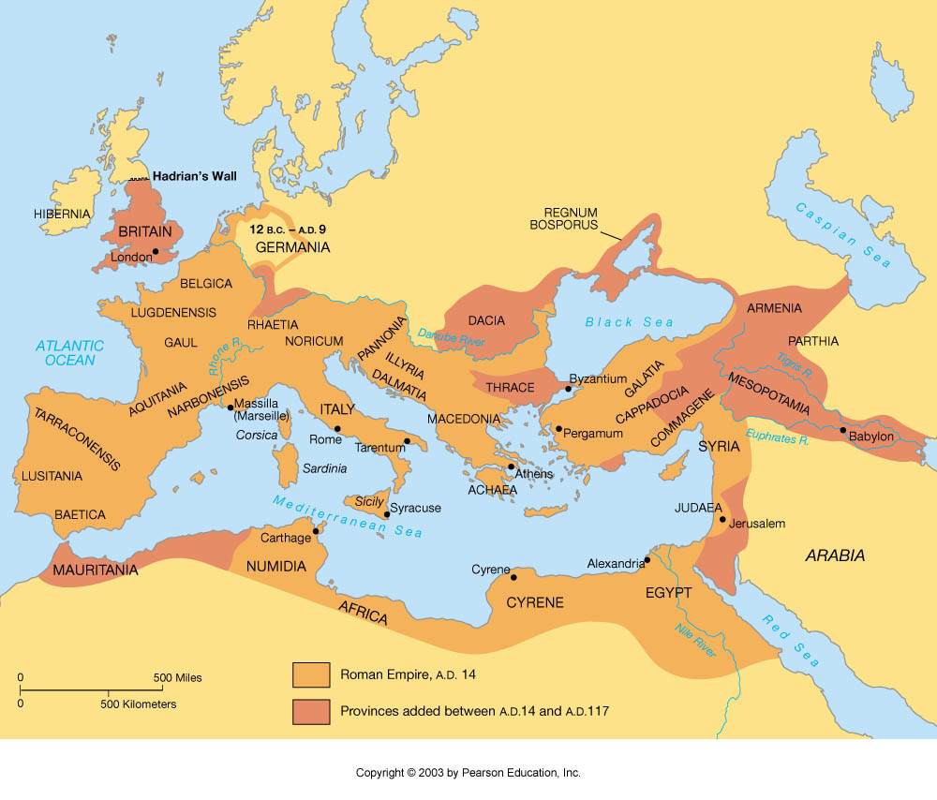
The Roman Empire

Slide 12
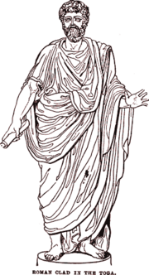
Rich Roman man wearing a toga.

Slide 13
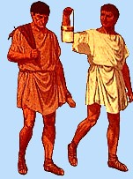
These men are wearing short tunics. Therefore they were members of the poorer classes

Slide 14
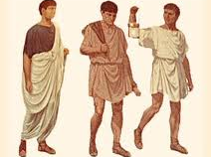
Can you tell which men are poor and which men are rich from this picture?

Slide 15
Roman Pastimes

Slide 16
Amphitheatres
The Roman amphitheatre was the centre of public entertainment in Rome, and all over the Roman Empire. People would go to the amphitheatre to see men fighting wild beasts or each other. These men were called gladiators. It was a cruel sport because someone was usually killed.
The most famous amphitheatre was the Coliseum. You can still visit the Coliseum in Rome today.

Slide 17
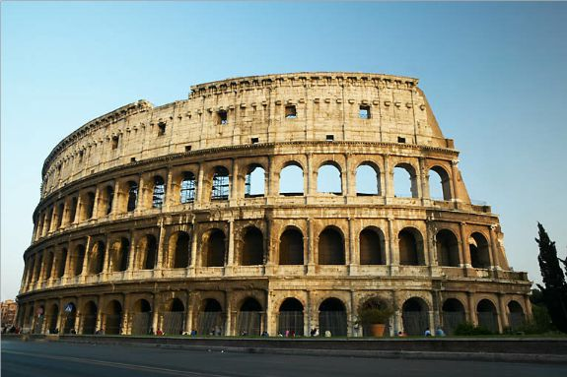

Slide 18
Chariot Racing
The stadium (or circus) was used for chariot-racing. A stadium had a long rectangular enclosure, curved at one end, with seats all around except at the end opposite the curve. Down the middle was the spine, which the chariots hurtled around, lap after lap, trying to cut in front of each other.
Chariot-racing was a very popular sport all over the Roman Empire.

Slide 19
However chariot racing was also very dangerous
When an accident occurred the chariot often fell to pieces in an instant and the driver was hurled out
The most famous Roman stadium was the Circus Maximus

Slide 20
