Slide 1
Rís, rís, rís. Rís, rís, rís.
Is brea liom rís, Is brea liom rís.
Ithim prátaí, is ithim glasraí,
Ithim prátaí, is ithim glasraí.
Is maith liom spaigití anois is arís,
Ach is brea liom rís.
Subh, subh, subh. Subh, subh, subh.
Is brea liom subh, Is brea liom subh.
Ithim torthaí, is ithim leitís,
Ithim torthaí, is ithim leitís.
Is maith liom sceallóga anois is arís,
Ach is brea liom subh.

Slide 2
Tae, tae, tae. Tae, tae, tae.
Is brea liom tae, Is brea liom tae.
Ólaim bainne is ólaim seacláid,
Ólaim bainne is ólaim seacláid.
Is maith liom deoch uisce anois is arís,
Ach is brea liom tae.

Slide 3
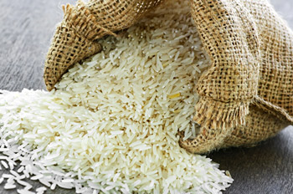
Rís rís Rís

Slide 4
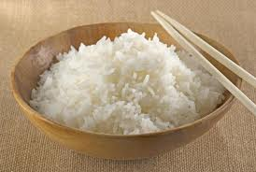
Rís rís Rís

Slide 5
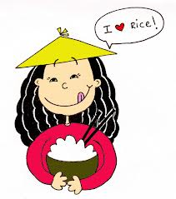
Is brea liom rís

Slide 6
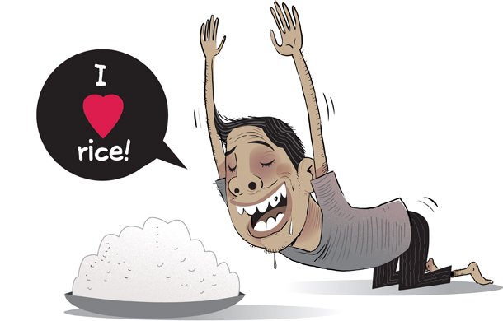
Is brea liom rís

Slide 7
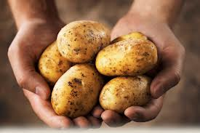
Ithim prátaí

Slide 8
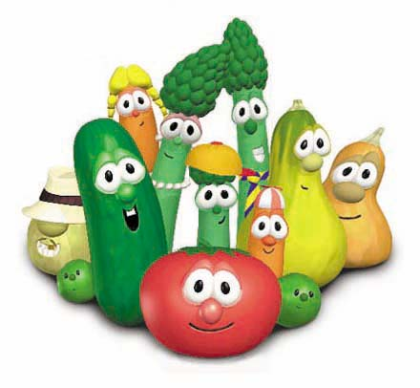
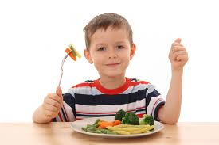
is Ithim glasraí

Slide 9
Ithim prátaí

Slide 10
is Ithim glasraí

Slide 11
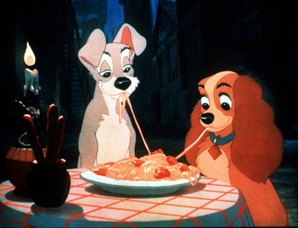
Is maith liom spaigití anois
is arís

Slide 12
Is brea liom rís
ACH

Slide 13
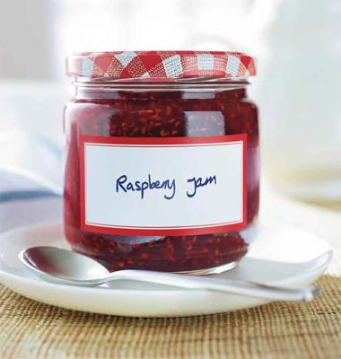
subh
subh
subh

Slide 14
subh
subh
subh

Slide 15
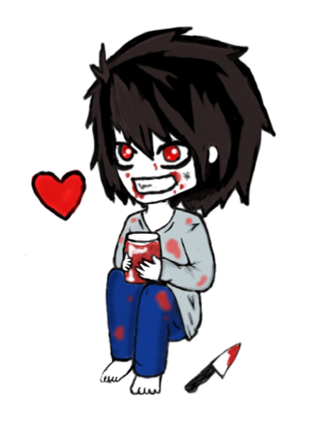

Is brea liom subh!
subh

Slide 16
Is brea liom subh!
subh

Slide 17
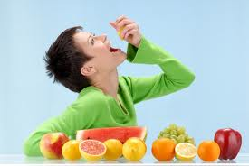
Ithim torthaí

Slide 18
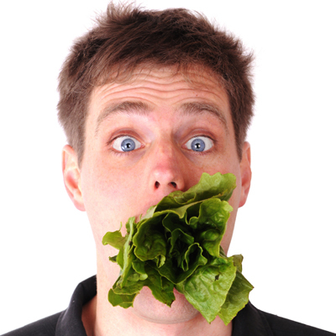
is Ithim leitís

Slide 19
Ithim torthaí

Slide 20
is Ithim leitís

Slide 21

sceallóga
Is maith liom sceallóga anois is arís

Slide 22
Is brea liom subh!
ACH
subh

Slide 23
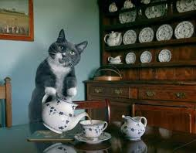
Tae Tae Tae

Slide 24
Tae Tae Tae

Slide 25
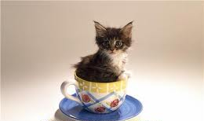




Is brea liom tae!

Slide 26
Is brea liom tae!

Slide 27
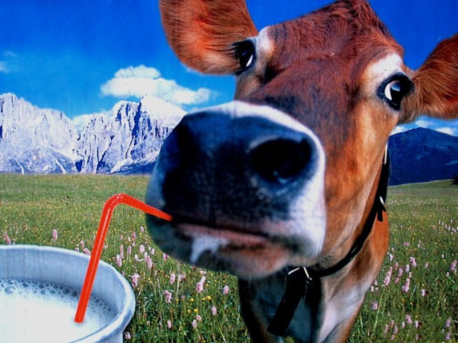
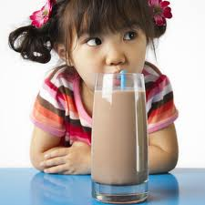
ólaim bainne
is ólaim
seacláid

Slide 28
is ólaim
seacláid
ólaim bainne

Slide 29
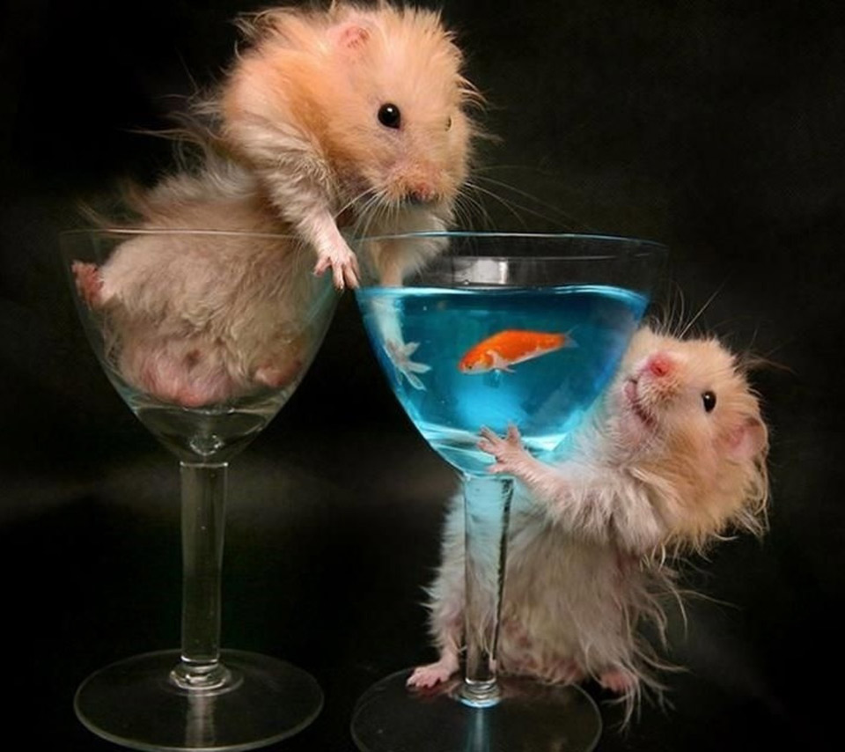
Is maith liom
deoch uisce
anois is arís

Slide 30
Is brea liom tae!
ach

