Slide 1

Woodland & Garden Birds

Slide 2
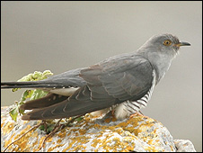

The Cuckoo – An Chuach
Visits Ireland from April to August
Shy birds
They lay their eggs in other birds’ nests

Slide 3
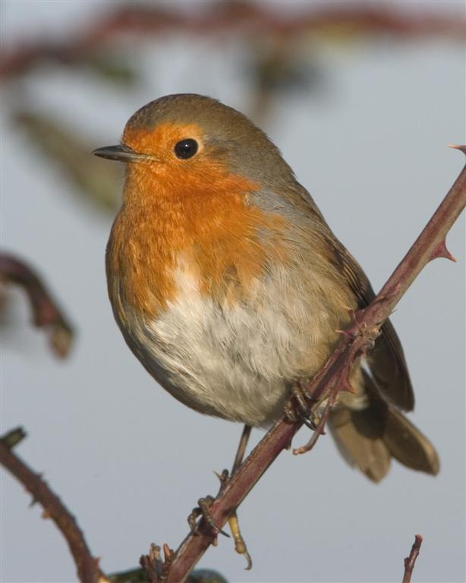
The Robin – An Spideóg
Live in Ireland all year round
They sing to protect their own territory
Often seen ‘on guard’ perched on a branch

Slide 4
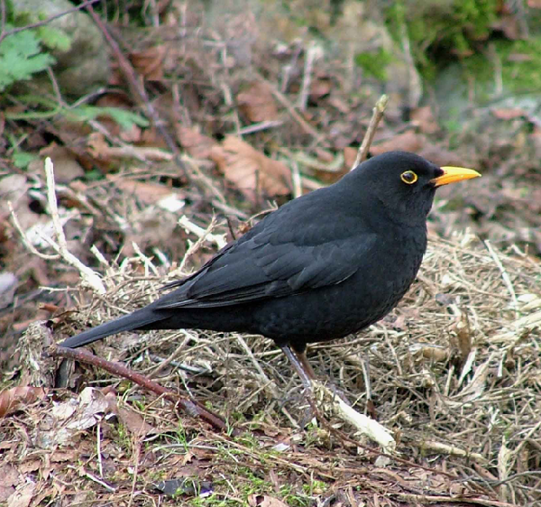
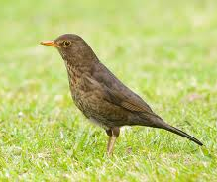
The Blackbird – An Lon Dubh
Male blackbird
Female blackbird
Males are fantastic singers
They call ‘tchak, tchak’ if alarmed by a cat or other enemy

Slide 5
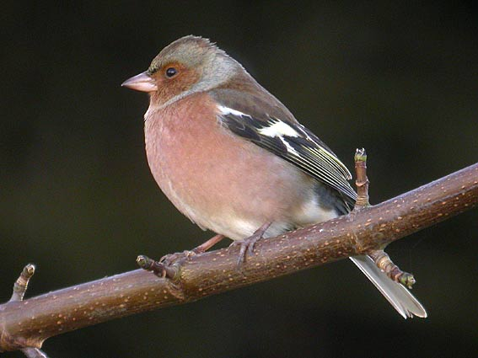
The Chaffinch – An Rí Rua
Small and common bird
Eat insects in summer when they are plentiful and seeds in winter
You can hear them call ‘pink pink’

Slide 6
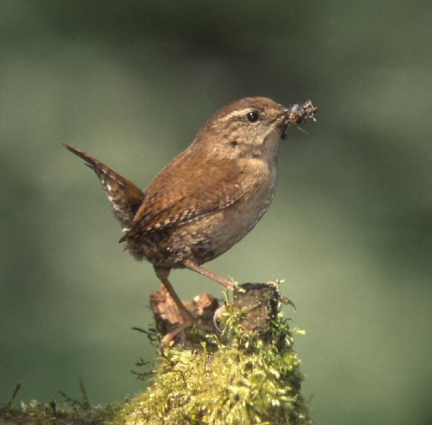
The Wren – An Dreoilín
One of Ireland’s smallest birds, common throughout Ireland
Eats small insects
Calls include an abrupt "check" or more prolonged "churrrrr.."

Slide 7
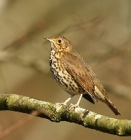
The Thrush – An Smólach
Common throughout Ireland
Eats insects, worms, berries. Snails are a favourite!
Typical calls include "cherry dew, cherry dew, cherry dew" and "knee-deep, knee-deep…."

Slide 8
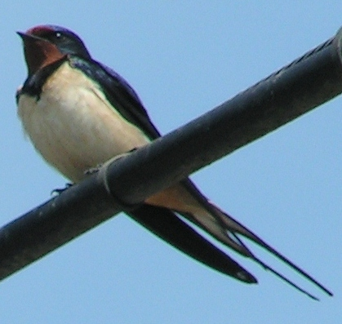
The Swallow - An Fáinleog
Swallows visits Ireland from mid-March to late September
Feed almost exclusively on insects caught in flight
They spend winter in Southern Africa

