Slide 1
1916 Uprising
Assessing what the children already know :
When did the event take place?
Where did it take place?
Who participated?
Were they successful?
Note: I estimate that it will take at least two days to explain
Useful website N1. http://www.nli.ie/1916

Slide 2
1914 -1918 First World War
24th July 1914 – 11th November 1918 (5 seasons)
The British army was extremely busy. Approximately 200,000 Irish soldiers participated in W.W.1 (North and South) and fought for the British army.(350,000 according to www.rte.ie/1918/thefallen.html)
Mainly England, France, and Russia versus Germany and the Austrian Hungarian Empire.
In total 30 countries were involved. Allies v Triple Axis.
Some of the Irish fought for the American, Canadian and Australian armies.
Approximately 49,000 Irish soldiers were killed. Many more were seriously injured.
http://imr.inflandersfields.be/search.html Data base of those killed (Simple insert a name or Town)
In total 9 million soldiers were killed and 21million were wounded.1million killed in the battle of the Somme alone.
Many believed that by helping England, Irelands chances of achieving Home Rule
(limited Independence) would be greatly enhanced.
Others believed that a rebellion would be more productive.
1798 - The last big uprising in Ireland by the United Irishmen (mainly Wexford).
There were however three minor ones 1803 (Robert Emmet),1848 (Young Irelanders) and 1867 (I.R.B./Fenians).

Slide 3
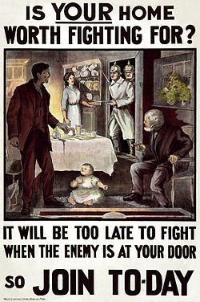
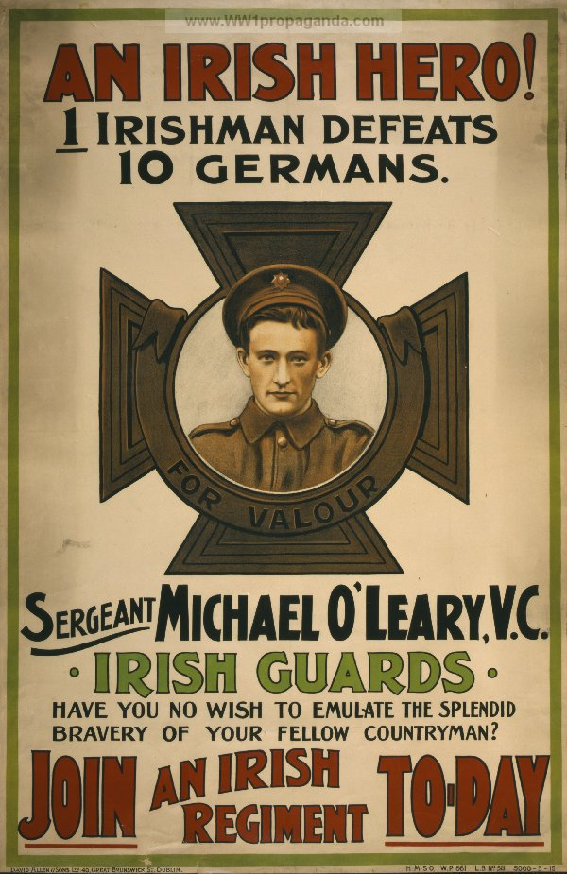
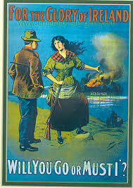
A sample of posters used during WW1 which tried to encourage Irish men to join the war.

Slide 4
The Aud and the Asgard
The Asgard was a relatively small boat (yacht): 900 guns were landed in Howth, Co. Dublin in July 1914 by Erskin Childers and his family. In skirmishes that followed that evening in Dublin, four Irish were killed and 38 others were injured.
The Aud –& Rodger Casement. Germany were only too happy to help and sent a boat load of 20,000 guns to Ireland. Communication was poor and the boat landed a few days early and was captured near Banna Beach in Co. Kerry. The Captain of the Aud sank the boat as it was being escorted to Cobh in Cork.
A group marched from Dingle and from other parts of Kerry to Tralee in order to pick up the guns. They stayed overnight in a disused skating Rink. www.bureauofmilitaryhistory.ie or http://cultura-project.eu/1916/?q=artefact/WS1413
Rodger Casement arrived from Germany in a U Boat a fed days after the Aud and was captured. (Good Friday 21st April) He had also tried to recruit an Irish Brigade amongst the Irish who had been captured by the Germans during WW1, but had very little success. Of a possible 2,300 Irish prisoners of war in Limburg prison only 56 volunteered. He was imprisoned in the tower of London and was hung in August 1916. In 1911 he had been knighted by King George 5th for work which he had done in Peru and the Congo.
Gaelscoil Mhic Easmainn in Tralee is named in his honour.
When Eoin McNeill (Irish Volunteers) heard that that the attempt to land guns had been unsuccessful he placed adds on the Sunday Paper cancelling the planned manoeuvres. Pearse and Connolly decided to go ahead with the uprising.

Slide 5
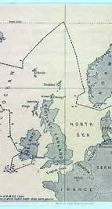
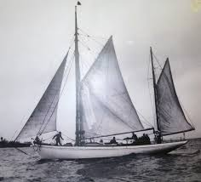
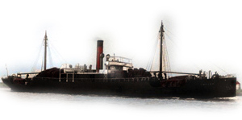
The journey of the Aud from Germany, The Aud and the Asgard .

Slide 6
Easter Rising 1916
It lasted for six days
It started on Easter Monday 24th April 1916
It finished on Saturday 29th April
Headquarters G.P.O. (General Post Office) in O’ Connells Street (Sackville Street)

Slide 7
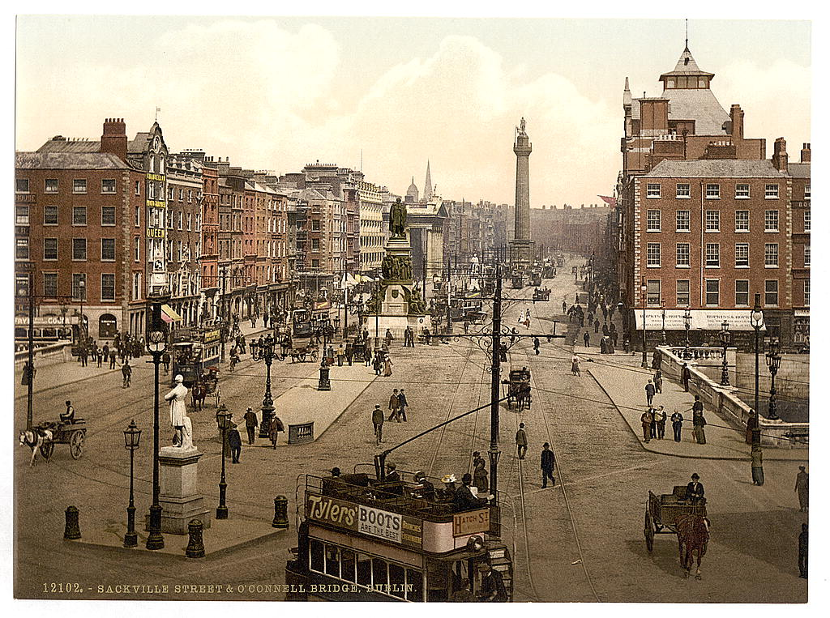
O'Connell's Street (Sackville St) before the Uprising.
It is named after a famous Kerry Person - Daniel O Connell.

Slide 8
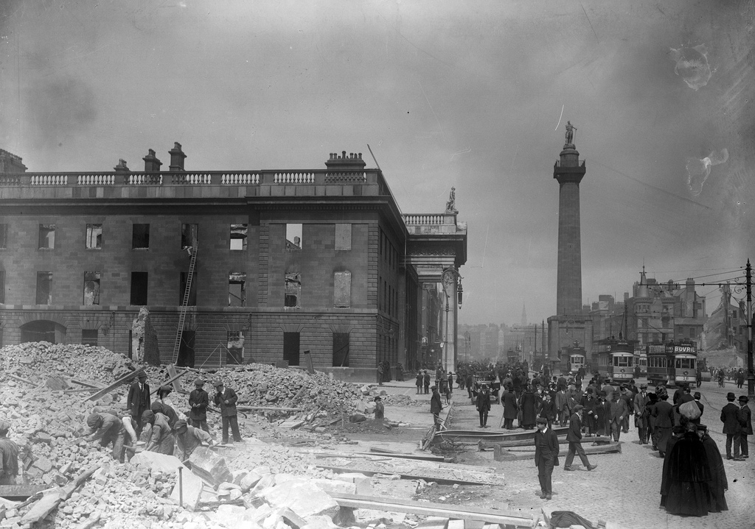
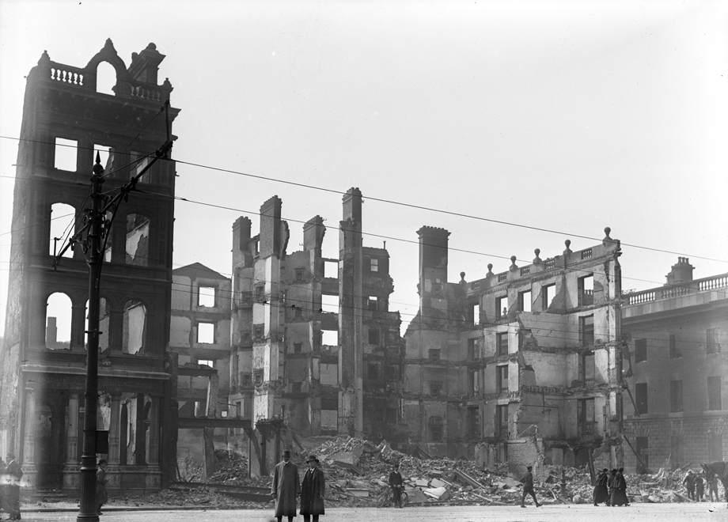
O’ Connells Street after the Uprising - Part 1

Slide 9
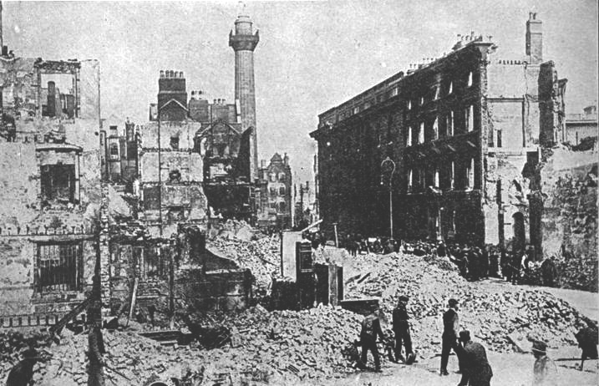
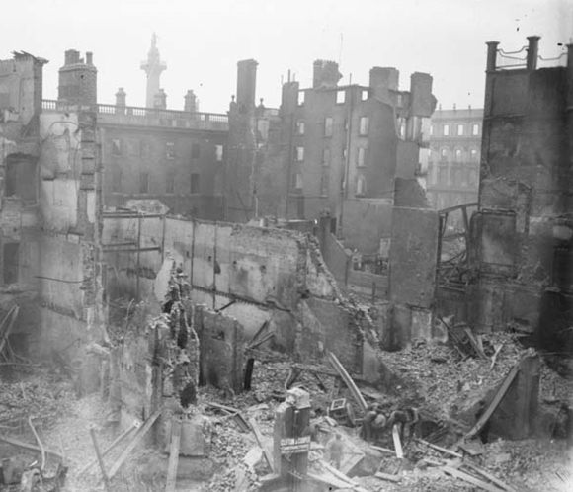
O’ Connells Street after the Uprising - part 2

Slide 10
Organisations which took part:
Cumann na mBan – 200 members took part
I.C.A. Irish Citizens Army – approx. 300 members
(Founded by James Larkin, James Connolly and Jack White in 1913 after the Dublin Lockout of 1913)
Irish Volunteers (this organisation though under the command of Eoin McNeill, had been infiltrated by the I.R.B)
Many of the Volunteers throughout Ireland did not take part as E. McNeill and M.J. O Rahilly were happy due to the lack of guns and ammunition.
Note: In 1917 Cathal Brugha brought the I.C.A. and Volunteers together as a new organisation which was called the IRA.

Slide 11
The leaders of the rebellion who signed the proclamation were executed
1. Padraic Pearse - Dublin. Teacher, poet writer. He founded Scoil Éanna in Rathfarnham, Co Dublin. Check out 1901 & 1911 – Padraic Mac Piarais http://www.census.nationalarchives.ie/
2. Thomas J. Clarke – Born in England. Shopkeeper.
3. Seán Mac Diarmada – Co. Leitirim. Journalist.
4. Thomas McDonagh – Tipperary. He was in charge of Jacobs Mills.
He initially trained as a Priest but decided to become a teacher, also a poet.
5. Éamonn Ceannt - Galway. Accomplished Piper.
6. Joseph Plunkett – Dublin. Journalist and Poet.
7. James Connolly – Scotland. He was heavily involved in Trade Unions and he founded the Labour Party. Connolly and James Larkin founded the I.C.A. (Irish Citizens Army)

Slide 12
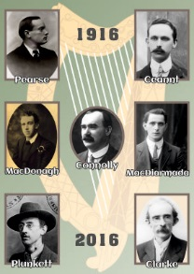
Picture of the seven signatories of the Proclamation .

Slide 13
Others who were executed:
8.Con Colbert: Limerick
9. Edward Daly: Limerick. He was in charge of the Four Courts.
10. Seán Heuston: Dublin. He worked in Kings bridge Station (Heuston).
11. Thomas Kent: Cork – The only person to be executed in the rebellion who did not take part in the Uprising. Captured in Cork. Kent Station in Cork City is named after him..
12. John MacBride: Mayo. Was married to Maude Gonne. Fought in Jacobs Mills.
13. Michael Mallin: Dublin. Mallin and Countess Markievitz fought in St. Stephens Greene and in the Royal College of Surgeons. His son still became a Priest and lives in Hong Kong.
14. Michael O Hanrahan: Wexford. Harahan and Thomas McDonagh fought in Jacobs Mills.
15. William Pearse: Dublin. A younger brother of Pádraig Mac Piarais
16. Roger Casement: Hanged in London in August 1916.
97 others had been sentenced to death. On 12 May Prime Minister Asquith travelled to Dublin and ordered that no more executions take place. http://www.nli.ie/1916

Slide 14
Other famous people who took part:
Éamonn de Valera. He was in charge of Boland's Mills. Probably escaped execution as he had been born in New York. His father was Spanish, but died when Eamonn was aged 2. He was reared by his grandmother in Bruree, Co. Limerick. He later became Taoiseach and President of Ireland. http://www.clarelibrary.ie/eolas/coclare/people/eamon.htm
Michael Collins. Clonakilty, Co. Cork (the youngest of eight children ,his father was aged 74 when Michael was born)
Cathal Brugha – Dublin
Tomás Ághas Liospóil, Dingle, Co. Kerry.

Slide 15
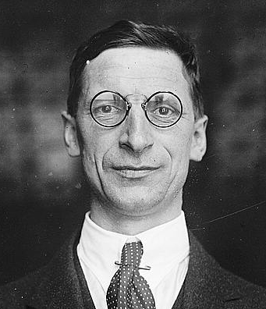
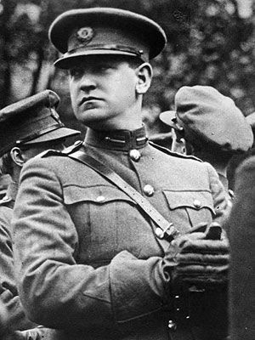
Éamon De Valera – Taoiseach agus President.
Michael Collins – Killed in August of 1922 during the Irish Civil war in Béal na mBláth, Co. Cork.

Slide 16
Pádraig Mac Piarais – Dublin – Teacher, barrister, writer, journalist, and poet.
He spent a good deal of time improving his Irish in Ros Muc, Connemara.
He was hugely interested in the Irish Language.
He founded Scoil Éanna in Dublin (Ranelagh and Rathfarnham)
The holiday Cottage in Rosmuc is still standing.
Mise Éire:
Sine mé ná an Cailleach Bhéarra
Mór mo ghlóir:
Mé do rug Cú Chulainn cróga.
Mór mo náir:
Mo chlann féin a dhíol a máthair.
Mise Éire
Uaignaí mé ná an Cailleach Bhéarra.

Slide 17
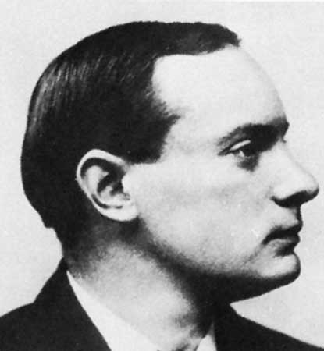
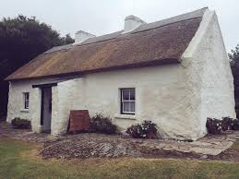
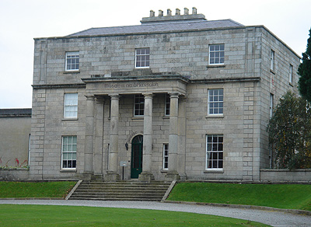
Pádraig Mac Piarais.
Pease's holiday cottage.
Scoil Éanna in Rathfarnham.

Slide 18
Tomás Ághas
Born in Liospóil, Co. Kerry and a near relation to Gregory Peck
An enthusastic speaker of the Irish Language, an excellent singer and an accomplished piper.
Dingle’s G.A.A pitch, ‘Páirc an Ásaigh’, Ash St., Tralee and ‘Ashe Memorial Hall’ were named in his honour.
He was a Primary School Principal in Corduff N.S. in Lusk, Co. Dublin.
He took command of the Volunteers in Ashbourne in Co. Meath.
He commanded approximately 50 men and captured a number of Barricks in the area.
He had been sentenced to death and was interned in England. Released in June 1917 but rearrested in August 1917.
He died in September1917 aged 32. He had been on hunger strike and choked as a result of being forced fed.
30,000 attended his funeral. Video footage still exists of the funeral.
Michael Collins gave the oration at his graveside.
www.bureauofmilitaryhistory.ie/reels/bmh/BMH.WS0645.pdf A fascinating account given by Tomás’s sister Nora Aghas

Slide 19
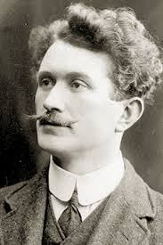
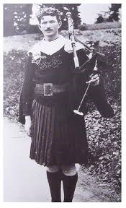
Tomás Ághas 1885-1917

Slide 20
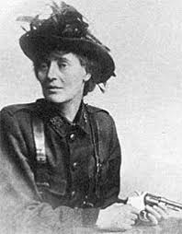
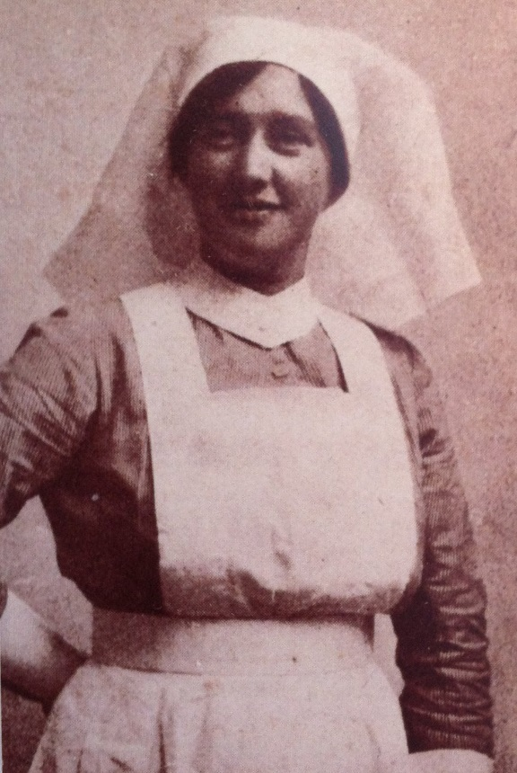
Famous women who took prt
Countess Markievicz: Reared in Lisadell house in Slogo. The first female politician to be elected to the English Parliament.
Elisabeth Farrell -midwife. She was in the G.P.O. during Easter week and carried the message of surrender on behalf of Pearse.

Slide 21
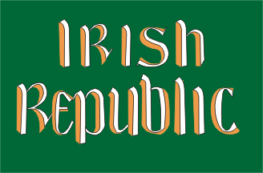
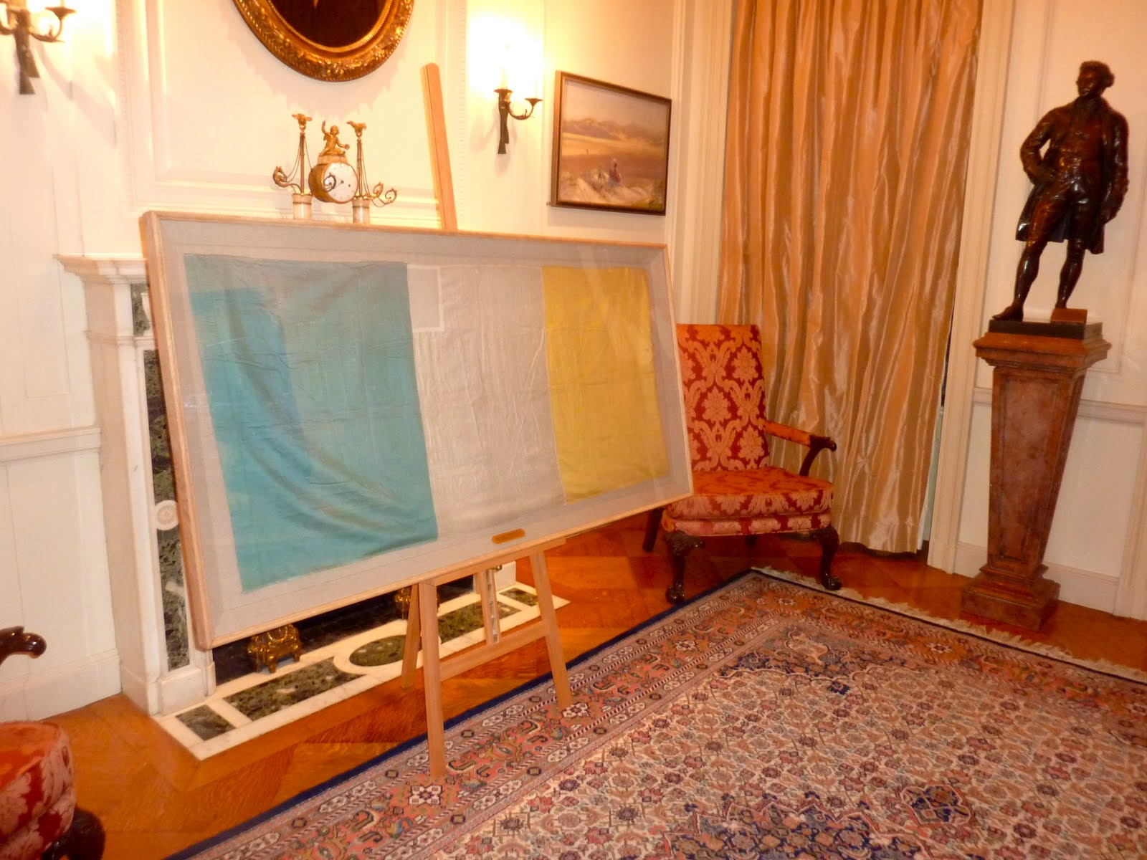
Both these flags were flown over the G.P.O. during Easter week. Thomas Francis Maher of Waterford had been presented the flag in France shortly after the French Revolution of 1848. The Orange symbolises the Orange Order, The Green symbolises the Nationalists. White symbolised peace between the two groups.

Slide 22
Buildings in Dublin which were captured.
General Post Office(G.P.O.) Centre of communications in Dublin (Phones, Telegrams and Post) Headquarters of uprising. Pádraig Mac Piaras was in charge of this building.
Liberty Hall - James Connolly and the ‘Irish Citizen Army’.
City Hall – located close to Dublin Castle.
South Dublin Union – now called St. James Hospital.
St. Stephens Green and the Royal College of Surgeon’s - English soldiers were on top of the Shelbourne Hotel
Jacobs Biscuit Factory
Bolands Mills – close to the ambush at Mount St. Bridge - Eamonn De Valera was in charge here.
The Four Courts.
Areas outside of Ireland:
Ashbourne, Co. Meath Tomás Aghas was in charge here
Enniscorthy, Co. Wexford www.theirishstory.com/2012/04/10/the-easter-rising-in-county-wexford

Slide 23
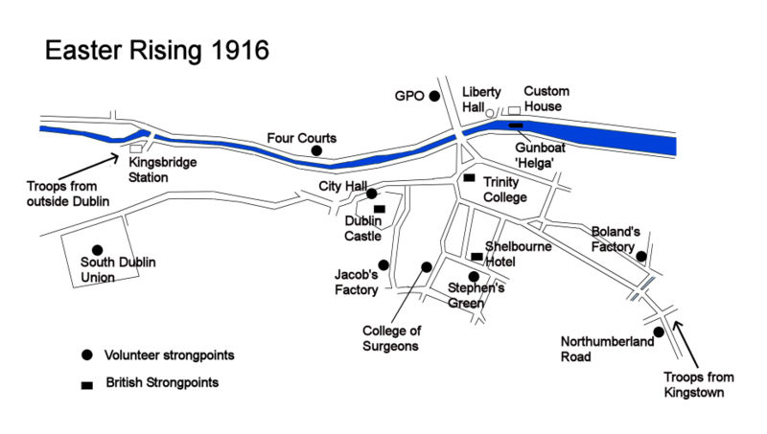

Slide 24
A source of amusement and bewilderment
Large crowds gathered on O Connells Street to have a look at the action on the Monday and Tuesday. Some were disgusted as they dependent on the salaries and pension of their husbands who were fighting/had died during WW1.
Once some people realised that the D.M.P./R.I.C. had abandoned the City centre, looting on a grand scale commenced.
‘Glory be to God ,will you look at them breaking all the lovely windows ’ – the comments of a Shawlie when she seen the windows of the G.P.O. been broken.
Residents of Fumbally Lane in the Liberties’, Dublin 8 attacked a group of Rebels.
Upon dismemberment the ‘Sherwood Foresters’ were welcomed in Kingstown (Dún Laoghaire). One English soldier briefly met his Irish wife and children in Dún Laoghaire, shortly before he was killed during the ambush near Mount St. Bridge
The National News Papers were not impressed (Independent and Times).The Irish Times hardly mentions the uprising when it was printed on Tuesday of Easter Week.
The biggest amount of fatal casualties during Easter week was regular civilians and children.

Slide 25
Statistics:
Approximately 1,250 – 1,400 Rebels took part of which 200 were women.
Approximately 400 were killed during week and about 2,000 were injured.
C. 40 Children (u16).
C. 150 civilians.
C. 66 Rebels.
C. 122 Soldiers and Police officers (D.M.P/R.I.C).
There were more Civilians and Children(190) killed than soldiers and Rebels(188) (source – Children of the Rising by Joe Duffy)

Slide 26
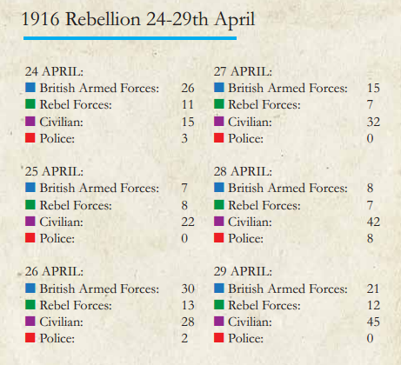
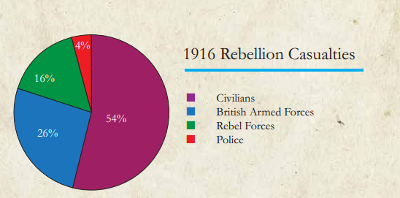
Information gathered from the Glasnevin Trust. www.glasnevintrust.ie

Slide 27
The Battle of Mount St. Bridge. http://www.theirishstory.com
This took place near Mount. St. Bridge.
At about midday on Wednesday a large group of approximately 2,000 English reinforcements were marching towards the City centre. These soldiers were generally young and had little experience. They had recently been recruited to the British Army. A few hours earlier they had arrived in Dún Laoghaire (Kingstown).
The Rebels though few in numbers (14) were strategically positioned.
Approximately 250 were either killed or injured.
The vast majority were English and 20 of those killed/injured were civilians..

Slide 28
The Helga, Machine Guns & Reinforcements.
The Helga gun boat anchored in the river Liffey.
The Helga had little difficulty knocking Liberty Hall.
From Wednesday onwards the City Centre came under constant ﬁre - soon many buildings were in ﬂames.
The English army also had the use of machine guns.
By Friday, approximately 20,000 soldiers were in Dublin City –these had come from various parts of Ireland, but particularly from the Curragh, Belfast and England.
There were huge food shortages in the city centre, as the area had been cordoned off and refrigeration was practically non existent.
It took a few days for the British army to organise themselves, but once they did the Rebels had little chance of success.

Slide 29
Saturday 29th April
As the G.P.O. was in ruins and on fire, it had to be abandoned on Friday night.
The Rebels relocated to the vicinity of Moore St. at the rear of the G.P.O.
General Maxwell who arrived on Friday gave a firm warning “Most rigorous measures will be taken by me, I shall not hesitate to destroy all buildings within any area occupied by rebels, and I warn all person within the area to now surrender”
Troops from the South Staffordshire Regiment ran amok in North King Street and killed 15 citizens.
After Pearse witnessed the killing of a publican and his family, he felt he had no option but to surrender.

Slide 30
3rd - 12th May 1916
Fourteen of the leaders were executed within a fortnight in Kilmainham Goal
N15. Thomas Kent who did not participate in the uprising was executed in Cork.
N16. Rodger Casement was hung in London in August 1916.
97 others had been sentenced to death.
It’s easy to remember how many were executed. ‘The 16 of 1916’.
Tomás Ághas died due to force feeding in September of 1917.
The British Government rounded up the Rebels and other known supporters. Almost double the number that took part in the uprising were interned.
Approximately 1,850 were sent to a camp in Frongach in Wales and approximately 650 more were sent to other parts of England. Many were released within 7/8 months. ‘Francach’ was the nick name given to the camp by the Irish.

Slide 31
Aftermath and effect:
Though the uprising failed, it had massive implications and with the passing of time the attitude of most ordinary people had changed. The numbers of Irish killed/wounded during WW1 also contributed.
The first elections in Britain and Ireland since 1910 were held in December 1918. There was none due to WW1.
Sinn Féin (who wanted a full Irish Republic) won 73 of 105 seats in Ireland.
Some who had won seats, were in prison.
The Sinn Féin politicians who were elected, refused to take their seats in Westminster.
A Provisional Government was set un in January 1919 (Mansion House)
War of Independence January 1919 – July 1921.
Civil War June 1922 – May 1923.

