Slide 1
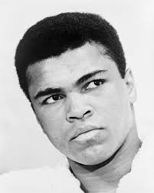
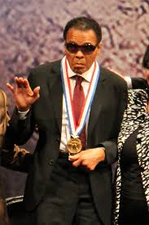

Title: News Over the Weekend
Starter:
Who is this man?
Why is he famous?
Turn to your partner and think of reasons for why he is famous.

Slide 2
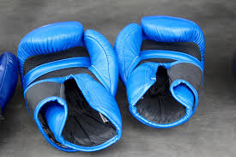
Recording your discussion
Notes:
Nominate a student to record the class ideas on why this man is famous and why he was in the news over the weekend. Recap on class discussion using the PPT on slideview mode.

Slide 3
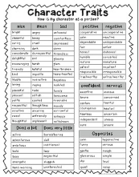

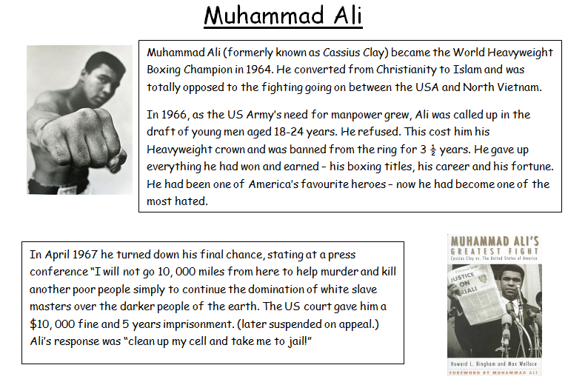
Read the article snap shots about Muhammad Ali. Think of words to describe Muhammad Ali.
Notes:
Use the character trait worksheets for students to highlight the words that could be used to represent Muhammad Ali.

Slide 4
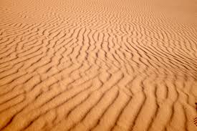
When asked what he would do when he retired, what do you think Muhammad Ali said?
Notes:
What is infinity like?

Slide 5
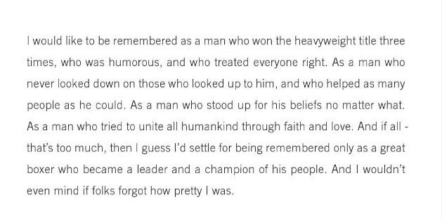
How he would like to be remembered.

Slide 6
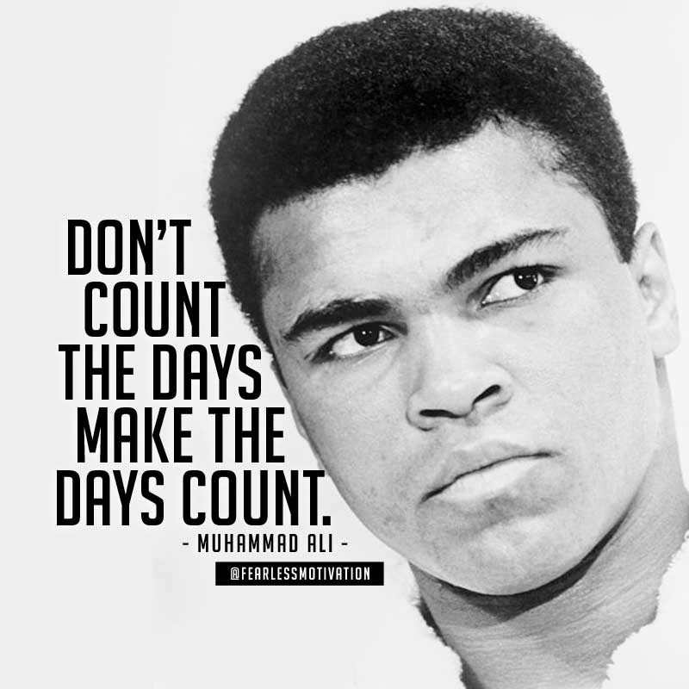
Muhammad Ali is described as an inspirational man, look at his quotes and explain why?
Notes:
http://www.azquotes.com/quote/461056

Slide 7
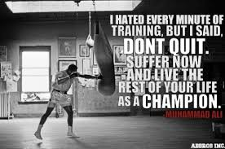
Notes:
http://quotesgram.net/muhammad-ali-dont-quit-quotes/

Slide 8
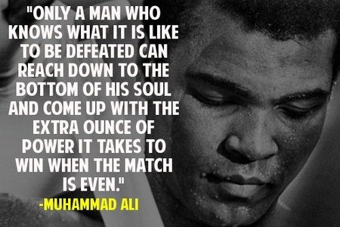
Notes:
https://uk.pinterest.com/pin/571605377676219683/

Slide 9
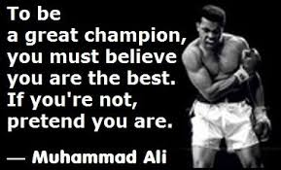
Notes:
http://quoteshunger.com/25-stirring-muhammad-ali-quotes/

Slide 10
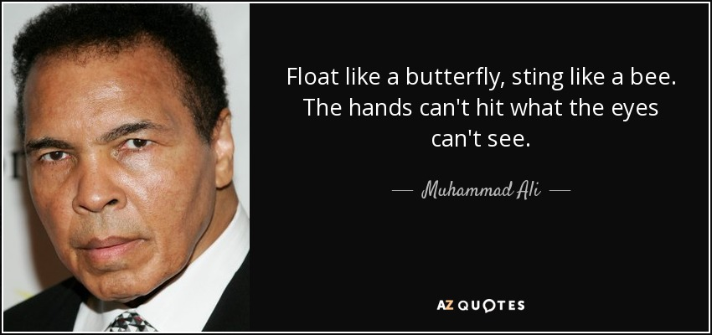
Notes:
http://www.azquotes.com/quote/461056

Slide 11
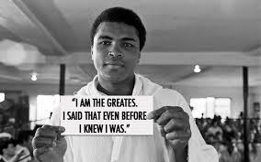

Slide 12
Motivational Video
Check video before class to see suitability for your class…
Show snap shots of this video to illustrate the use of symbolism and metaphors.

Slide 13
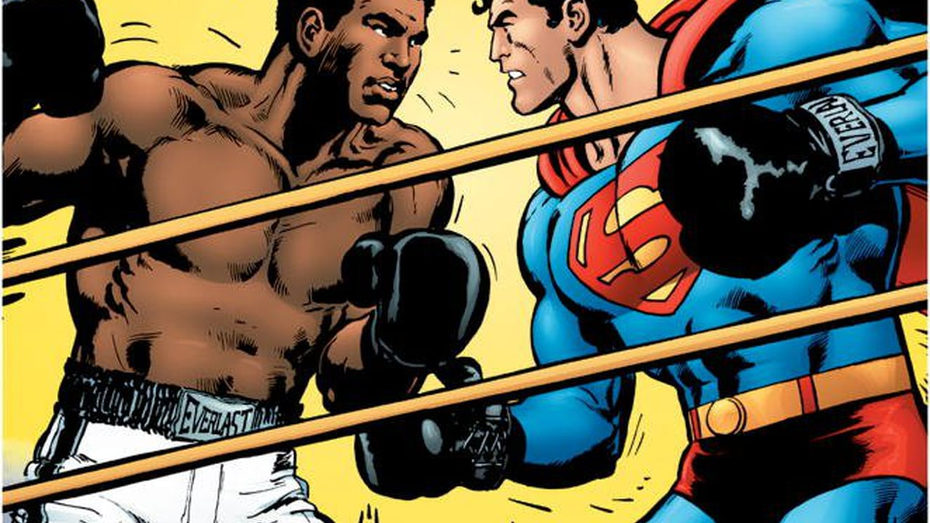
Write an news article about Muhammad Ali.RIP
Notes:
Teacher could bring in newspaper articles for students to compare before/ after writing their newspaper article.

