Slide 1
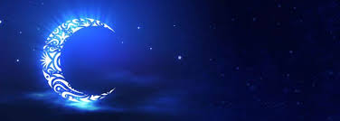
Ramadan
Sawm (Fasting)
The 4th Pillar of Islam
@MsKeleghanEducationBlog

Slide 2
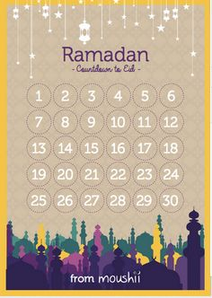
Ramadan is the most important month in
the Islamic Calendar.
It is the 9th month of their Calendar.
The Islamic Calendar is based on the
phases of the moon. As a result it does
not start on the same day every year.
@MsKeleghanEducationBlog

Slide 3
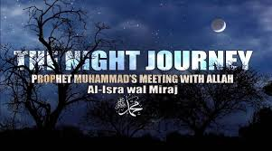
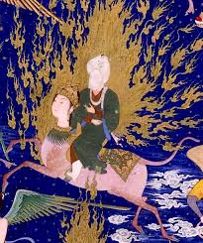

Prophet Muhammad
Ramadan is believed to happen around the time when the Prophet Muhammad was visited by the Angel Gabriel and was sent on his Night Journey.
After this he wrote the Quran.
@MsKeleghanEducationBlog

Slide 4
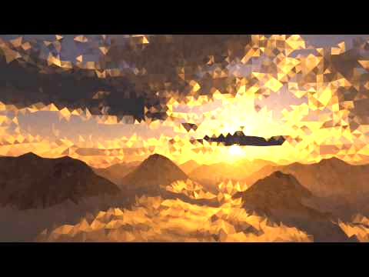
From Sunrise to Sunset
During Ramadan Muslims fast from Sunrise to Sunset.
Only those who are healthy and at the right age are allowed to fast.
As well as giving up food and drink they also focus on being better people.
@MsKeleghanEducationBlog

Slide 5
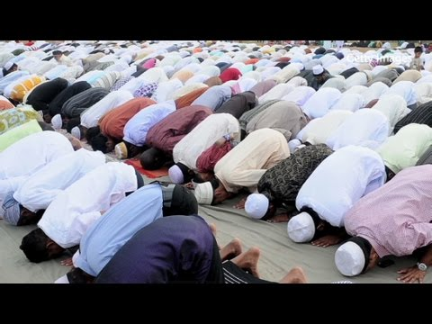
Answer Questions on Worksheet

Slide 6
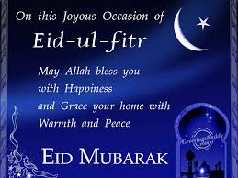
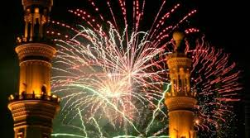
EiD Al-Fitr
Ramadan ends with a big celebration called Eid Al- Fitr
In English it is The Feast of Fast-Breaking.
It lasts for 3 days.
Families and friends celebrate with a big feast and exchange gifts.
Video Link: https://www.truetube.co.uk/film/my-faith-eid
@MsKeleghanEducationBlog

