Slide 1
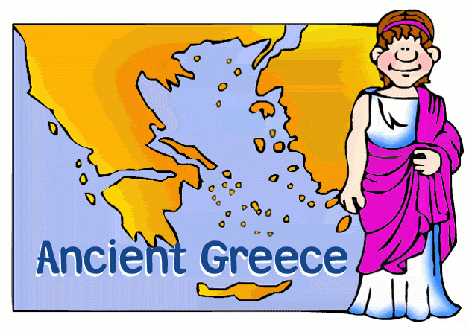
Ancient Greece

Slide 2
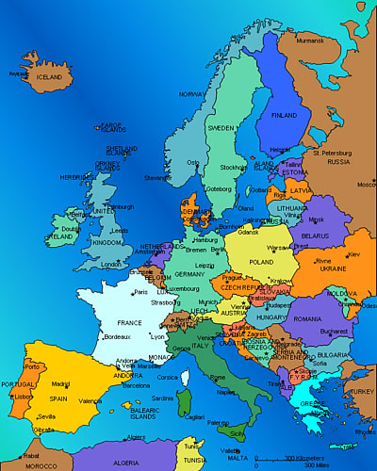
Where is Greece?

Slide 3
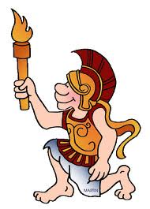
Life in Ancient Greece
2,500 years ago
We still use Greek ideas and inventions – Maths, alphabet, plays, sports, trial by jury, democracy, the Olympics, tragedy and comedy etc.
Lived near the coast or on plains.
Small – grew into towns and cities.
Sailors
Aegean Sea and Mediterranean Sea.
http://www.bbc.co.uk/education/topics/z87tn39/resources/1

Slide 4
Life in Ancient Greece
Colonies – trade
Wealthy
Towns had markets, bars, schools and theatres.
Doctors, police officers and law-makers.
5th Century BC richest city was Athens.
Slaves
Leisure time
Temples – Parthenon.
Writers – Sophocles.

Slide 5
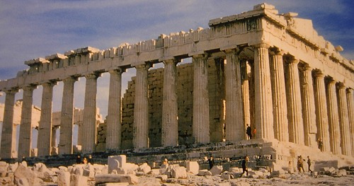
Parthenon

Slide 6
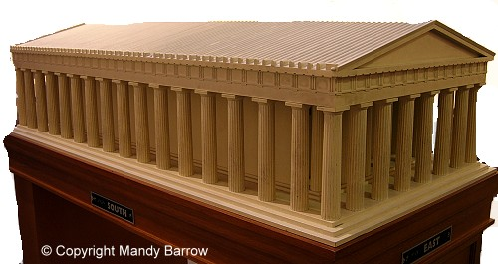
What the Parthenon looked like

Slide 7
How they lived.
The Greeks lived in City States.
Each state had its own laws, government and money but they shared the same language and religion.
Athens and Sparta
Kings – then small groups of powerful people (oligarchies)
Athens – democracy. Sparta – oligarchy.

Slide 8
Ruling in Athens
The people of Athens believed that no one group of people should make the laws and so citizens could choose the government officials, and vote for or against new laws. The people of Athens chose their ruler.
They held a large meeting on the slopes of a hill in Athens where any citizen could speak, and tell the government what it should be doing. This was called the Assembly, and there had to be at least 6,000 citizens at every Assembly.
Athenian democracy was not like modern democracy. Only citizens over 18 could vote. Women, slaves and foreigners could not become citizens. So democracy in Athens meant rule by the men of Athens.

Slide 9
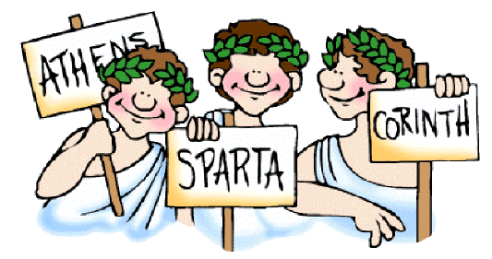
Sparta
Famous for its warriors.
Peloponnesian War.
Trained from 7!!
Sparta won – 404BC
Ancient Greece was never as strong again.

Slide 10
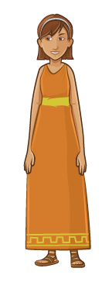
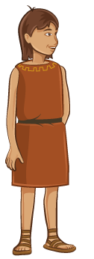
School
Boys went to school.
Reading, writing, music and poetry.
Wrestling and how to fight.
Girls stayed at home.
Spinning, weaving and cooking.
http://www.bbc.co.uk/guides/zc8yb9q#zxnj2hv

Slide 11
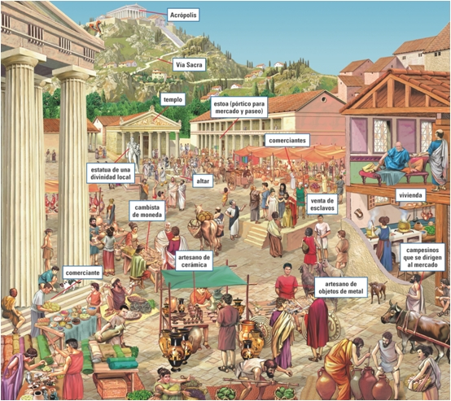
Agora

Slide 12
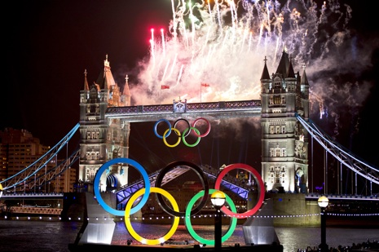
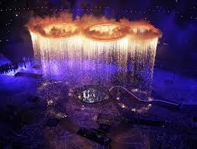
Olympics
http://www.perseus.tufts.edu/Olympics/
http://www.bbc.co.uk/schools/primaryhistory/ancient_greeks/the_olympic_games/

Slide 13
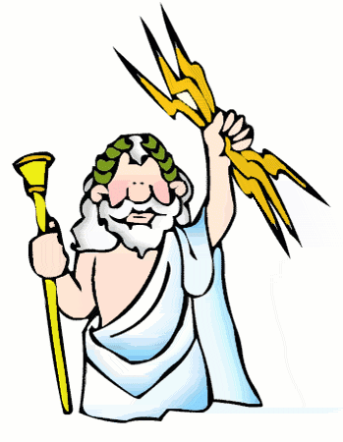
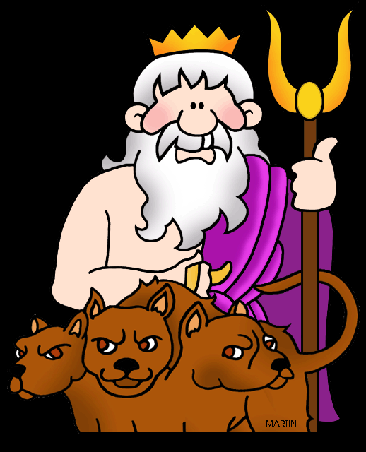
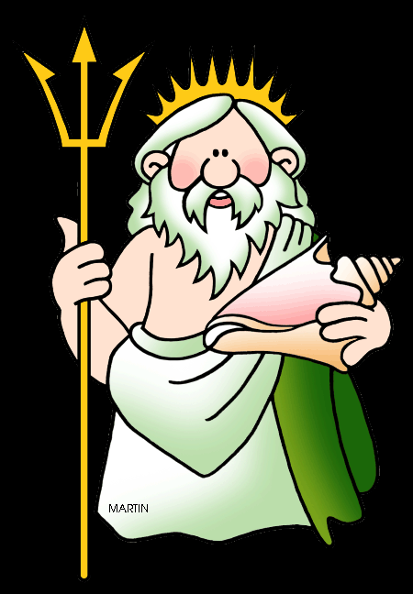
Gods
According to the Ancient Greeks, the first gods to rule the earth were the Titans!
Cronus – ruler.
Zues – Hades - Poseidon

Slide 14
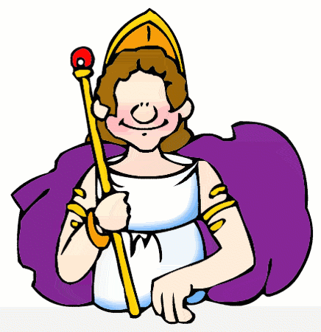
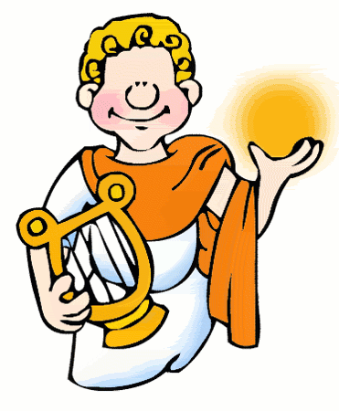
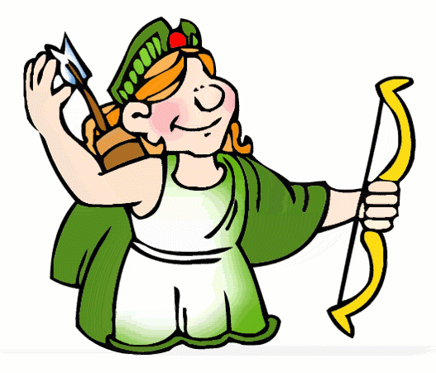
Greek Gods
Servant - Argus
Hera
Zeus
Apollo
Artemis

Slide 15
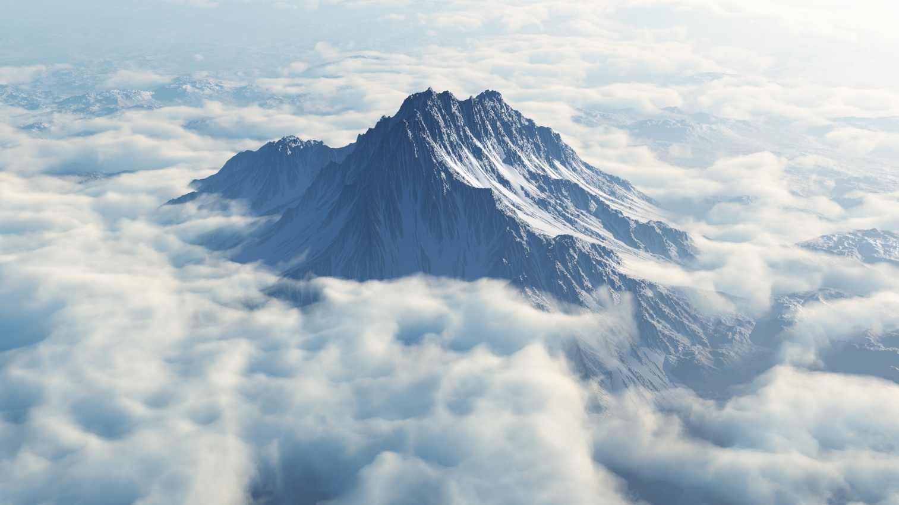
Greek Gods
They believed if they made them happy, life would go well for them.
Gods lived on a mountain in the clouds – Mount Olympus.

Slide 16
Greek Gods
Prayers at home.
Took part in festivals.
Temples
Priests sacrificed animals to the gods in return for their help.
Sang and danced to the gods.
The Ancient Greeks didn't understand about death, storms or sickness so they decided it must be the work of the Gods. These stories spread all over Greece and beyond!
Told stories, known as myths and legends about gods, heroes and monsters.
Sophocles made plays from them.

Slide 17
Appearance and fashion
Both men and women enjoyed using mirrors and hair-brushes.
Hair was curled, arranged in interesting and carefully designed styles, and held in place with scented waxes and lotions.
Women kept their hair long, in braids, arranged on top of their head, or wore their hair in ponytails.
Headbands, made of ribbon or metal, were very popular.

Slide 18
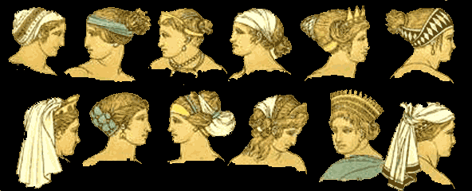
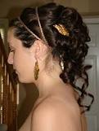
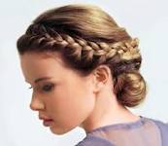
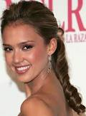
Appearance and Fashion

Slide 19
Appearance and fashion
Blond hair was rare. Greek admired the blonde look and many tried bleaching their hair.
Men cut their hair short and, unless they were soldiers, wore beards.
Barber shops first became popular in ancient Greece, and were an important part of the social life of many ancient Greek males. In the barber shop, the men exchanged political and sports news, philosophy, and gossip!
http://www.bbc.co.uk/guides/zc8yb9q#zxnj2hv

