Slide 1

What do you know?
List all you know about this topic in your books now.

Slide 2

Stuck? See if you can answer these questions…
Where is it taking place?
What countries are involved?
How many groups are there?
Who are the sponsors of this event?
How long will it go on for?
Can you name any players who will be involved?
Why are people in Wales so excited about it?

Slide 3
Euros 2016 – The basics.
This is Wales’ first major tournament in 58 years!
The opening ceremony will take place in the Stade de France on June 10th.
The first match will be France vs. Romania.
The England vs. Wales match is on June 16th… at 2pm.
You can still buy a ticket to watch the game. The cheapest ticket is £324. ☺

Slide 4
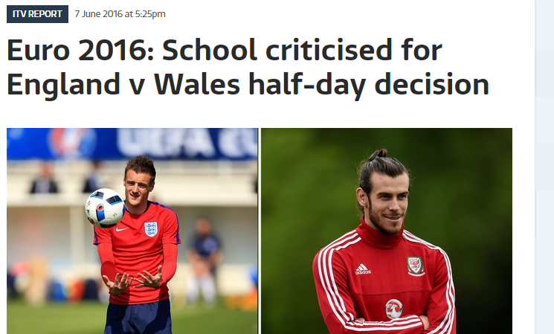
Read the ITV news report.

Slide 5

The head teacher has been branded as hypocritical. What does this mean?
What is the name of the place where the Wales and England match is?
What is the name of the group of parents who disagreed with Mr Golding’s decision?
Find the phrase which shows Craig Langman doesn’t agree with this decision.
“It feels like we are living in a dictatorship state.” – What does this mean?

Slide 6
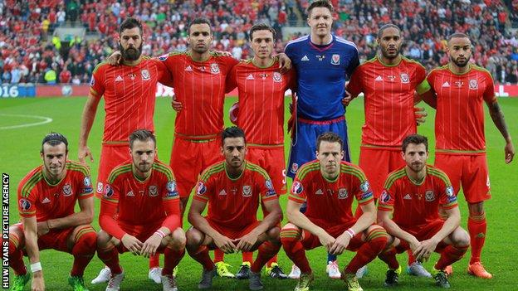
Should pupils be allowed home
early to watch the Wales
Euro 2016 matches?

Slide 7

Argumentation
Yes, it’s a brilliant idea!
No, it’s ridiculous!

Slide 8
Choose one of the following tasks.
Create a speech to deliver to your school Principal persuading him/her to allow the pupils in your school to take a half day on the three days Ireland are playing.
OR
Write a letter to your school Principal criticising his/her decision to allow the pupils at your school take a half day on the three days Ireland are playing.

