Slide 1

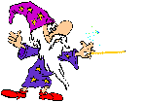
Magic ‘e’

Slide 2
By adding an e to the end of some words, Sidney can change how they sound…

Slide 3
The vowel in the middle of the word changes from it’s sound to it’s name. Let’s look at some examples…

Slide 4

Look! It’s a pan
Add a magic e…

Slide 5

Now it’s a Pane!

Slide 6
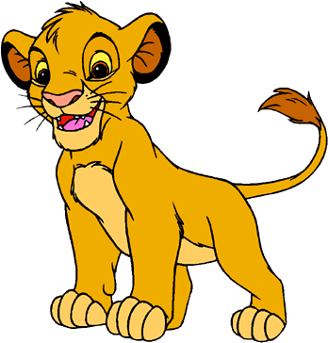
Look! It’s a cub
Add a magic e…

Slide 7
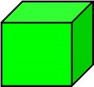
Now it’s a cube!

Slide 8
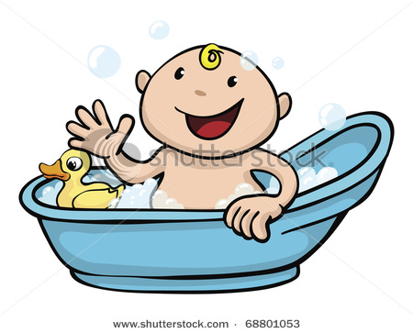
Look! It’s a tub
Add a magic e…

Slide 9

Now it’s a tube!

Slide 10

Look! It’s a hat
Add a magic e…

Slide 11

Now it’s hate!

Slide 12
I think that’s enough now Sidney!
Can you think of any words that have a magic ‘e’ at the end?

