Slide 1
A Framework for examining
Inequality: Facing up to challenges
Kathleen Lynch
UCD Equality Studies Centre
School of Social Justice
Voicing Concerns: Quality, Inclusion and Participation in Music Education. TCD 26th Sept. 2012

Slide 2
Four key social systems (contexts) where inequality can be generated
Economic system
  Production, distribution and exchange of goods and services
Cultural system
  Production, transmission and legitimation of cultural practices and products
Political system
  Making and enforcing collectively binding decisions
Affective
  Providing and sustaining – or frustrating - relationships of love, care and solidarity

Slide 3
Four dimensions of inequality: 4 Rs
Baker, Lynch et al. (2009) Equality: From Theory to Action. Palgrave Macmillan
Resources
How unequal is the distribution of income and wealth in Ireland?
Does everyone have equal access to music education? If not why not? What will you do about it?
Respect and recognition
Is everyone in Ireland recognised as having an equal status as a citizen or member of society?
Do some social groups have a higher status than other groups? Are their musical hierarchies? Who benefits from these? Are the members of some groups derided, stereotyped and/or ignored when it comes to music?
Representation of interests: Power
Who exercises power over others in the music education field?
What groups have the power to achieve their aims? What groups do not have power?
Relationality: Love, care and solidarity
Does everyone in Ireland have access to the love and care they need to learn music? To work well one needs care at family, community/country / national level….what care infrastructures exist?

Slide 4
Four Key Systems where equality/inequality is generated mapped with four key dimensions of equality/inequality
Source:Baker, Lynch, Cantillon and Walsh (2004, 2009) Equality: From Theory to Action Palgrave Macmillan
Systems | Redistribution (Resources) | Dimensions of Respect and Recognition (Cultural representation) | In/equality Representation (Power) | Relationality (Love, Care and Solidarity)
Economic System | xx | x | x | x
Political System | x | x | xx | x
Cultural System | x | xx | x | x
Affective System | x | x | x | xx
Notes:
What is shown in this table is the link between the systems that may generate inequalities (the economic, political, cultural and affective systems) and the different forms that inequality takes (the dimensions of inequality). The table is colour coded to indicate where the generative source of injustice may lie and how than then impacts on equality. Inequalities in power relations manifest themselves in terms of not have an equal right to influence decisions that affect you, generally – the solution lies in having equal representation. Inequalities in economic terms finds expression first in the lack of adequate resources – income, wealth and general economic security. The solution is redistribution of wealth etc.
The point to remember here is that even if one site (eg. the economic system) is the primary site for generating economic inequality, it can and does interface with other systems. For example, people who lack power, such as children are also disproportionately poor – see my slides below . Equally, those who are not respected in the cultural sphere, for example due to the colour of their skin, their Traveller status, or other differences (use of Irish Sign Language rather than English) also experience respect-related injustices which have economic outcomes (they do not get work or experience discrimination in work) and they may also lack power and influence in society.
Equally, those for whom the generative site of injustice is lack of respect for their differences (those with intellectual disabilities for example) also suffer from a lack of power and limited economic resources. Etc.

Slide 5
The Generative sources of inequality vary between groups
Economic Inequality is the principal source of Social Class-related inequalities –
It results in lack of access to resources to participate on equal terms with others in society; the cost of living is the cost of participating –
Relative poverty or deprivation is what makes you isolated and leaves you out of music, especially as most performance-based learning is privatised and commercial – it is what advantages others
Culturally-generated inequalities find expression in terms of lack of respect or recognition –
  Many groups that are stigmatised/marginalised because of their identity, not because of their lack of money; they experience culturally-generated injustices
  Intellectually disabled people; people with mental health issues; LGBT people; Travellers; Carers; Deaf people –old people (old fogies, old biddies, fuddy-duddies), Women, Migrants, Black people, Carers

Slide 6
The Generative sources of inequality vary between groups
Unequal power relations
  Are a major equality issue for children within schools and families; power inequalities are also institutionalised in most bureaucratic organisations (educational institutions and work)
Affective Inequality –
    People who are institutionalised(e.g. in prison, long-term psychiatric care) and those who are abused or neglected in their families etc. or are homeless experience affective injustice as they are often deprived of love and care
Intersectionality of Inequality
  e.g. the economically marginalised often lack respect, power and cultural recognition for themselves as persons but also for their culture and cultural products, including music…

Slide 7
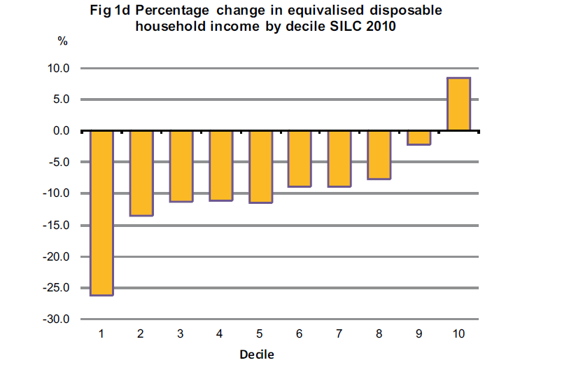
Growing Income Inequality (SILC) Survey of Income and Living Conditions (2010: 11). The top 10% (far right) had an 8% increase in disposable income in 2010 compared with 2009 while the bottom 10% had a drop of over 26% in disposable income (far left)

Slide 8
Differential impacts of economic inequality
Notes:
The CSO’s SILC (Study of Income and Living Conditions) data forms part of a set of harmonized surveys used by Eurostat to analyse poverty, social inclusion and other issues.
This graph above shows that those at most risk of poverty – the brown bars - are those who are unemployed (26% are at risk of poverty), those who parent alone, those out of work due to illness or disability, and those in rented accommodation (especially those in local authority housing and certain areas of the private rented market) and children. Deprivation (green bars) is highest among those parenting alone, those with no work due to illness or disability and the unemployed.
There are limitations to this data and one of them is that a number of groups are not visible as they are too small to be analysed separately, yet they experience extreme poverty in some cases. These include some minority ethnic groups (including Travellers who also experience intense discrimination), homeless and people living in or leaving institutions, etc..
It is important to realise too that having a job is not, in itself, a guarantee that one lives in a poverty-free household.: 7.8 % households in which people have jobs were at risk of poverty in 2010 compared with 5.5% in 2009.

Slide 9
Why Inequality is dysfunctional for society
Economic and Social Inequalities do not simply impact on economic well being – they have multiplier effects on people’s sense of their own value…sense of self worth/confidence…on their ability to learn and to achieve
Those who are very poor or defined as having low status feel less moral worthy and this negatively impacts on their health and well being
Inequality produces Socially Evaluative Threats and Evaluation Anxieties… that impedes our learning.
Notes:
Economic and Social Inequalities do not simply impact on economic well being – they have multiplier effects on people’s sense of their own value. Because human being are social animals, their sense of well-being is related to their social status in society. Feeling well in many ways is about feeling equal to others around you.
In highly divided societies, those who are very poor or defined as having low status feel of less moral worth than those who are wealthier, high status and this negatively impacts on their health and well being. It literally gets under your skin and makes you unwell.
Inequality produces Socially Evaluative Threats and Evaluation Anxieties - as people feel inferior to those who are much better off - this impacts negatively on their health, social behaviour, levels of trust and solidarity, violence; unequal societies are bad for all groups
See Wilkinson, R and K. Pickett (2009) The Spirit Level: why more equal societies almost always do better. Chapter 3

Slide 10
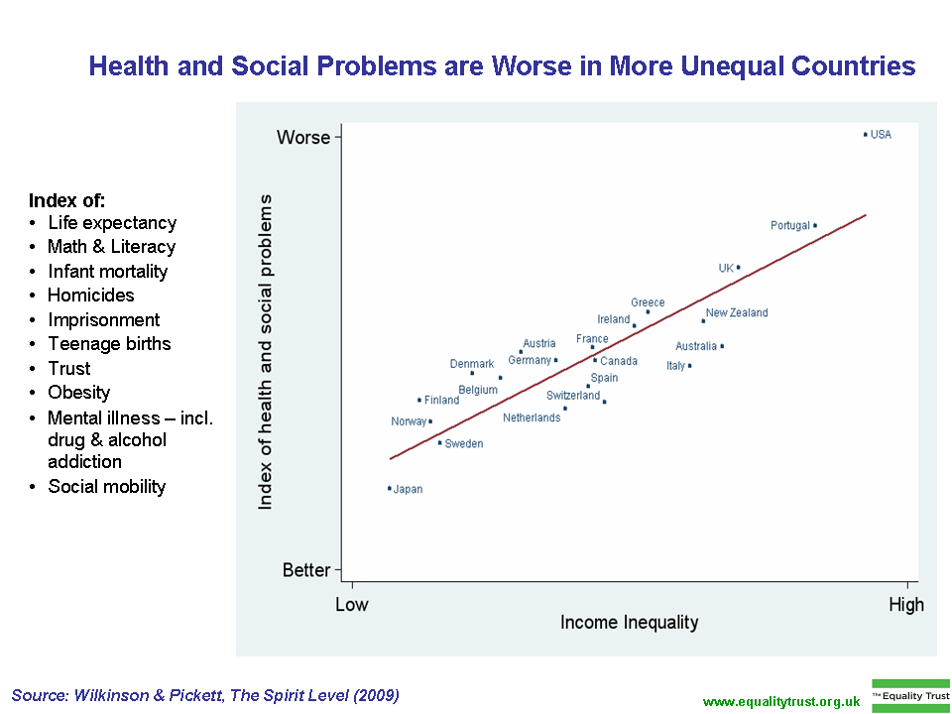

Slide 11
Neo-liberalism is the governing ideology of our time: it is premised on a market view of citizenship
  Neoliberalism is premised on the assumption that the citizen’s relationship to the State and others is mediated via the Market – citizens are redefined as ‘customers’…the DES….even holds this view!
  http://www.education.ie/en/The-Department/Customer-Service/
  Neoliberalism is fundamentally Hobbesian in character, focusing on creating privatised citizens who manage their own ‘risks’ – breaking up of public solidarity – e.g. decline of mutual societies, rise of private education, ‘
  Paying as you go’ culture in Education (in all public services)
    The iphone, the ipad symbolise the importance of the possessive ‘I’ factor in marketing (the self is defined through Consumption)
Notes:
You are defined by your capacity to consume on the market: ideology of ‘consumers’ or ‘customers’ has entered education- DES website uses this neoliberal terminology.

Slide 12
Neo-liberal values impact on the culture of education
In adopting business (output-led) models of operation schools and colleges move to institutionalise commercial values in their systems and processes by default if not design:
  Schools and colleges move from being centres of learning to service-delivery operations with productivity targets
  Business models increasingly legitimate the pursuit of individualised economic self-interest and credentials among students, and career interests among staff…
Student and staff idealism to work in ‘the public interest’ is diminished
Glorification of competition (meeting targets)…vulnerable become a ‘nuisance’

Slide 13
The challenge to public interest values in Education
Reducing Costs to Capital on Public Expenditure (including education) is the principal goal of neo-liberal capitalism
  Net outcome is more for-profit and/or break-even education
Reducing investment in education is presented in ‘soft’ market language – in the name of ‘efficiency, avoiding ‘waste’ ‘restructuring’, regenerating’…offering people ‘choices’
The WTO (World Trade Organisation) and the GATS (General Agreement on Trade in Services) promote education in marketable and measurable forms
  ‘Education should be viewed as a commodity rather than a consciousness-raising experience’
NET Outcome: Deep undermining of education as a ‘public good’

Slide 14
Private enterprise and Exclusion
Musical Voice or instrumental capabilities are developed through private industry not public investment in Ireland – Leaving Certificate examination in music is deeply class-biased.
    ESRI data – 94% of extracurricular activities of children in the cultural area involve fees
Maintaining class advantage by maintaining the status quo….
Solutions offered are ‘projects’ ‘local initiatives’..

Slide 15
Charity….challenges it presents
Charity as a way of funding initiatives is
  Generally short term
  Highly individualistic and dependent on the interest of the benefactor
  Can be withdrawn
  Conceals deep structural injustices
  It reinforces structural inequalities

Slide 16
Reflexivity …examining the doxas of your own trade..
Music is a
  cultural activity
  a profession and
  an industry……….recognising the inherent tensions and contradictions in this
Who benefits most in the present music education arrangements? In class terms, ethnic/racial, gender, dis/ability, age etc?

Slide 17
Class is an uncomfortable subject
There is no moral justification for class-based injustices- they are largely the outcomes of power struggles over history
The immorality of class inequality makes it an inadmissible subject for discussion
  Those who are class-privileged feel guilty at times about their class privilege – and denial is a way of managing class discomfort
  Those who are less class-privileged/very unprivileged may feel uncomfortable for very different reasons – fear, shame etc.,
  Embarrassment and shame silence debates about class
Silences around class issues reflect the power of class itself – the doxas (unspoken norms/values) of a society are often the most important issues in that society

Slide 18
Major issue: myth of equality of opportunity without equality of condition
  Equality of opportunity is about equal formal rights; it is about making sure the rules are fair for distributing educational ‘goods’ or privileges – changing some of the faces at the top of the hierarchy
  Equality of condition is the belief that people should be as equal as possible in relation to the central conditions of their lives. It is about eliminating hierarchies of wealth, power and privilege so that everyone has roughly equal prospects music education. It is about enabling and empowering people to learn in education
International evidence is overwhelming that the more unequal a society is economically, the more unequal it is educationally;
WE need to recognise our own insider status in education, and our role in Excluding others ……

