Slide 1
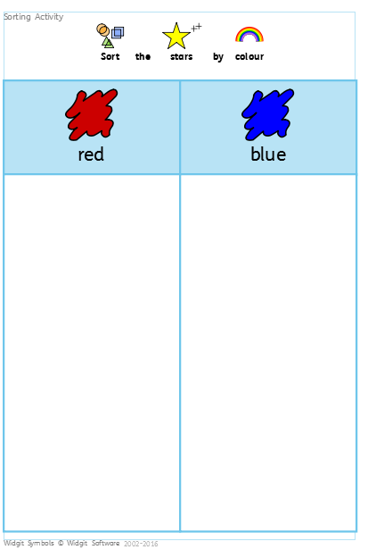
Inclusiveteach.com

Slide 2

Inclusiveteach.com

Slide 3
Inclusiveteach.com

