Slide 1

Leaving Cert Maths Date:
_________(Paper 1) (F.L)
__________(Paper 2)

Slide 2

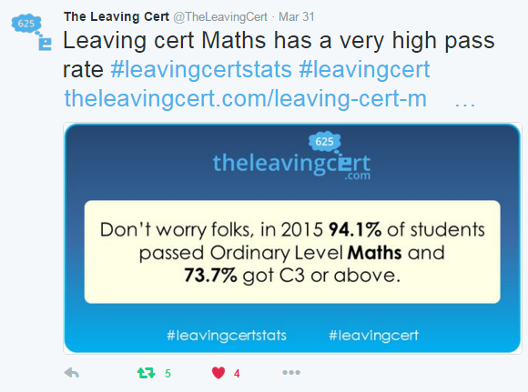

Slide 3


Slide 4

25 Mark Question = ___ minutes
50 mark Question = ___ minutes
75 mark Question = ___ minutes.
Attempt all questions…don’t leave a blank.

Slide 5

Question | Marks | Time on Question
1 | 25 | MIN
2 | 25 | MIN
3 | 25 | MIN
4 | 25 | MIN
5 | 25 | MIN
6 | 25 | MIN
7 | 35 | MIN
8 | 45 | MIN
9 | 70 | MIN
2015 Paper
PRACTICE THE TIMING

Slide 6




10 MIN
tIMED
1
2

