Slide 1
Ancient rome

Slide 2
Question 1
Give one way how we know about Ancient Rome

Slide 3
question2
What was The Forum
Stadium for chariot racing
Central marketplace
Where the gladiators fought

Slide 4
Question 3
What were rich Romans called?

Slide 5
Question 4
Name ONE room in a domus

Slide 6
Question 5
Who live in Insulae?

Slide 7
Question 6
What was a mothers main job in a Roman Family?

Slide 8
Question 7
What did wealthy Roman men wear?
Stola
Tunic
toga

Slide 9
Question 8
Name ONE Roman God and what she or he was god of.

Slide 10
Question 9
What was cena?
Breakfast
Lunch
Evening meal

Slide 11
Question 10
What did Romans eat for breakfast or lunch?

Slide 12
Round 2

Slide 13
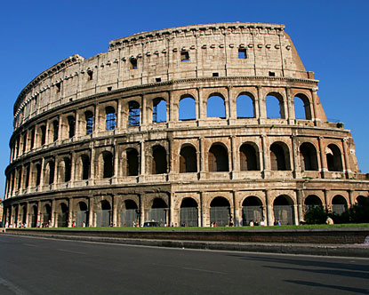
Question 1

Slide 14
Question 2
Where did the chariot races take place?

Slide 15
Question 3
What did married roman women wear?
Stola
Tunic
toga

Slide 16
Question 4
Ho w was girls’ education different from boys?

Slide 17
Question 5
Give one thing that Romans did at the Baths.

Slide 18
Question 6
Mention one thing about Roman funerals

Slide 19
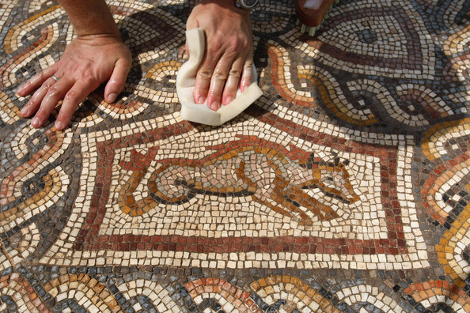
Question 7

Slide 20
question8
What were freedmen?

Slide 21
Question 9
Give one thing that the Romans believed about death?

Slide 22
Question 10
Mention ONE influence of Ancient Rome

