Slide 1
Ireland in 1500
Key words: the Pale, Brehon Law, Anglo-Norman
to think about what it was like to live in Ireland in 1500
to know three groups living in Ireland in 1500
to describe their customs and practices

Slide 2
Think-pair-share How do you think Ireland in 1500 is different from Ireland today?

Slide 3
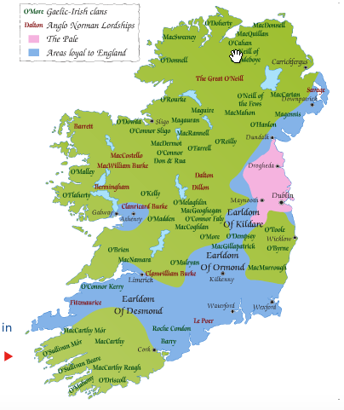
Land ownership in Ireland in 1500

Slide 4
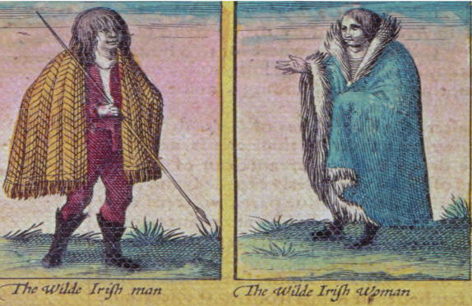
Group 1: Gaelic Irish
These were the Gaelic Irish families who had survived since Celtic times.
They were loyal to their chieftain, not to the English king.
They used Brehon law. When the father died the land was divided between all the children.
They spoke Irish.

Slide 5
Group 1: Gaelic Irish
They kept cattle.
Their land belonged to the whole family and all their cattle could graze on it.
They included families like the O'Moores, the O'Donnells and the O'Neills.

Slide 6

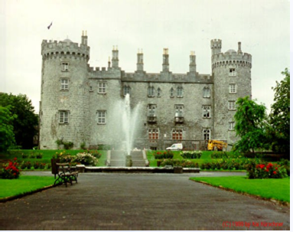
Group 2: The Anglo-Normans
These families were descended from the English Normans who had come to Ireland in 1169.
Over time they married in to Gaelic Irish families and adopted their customs.
They included families like the Butlers of Ormond in Kilkenny and Tipperary and the Fitzgeralds of Kildare.

Slide 7
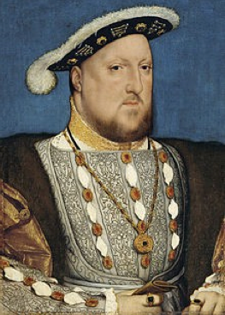
Group 3: English living in the Pale
They lived in the Pale an area surrounding Dublin.
They spoke English.
They grew crops instead of raising cattle.
They were ruled by English common law instead of Gaelic Brehon law.
They were loyal to the king of England.

