Slide 1
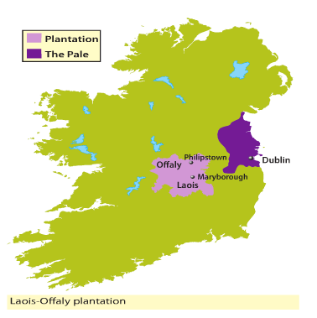
Laois-Offaly plantation
Important people:
O’Connor family
O’More family
Queen Mary
Key word: plantation
to understand the word plantation
to identify the cause of the plantation of Laois and Offaly
to list the rules of the Laois-Offaly plantation

Slide 2
What does the word plantation suggest to you?

Slide 3
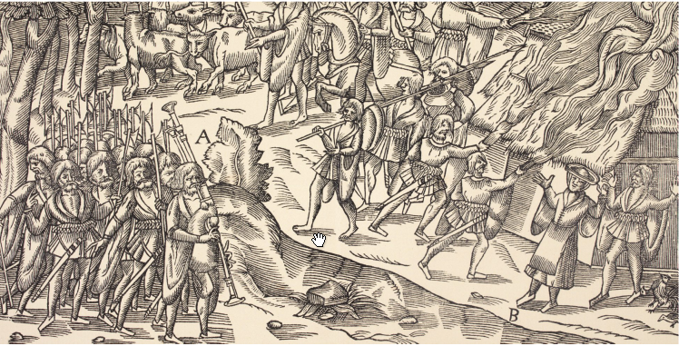
Cause of the Laois-Offaly plantation
Two families, the O’Mores of Offaly and the O’Connors of Laois were attacking the Pale.
They were stealing cattle and raiding the homes of the people who lived there.
Queen Mary, the queen of England, decided she needed to do something to stop this.

Slide 4
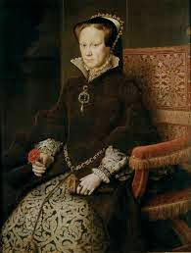
Laois-Offaly plantation
Queen Mary renamed Laois Queen’s County and Offaly King’s County.
Land was confiscated from the O’Mores and the O’Connors.
She wanted to send loyal English settlers to these counties to spread English control.

Slide 5
Do you think the Laois-Offaly plantation was successful? Why/why not?

Slide 6
Laois-Offaly plantation: results
The plantation failed because not enough English settlers came.

Slide 7
Activity
Using a blank map of Ireland, mark in the areas of the Laois-Offaly plantation on your map.
Be sure to label your map.

Slide 8
By reading this document, can you figure out Queen Mary’s solution to the problem of the O’Mores and the O’Connors?
For as much as the O’Mores, O’Dempsies, O’Connors and others of Irishry by their sundry [many] manifest [obvious] treasons after much pardons granted to them have yet often rebelled committing great hurts to the King’s and Queen’s most loyal servants. Be it therefore ordained, enacted and established that the said King’s and Queen’s majesties shall have, hold and possess for ever, the said counties at Leix and Offaly.

Slide 9
Read ‘How did the plantation work?’ on p.195 and answer these questions in your copybook.
How much of their land did Queen Mary give back to the O’More’s and the O’Connors? What type of land was it?
Two-thirds of the land was given to which category of people?
Identify the town in King’s County (Offaly) named after the king.
Identify the town in Queen’s County (Laois) named after the queen.

