Slide 1
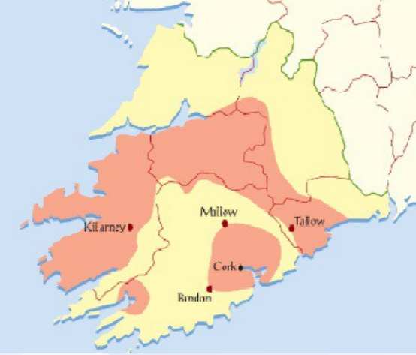

Munster Plantation
Learn about the reasons why the Munster
Plantation happened.
Learn how the Munster Plantation happened.
Complete a worksheet on the Munster Plantation.

Slide 2
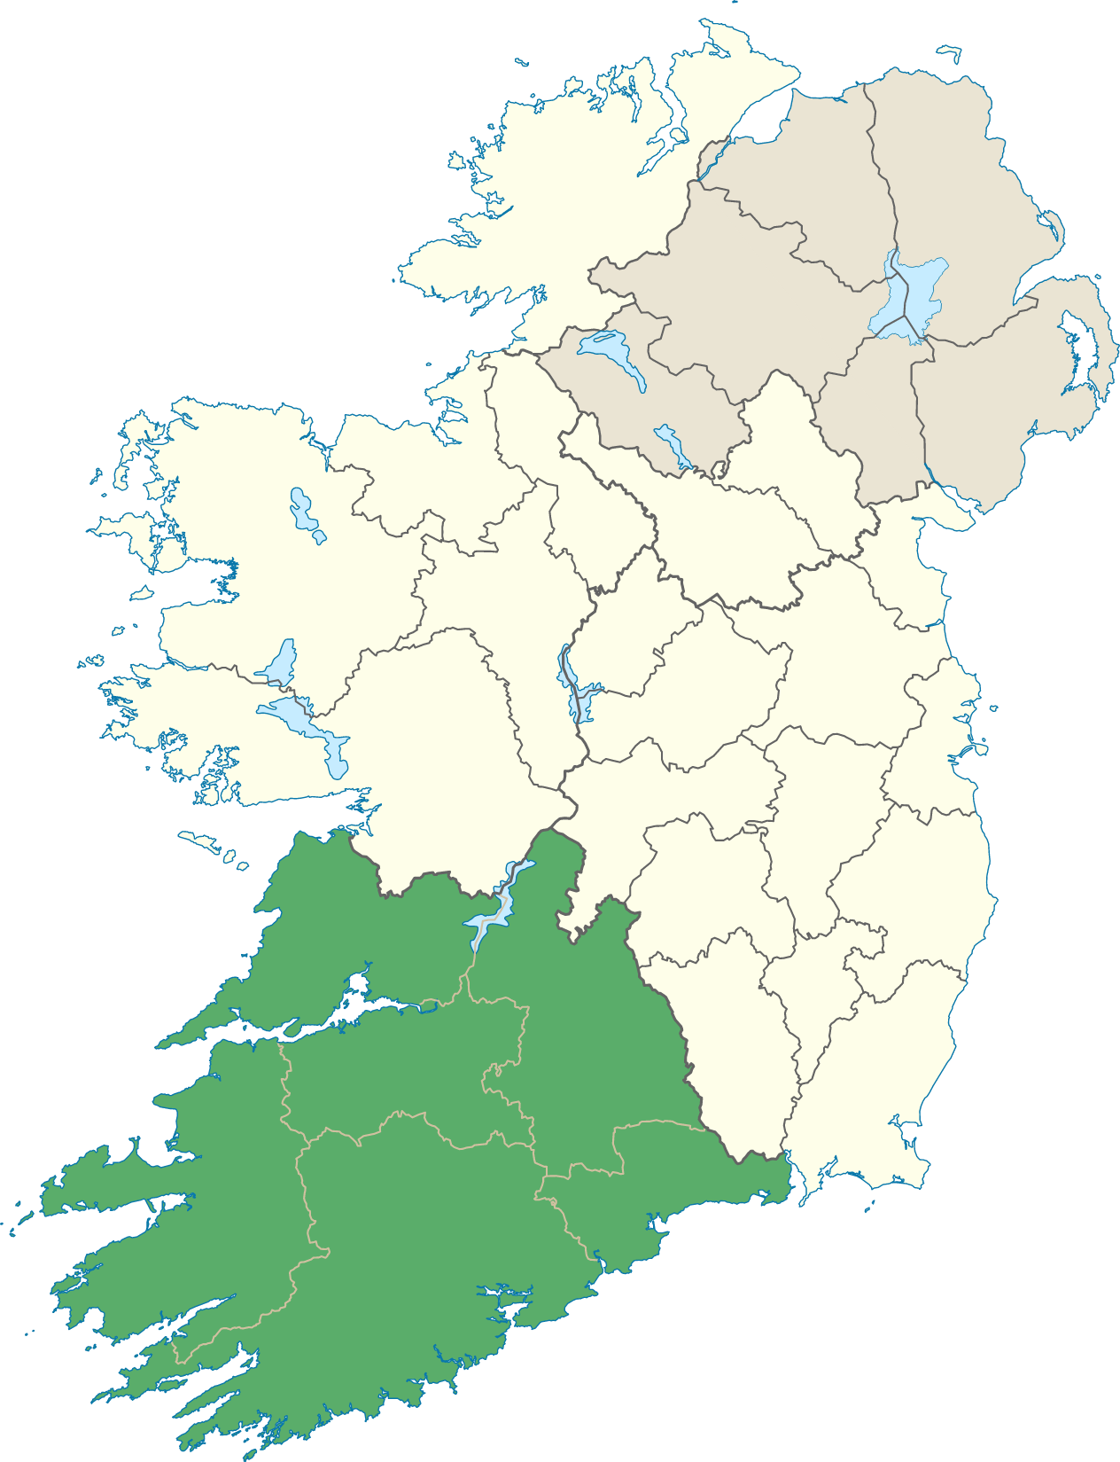
Why did the Munster plantation happen?
Queen Elizabeth was a Protestant Queen.
She wanted to convert the Catholic Irish.
The Fitzgeralds of Desmond were the
biggest family in Munster. They were loyal
to the Catholics and refused to become
Protestants.
They rebelled against Elizabeth I.
During the Desmond rebellion the English
destroyed the crops of the Irish.

Slide 3
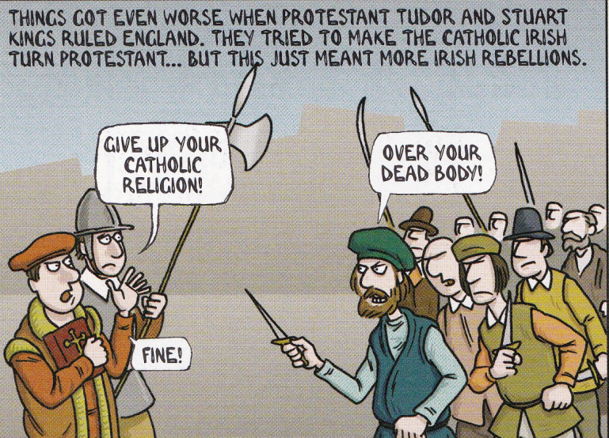
The Irish refused to become Protestant.

Slide 4
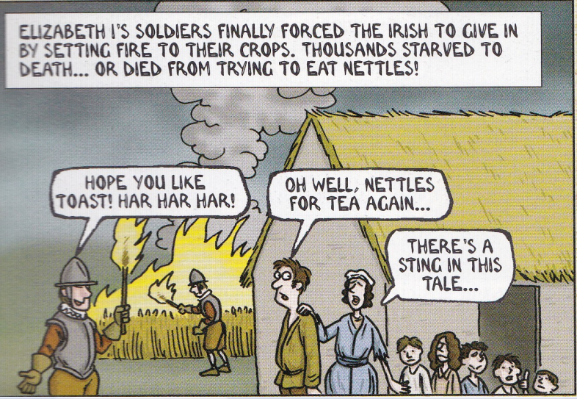
The English army went to war against the Desmonds, destroying their crops.

Slide 5
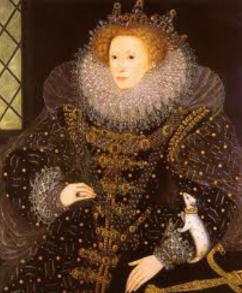
Munster Plantation
The Munster Plantation
was ordered by Queen Elizabeth I.
She divided up the land
of the Desmonds and gave them
to loyal subjects.
She created new towns,
like Youghal and Bandon.

Slide 6
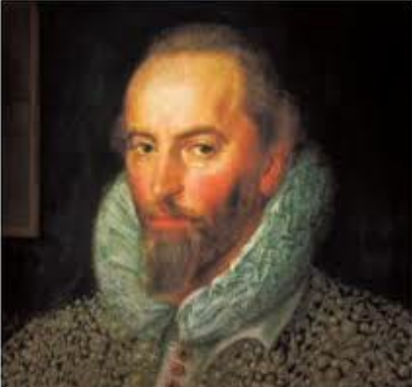
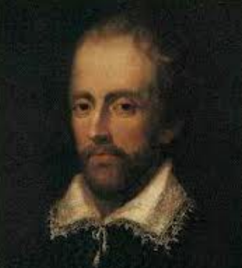
Two famous Englishmen were given lands during the Munster plantation...
Sir Walter Raleigh, an explorer
Edmund Spenser, a poet

Slide 7
What we learned today...
● Why the Munster plantation happened: Queen Elizabeth wanted the Irish to convert to Protestantism. The Fitzgeralds of Desmond refused, which led to a war in Munster.
● How the Munster plantation happened: Elizabeth confiscated the lands of the Desmonds and divided it up between new settlers. She created new towns, like Bandon and Killarney.

