Slide 1
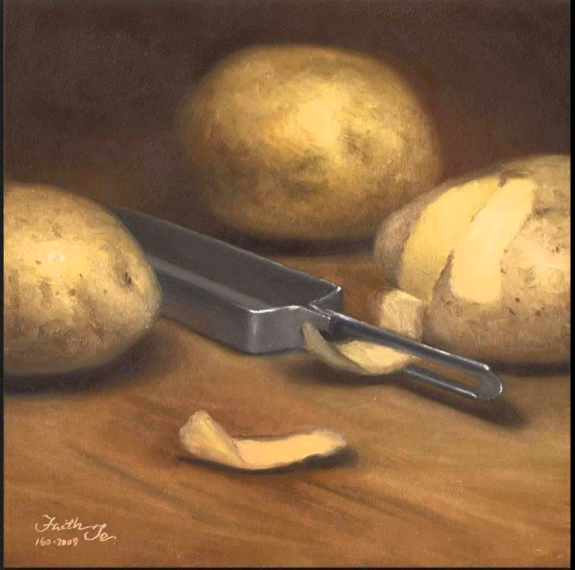
‘When all the others were away at Mass’
by Seamus Heaney

Slide 2
Key themes
how love is expressed silently between a mother and son.
how the ordinary moments in life can be the most meaningful.

Slide 3
Style: sonnet
A sonnet is a 14 line poem. It is often divided into an octet and a sestet.
The octet contains a description of a childhood memory between Heaney and his mother.
The sestet recalls the moment of his mother’s death and contains a message about the importance of ordinary moments.

Slide 4
Style: sound effects
Heaney uses alliteration ‘Cold comforts’ and assonance ‘between us…gleaming in a bucket of clean water’ to create music in the poem.
There is also onomatopoeia. We can hear the ‘splashes’ of the potatoes as they fall into the water. The droning noise of the prayers is captured in ‘hammer and tongs’.
Heaney’s use of sound effects helps to make an ordinary moment extraordinary.

