Slide 1
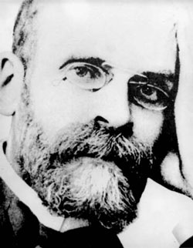
Émile Durkheim
April 15, 1858 - November 15, 1917

Slide 2
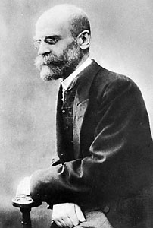
Life and Influences
Born April 15, 1858 in France.
Father, Grandfather, and Great-Grandfather were all rabbis.
He believed religion could be explained from social rather than divine factors.
Entered the École Normale Supérieure in 1879.
Read and studied with classicists with a social scientific outlook while in school.
The French academic system had no social science curriculum at the time, and he finished second to last in this graduating class in 1882.
Spent a year studying sociology in Germany.

Slide 3

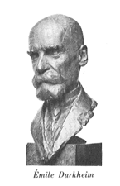
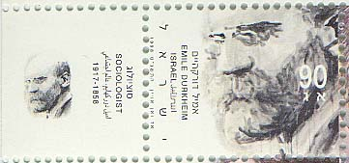

Life and Influences
1887 - went to Bordeaux to teach pedagogy and social science to new teachers.
Through his new position, he reformed the French school system and introduced social science into its curriculum.
1893 - published The Division of Labor in Society.
1895 - published Rules of the Sociological Method, and founded the European Department of Sociologique at the University of Bordeaux.
1896 - founded the journal L'Année Sociologique.

Slide 4
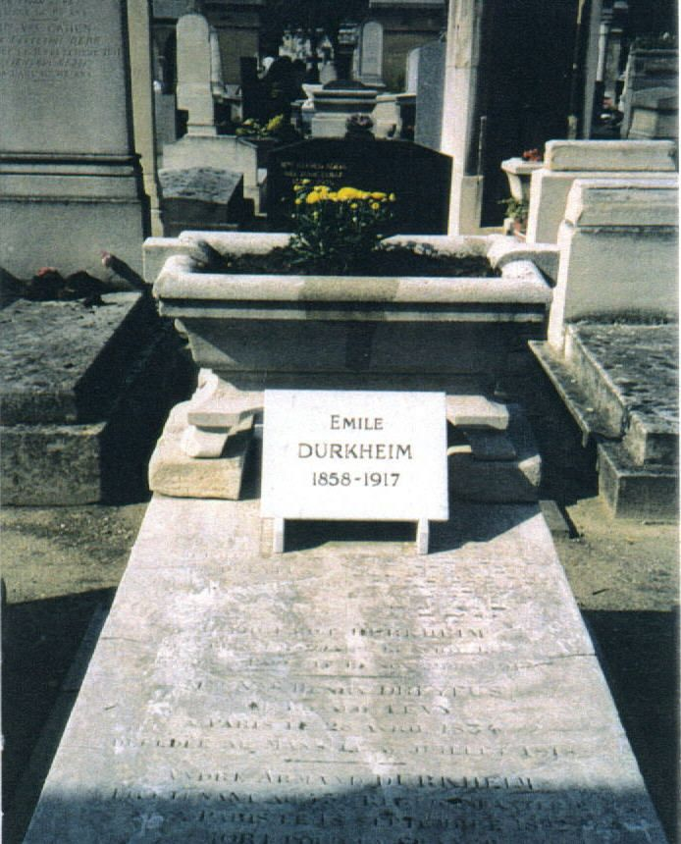
Life and Influences
1897 - published Suicide
1902 - awarded a prominent position in Paris as the chair of education at the Sorbonne.
1912 - published Elementary Forms of the Religious Life, and his position became permanent and he renamed it the chair of education and sociology.
His son died in World War I, and he never recovered emotionally.
Suffered a stroke in Paris in 1917, but recovered and resumed work on La Morale.
Later that year on November 15, he died at age 59 from exhaustion.

Slide 5




Contributions and Theories
He sought to construct one of the first scientific approaches to social phenomena.
Said that traditional societies were held together by the fact that everyone was more or less the same.
Along with Herbert Spencer, he was one of the first to conceptualize the idea of Functionalism:
  Functionalism views society as a system of interdependent parts whose functions contribute to the stability and survival of the system.
Thought that society was more than the sum of its parts, and coined the term social facts:
  Social Facts have an existence all their own, and are not bound to the action of individuals.

Slide 6

Contributions and Theories
Durkheim on Education:
  Believed that education served many functions:
  1) To reinforce social solidarity
    Pledging allegiance: makes individuals feel part of a group and therefore less likely to break rules.
  2) To maintain social roles
    School is a society in miniature: it has a similar hierarchy, rules, expectations to the “outside world,” and trains people to fulfill roles.
  3) To maintain division of labor
    School sorts students into skill groups, encouraging students to take up employment in fields best suited to their abilities.
He was professionally employed to train teachers, so he used his ability to shape France’s curriculum to spread the instruction of sociology.

Slide 7

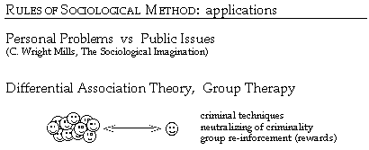
Contributions and Theories
Durkheim’s Anomie:
  Anomie is the breakdown of social norms regulating behavior.
  Durkheim and other sociological theorists coined anomie as ‘a reaction against, or retreat from, the social controls of society.’
  All deviant behavior stems from a state of anomie, including suicide.
Durkheim on Crime:
  His views on crime were unconventional at the time.
  Crime serves as a social function, meaning that it has a purpose in society.
  He saw crime as being able to release certain social tensions and so have a cleansing or purging effect in society.

Slide 8
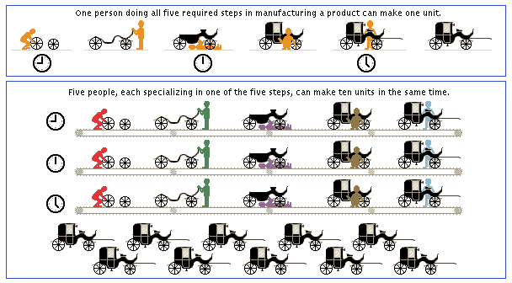
The Division of Labor
Division of labor examined how social order was maintained in different types of societies.
Traditional societies were held together by the fact that everyone was more or less the same. The collective consciousness entirely includes individual consciousness.
In modern societies, the high complex division of labor resulted in the binding of people together with different specializations in employment. This created dependencies that tied people to one another since no one person could fill all of the need by themselves.
Anomie: Increasing division of labor can lead to rapid change in a society. This can produce a state of confusion with regards to norms and impersonality in social life. This leads to a state in which the norms regulating behavior have been broken down.

Slide 9
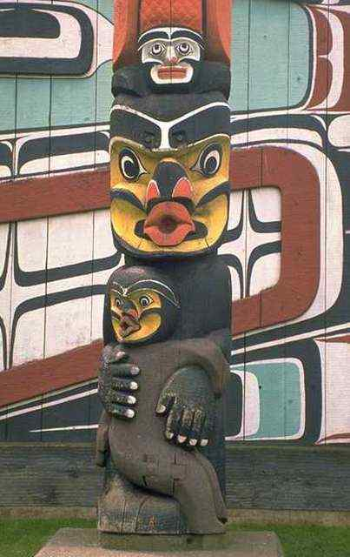
Elementary Forms of Religious Life
Thought religion was a form of social cohesion, which holds complex societies together.
Saw totemism as the original form of religion, because it was the emblem for the social group, the clan.
Believed that the function of religion was to make people willing to put the interests of others ahead of themselves.
The model for relationships between people and the supernatural was the relationship between individuals and the community.
  “God is society, writ large.”
Saw religion as a mechanism that protected a threatened social order.

Slide 10

Elementary Forms of Religious Life
In the past, religion had been the cement of society - the means by which men had been led to turn from the everyday concerns in which they were variously enmeshed to a common devotion to sacred things.
  “A religion is a unified system of beliefs…relative to sacred things…beliefs and practices which unite in one single moral community called a Church, all those who adhere to them.”
Condensed religion into 4 major functions:
  1) Disciplinary: forcing or administrating discipline
  2) Cohesive: bringing people together, a strong bond
  3) Vitalizing: to make more lively or vigorous, vitalize, boost spirit
  4) Euphoric: a good feeling, happiness, confidence, well-being

Slide 11
Suicide
Defined suicide as the act of severing social relationships.
Goal was to show that an individual act is actually the result of the social world that he would show the usefulness of sociology.
He explored the differing suicide rates among Protestants and Catholics. He explained how socially controlled Catholics had a lower suicide rate.
Social integration: the integration of a group of people into the mainstream of society.
Said that abnormally high or low levels or social integration may result in increased suicide rates.
Results he found include:
  Suicide rates are higher for widowed, single or divorced people rather than those who are married.
  Rates are higher for those who have no children rather than those who do .
  Rates are higher among Protestants than Catholics.
  Coroners in a Catholic country are less likely to record a suicide as the reason of death because in Catholism it is a sin.

Slide 12


Suicide
Suicide may be caused by weak social bonds.
Social bond is made up of social integration and social regulation.
Distinguished 4 types of suicide:
  1) Egoistic Suicide: Individual is weakly integrated into a society so ending their life will have little impact on the rest of society.
  2) Altruistic suicide: Individual is extremely attached to the society and because of this has no life of their own.
  3) Anomic suicide: There is a weak social regulation between society’s norms and the individual and is most often brought on by dramatic economic or social changes.
  4) Fatalistic suicide: Social regulation is completely instilled in the individual. There is no hope of change against the oppressive discipline of the society. Feels that the only way to escape this state is suicide.

Slide 13
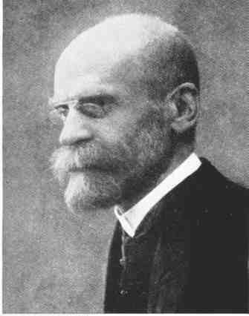

Durkheim’s Legacy
Durkheim helped make the study of sociology mainstream. Sociology today has gained tremendous popularity in Europe, the US, and across the world.
Many of Durkheim’s students pursued his ideas in their own studies.
Founded the academic journal, L'Annee Sociologique.
In recent decades, Durkheim’s philosophies have been more influential in the US and Britain than in France, his native country.
Durkheim’s ideas influenced several major theoretical movements in the twentieth century.
  His work was strongly present in the emergence of ‘structuralism’ through the work of Jean Piaget and Claude Levi-Strauss.

Slide 14
Discussion Questions
From Durkheims Suicide, one of the four types of suicide was altruistic suicide. Under this type people saw the social world as meaningless and would choose to sacrifice themselves for the greater ideal. What are some examples you can think of that have happened in the world where people may have committed suicide for this purpose? Did they believe that they were doing the right thing? Did others consider it the right thing?
Durkheim considered himself to be a functionalist. Functionalism is the view that society is a system of interdependent parts whose functions contribute to the stability and survival of the system. Do you agree with this theory or do you disagree? Why or why not?

Slide 15
Discussion Questions
Durkheim said that one of the ways to maintain the division of labor, schools should sort students into skill groups, encouraging students to take up employment in fields best suited to their abilities. For today’s society do you think that this may be a good idea? Should this be the schools responsibility or the students? What age is best for this to happen?
Durkheim believed that crime was merely a departure from conventional notions and that it served as a function of society. Do you agree with Durkheim that crime is a necessary part of society?
  Is an ideal society one in which there is no crime (meaning no reformation or progress in ideas) or one in which crime does occur?

Slide 16
Discussion Questions
Durkheim believed that the division of labor was an essential part of society and that it evolved ‘spontaneously’ from human nature. Where else do you see examples of the division of labor, other than in the workplace? Why do you think that the division of labor was crucial to success?
Presentation by: Jennifer Summe, Stephanie Scholl, and Jess Webb

