Slide 1


Notes:
"RBS 6 Nations Fixtures Announced For 2014 & 2015 Championships". rbs6nations.com. N.p., 2017. Web. 25 Jan. 2017.

Slide 2
What is the 6 Nations?

Slide 3

What do think the 6 Nations is?
Notes:
English – Oral Language – Ask the class to discuss with the class or in groups/pairs what they know about the RBS 6 Nations and what they would like to fins out about the RBS 6 Nations.

Slide 4
Rugby Championship
France, England, Ireland, Italy, Scotland and Wales
Over 120 years old!
Each team play each other once

Slide 5
Played on a yearly basis
15 matches per championship
Played over 7 weekends during Feb – April
Home advantage swapped every year

Slide 6
When did it begin?

Slide 7
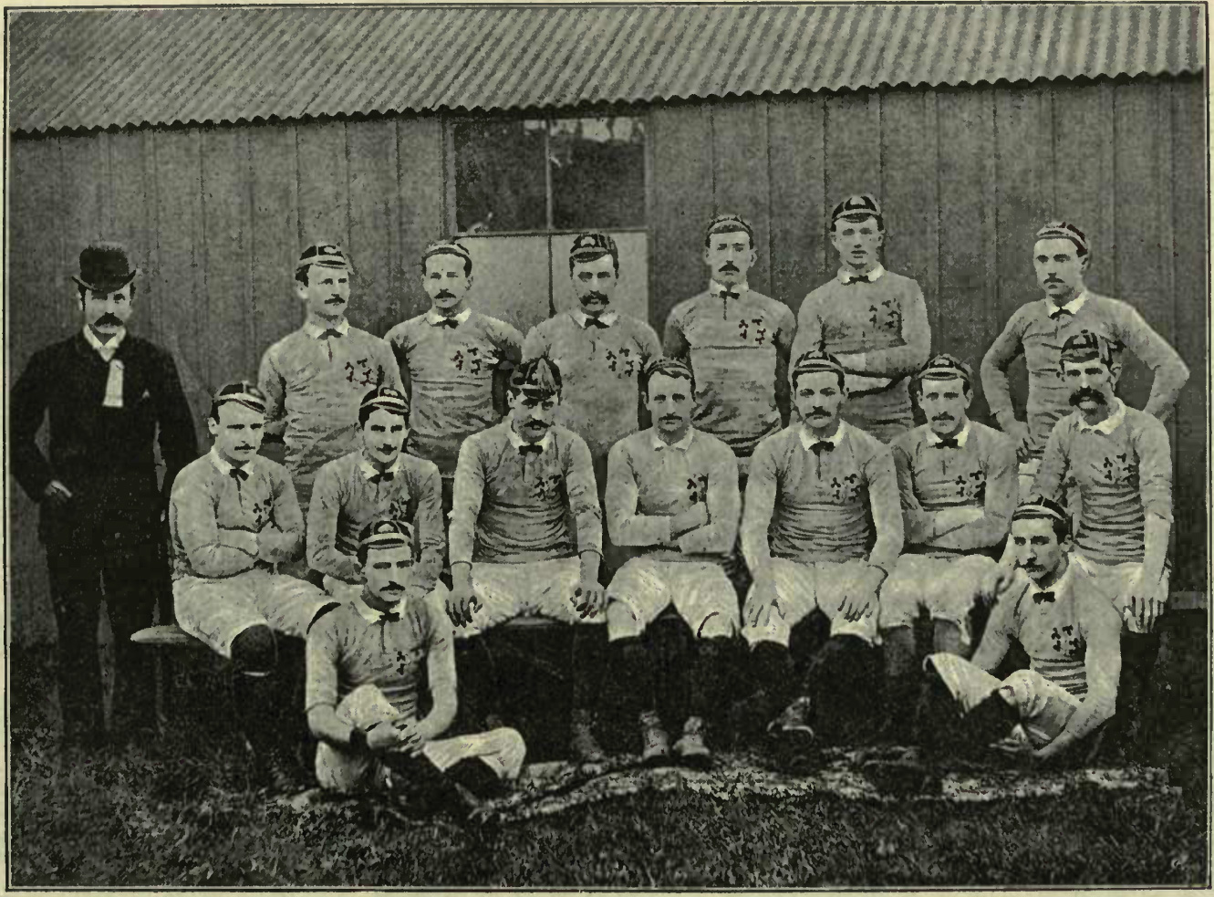
Irish Rugby Team 1887
Notes:
Ireland’s Rugby Team – 1887
"File:Ireland Rugby 1887.Jpg - Wikimedia Commons". Commons.wikimedia.org. N.p., 2017. Web. 25 Jan. 2017.

Slide 8
Can you match the event to the important years in 6 Nations history?
Notes:
History/English/Numeracy – Print the next slide and give a copy to each group/pairs. Ask them to match what year they think each event happened. They are not in the correct order here.

Slide 9
1883
The Five Nations returns and France is welcomed back into the Championship
1910
Italy joined the championship and its name changed to the 6 Nations.
1914
The championship was again called the Home Nations
1931
A trophy given to the winners of Five Nations for first time.
1932 - 1939
France were removed from the tournament
1939
The Championship was put on hold during World War I
1947
France joined and the Championship’s name changed to the Five Nations
1993
The championship was put on hold again during World War II
2000
Home International Championship began with England, Ireland, Scotland and Wales
Notes:
History/English/Numeracy – Print this slide and give a copy to each group/pairs. Ask them to match what year they think each event happened. They are not in the correct order here.

Slide 10
1883
Home International Championship began with England, Ireland, Scotland and Wales
1910
France joined and the Championship’s name changed to the Five Nations
1914
The Championship was put on hold during World War I
1931
France were removed from the tournament
1932 - 1939
The championship was again called the Home Nations
1939
The championship was put on hold again during World War II
The Five Nations returns and France is welcomed back into the Championship
1947
1993
A trophy given to the winners of Five Nations for first time.
2000
Italy joined the championship and its name changed to the 6 Nations.
Notes:
Here are is the correct timeline.

Slide 11
Did you know that there are 7 over competitions within the 6 Nations Championship?
What might they be?
Notes:
English – Oral Language – Ask the class to discuss with the class or in groups/pairs can they think of what these other competitions might be?

Slide 12

Since 1879 the Calcutta Cup has been awarded on the winner between England and Scotland

Slide 13

Since 1989 the Millennium Trophy has been awarded to the winner between England and Ireland

Slide 14

From 1989 the Centenary Quaich has been awarded on the winner of the Ireland v Scotland game.

Slide 15

From 2007 the Giuseppe Garibaldi Trophy has been presented to the winner of the 6 nations France v Italy game.

Slide 16

Grand Slam – to win the Grand Slam all 15 games in the tournament must be won. Ireland have won 2 Grand Slams.

Slide 17

If either Ireland, England or Wales win all games against each other they are awarded the Triple Crown.
Notes:
Additional Notes: Ireland have won the Triple Crown 10 times and since 2006 a trophy is awarded for winning the Triple Crown.

Slide 18

Although there is no trophy it is said that the last-placed team in the Championship is awarded the Wooden Spoon.

Slide 19
The 6 Nations Trophy

Slide 20

It was the Earl of Westmorland’s idea to present the winning team with a trophy.
In 1993 France were the first team to be presented with the trophy.
In 2015 a new trophy was commissioned to replace the old trophy
Notes:
1993’s was for Five Nations Championship before Italy
Designed by Thomas Lyte and represents all 6 nations
Has names of past winners on band of the plinth and space for future winners
6 sides – 1 for each country and their crest the year they joined
7kg of sliver, 75cm high, gold plated 6 on both handles and a rugby ball and crown on the lid
Took over 200 hours to make

Slide 21
Why do you think it was decided to commission a new trophy?

Slide 22

The old trophy was for Five Nations Championship before Italy joined
The new trophy was designed by Thomas Lyte and represents all 6 nations
The new trophy has the names of past winners on band of the plinth and space for future winners
There are 6 sides on the new trophy – 1 for each country
It is made of 7kg of sliver, is 75cm high, and has a gold plated 6 on both handles and a rugby ball and crown on the lid
It took over 200 hours to make it

Slide 23
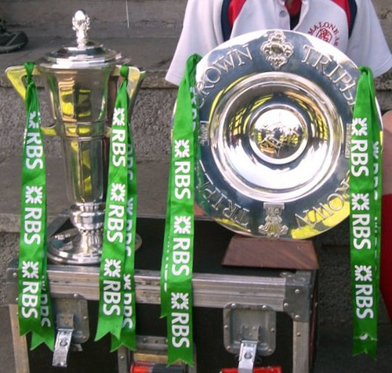
Here is an image of the old trophy and the triple crown, can you find an image of the new trophy?
Notes:
Visual Arts – Drawing – Making Drawing and Fabric and Fibre – Ask the class to draw the new trophy and use tine foil to ‘colour it in’, ribbon can also be used added to the handles. Another option would be to ask the class to imagine that they are Thomas Lyte, how would they design the new trophy?
"File:Ireland 2009 6 Nations Triple Crown.Jpg - Wikimedia Commons". Commons.wikimedia.org. N.p., 2017. Web. 25 Jan. 2017.

Slide 24
Sat 2nd Feb Ireland Vs England (Aviva Stadium)
Sat 9th Feb Scotland Vs Ireland (Murrayfield)
Sat 23rd Feb Italy Vs Ireland (Stadio Olimpico)
Sun 10th March Ireland Vs France (Aviva Stadium)
Sat 16th March Wales Vs Ireland (Principality Stadium)
2019 Irish Fixtures

